Slide 1
Diabetes Analysis on Female
Prepared by :
Jaydeep Chotaliya

Slide 2
Overview
Diabetes is a chronic disease that occurs either when the pancreas does not produce enough insulin or when the body cannot effectively use the insulin it produces. Insulin is a hormone that regulates blood glucose.
In 2014, 8.5% of adults aged 18 years and older had diabetes. In 2019, diabetes was the direct cause of 1.5 million deaths and 48% of all deaths due to diabetes occurred before the age of 70 years.
According to the growing morbidity in recent years, in 2040, the world’s diabetic patients will reach 642 million, which means that one of the ten adults in the future is suffering from diabetes.
Another 460 000 kidney disease deaths were caused by diabetes, and raised blood glucose causes around 20% of cardiovascular deaths

Slide 3
Dataset details
This dataset is originally from the National Institute of Diabetes and Digestive and Kidney Diseases.
The objective of the dataset is to diagnostically predict whether a patient has diabetes, based on certain diagnostic measurements included in the dataset.
Several constraints were placed on the selection of these instances from a larger database.
Only Female Data

Slide 4
General Term used in Dataset
Glucose: To express the Glucose level in blood
BloodPressure: To express the Blood pressure measurement
Insulin: To express the Insulin level in blood
BMI: To express the Body mass index
DiabetesPedigreeFunction: To express the Diabetes percentage

Slide 5
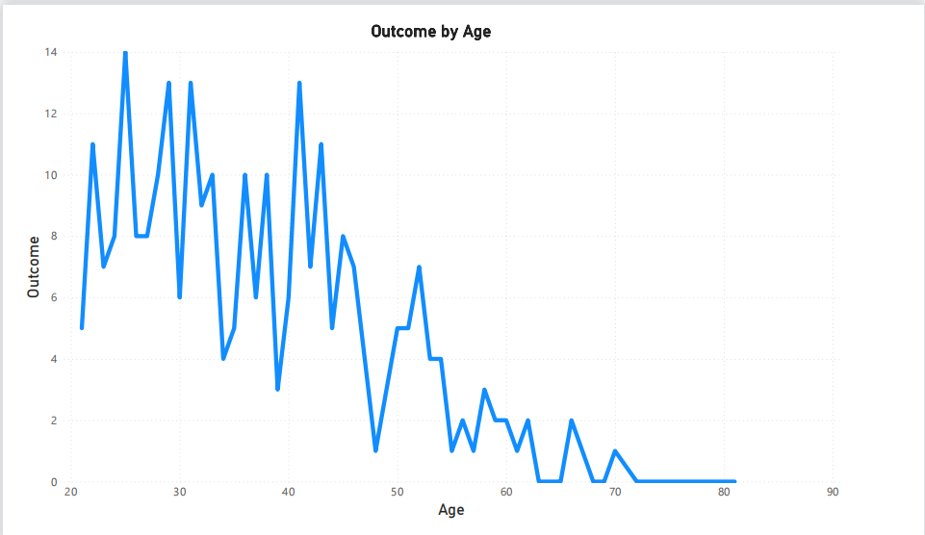
Age wise Diabites

Slide 6
Age wise Diabetes
from above graph we can illustrate that from age between 25 to 45 we can clearly see that the number of patient is more so, female from that age category are not very care about the diabetes control level.
After age 45+, people are realize that improvement of health so, the number of patient is decrease.

Slide 7
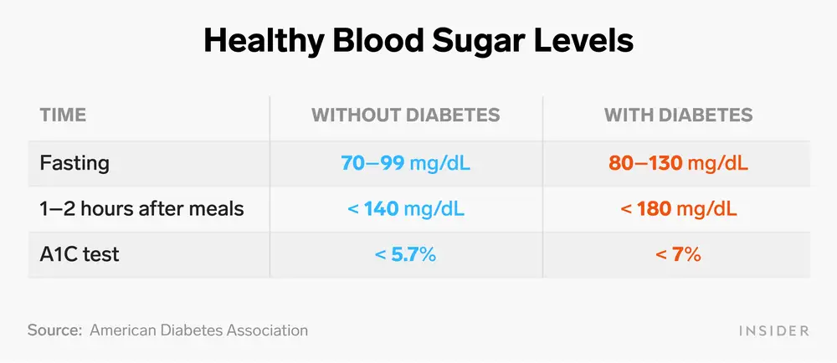
Some import key matrix on Glucose level

Slide 8
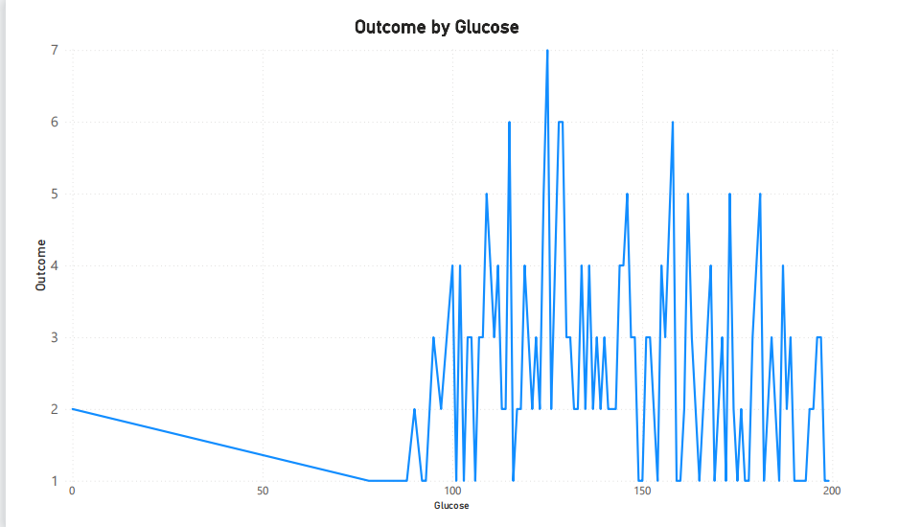
Glucose level and diabetes

Slide 9
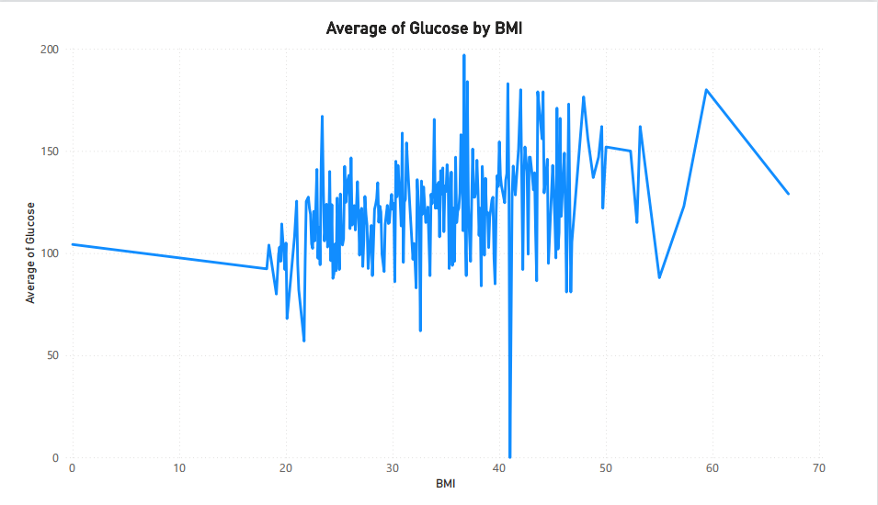
Avg Glucose by BMI

Slide 10
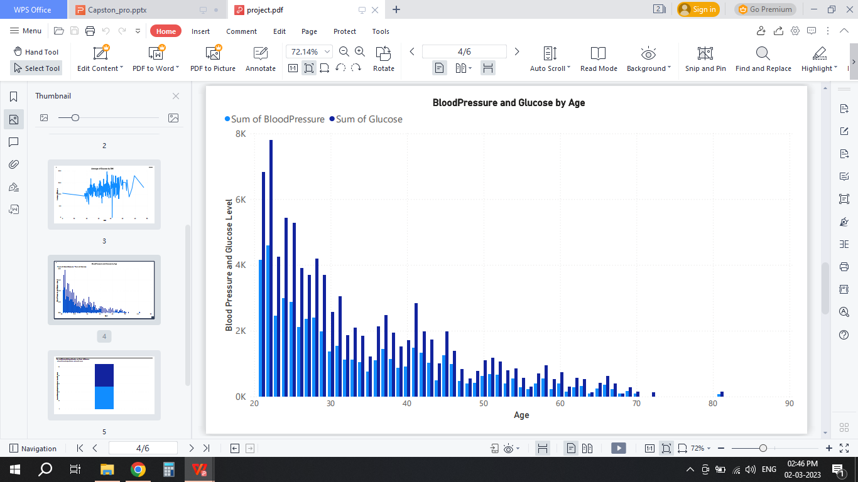
BloodPressure and Glucose level at different age

Slide 11
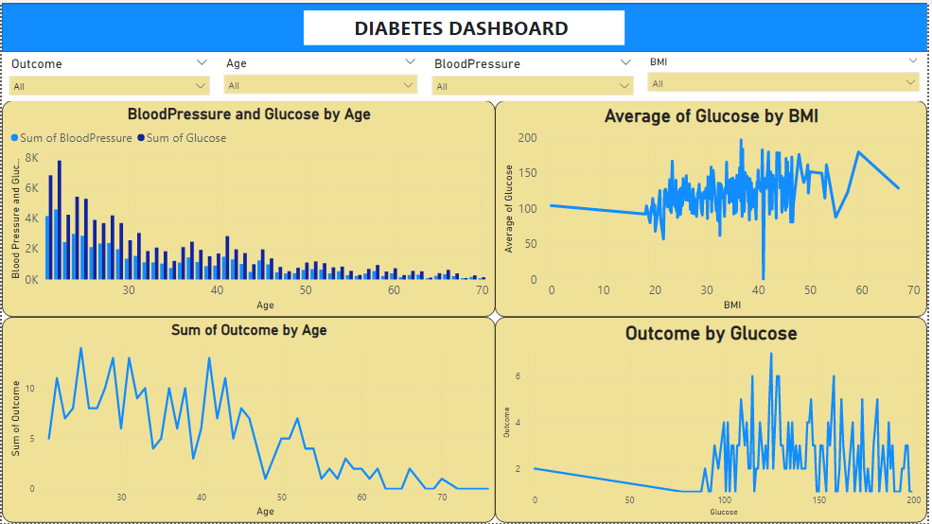
Final Dashboard

Slide 12
Conclusion
To conclude,find the diabetes is depend on many factor. we can find some co-relation between some parameter of Body like BMI, Glucose level, BloodPressure, diabetes pedigree function and Age but, we cant confidently say that this parameter is perfectly suitable for diabetes

Slide 13
THANK YOU

