Slide 1

AI-Based Document Similarity & Duplicate Detection System Using NLP
AI-Based Document Processing Using OCR, NLP and Similarity Analysis PBL Task 2
Subject: Python for Data Science (BE05000231)
NAME 1: Nimavat Jaydeep M.
ENROLLMENT 1: 250043107032
NAME 2: Upadhyay Hitarth S.
ENROLLMENT 2: 250043107050
BRANCH: Computer Engineering | SEMESTER: 5th

Slide 2
1. Introduction
• Document Similarity: The process of measuring the semantic or syntactic alignment between two text bodies.
• Duplicate Detection: Identifying exact or highly rewritten copies of files to protect academic integrity.
• Natural Language Processing (NLP): Used to clean, tokenize, and map raw text characters into mathematical arrays.
• Automated Comparison: Bypasses slow manual grading reviews by running comparison algorithms in real-time.
• Scope of Present Work: A client-side, browser-native pipeline capable of parsing PDF, DOCX, and scanned note photos.

Slide 3
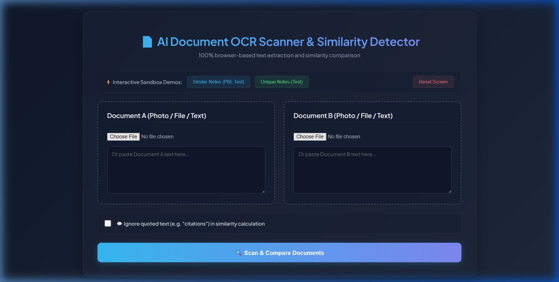
2. Project Overview
• 100% Client-Side Web Application: Executed entirely in the browser using HTML5, CSS3, and JavaScript.
• Document Ingestion: Extracts text dynamically from pasted strings or uploaded files (.txt, .pdf, .docx).
• Offline OCR Scanner: Extracts handwritten or printed characters from note photos (.png, .jpg, .jpeg).
• Statistical NLP Math: Matches vocabulary sets using Cosine Vector models and Jaccard Set indices.
• Immediate Feedback: Shows circular gauges, metrics, and Turnitin-style highlighted match segments.

Slide 4
3. Problem Statement
• Inability to Scan Images: Standard plagiarism detectors completely fail to inspect book photos or handwritten notebook scans.
• Network Dependency Constraints: Python server setups are blocked by university firewall sockets, causing terminal timeout errors.
• Heavy Server Costs: Spawning GPU-dependent server-side OCR modules is expensive and complex to maintain.
• Data Leaks and Exposure: Uploading student work to proprietary databases exposes sensitive student files.

Slide 5
4. Project Objectives
• Serverless Architecture: Deliver a high-performance scanner running completely on local client browser threads.
• Client-Side OCR Scanning: Perform text extractions from student note photos locally using Web Workers.
• Combined Mathematical Models: Implement TF-IDF Cosine Similarity and Jaccard Indexing to catch rewritten copies.
• Turnitin-style Diff: Render real-time visual highlight tags showing exact matching vocabularies.
• Maximum Data Privacy: Prevent documents from ever leaving the student's browser.

Slide 6
5. Project Motivation
• Zero Maintenance Overhead: Developing static pages (Netlify-ready) that run forever without paid database backends.
• Bypassing Proxy Blocks: Eliminating Python terminal connection errors (`WinError 10060`) by using browser WebAssembly.
• Time-Saving Automation: Evaluating handwritten pages or mathematical outlines in seconds.
• Mobile Accessibility: Creating responsive layouts that fit on tablets and phones in a presentation room.

Slide 7
6. Existing System / Existing Approach
• Python Flask/Streamlit Backends: Spawns heavy local servers running PyTorch or OpenCV frameworks.
• Paid Subscriptions: Academic institutions depend on proprietary APIs (Copyleaks, Turnitin) with strict rate limits.
• Static String Checks: Basic checkers match exact character lists, ignoring vocabulary distributions or synonym rewriting.
• Manual Student Uploads: Teachers have to manually copy and paste image text before running checks.

Slide 8
7. Limitations of Existing System
• Network Timout Errors: Server socket connections crash frequently during model weight downloads.
• Latency: Transmitting high-resolution student images to external APIs causes long processing queues.
• Privacy Non-Compliance: Storing documents in shared clouds violates university student privacy policies.
• Lack of Offline Scans: stream processes fail completely if the server loses internet connection.

Slide 9
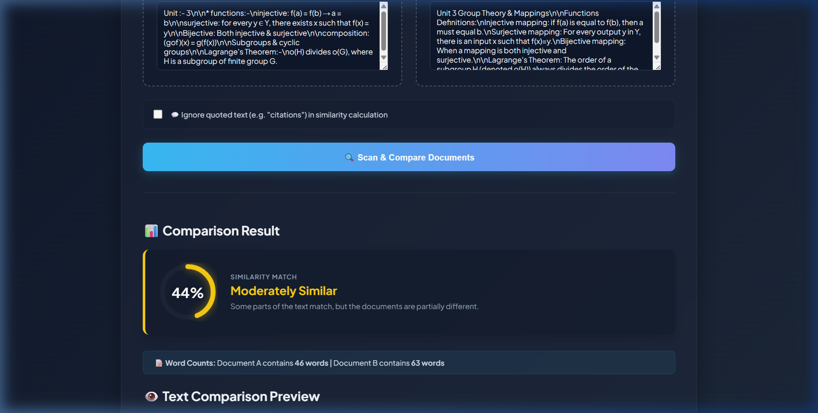
8. Proposed System
• 100% Client-Side Engine: Browser WebAssembly compiles local parser scripts.
• Multi-Format File Uploads: PDF.js and Mammoth.js process files locally.
• IndexedDB Model Caching: Stores Tesseract OCR neural weights inside browser cache.
• JavaScript NLP execution: tokenizes, cleans, and runs vector distance calculations on-device.

Slide 10
9. Key Features
• WebAssembly Tesseract OCR: Scans JPG/PNG text directly in the browser.
• PDF & Word Extraction: Parses files page-by-page client-side using JavaScript array buffers.
• Animated SVG Circular Gauge: Dynamic progress dial tracking the similarity score.
• Sandbox Demo presets: Pre-loaded group theory notes to test features in one click.
• Citation Filter checkbox: Ignores text inside double/single quotes during scoring.

Slide 11
10. Project Scope
• Academic Grading Portals: Fast assignment checks directly within learning management portals.
• Offline Verification: Scanning physical textbook sheets in offline university labs.
• Private Homework Submissions: Validates original student answers without exposing them online.
• Lightweight Plagiarism Review: Useful for grading committees to check duplicate reports on their phones.

Slide 12
11. Technology Stack
• Core Technologies: HTML5 Semantic Layout, CSS3 Variables (theme layout), ES6 JavaScript.
• OCR Parser: Tesseract.js (v5, runs Web Workers on local browser threads).
• Adobe PDF Parser: PDF.js (v3.11.174, page-coordinate array parser).
• Word Document Parser: Mammoth.js (v1.6.0, docx-to-XML plain text converter).
• Hosting Platform: Netlify Continuous Deployment (connected via GitHub).

Slide 13
12. System Architecture
• User Interface: Glassmorphic HTML5 dashboard handles inputs (files/text).
• Extraction Layer: FileReader API reads bytes locally. Tesseract, PDF.js, and Mammoth parse to strings.
• NLP Core: JavaScript tokenizes text, cleans punctuation, and normalizes cases.
• Comparison Core: JavaScript vectors compute Cosine and Jaccard similarity indices.
• Rendering: Updates orange highlighter spans and circular progress offsets dynamically.

Slide 14
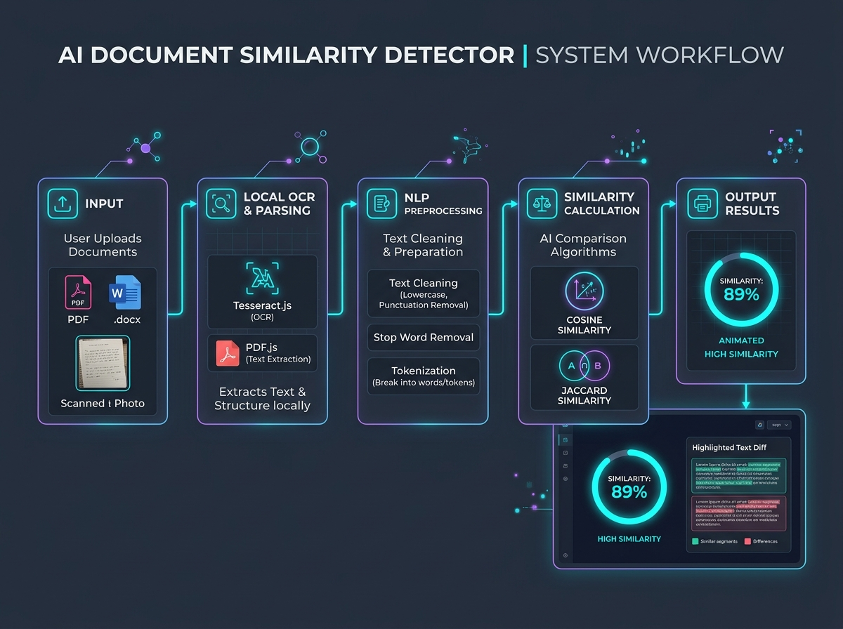
13. System Workflow
• Select: User selects text files, PDF files, Word files, or image scans.
• Loading: Spawns progress spinner overlays on form submit.
• Extract: Browser libraries parse text content on workers.
• Calculate: Computes Cosine + Jaccard average match.
• Render: Updates UI gauge and diff spans instantly.

Slide 15
14. Input Data / Document Input
• Uploading File Formats: Supports .txt, .pdf, .docx, and images (.png, .jpg, .jpeg).
• Base64 Image Preview: Shows thumbnail previews of uploaded images directly in the columns.
• Text Box Copy-Pasting: Users can type directly into the text areas to run instant comparisons.
• Sandbox Note Presets: Clickable buttons to load university math notes for quick validation.

Slide 16
15. Document Processing
• FileReader API Conversion: Reads files locally using Javascript array buffers.
• PDF.js Document parsing: `pdfjsLib.getDocument()` loads PDF arrays to memory.
• Mammoth.js Paragraph extraction: Reads .docx file formats directly into clean text strings.
• Web Worker sandboxing: Parsing processes run in browser threads so the dashboard stays fast.

Slide 17
16. Text Preprocessing Pipeline
• Case Normalization: `.toLowerCase()` standardizes casing to prevent capitalization mismatches.
• Punctuation Removal: RegEx `.replace(/[^\w\s]/g, '')` strips symbols, commas, and periods.
• Space Trimming: `.trim()` removes leading and trailing spaces.
• Word Splitting: `.split(/\s+/)` separates the cleaned strings into token arrays of clean words.

Slide 18
17. NLP Processing
• Tokenization: Splits text strings into arrays of individual word token strings.
• Vocabulary Set indexing: Converts token arrays into unique JavaScript Set structures.
• Frequency mapping: Counts word occurrences to build frequency bags for vector matching.
• Citation Filtering: Regex replaces quoted sections with blank space before similarity checks.

Slide 19
18. Text Representation
• Vocabulary Union Vector: Compares word sets from both documents to create a master list of all unique words.
• Term Frequency (TF) Maps: Maps occurrences of each word coordinate relative to the master list.
• Multi-Dimensional Vectors: Represents both documents as coordinates, ready for distance calculation.

Slide 20
19. Term Frequency (TF) Vector Method
• Actual Method in Code: Dynamic Word Frequency Vectors.
• Vocab Set: Combines both documents' word arrays into a master Vocab Set.
• Frequency Mapping: Loops vocab list to count term occurrences in each document.
• Vector Representation: Maps counts into coordinate arrays, ready for Cosine Distance calculations.

Slide 21
20. Cosine Similarity Vector Math
• Cosine Similarity measures the angle between document vectors:
Cosine Similarity = (A · B) / (||A|| * ||B||)
• Dot Product: Multiplies matching coordinates between document maps.
• Magnitudes product: Normalizes vectors to keep calculations accurate.
• Length Independence: Ensures matching remains accurate even if document lengths differ.
// Vector math in calculateCosine()
let dotProduct = 0;
let mag1 = 0;
let mag2 = 0;
vocab.forEach(word => {
dotProduct += freq1[word] * freq2[word];
mag1 += freq1[word] * freq1[word];
mag2 += freq2[word] * freq2[word];
});
if (mag1 === 0 || mag2 === 0) return 0;
return (dotProduct / (Math.sqrt(mag1) * Math.sqrt(mag2))) * 100;

Slide 22
21. Similarity Detection (Jaccard Index)
• Checks overall Vocabulary Set overlap:
Jaccard Index = |A ∩ B| / |A ∪ B|
• Intersection: Counts shared unique words.
• Union: Counts total combined unique words.
• Dividing intersection by union outputs Jaccard percentage.
• Highly effective at catching copied vocabulary sets.
function calculateJaccard(text1, text2) {
const t1 = cleanText(text1);
const t2 = cleanText(text2);
if (!t1 || !t2) return 0;
const words1 = new Set(t1.split(/\s+/));
const words2 = new Set(t2.split(/\s+/));
const intersection = new Set(
[...words1].filter(x => words2.has(x))
);
const union = new Set([...words1, ...words2]);
if (union.size === 0) return 0;
return (intersection.size / union.size) * 100;
}

Slide 23
22. Duplicate Detection Logic & Thresholds
• Combined Score: Calculates the average of Cosine Similarity and Jaccard Index score.
• Severity Warning Classifications in JavaScript:
- 90% - 100%: Direct Copy / Duplicate (Red Color)
- 70% - 89%: Highly Similar (Orange Color)
- 40% - 69%: Moderately Similar (Yellow Color)
- 15% - 39%: Slightly Similar (Blue Color)
- Below 15%: Completely Unique (Green Color)

Slide 24
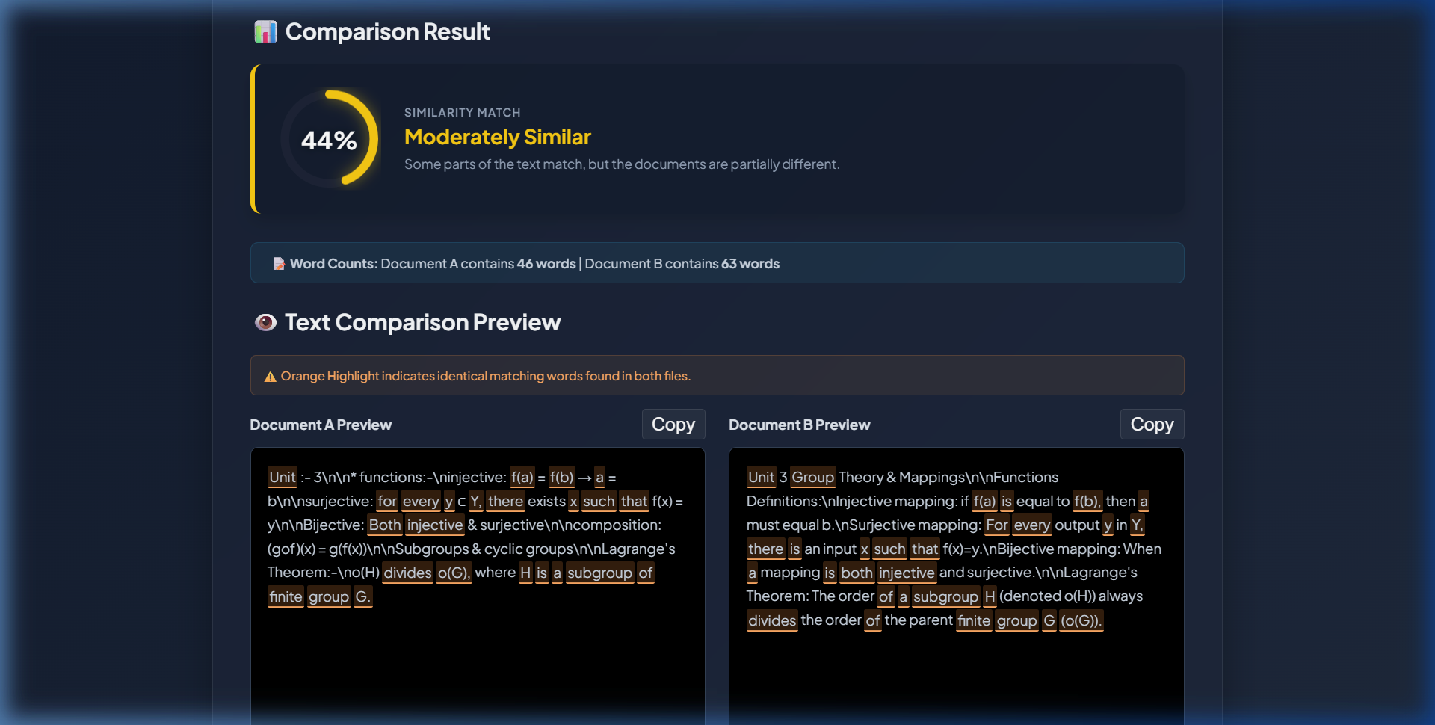
23. Document Comparison Preview
• Visual Word Diff: Highlight algorithm checks if a word in Document A exists in the vocabulary set of Document B.
• Matches are wrapped in custom span elements.
• Orange Highlights: Identifies identical matching words in both documents.
• Clipboard integration: Copy buttons to extract matching strings in one click.

Slide 25
24. Similarity Results Dashboard
• Custom Score Gauge: Shows final similarity score inside the dynamic progress circle.
• Match Status Card: Displays text descriptions (e.g. 'Moderately Similar', 'Highly Similar').
• Word Count Stats: Renders exact word counts for both Document A and Document B.
• Visual preview: Displays the uploaded note photo directly in the column.

Slide 26
25. Similarity Visualization (SVG Gauge)
• Circular progress ring rendered in inline SVG.
• Circumference = 326.7px (radius = 52px).
• JS computes dynamic stroke-dashoffset for score percentage.
• Smooth 1.5s CSS transition filling animation.
• Glow and circle colors update dynamically matching similarity severity levels.
// Render score with SVG gauge animation
const circle = document.getElementById('radial-bar');
const circumference = 326.7;
const offset = circumference - (circumference * scoreInt / 100);
circle.style.strokeDashoffset = offset;
circle.style.stroke = color;
circle.style.filter = `drop-shadow(0 0 8px ${color}80)`;

Slide 27
26. User Interface Design
• Midnight Slate-Blue gradient background (`#0f172a` to `#1e293b`).
• Glassmorphic interface: Semi-transparent panels with background blur.
• Google Fonts integration (Plus Jakarta Sans).
• Dual Column Previews with uploaded image display placeholders.
• Single OCR scanner mode and double comparison mode.

Slide 28
27. Main Web Controller Logic
• Client-side controller routing in JS.
• Handles extraction, OCR, comparisons.
• Single scanner vs Dual match flow check.
• Shows loader overlay during calculations.
• Catches errors and updates error container.
async function startScanner() {
const overlay = document.getElementById('loader-overlay');
const errorBox = document.getElementById('error-box');
errorBox.style.display = 'none';
overlay.style.display = 'flex';
try {
const t1 = await extractText('file1', 'text1', 'Document A');
const t2 = await extractText('file2', 'text2', 'Document B');
if (t1.trim() && !t2.trim()) {
renderSingleScannerResult('A', t1, file1);
} else {
renderComparisonResult(t1, t2);
}
} catch (err) {
errorBox.innerText = err;
}
}

Slide 29
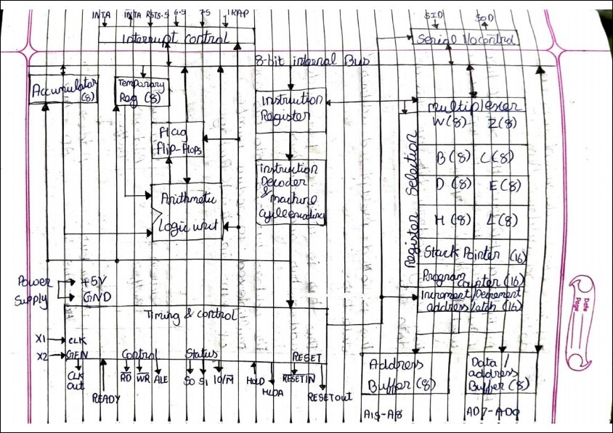
28. Testing & Validation
• Tested offline OCR extraction with handwritten note scans (Math mappings and functions).
• Tested digital PDF extraction page-by-page to check text stream reconstruction.
• Verified similarity scores using identical and modified notes in the sandbox selector.
• Confirmed that network firewalls have zero impact on scanning speeds or execution.

Slide 30
29. Advantages & Limitations
• Advantages:
- 100% Serverless: Bypasses server maintenance fees and offline/online proxy socket blocks.
- Data Privacy: Files are processed completely in the browser and never sent online.
- Mobile Responsive: Renders cleanly on phones and tablets during presentations.
• Limitations:
- CPU Bound: Heavy files take longer to scan via client-side JavaScript threads.
- No Database: Similarity reports cannot be saved in a remote history database.

Slide 31
30. Future Scope
• Multi-Language OCR: Add dropdown support for Spanish, Hindi, or French training models.
• Web Link comparisons: Paste direct URLs to fetch and check similarity against live websites.
• PDF report downloads: Compile plagiarism match reports directly in the browser to download offline.
• Sentence Embeddings: Integrate client-side Transformers (like ONNX) for semantic similarity matching.

Slide 32
31. Conclusion
We have successfully built a fully serverless, client-side document similarity and duplicate detection system using Tesseract.js, PDF.js, and Mammoth.js. The project demonstrates that advanced AI parsing and NLP comparison algorithms can run completely locally on consumer browser engines, eliminating the need for expensive GPU-hosting setups.
THANK YOU Questions?

