Slide 1
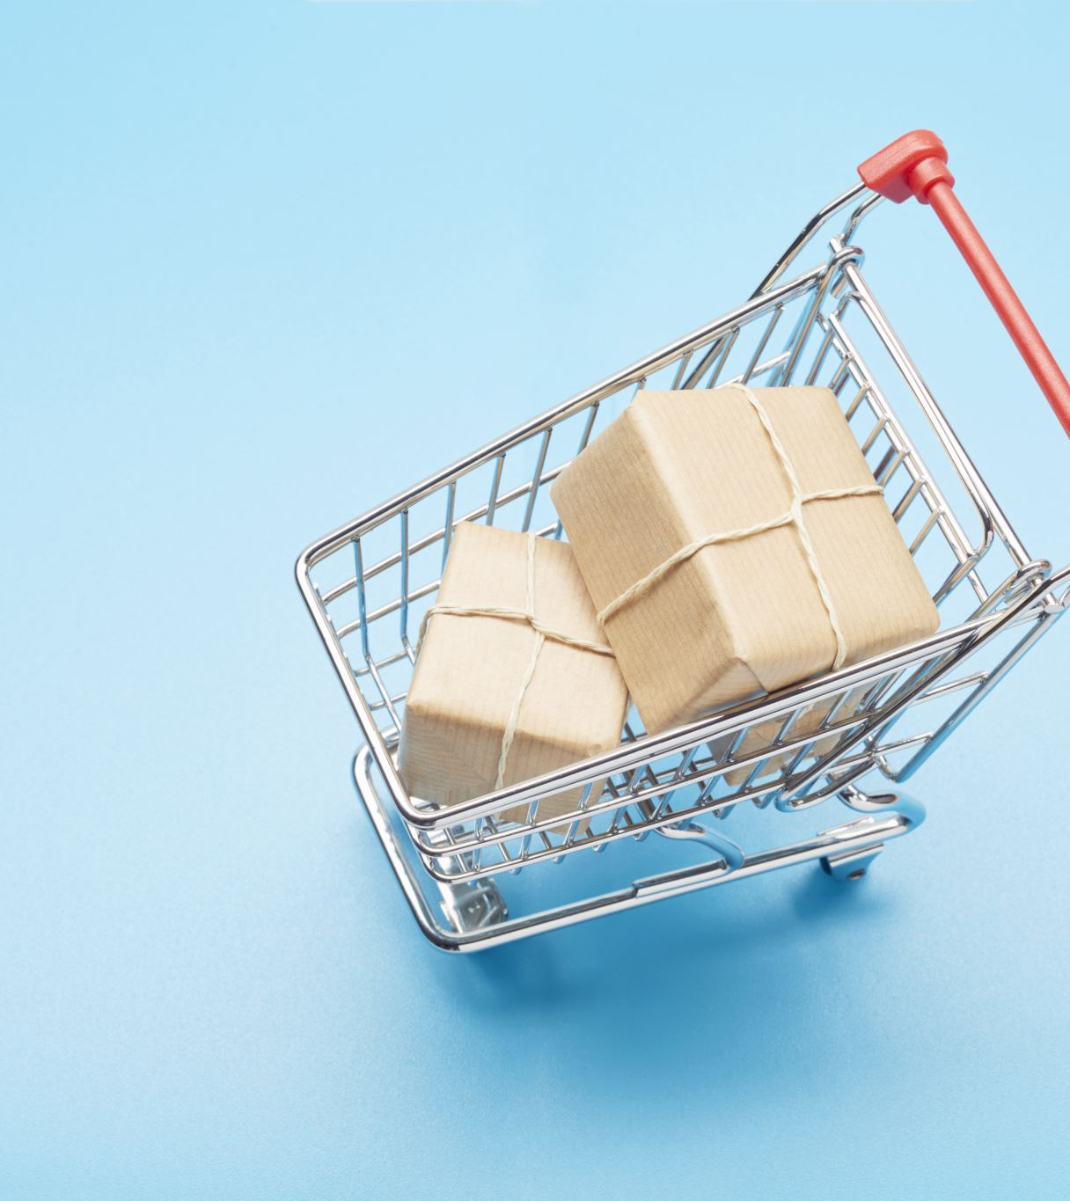
Market Basket Analysis
Advanced Database Topics
COMP-8157
Professor : Olena Syrotkina

Slide 2
Team Members(The Brogrammers)
Henishkumar Kiritkumar Patel (110073489)
Jaydeep Pritesh Dharamsey (110088507)
Veera Venkata Bharat Kumar Vayitla (110088432)
Yash Somaiya (110087733)

Slide 3
Introduction
According to research we done, we find out restaurants struggle to decide their menu items when they are starting out as well as which food offer, they can provide, so to solve this problem we use data mining techniques called association rules to determine the items ordered frequently together by customers.
After using this Web-App restaurants can determine items ordered frequently by customers and it can be also useful and give co-related option to customers who are confused for what to buy next.

Slide 4
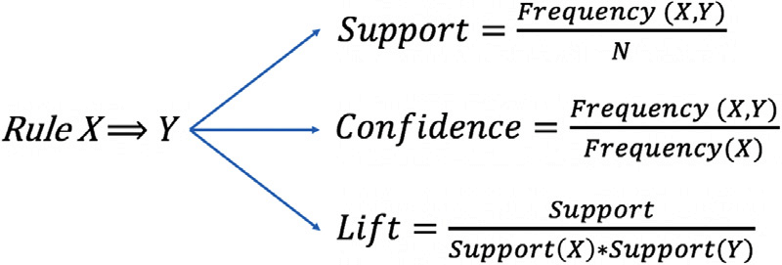
Association Rule Mining
It is a data mining technique to find associative rules between a combination of items.
Metrics to measure Association

Slide 5
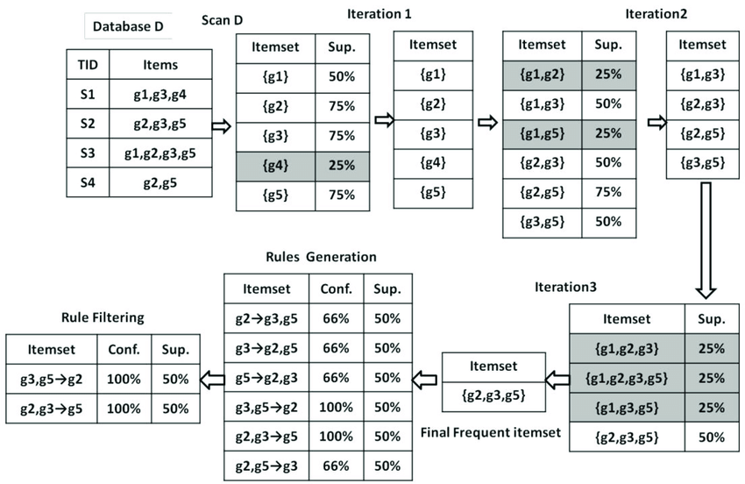
Apriori Algorithm
Apriori Algorithm used frequent item sets to generate association rules. It is based on the concept that a subset of a frequent data set must also be a frequent data set.

Slide 6

FP Growth Algorithm
FP-growth is an improved version of the Apriori Algorithm which is widely used for frequent pattern mining(AKA Association Rule Mining).
It is used as an analytical process that finds frequent patterns or associations from data sets.

Slide 7
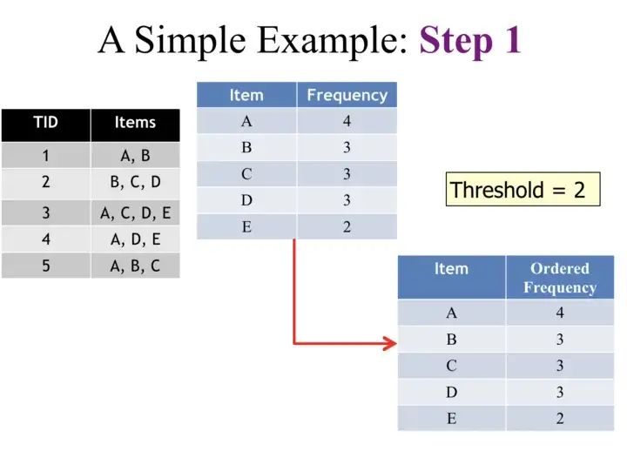
FP Growth Algorithm Step-1

Slide 8
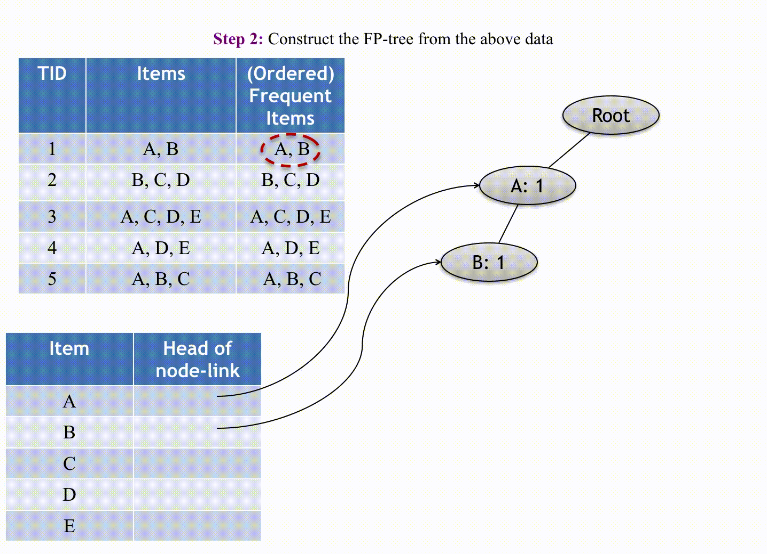
FP Growth Algorithm Step-2

Slide 9
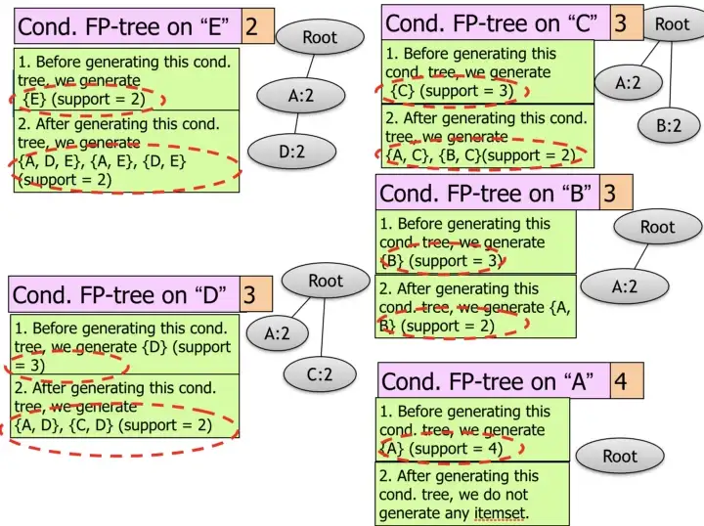
FP Growth Algorithm Step-3

Slide 10
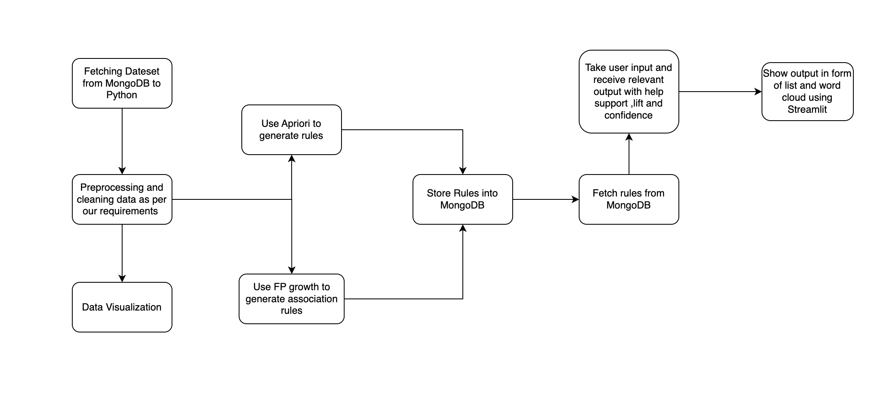
Proposed Model

Slide 11
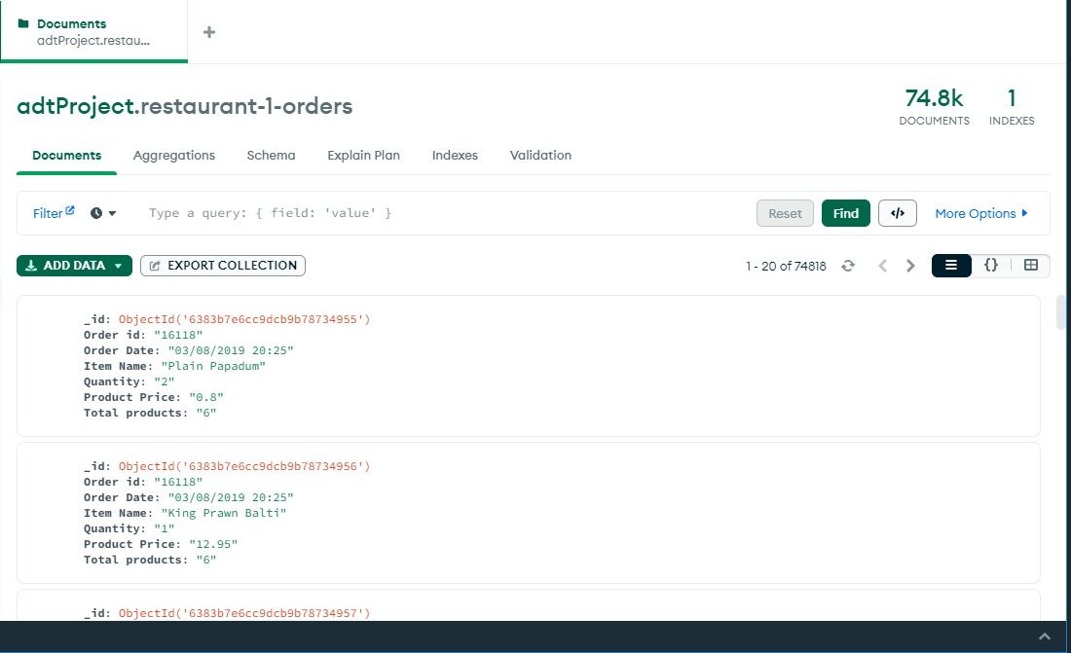
Implementation MongoDB

Slide 12
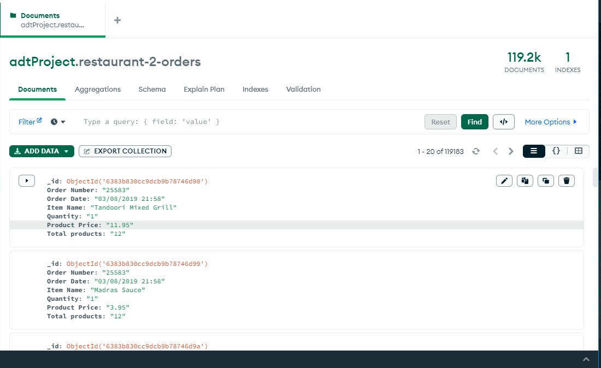
Implementation MongoDB

Slide 13
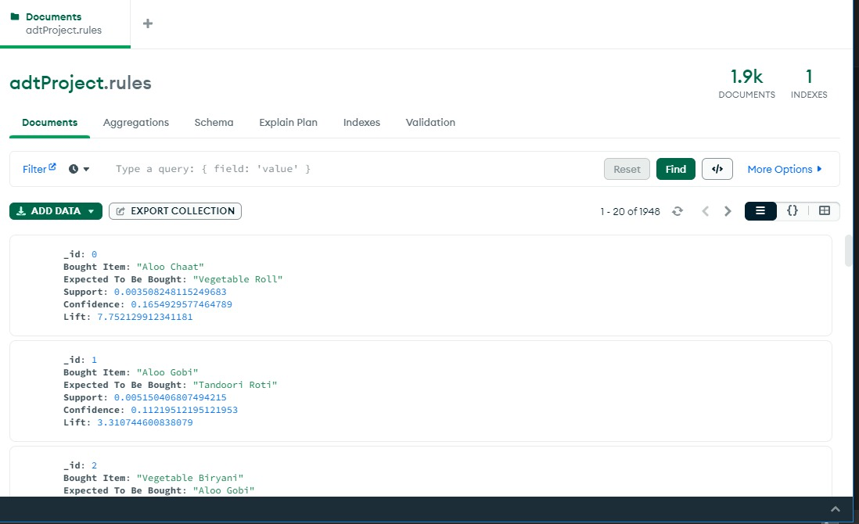
Implementation MongoDB

Slide 14
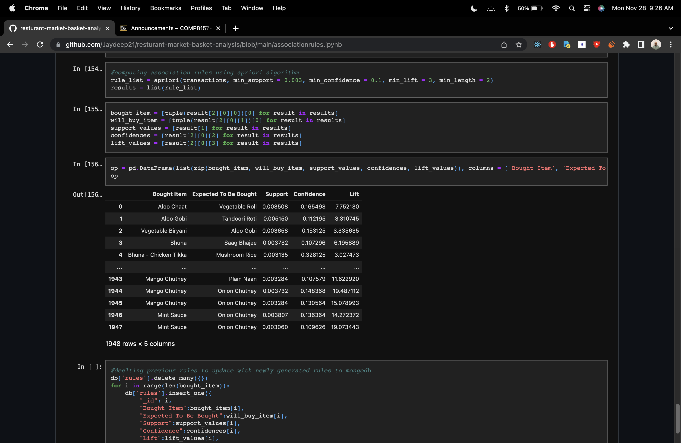
Implementation Rules

Slide 15
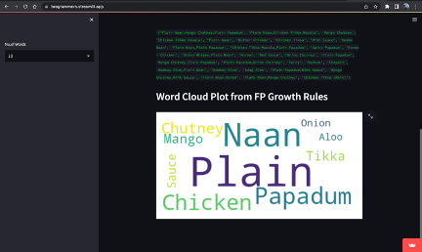
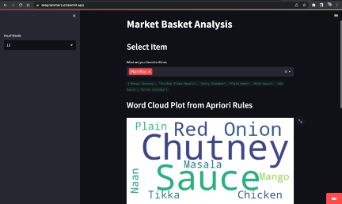
Implementation Landing Page

Slide 16

DEMO

Slide 17
Contribution
Henishkumar Kiritkumar Patel
Setting up MongoDB Connnection (Cloud), Data Cleaning, ppt
Jaydeep Pritesh Dharamsey
UI (Streamlit) ,Hosting, fp-growth, report
Veera Venkata Bharath Kumar Vayitla
Associations Rules, Apriori, report
Yash Somaiya
Data Cleaning ,Data Visualizations, ppt

Slide 18
References
S. Li, “A gentle introduction on Market Basket Analysis - association rules,” Medium, 27-Sep- 2017. [Online]. Available: https://towardsdatascience.com/a-gentle-introduction-on-market- basket-analysis-association-rules-fa4b986a40ce [Accessed: 01-Oct-2022].
WebAI, “Takeaway Food Orders - updated,” Kaggle, 04-Aug-2019. [Online]. Available: https://www.kaggle.com/datasets/henslersoftware/19560-indian-takeaway-orders [Accessed: 15-Oct-2022].
https://towardsdatascience.com/understand-and-build-fp-growth-algorithm-in-python-d8b989bab342

Slide 19

Thankyou

