Slide 1

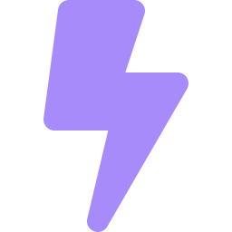
SYNAPSE AI
AI OPTIONS-TRADING THESIS ENGINE
Where the math meets
the moment.
Turning intimidating options data and live market news into one clear, plain-English trading thesis — powered by AI.
J’s Team
· Level 1 — Idea Submission
Submission deadline
2 July 2026

Slide 2


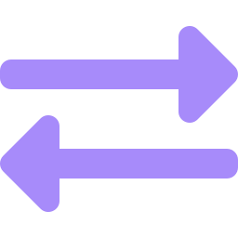

THE PROBLEM
Retail traders are drowning in data — and starving for clarity.
An intimidating wall of numbers
~9 in 10
Option chains bury people in Greeks, open interest and implied volatility — unreadable to most.
Two worlds that never talk
retail F&O traders in India lose money
The options math says one thing; the news says another. Nobody connects the two.
Tools show data, not decisions
Source: SEBI study on individual traders in equity derivatives, 2024
Dashboards dump charts and grids, but never answer the only question that matters: 'so what?'
SYNAPSE AI
Level 1 · Idea Submission · 2 July 2026
2

Slide 3
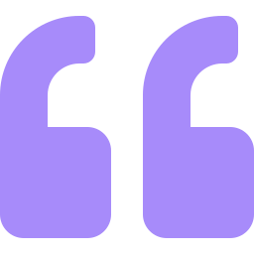
PROBLEM STATEMENT
Retail traders have access to more market data than ever — yet less clarity than ever.
They cannot reconcile what the
options math implies with what real-world news means — so they trade blind. No tool translates both into a single, human decision.
Synapse AI exists to close that gap.
SYNAPSE AI
Level 1 · Idea Submission · 2 July 2026
3

Slide 4
OUR SOLUTION
Synapse AI — a translation & synthesis engine.
We read two worlds that never talk to each other — the live options math and the real-world news — and use AI to find where they disagree. That gap is the edge. The output is one calm, plain-English thesis anyone can act on.
SYNTHESIS · NIFTY
The mood Traders lean bullish on NIFTY, near 24,000.
The news RBI unexpectedly paused rate hikes — supportive.
The twist Math and news AGREE — momentum has room to run.
NO charts to decode. NO jargon. NO data overload.
Bottom line A cautious bet that the price drifts higher.
Just information, not financial advice.
SYNAPSE AI
Level 1 · Idea Submission · 2 July 2026
4

Slide 5
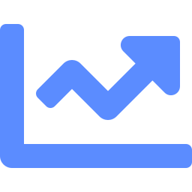


HOW IT WORKS
Three engines, one clear answer.
GreekSpeak
AlphaRAG
Synthesis
THE MATH
THE REAL WORLD
THE ALPHA
Reads the live options chain — Put-Call Ratio, Max Pain — and turns it into a simple bullish or bearish read.
Continuously reads live market news and retrieves what's relevant using an AI vector memory (RAG).
Gemini AI compares both realities and writes one plain-English thesis — where they agree, where they clash.
SYNAPSE AI
Level 1 · Idea Submission · 2 July 2026
5

Slide 6


THE CORE INSIGHT
The edge lives where the math and the news disagree.
THE MATH
THE NEWS
Options positioning leans bearish — traders are betting NIFTY drops this expiry.
The RBI just paused rate hikes unexpectedly — a strongly bullish real-world signal.
Divergence detected. The two realities clash — the market may be mispriced. That gap is the opportunity Synapse surfaces.
SYNAPSE AI
Level 1 · Idea Submission · 2 July 2026
6

Slide 7


WHY SYNAPSE IS DIFFERENT
Everyone shows data. We deliver a decision.
TYPICAL TRADING TOOLS
SYNAPSE AI
Walls of numbers & Greeks
One plain-English sentence
Cluttered charts and data grids
Calm, abstract visuals
You decode it yourself
AI interprets it for you
Math and news kept separate
Math + news fused into one view
Built for experts only
Built for everyone
SYNAPSE AI
Level 1 · Idea Submission · 2 July 2026
7

Slide 8

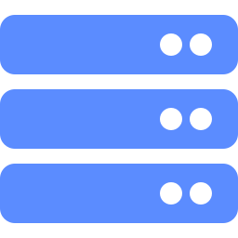
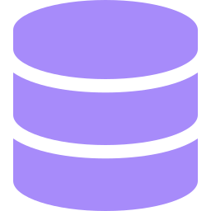
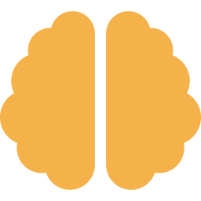

ARCHITECTURE & FEASIBILITY
Not just an idea — a working prototype.
React UI
Node engine
Live data + RAG
Gemini AI
Clean dashboard
Runs the pipelines
Upstox · news · pgvector
Writes the thesis
Already functional: live exchange options data, an AI vector-search news memory, and a plain-English AI thesis — all working end-to-end today.
SYNAPSE AI
Level 1 · Idea Submission · 2 July 2026
8

Slide 9



IMPACT & TIMING
The right product at the right moment.
World's largest
A painful gap
AI makes it possible
India's NSE is the world's biggest derivatives exchange by contracts traded — retail F&O is booming.
~90% of retail derivatives traders lose money — a desperate, unmet need for clarity and guidance.
Modern AI makes institutional-grade synthesis affordable for every individual trader, right now.
Our impact: we democratise institutional-grade market reasoning — clarity for the everyday trader.
SYNAPSE AI
Level 1 · Idea Submission · 2 July 2026
9

Slide 10
ROADMAP
From idea to a personal AI markets analyst.
1
NOW · LEVEL 1
Working prototype: live options + news RAG + AI thesis.
2
NEXT
More instruments, expiry selection, accuracy tuning.
3
THEN
Divergence alerts, portfolio view, mobile app.
4
VISION
A personal AI markets analyst for every retail trader.
SYNAPSE AI
Level 1 · Idea Submission · 2 July 2026
10

Slide 11
SYNAPSE AI
Where the math meets the moment.
Clarity for every trader — the math, the news, and the edge between them.
J’s Team - Juveriyah , Jaydeep Manchanda

