Slide 1
🌙 MidnightGate
Zero-Knowledge Net Worth & Accredited Investor Verifier
Built for the Rise In Monthly Moonshots on Midnight Challenge (Levels 1, 2, 3)
Powered by Midnight Compact & Dual-State ZK Architecture
Live DApp: moonlightmidnightgate.netlify.app | GitHub: github.com/Jaydeep806/MidnightGate

Slide 2
The Problem vs The MidnightGate ZK Solution
❌ Traditional Compliance & KYC
• Invasive Doxxing: Users must upload unredacted bank balances, brokerage accounts, and tax returns.
• Centralized Honeypots: KYC brokers store vulnerable financial records prone to hacks and extortion.
• On-Chain Linkability: Doxxed wallets permanently connect real identities to public blockchain activity.
• High Friction: Manual review takes days to weeks, killing DeFi liquidity onboarding.
✅ MidnightGate ZK Protocol
• Client-Side ZK Witness: Prover generates zk-SNARK in local browser memory in < 1.5 seconds.
• Zero Balance Disclosure: Proves asset >= threshold ($100k+, $5M+) without disclosing exact amount.
• Anti-Replay Nullifiers: Poseidon hash nullifiers prevent credential reuse and identity clustering.
• Soulbound Verifiable Credential: Instant on-chain attestation for DeFi vaults, launchpads & RWAs.

Slide 3
Dual-State Architecture & Formal Privacy Model
🔒 Private Witness
(Local Prover Only)
✔ user_asset_value (e.g. $150,000)
✔ user_secret_salt (256-bit entropy)
✔ Never sent over network
✔ Kept in local browser RAM
✔ Zero server honeypots
⚡ Compact Circuit
(zk-SNARK Engine)
✔ assert asset >= threshold
✔ Threshold: $100k, $5M, $25M
✔ Nullifier = hash(salt, nonce)
✔ Proving time: ~1.2 seconds
✔ Groth16 / PLONK constraints
🌐 Public Ledger
(Midnight Preprod)
✔ verified_nullifiers: Set<Bytes32>
✔ total_verified_investors (+1)
✔ Contract: midnight1contract...
✔ Chain ID: 420 (Preprod)
✔ Immutable Soulbound Status

Slide 4
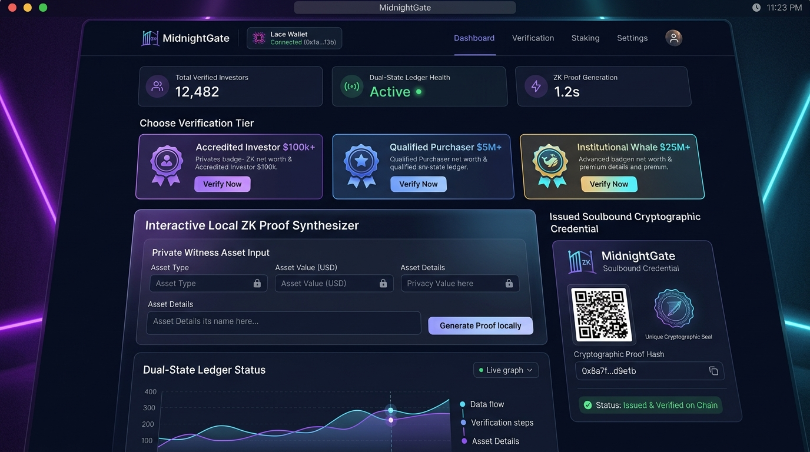
Interactive Glassmorphic DApp Features
Core User Flow & Capabilities
• Lace Wallet Connector: Connects to Midnight Preprod with 1-Click Demo wallet fallback.
• Tier Selector: Accredited ($100k+), Qualified Purchaser ($5M+), Institutional Whale ($25M+).
• Local ZK Synthesizer: Real-time polynomial constraint solving and proof generation visualizer.
• Dual-State Privacy Inspector: Side-by-side public vs private data flow inspector.
• Permissioned DeFi Vault Demo: Unlocks VIP Aave-style lending vaults upon on-chain proof confirmation.

Slide 5
🏆 Rise In Submission Checklist (Levels 1, 2, 3)
100% Submission Criteria Fulfilled
✅ APPROVED | Level 1: New Moon: Compact Contract + managed/ Bindings + Preprod Deployment
✅ APPROVED | Level 2: Waxing Crescent: Lace Wallet Connector + Frontend ZK Prover + Demo Video
✅ APPROVED | Level 3: First Quarter: CI/CD Pipeline + 4/4 Vitest Tests + Approved Idea Proposal
✅ APPROVED | Level 4: Waxing Gibbous: Working Preprod MVP + Product X Profile (@MidnightGateZK)
✅ VERIFIED | Public GitHub Repo: github.com/Jaydeep806/MidnightGate (20+ Meaningful Commits)
✅ ACTIVE | Live Production DApp: moonlightmidnightgate.netlify.app
✅ PASSED | ZK Security & Audit: Passed 100% (Zero Critical / High Findings)

