Slide 1

TCS InfraMind -Season 4
Topic – Enterprise AI
Name : Jaydeep Das
College : Murshidabad College of Engineering and Technology
Reference No. : dt20207411725
E - mail : jaydeep.das@outlook.in / jaydeep.msd@gmail.com
Github – project link: https://github.com/JaydeepDas2000/PyAnalyzer_Restaurant_TCS_InfraMind
Youtube link: https://youtu.be/TuV4TRK1Aps

Slide 2
Objective :
Enhance the customer satisfaction index and to ensure customer stickiness to your organization, thereby maximizing revenue and optimizing cost. Infuse emerging technologies to draw, engage and retain new era of tech savvy (and demanding) set of customers

Slide 3
MODEL USED
- Bayes’ Theorem
- Logistic Regression
- SVM => (perfect model for our dataset)
- Decision Tree
- Random Forest Classifier
- Multinomial Nb

Slide 4

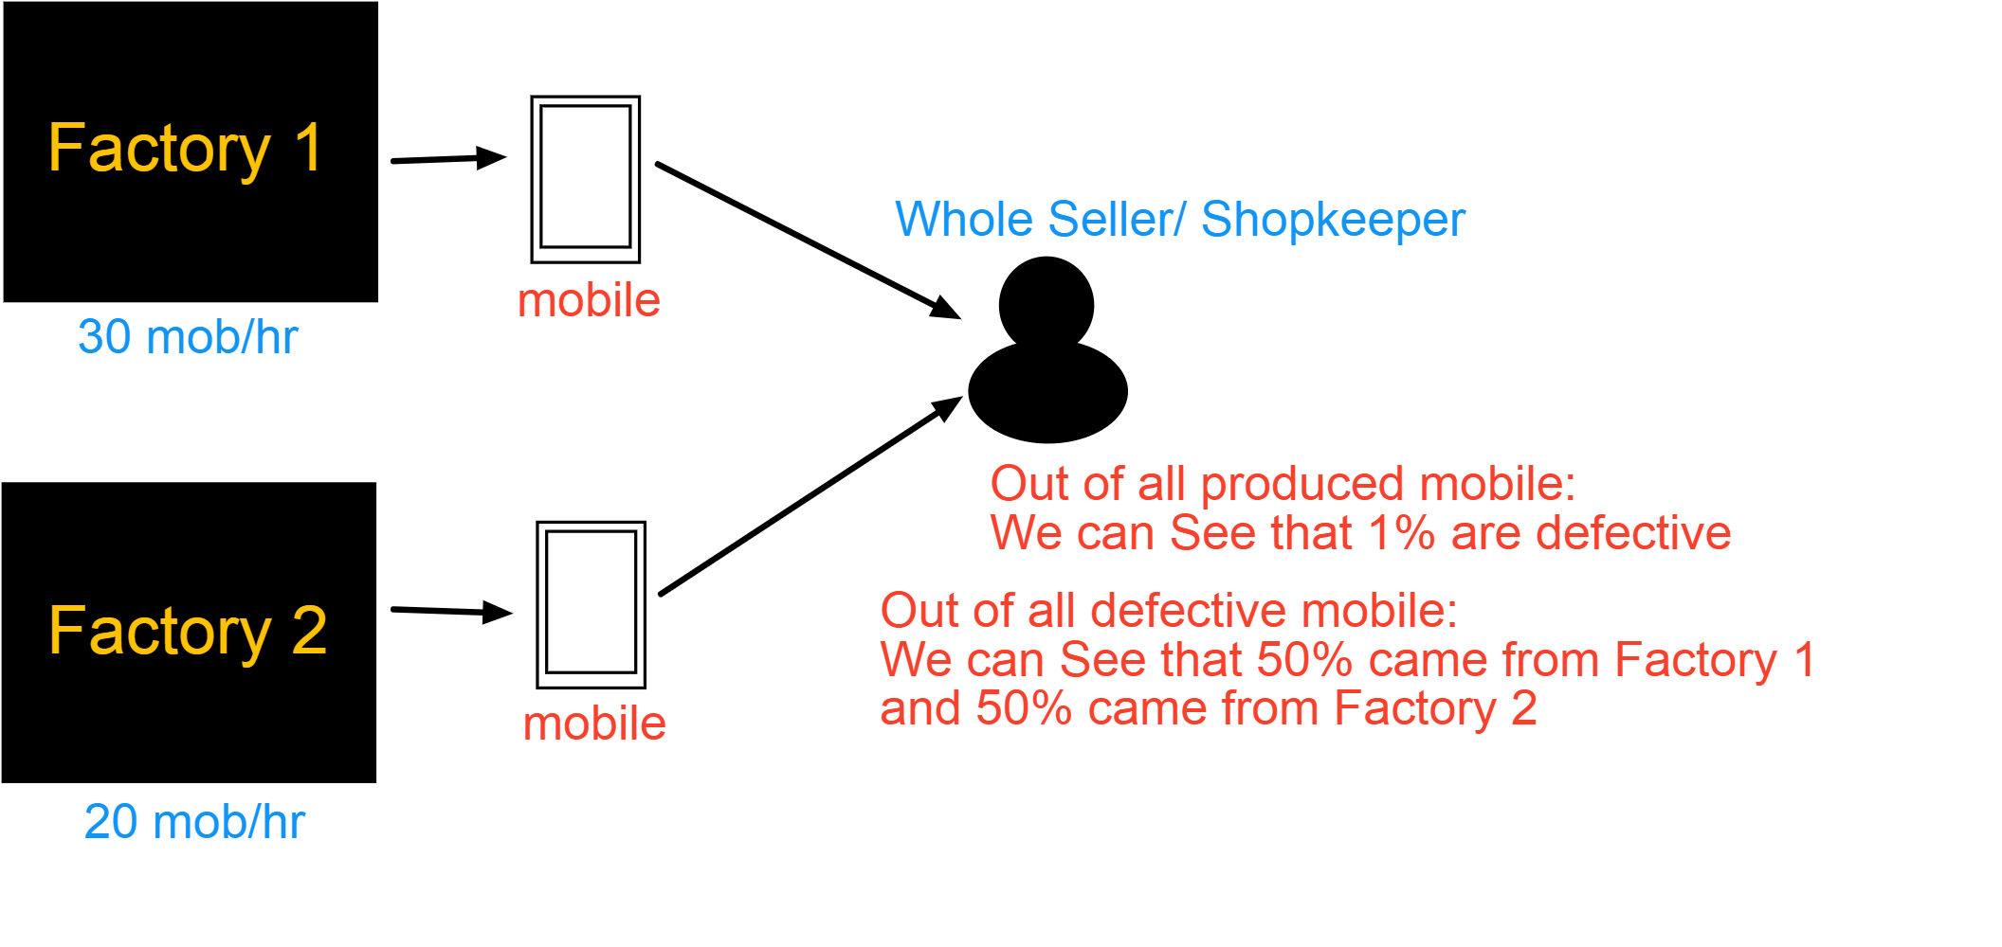
Bayes’ Theorem
What is the probability that a mobile produced by Factory 2 is defective ??

Slide 5








Slide 6
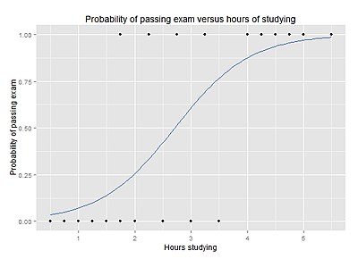
Logistic Regression
Logistic regression is a statistical model that in its basic form uses a logistic function to model a binary dependent variable, although many more complex extensions exist. In regression analysis, logistic regression (or logit regression) is estimating the parameters of a logistic model (a form of binary regression)

Slide 7
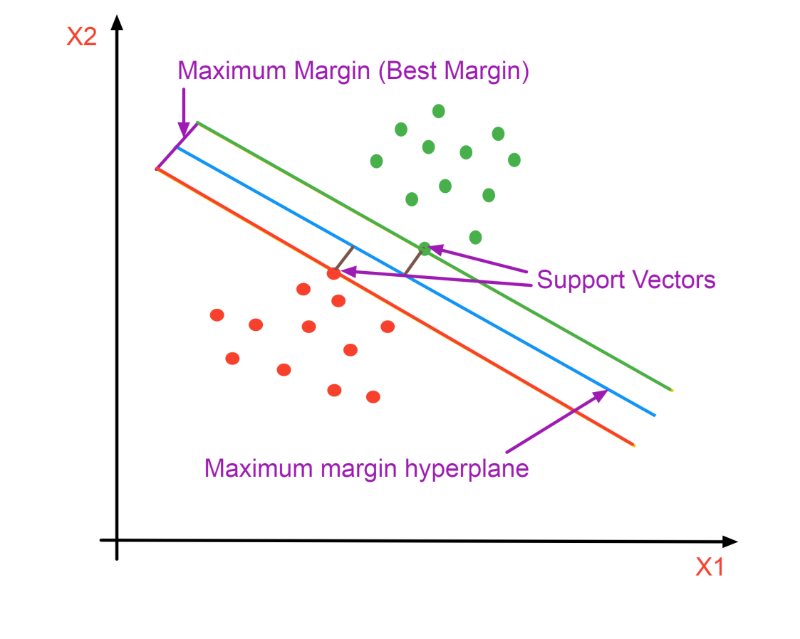
SVM (Support vector machine)
(perfect model for our dataset)
A Support Vector Machine (SVM) is a supervised machine learning algorithm that can be employed for both classification and regression purposes. SVMs are more commonly used in classification problems and as such, this is what we will focus on in this post.
SVMs are based on the idea of finding a hyperplane that best divides a dataset into two classes, as shown in the image
Support vectors are the data points nearest to the hyperplane, the points of a data set that, if removed, would alter the position of the dividing hyperplane. Because of this, they can be considered the critical elements of a data set.

Slide 8
Decision Tree
CART
Classification Trees
It help to classify your data.
So, variable are categorical like Male and Female, Yes or No
Regression Trees
It help to prediction real number outcomes like salary of a person, temperature of an area

Slide 9
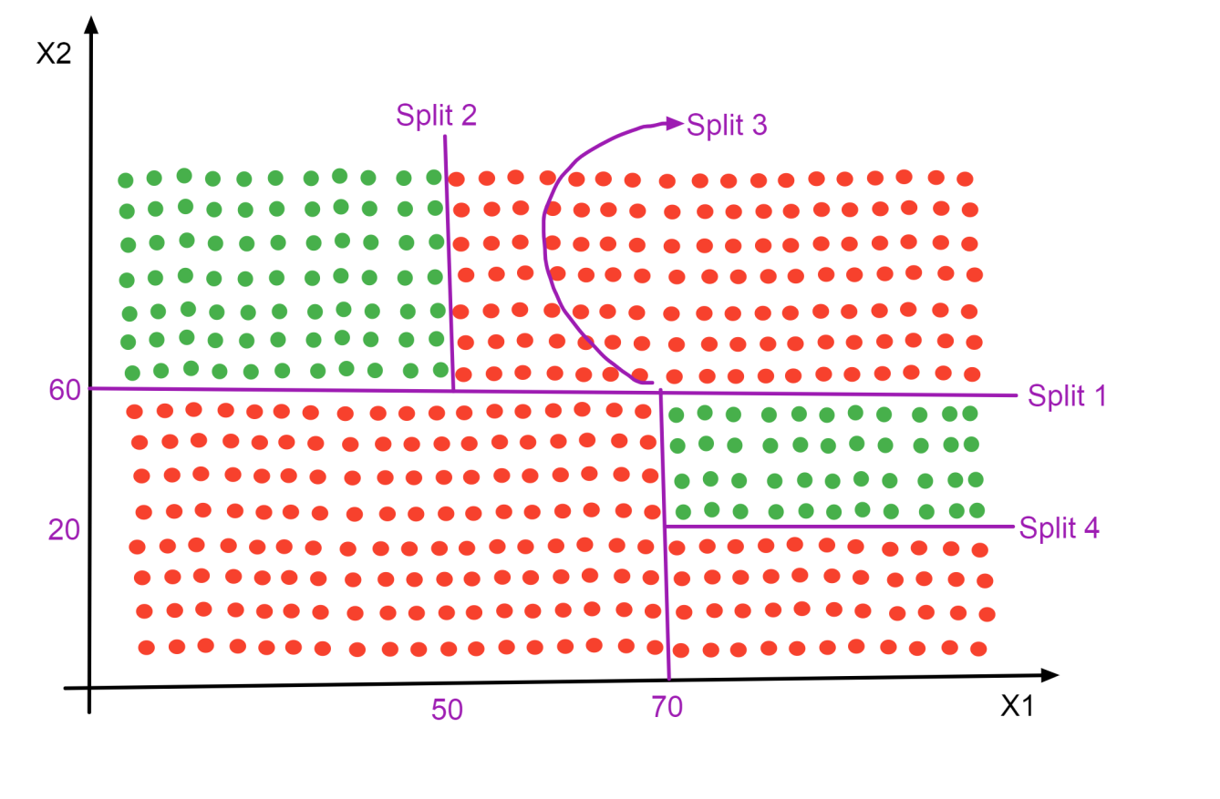
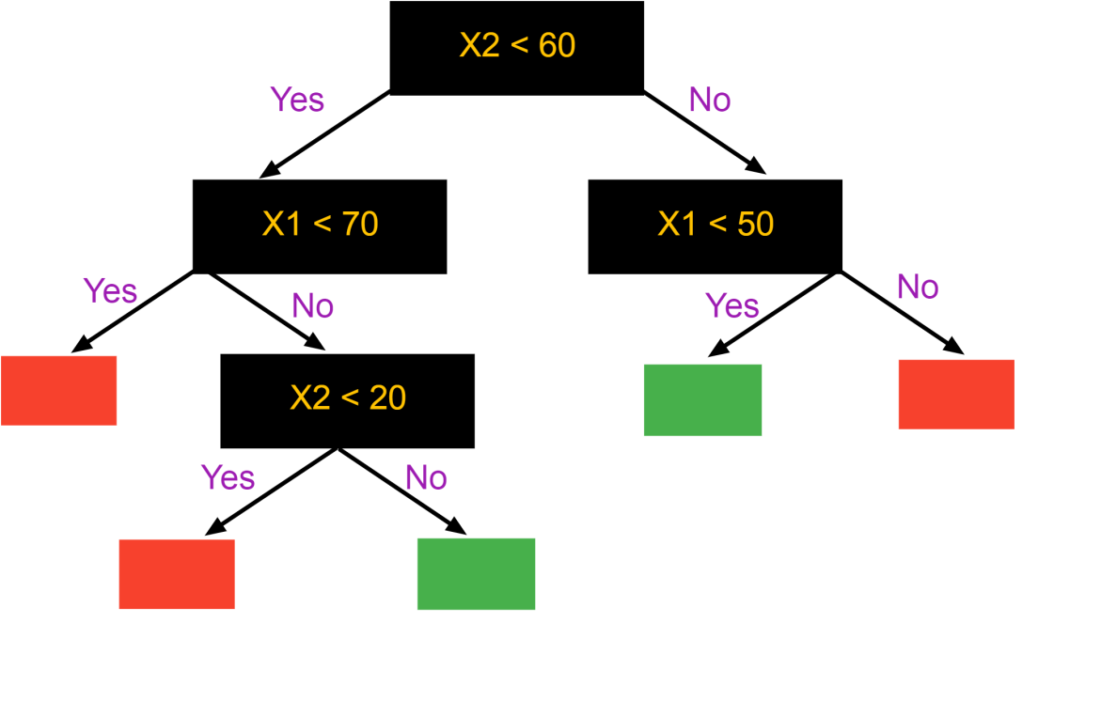

Slide 10
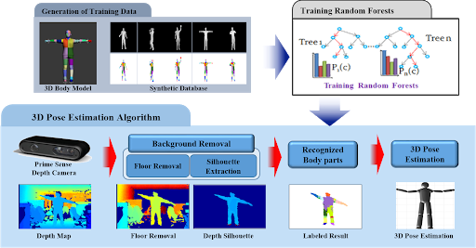
Random Forest Classifier
Step 1 : Pick at random K data points from the Training set
Step 2 : Build the Decision Tree Associated to these K data points.
Step 3 : Choose the number of trees you want to build and repeat Steps 1 & 2
Step 4 : For a new data point. Make each one of your Ntree trees predict the category to which the data points belongs, and assign the new data point to the category that wins the majority vote.

Slide 11
Multinomial Nb
Multinomial Naive Bayes is a specialized version of Naive Bayes that is designed more for text documents.
Whereas simple naive Bayes would model a document as the presence and absence of particular words, multinomial naive Bayes explicitly models the word counts and adjusts the underlying calculations to deal within.

Slide 12
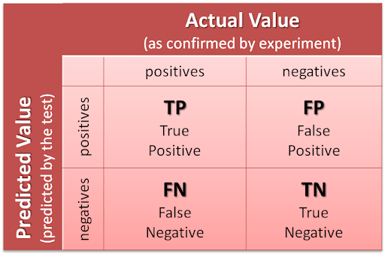
Confusion Matrix

Slide 13
Project :
To determine how the customer base feels about certain foods and Reviews

Slide 14
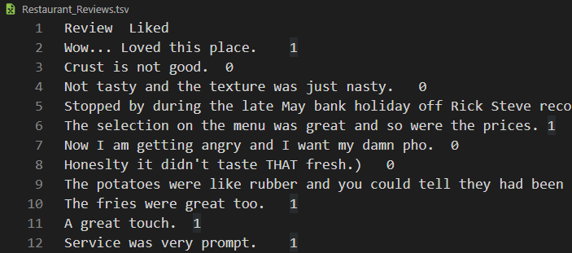
Our Dataset
This is .tsv (tab-separated values) file format Dataset
Anyone can get this dataset from this link : https://www.kaggle.com/hj5992/restaurantreviews
There are total 1000 rows and 2 column
1st column for Review and 2nd column for like-dislike (represent by 1 and 0)

Slide 15

Project Prototype
Home Page

Slide 16
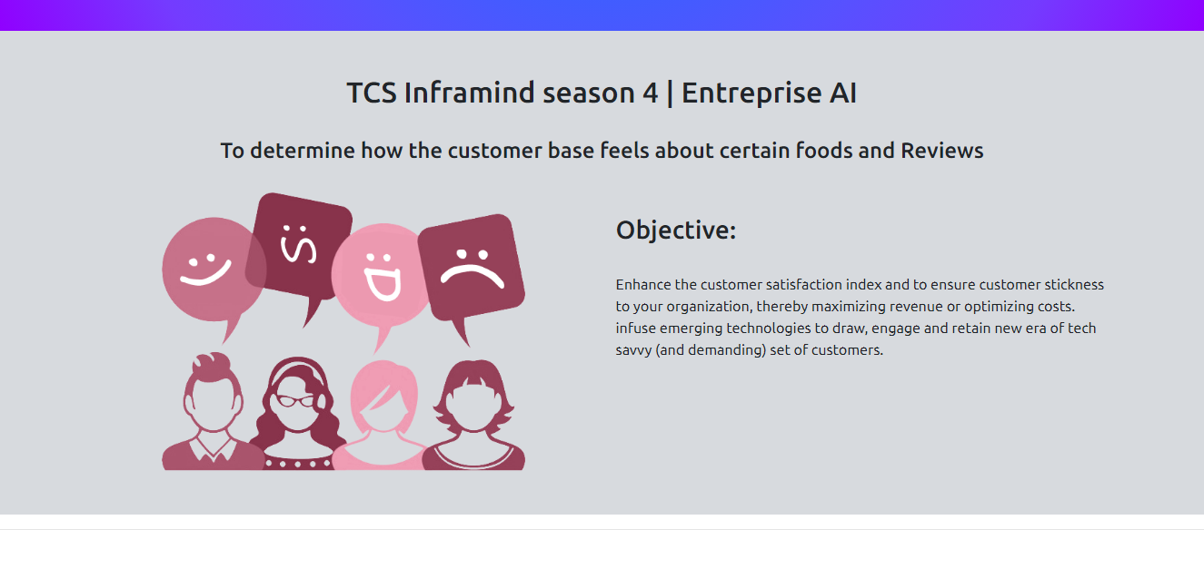

Slide 17
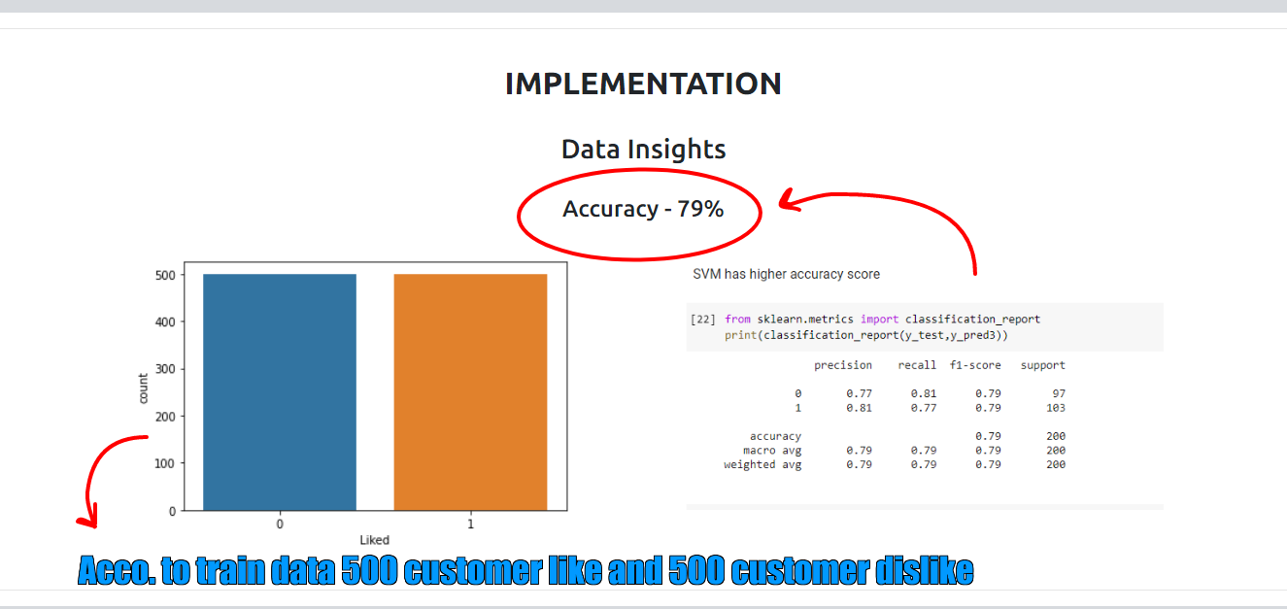

Slide 18
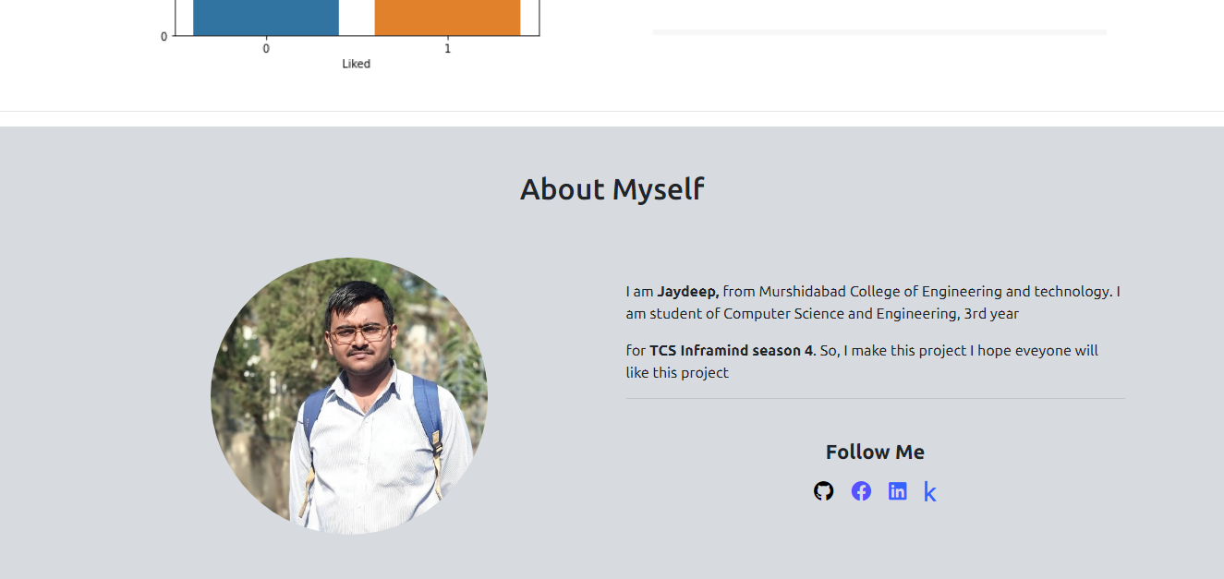

Slide 19
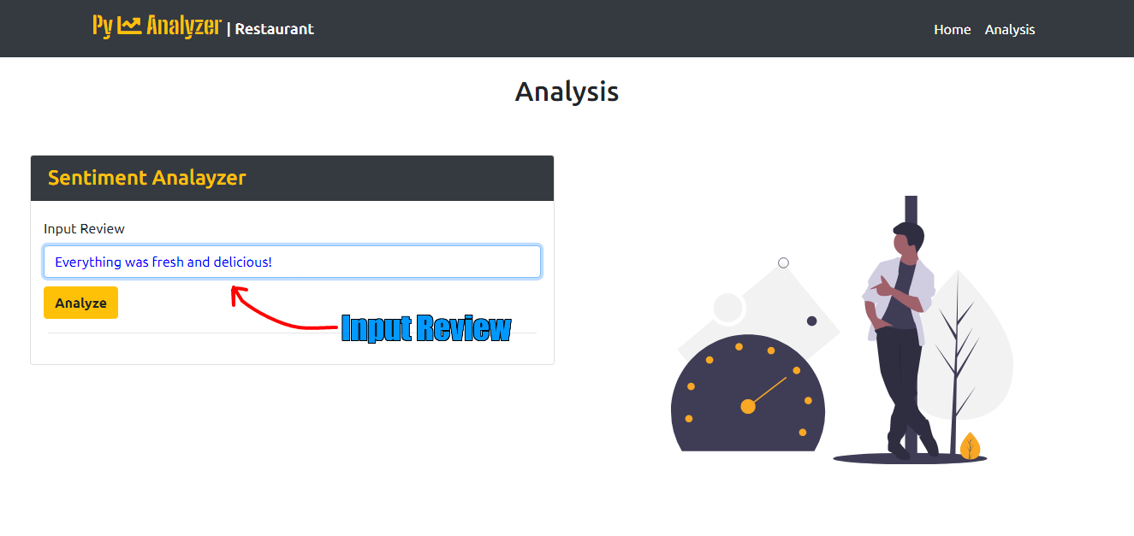
Analysis Page

Slide 20
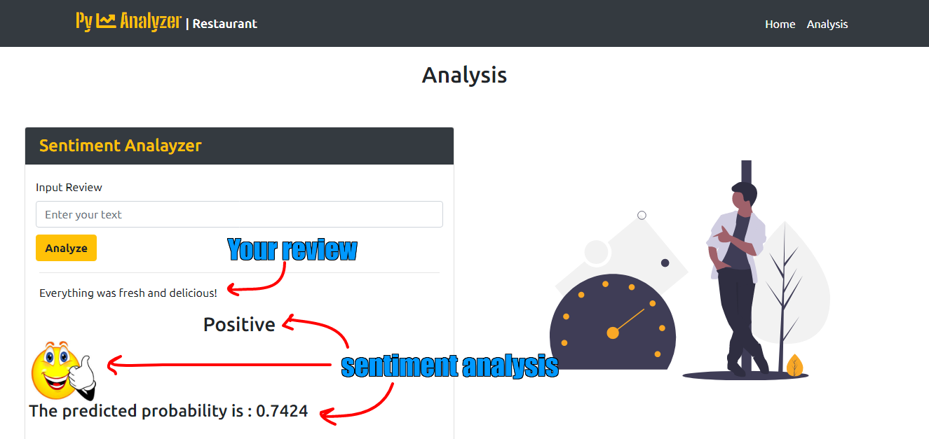

Slide 21
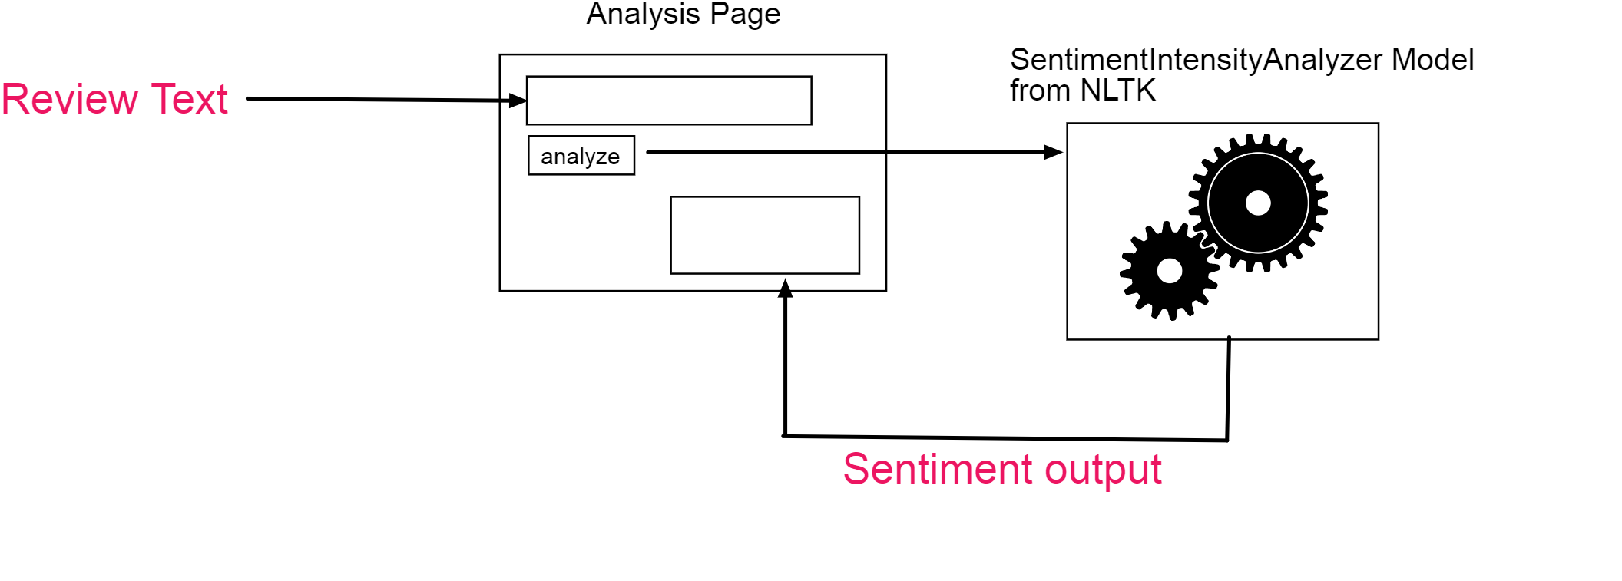
Flow Chart

Slide 22
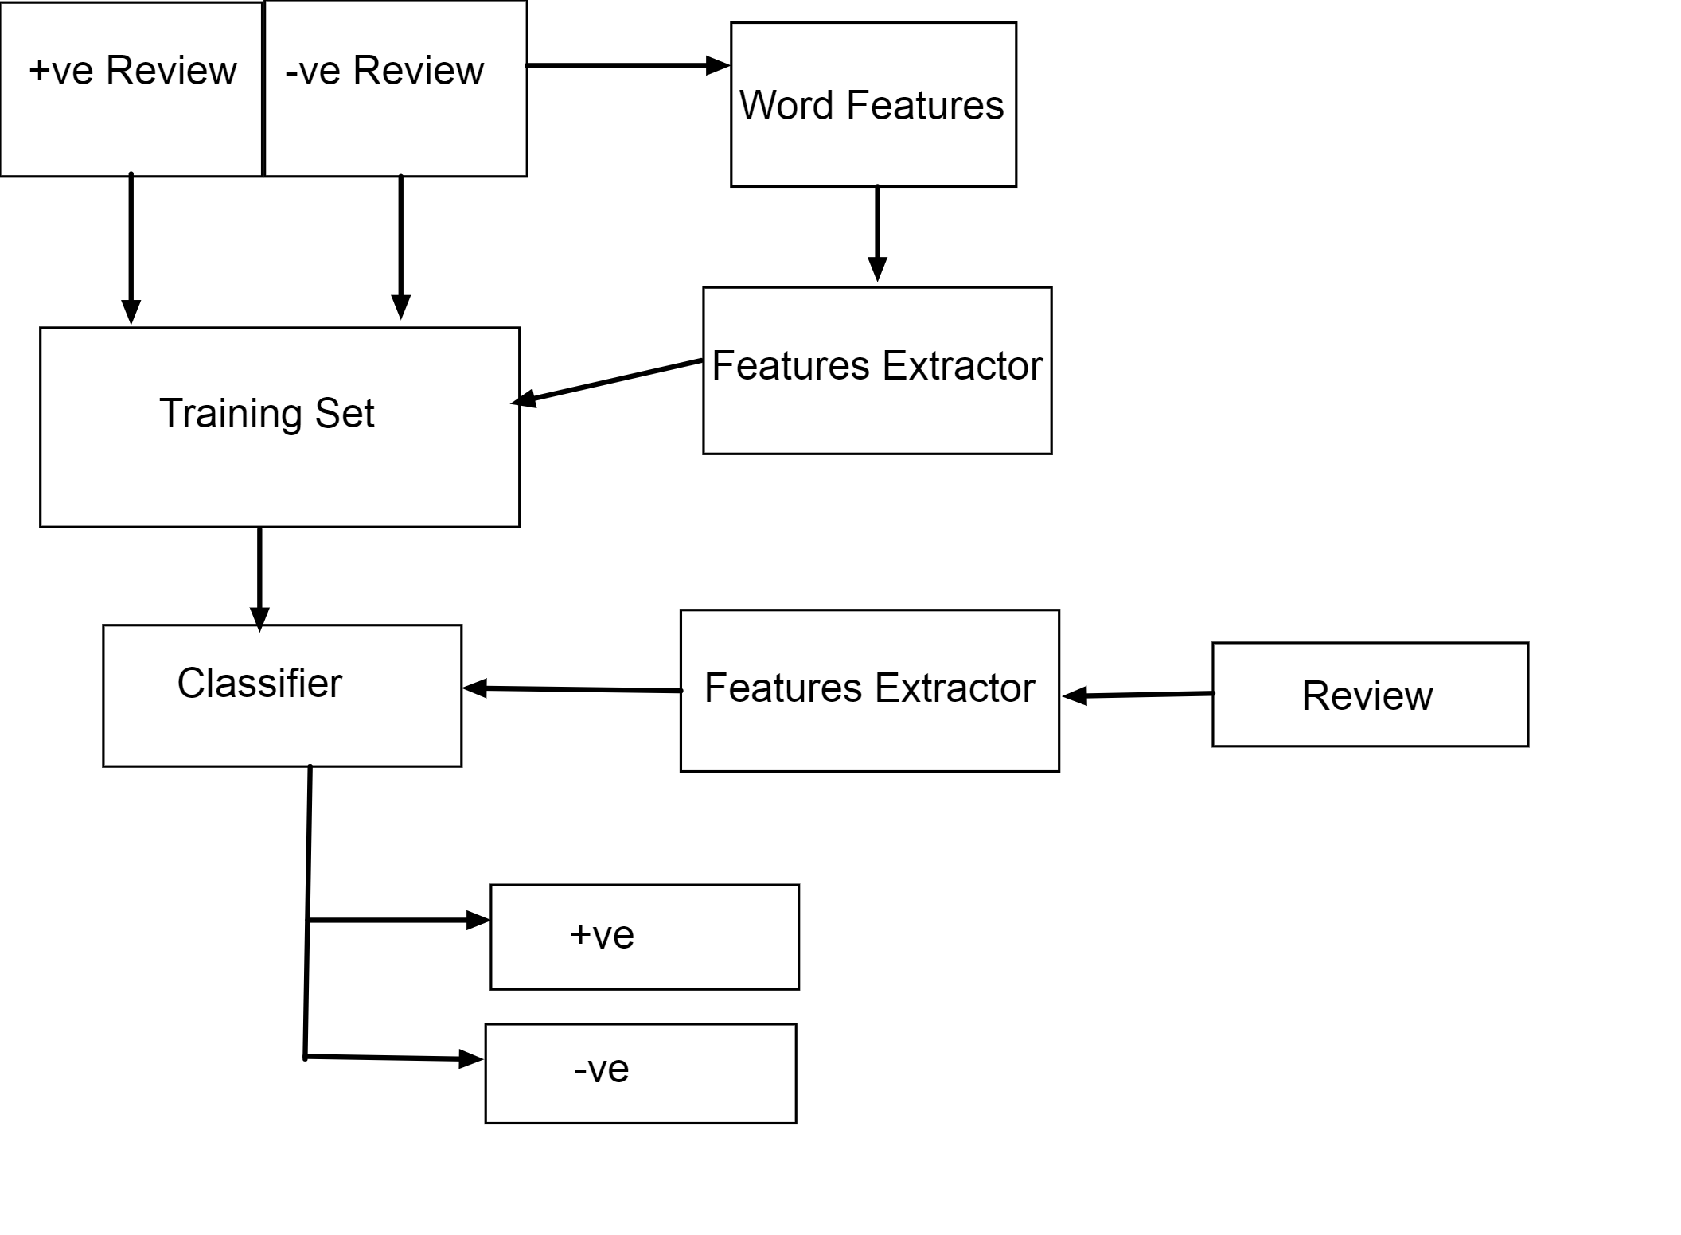

Slide 23
PYTHON MODULE USED
- Numpy
- Matplotlib
- Pandas
- Jovian
- Seaborn
- NLTK
- Sklearn

Slide 24
LANGUAGE, FRAMEWORK, IDE USED
- Python
- Flask
- HTML / CSS
- VScode
- Google Colab
- Git and Github
- Jovian

Slide 25
BIBLIOGRAPHY
- https://www.nltk.org
- https://www.kaggle.com/hj5992/restaurantreviews
- https://scikit-learn.org/stable/
- https://numpy.org

