Slide 1
Apache WebServer

Slide 2
Web Servers
A Web Server is obviously a content server for serving up web Pages
Apache, historically has been one of the more popular web Servers
Netcraft – web server survey organization
We will use apache for a couple of reasons
Historically very popular
Especially for school sites
Configuration, although messy is relatively straightforward

Slide 3
Review of How Web Servers WOrk
Port 80,443
Web Server
Browser
Other port
File System

Slide 4
Installing Apache on UBuntu
sudo apt install apache2
Verify that apache is working
sudo systemctl status apache2
Additionally to allow users to have their own directory/sites
sudo a2enmod userdir
sudo systemctl restart apache2

Slide 5
Where Things are located
Configuration Directory
/etc/apache2
/etc/apache2/apache2.conf - is the main configuration file
/etc/apache2/ports.conf - specifies the ports on which apache listens
/etc/apache2/envars - is for apache environment variables
/etc/apache2/mods-enabled – holds modules that are running on the system
HTML pages by default are located at /var/www/html

Slide 6



Environment Variable File
The file envvars in the home directory sets some critical environment variables
Amongst the important ones
User and Group IDS
Apache PID id and run directories
Apache Log files

Slide 7
Main Apache2 Configuration Settings
LogLevel
Indicates the level of logging we should be doing
What exactly is stored here for logs – look at the log directory
Include ports.conf
Specifies what ports are to be listened to by apache
80,443 Default

Slide 8
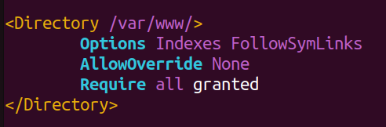
Apache Directory Configuration
The <Directory> </Directory> specifies a series options that can be applied when serving out the Given Directory. These options apply to the specified directory and all subdirectories under that directory. Let’s look at the specification for the default web server directory….

Slide 9
Explanation
Options Indexes FollowSymLinks
This statement says that we will be using the indexes options that will allow for us to look for index.html, index.php etc as the file to open up if no files are specified.
This will allow Apache to load an index of all files available in the directory when there is no index.html or index.php available.
The FollowSymLinks
This directive allows us to follow symbolic links.
AllowOverride none
This basically states that security is enabled at the server level and subdirectories cannot have their own security settings.

Slide 10
Apache commands for enabling Mods
a2enmod – This will enable a given mod as long as the mod is available
Creates a symbolic link in the mods enabled directory
a2dismod – This will disable a mod
This will remove the symbolic link
In all cases after making the changes you are going to have to restart apache
sudo systemctl apache2 restart

Slide 11
Apache and User Directories
One of the main reasons that apache has worked well with linux distributions is that users can set up their individual websites without having to configure apache directly
They are in charge of their own configurations
Remember that I had you sudo a2enmod userdir
This sets up a configuration file for us in mods-available called userdir.conf
The directory specification indicates which directory is to be used for user’s own site
The default directory for a user’s web pages is ~/public_html
The permissions on this directory should be 755 to allow access
To access a user’s public_html directory from a browser you would type
http://hostname/~user

Slide 12
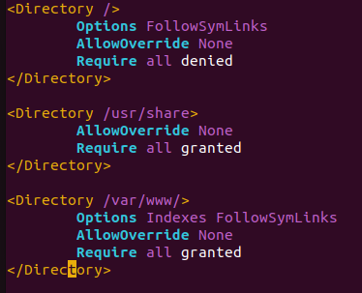
Looking at the main Apache2 web server
The following are the main configuration settings
Note that / is blocked, /usr/share is used for web applications and /var/www/html is the main root server

Slide 13
Restricting access to Directories
Apache has very fine-grained access controls
Suppose we want to set up a local web server that allows access to local machines but blocks access from other sites
The directives to allow for this are the following
Require all Granted
require not ip 10.38.107.54 ← blocks this IP address from accessing the website
require not host www.saskpolytech.ca ←blocks the saskpolytech webserver from accessing
require not host gov ←blocks all clients with IP addresses in the .gov domain

Slide 14
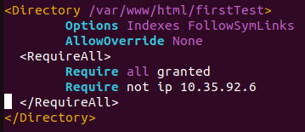
Sample set up for a First Test directory
Let’s look at a sample for restricting access to a FirstTest Directory
Note that if you have multiple require directives, by default they are “or” statements. If the client satisfies any one, it will be allowed through. In order to change this to “and” statements the <RequireAll> block needs to be used:

Slide 15
Exercise
Pair or Triple up
Create Directories that are your NameCompnay
Place an appropriate index.html file in that directory
Configure for this directory (should be somewhere under /var/www/html) such that only your partners can access this directory.

Slide 16
AllowOverride all
This is used to enable .htaccess files
If we state that a directory can override the system security settings.
If there is an .htaccess file in that directory:
You can set up your own restrictions in this file.
This should be at the root of the directory structure for which it is to apply.
If allowed, this means the owner of the directory can set up their own security specifications including authentication.

