Slide 1
Apache2

Slide 2
Restricting Access On a directory basis
If as part of the specifications for allowing an override on a directory we can specify
AllowOverride AuthConfig ← this will make the .htaccess file only for configuring authentication, no other config changes (error docs, etc) can be configured.
This allows us to set up a user/password situation
Note that this is minimal security and that if not using SSL the password will be transmitted in the clear.
To do this we can make use of the htpasswd utility to create username/password combinations that should be used by Apache.

Slide 3
Steps
Review the userDir.conf file in the available-mods directory You will see the following line
AuthConfig implies that we can enforce local security on home directories
Under your public html directory create a sub-directory that is called secure (755)
Create an html file there that is called secret.html
Make sure that you access this from your web server

Slide 4
Using htpasswd
We can use the hpasswd file to generate passwords that can be used by apache
Let’s suppose we want to store a password (nuts) for user bryce in .htpass
-c creates a new file
-b include the password on the same command line
If we want to add a new user/password combination to this file.

Slide 5
Directive for setting up local security for a website
Following directives are to be included in the secure directory under your public_html/secure directory in the .htaccess file
AuthUserFile <Specifies the absolute path to a file generated by htpasswd>
AuthName “Name of an organization”
AuthType basic
Require valid-user # Specifies that only valid users can access this directory
Note that AuthName doesn’t really seem to do anything in modern browsers.

Slide 6
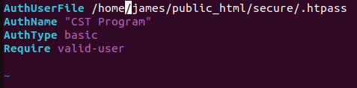
Sample .htaccess file

Slide 7
Apache Virtual Hosts
A feature of Apache (as well as other httpd software) is the ability to mimic the idea of having multiple websites all running at one time.
You have multiple domains you are working with:
www.Acme.com
www.CarrotPath.com
www.FuddHunters.com
It would be to nice have one server to handle them all
This feature is called Vitual Hosts in apache
Is used all the time by web hosting companies

Slide 8
BacK Ground Details
Normally to work with this you are going to have to register a domain name with a specific ip
Fortunately, we don’t have to actually do that to test this out – we have the hosts file that we can use to actually mimic the idea of having our own domains
Exercise today will involve us setting up a domain for www.acme.com

Slide 9
Step 1
Modify the hosts file to have an entry for www.acme.com
Note don’t use acme.com – apache is relying on the www prefix
Check by pinging for that address it should come back with your assigned IP address.

Slide 10
Step 2
We need a directory structure for the location of all Acme related files
The normal thing to do here is to create a different directory structure hanging under our server root (/var/www)
/var/www/acme.com
/var/www/acme.com/html( directory root)
Be aware of permissions – the entire site should be readable by www-data
Chown –R www-data:www-data acme.com
(The user Apache runs under is called www-data, this is a security weakness – we our current user tp be the owner, www-data should only have read access. The default 755 is good enough.)

Slide 11
Step 3
Background
There are two directories in the /etc/apache2 configuration directory responsible for virtual hosts
sites-available
sites-enabled
We are going to place a configuration file for each of the virtual hosts in the sites-available directory
These will have some of the same options you see in the apache2.conf file but be specific for the virtual host
We will then create a symbolic link from the configuration file in sites-available to sites-enabled
This step can also be done using a2ensite**

Slide 12
Step 3
Create a configuration file in sites-available for our new virtual hosts
To keep things straight we will call it acme.com.conf
Apache has a skeleton virtual host configuration file that we can copy from

Slide 13
Directives Explanation
<VirtualHost *:80>
This specifies we are going to be creating directives for a virtual host
The virtual host is going to be listening on Port 80 for incoming connections on all (*) IP addresses
Any directives that we place between the beginning tag and the end tag will apply to that virtual hosts
SeverName acme.com
This is a handle for our server name – indicates what the server will be know by to apache
ServerAlias
Another way to refer to the server – to actually call it with the www prefix here

Slide 14
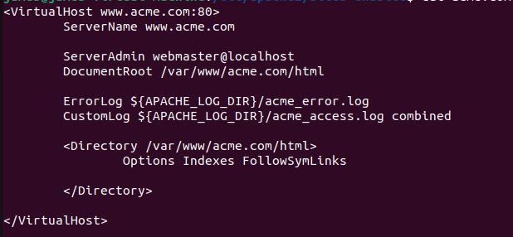
Directives

Slide 15
Enabling the Virtual host
You can either just create a symbolic link to the sites-enabled
You can use the a2ensite command instead

Slide 16
Create another Virtual Server for the
www.carrotpatch.com
Step 1
Step 2 Create the directory structure
For the main index file just add “Carrots for Everybody”
Specify that only hosts in our local 10.36.107.0/255.255.252.0 can access Carrotpatch

