Slide 1
FTP
FTP

Slide 2

Traditional way of Moving files across the network
FTP (File Transfer Protocol) has been around for a while
Originally described in RF114 in April 1971
Internet Standard ins RFC 959 October 1985
Still one of the best ways to allow remote users to transfer files to their systems.
While we are doing this let's install the ftp daemon on our system
apt install vsftpd
Special note – there is an ftp client which is available through apps-anywhere called putty – this actually has ftp client which we will use today

Slide 3
Typical Client/Server architecture
The client connects to a remote host
Service will be listening on two ports
Port 21 is used for transmission of control characters
Port 20 is used for actual data transfer.
Verify this by looking at /etc/services
Note that we are going to have set up some passive ports to allow this to happen.

Slide 4
Practice using ftp from the command line
Some server will allow you to log in anonymously from a client
I have set my server up at 10.36.107.3 or server
To login anonymously
The user Challenge – respond with anonymous
You will see a pub directory if you list this using either ls or dir
Cd into that directory and get the file that is there
What is the contents of the file?

Slide 5
Standard FTP Commands
ls will show the contents of the remote directory we are logged in to
cd will change directories on the remote site
Transferring files
From Host to client
get – will transfer a single file
mget will transfer multiple files (understands wildcards)
other useful commands
Transferring Files
from Client to Host
put – transfers a sing file
mput – transfers multiple files (Uses wildcards)

Slide 6

Other Commands
lcd – Local change dir
pwd path on the remote host
Help
Provides a list of all the ftp commands
Help command
Provides in-depth information on a command

Slide 7
UFW (Passive ports)
When establish a connection to an FTP server – we have to deal with firewalls on both sides.
Generally, Client firewalls will open a port if the client software (FTP) requests it.
For ftp we connect on port 21 – -
The connection sequence goes like this
Client Sends a PORT command to FTP server on port 21
Server responds with an ACK
When the client initiates a passive command (like ls)
The server will tell the client what passive port is to be used for communication.

Slide 8
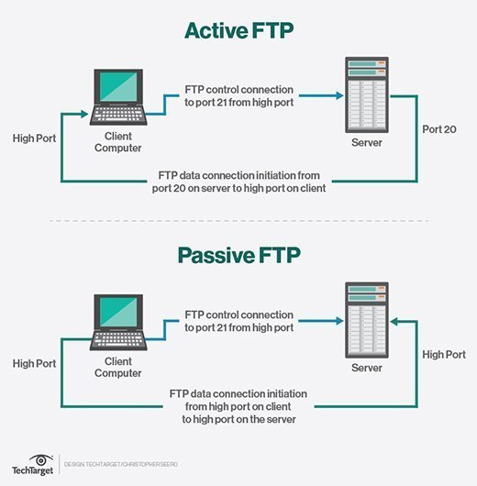
From TechTarget

Slide 9
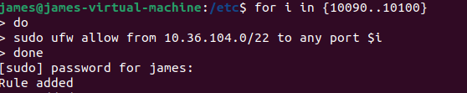
UFW Setting up Passive Ports

Slide 10
Graphical Clients
Linux Graphical Clients
FileZilla (one of many)
sudo apt install filezilla
Graphical Windows Clients
winscp
win_ftp
Remember ftp is very fast and is a good low-tech solution for file distribution

Slide 11

Steps in setting up your Very own VSFTP Server
We are going to be using VSFTP (Very Secure File Transfer Protocol) to act as our FTP Server
The configuration files for this live in
/etc/vsftpd.conf
The Main configuration file there for our purposes is vsftpd.conf
We need to establish a local directory where we can read files from
mkdir –p /var/ftp/pub
Chown nobody:nogroup /var/ftp/pub

Slide 12
VSFTP Setting up an anonymous server
Remember configuration file /etc/vsftpd.conf
Not recommended unless that is what you want to do
You are allowing everyone access (even though they are chrooted) to your system
anonymous_enable=YES
anon_root=var/ftp
no_anon_password=yes
pasv_min_port=10090
pasv_max_port=10100
Note for our example we are only allowing 10 passive ports, note that these correspond to the previous ufw settings
After any changes are made to the system we do have to restart our server
sudo systemctl restart vsftpd

Slide 13
Scenario1 Accessing your own ftp server
Place a file in the /var/ftp/pub directory
echo “vsftpd test file1” | sudo tee /var/ftp/pub/test1.txt
echo “vsftpd test file2” | sudo tee /var/ftp/pub/test2.txt
Access this
Type ftp 10.36.107.XX Where xx is the last part of your IP address
Download a local copy of this into your /tmp directory (look up lcd again)
Examine the /var/log/vsftpd.log file
This will show you a list of the incoming connections on your machine.

Slide 14
What about uploads?
let us go into /var/ftp/pub
Create subdirectory uploads with permissions 777
on the server we must add
write_enable=YES
anon_upload_enable=YES
Restart the VSFTP SERVER

Slide 15
Allowing individual users
To Set up ftp to handle users with given accounts
More appropriate for distribution in local environments.
local_enable=YES

Slide 16
FTP Notes
ftp normally transmits in the clear.
There is another protocol sftp but that actually utilizes ssh as a backbone and does not require vsftpd.

Slide 17
Exercise 2
Create a file test.txt in your home directory
echo “Testing ftp “ > text.txt
ftp into your local machine
cd /tmp
put text.txt
This operation will have copied the file up to our own local ftp server
What permissions are on this file?

Slide 18
Allowing local users to Log in using FTP
This is a standard way of setting up an ftp server on a local network to distribute large files (like rpm files)
To allow local users to log into their system and essentially move about the system freely we specify the following in the vsftpd configuration file:
local_enable=YES
write_enable=Yes
The write enable allows us to upload files from the client to the server (host)
Be careful with this as you are allowing anybody who logs to grab anything of the system, they have read access to

Slide 19
Scenario 2 – To be done in pairs/threes
Allow for ftp user access as described previously
Create a file on your local system whose name is your name
Ftp into your partners machine using cstUser2 (cst2022)
Upload this file
After both users are finished
Verify that the home directories of the cstUser2 on the other machine contain that file
Look at the /var/log/vsftpd.conf file again – do you see your partner accessing your machine?

Slide 20
Chrooting a User
For security reasons it is a good idea to chroot users whenever possible
Chroot is short for change root
Chrooting is essentially establishing a chroot jail from which a user cannot escape
To chroot Users we must add the following commands to our vsftpd.conf file
chroot_local_user=YES
allow_writeable_chroot=YES

Slide 21
Chrooting a user
chroot allows us to restrict what a user can see on a system
chroot comes from change root – what we are doing here is restricting a user to a specified “home” directory”
to actually accomplish this
chroot_local_user=YES
allow_writeable_chroot=YES

Slide 22
What happens if we only want to chroot specific users?
We can do a chroot list entry
That is we can create a list of users who we want chrooted to their home directories
We want to add the following entry
chroot_list_file=/etc/vsftpd.chroot_list
chroot_list_enable=YES
Note if:
chroot_local_user=NO
This is a list of users who can login and be chrooted
Other users can log in normally
chroot_local_user=YES
This is a list of users who are not chrooted

Slide 23
Grid Assume Chroot file contains only cstuser1
Chroot_local_user | Chroot_LIST_ENABLE | cstUser1 | cstUser2
NO | YES | Chrooted | Not chrooted
Yes | Yes | NOT Chrooted | Chrooted
No | NO | Not Chrooted | Not Chrooted
YES | NO | Chrooted | chrooted

Slide 24
Only Allowing Specific users
There is another option that can be used with vsftpd
Setting up to allow only users in the file to log in
userlist_enable=YES
userlist_file=/etc/vsftpd.userlist
userlist_deny=NO
If you want the values to be a list of users who are denied ftp access change this to be
userlist_deny=YES
You must be somewhat careful in doing this as this also interacts with chroot settings.

Slide 25
Types of Questions that might be asked
Suppose you have been aske to create a new Group Hobbits with two members SamWise and Frodo
Only SamWise can ftp into the localsystem
But this hobbit is chrooted
Local anonymous access is allowed
But this is set to be the home directory of Frodo (/home/hobbits/Frodo)

Slide 26
VSFTPD setting directory message
dirmessage_enable=YES
message_file=.message
This means that we want to have the user see a certain message when they go into a particular directory (directory specific)
The .message file can be different for different directories.

Slide 27
Setting up SSL
We can force ftp connections to go over SSL
This means that
Changes to the configuration file
rsa_cert_file=/etc/ssl/certs/apache-selfsigned.crt rsa_private_key_file=/etc/ssl/private/apache-selfsigned.key ssl_enable=YES
pasv_min_port=2121
Pasv_max_port=2142
In addition we are going to open up a couple of ports on the the firewall:
ufw allow 2121:2142
We are going to have to install file_zilla to see how this works
Make Sure you disable this at the end of the session

Slide 28
umask
Type umask on your system
You should get back a response that reads 0022
This is the mask that is used when you create a new file or directory
Let us consider the last 3 digits of the umask
These will determine rwx (421) permission for files and directories you create
For Files the umask value is subtracted from 666 to get the file permissions for any files you create
So 666 – 022 = 644 (rw For User, read for everyone else)
Try this out create a file using touch newFile – What are the permission on this?

Slide 29
umask Directory permissions
For directories, the umask value is subtracted from 777
Let us subtract the 0022 (standard mask) from 777
777 – 0022 = 755 User (rwx) Everyone Else (rx)
Try this create a new directory. What are the permissions?

Slide 30
Changing a umask
To change a umask we just type umask pattern where pattern is the patten we want the umask to take on.
Let’s change the umask to be 0002
Now try create a new file and new directory
What are the permissions on those new files/directories?

Slide 31
What is with the first Value in Umask
This value can be used to set
A Sticky Bit (1)
This is a value that indicates that regardless of permissions the only users who can remove a file are the owners of the file and the root user.
SGID Bit (2)
Set Group ID
If a directory has the SGID bit set than a file created within that directory belongs to the group of the directory, not necessarily the group of the user who created the file
SUID Bit (4)
Set User ID
If the file is owned by the root user’s group and is executable the file runs with root privileges even if a regular user accesses, it.
Do a ls –l on the file /usr/bin/passwd file
The s signifies the SUID bit is set – why do you need to root as root when running passwd?

Slide 32
Exercise 1 Setting the Sticky bit
Set your umask to be 1002
Create a new file → touch testSticky
What are the permissions on the file
Now become another user
sudo su cstUser2
According to the permissions you should be able to remove this file.
Can you?

