Slide 1
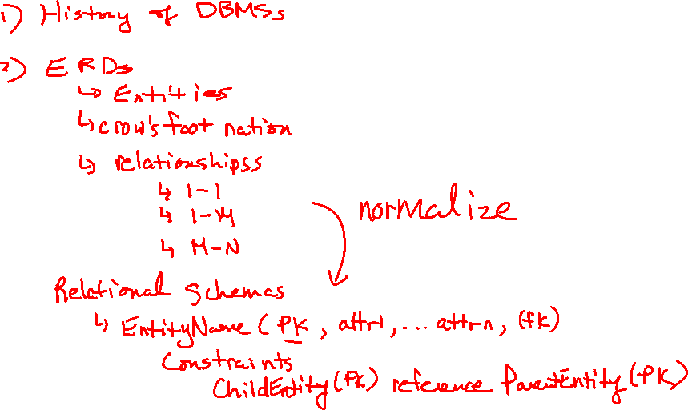
CDBM 280
Normalization

Slide 2
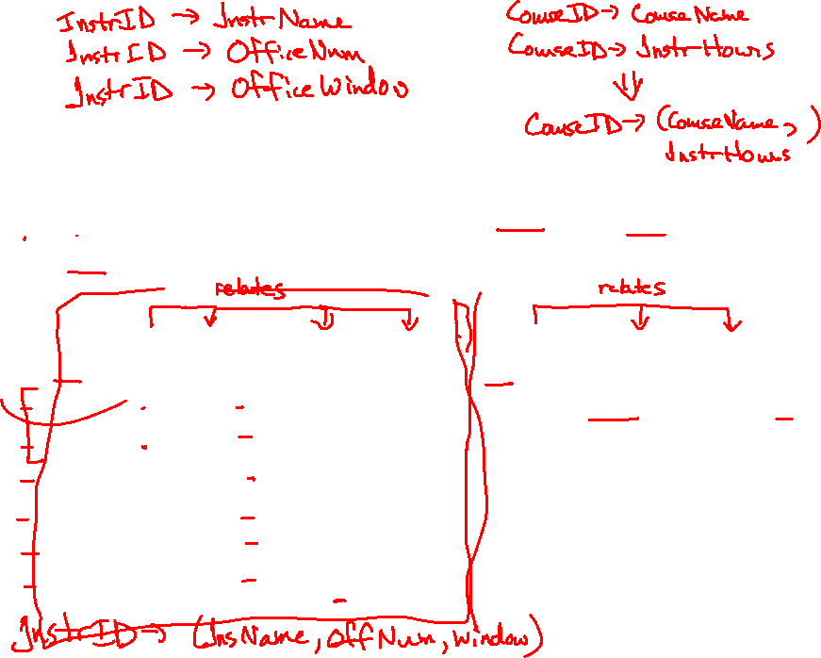
Modifying table data
What problems could arise by deleting, adding, or editing data from the following InstructorCourse table?
InstructorID (PK) | Instructor Name | Office Number | Office Windows | CourseID (PK) | Course Name | Instructor Hours
1 | Jason | 243.7 | No | CDBM280 | Adv DB | 160
1 | Jason | 243.7 | No | COSA290 | Projects | 192
2 | Leon | 243.8 | No | CDBM280 | Adv DB | 160
2 | Leon | 243.8 | No | MATH282 | App Math | 96
3 | Rick | 243.6 | Yes | SUSS285 | Adv Prog | 160
4 | Rob | 240A.2 | Yes | MATH282 | App Math | 96
Notes:
Deletion – We can delete rows according to PK(s), but it also deletes Instructor info and Course info
Adding – We can’t add Instructor info until we have info about their courses
Editing – We can’t edit a record without potentially editing other information that we don’t want to. For example, we can’t edit Jason’s info without potentially effecting his courses.

Slide 3
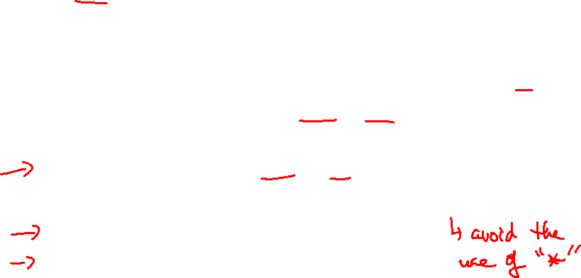
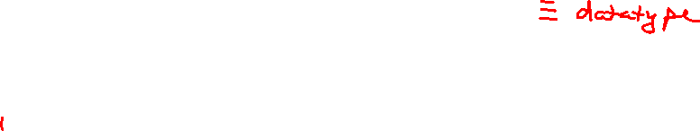
Characteristics of a relation
A relation is a two-dimensional table that has the characteristics listed below:
rows contain data about an entity
columns contain data about attributes of the entity
cells of the table hold a single value
all entries in a column are of the same kind
each column has a unique name
the order of the columns is unimportant
the order of the rows is unimportant
no two rows may be identical

Slide 4
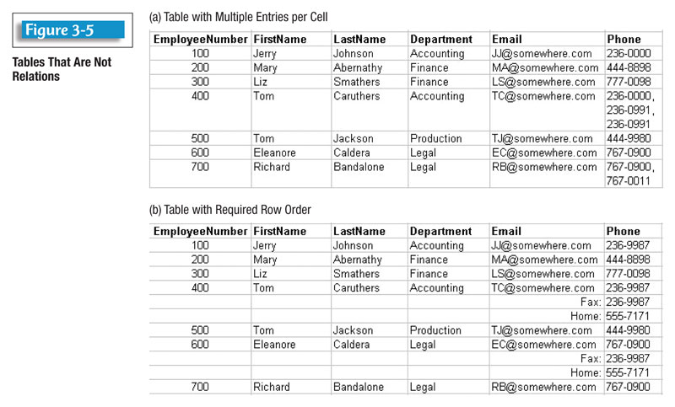
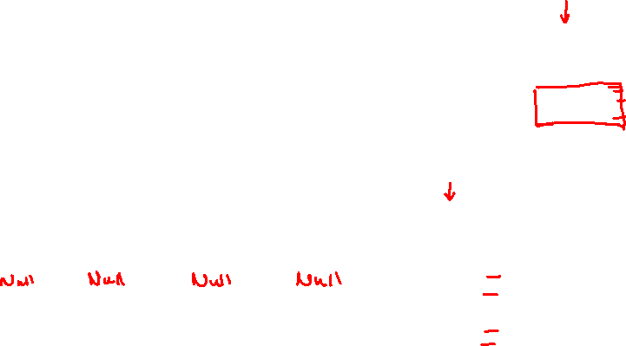
Tables vs Relations
These tables are not relations

Slide 5
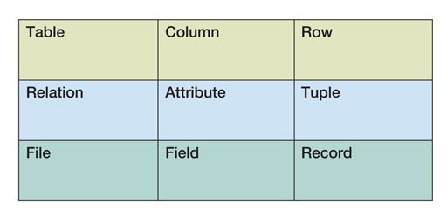
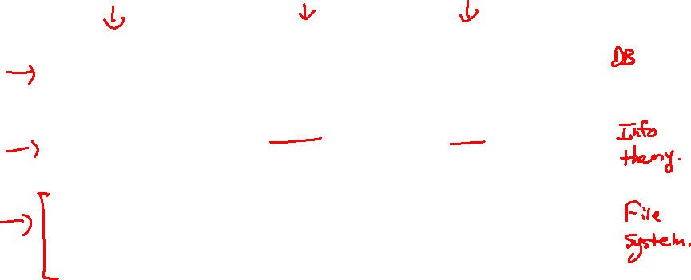
Terms
The terms table and relation are used interchangeably.
Three sets of equivalent terms:

Slide 6
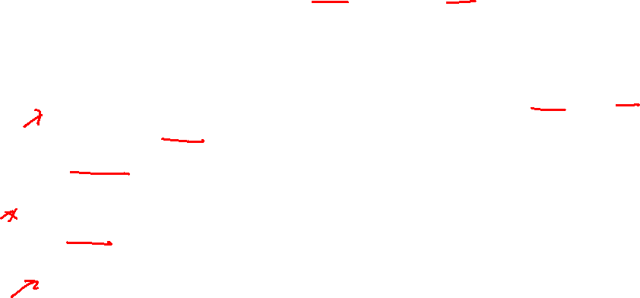
Functional Dependencies
To understand the rules of normalization, it is useful to understand how "functional dependencies" work.
The reason for having relations is to store instances of functional dependencies.
A functional dependency exists when the value of one or more attributes determines the value of other attributes.
The functional dependency holds for the whole relation, not just a particular instance of the relation.
Dependency Diagrams – graphical representation

Slide 7
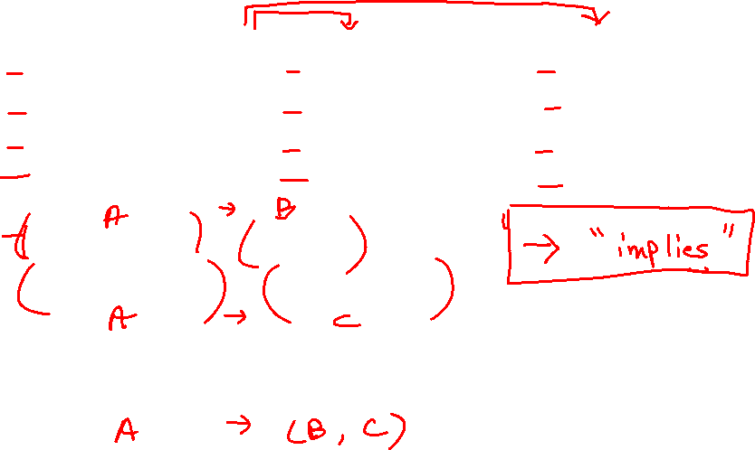
FD example
Channel # | Name | Language
100 | CNN | English
200 | Cartoon Network | English
255 | Radio Canada | French
138 | Turner Classic Movies | English
Channel# → Name
Channel# → Language
Or may be written as:
Channel# → (Name, Language)

Slide 8
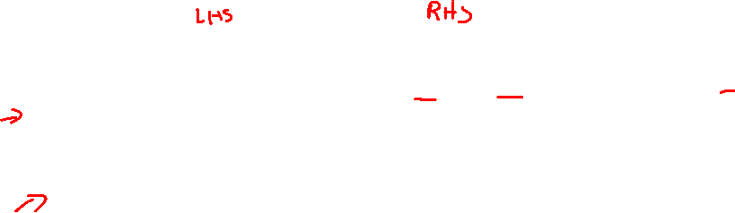
Composite FDs
A composite group can occur on either side of a FD
A grade in a course is determined by both the student and the course
(StudentID, CourseID) → Grade
If (A, B) → C, then neither A nor B will determine C by itself
If A → (B, C), then it is true that A → B and A → C

Slide 9
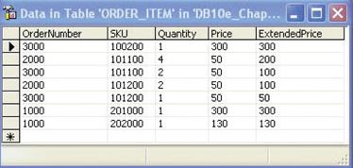
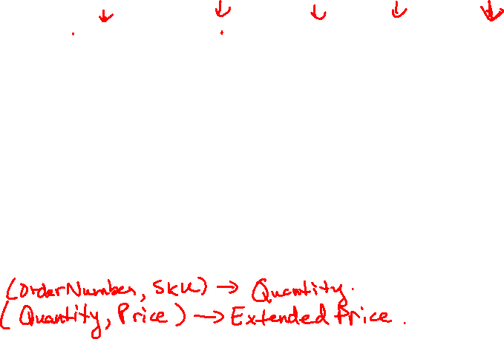
Finding Functional Dependencies
Notes:
(OrderNumber, SKU) -> (Quantity)
(Quantity, Price) -> (ExtendedPrice)

Slide 10
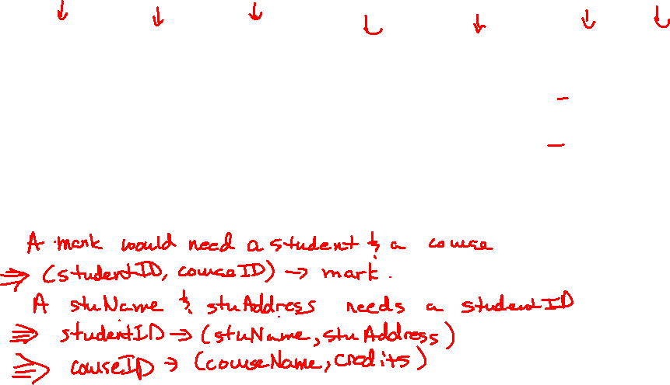
Functional Dependency Ex
studentID | stuName | stuAddress | courseID | courseName | credits | mark
CST201 | Fred | 123 Main St | CDBM190 | SQL | 4 | 86
CST202 | Jane | 6 Last Ave | CDBM190 | SQL | 4 | 76
CST201 | Fred | 123 Main St | COSC285 | Internet Prog | 5 | 75
CST202 | Jane | 6 Last Ave | COSC285 | Internet Prog | 5 | 88
Notes:
FDs:
studentID -> (stuName,stuAddress)
courseID -> (courseName, credits)
(studentID, courseID) -> mark

Slide 11
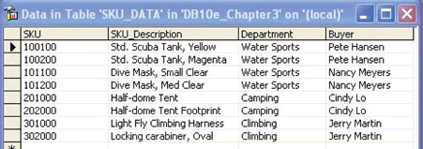
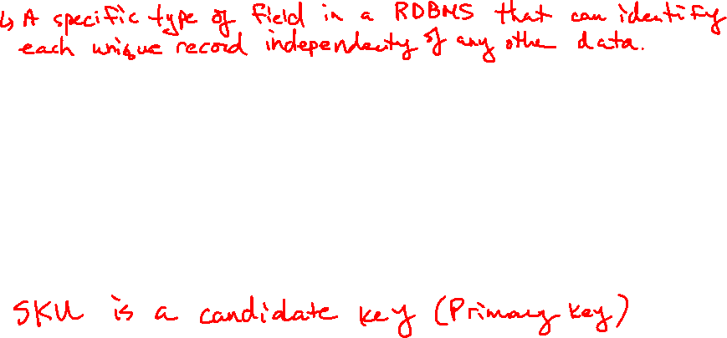
Candidate Key Example
Notes:
Candidate Key: A specific type of field in a RDBMS that can identify each unique record independently of any other data.
SKU is the Candidate Key (Primary Key)

Slide 12
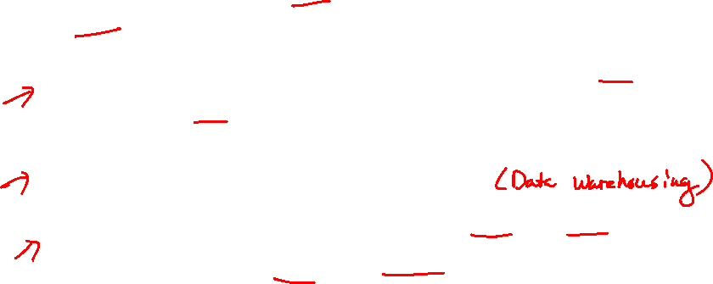
Normalization
Normalization are rules designed to prevent update anomalies and data inconsistencies.
These are the principles which one should strive to achieve in design.
In implementation, "denormalization", may be required for performance reasons.
Relations are categorized into Normal Forms, according to the kinds of problems that they have.

Slide 13

Modification Anomalies
Occur when changing the data creates undesirable consequences.
Three types:
Deletion anomaly
Insertion anomaly
Update anomaly

Slide 14
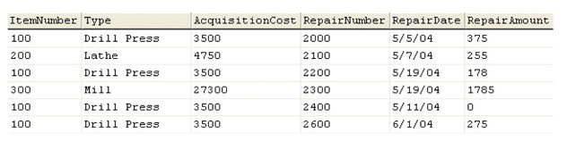
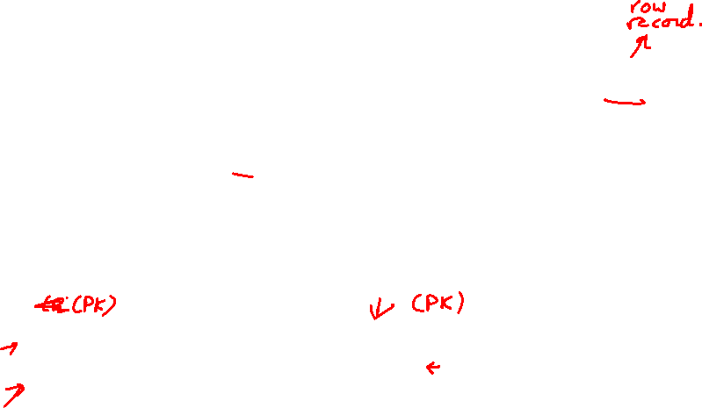
Deletion Anomaly
A deletion anomaly occurs when you delete a tuple and it not only deletes the facts you wanted but also deletes another piece of data.
EquipmentRepair(ItemNumber, RepairNumber, Type, AcquisitionCost, RepairDate, RepairAmount)
Ex: Delete repair number 2100
Notes:
ItemNumber and RepairNumber are composite key (both primary keys)

Slide 15
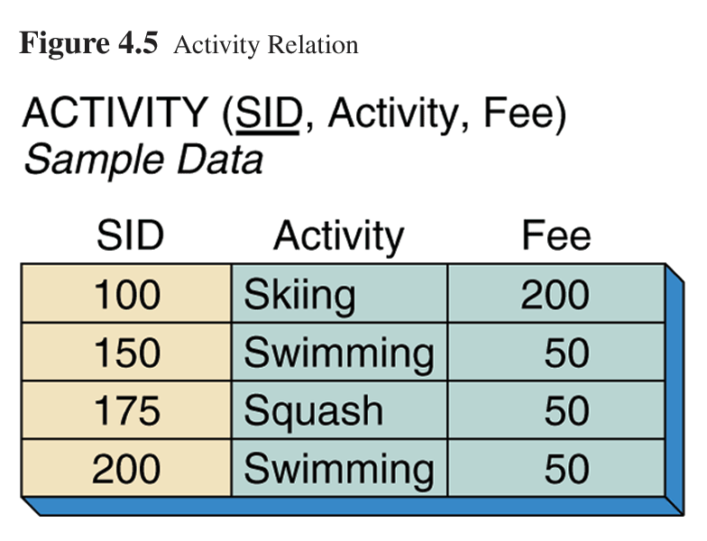
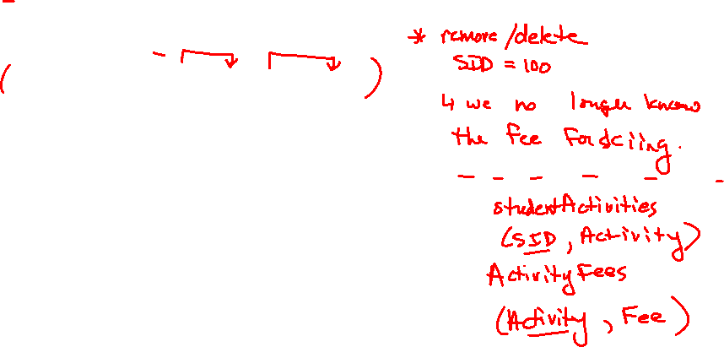
Deletion Anomaly
This relation stores a list of all activities offered (and the activity's associated fee) and students taking those activities.
SID → Activity
Activity → Fee

Slide 16
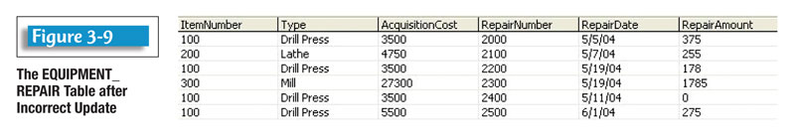
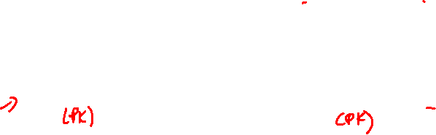
Insertion Anomaly
An insertion anomaly occurs when we cannot insert a fact about one entity until we have an additional fact about another entity.
EquipmentRepair(ItemNumber, RepairNumber, Type, AcquisitionCost, RepairDate, RepairAmount)
Ex: Add a new item to the table: ItemNumber (400) for a Drill Bit that’s acquisition cost is $67.00.

Slide 17

Insert Anomaly
Notes:
Assuming we have SID, can we have null values for Activity and Fee during insertion?
Would need to look at the attribute in the schema to see if it allows for null values

Slide 18
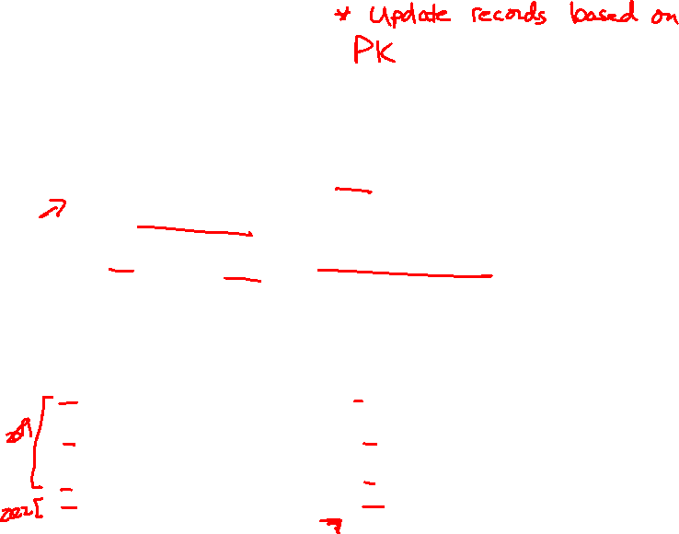
Update Anomaly
Occurs when the same information can be expressed on multiple rows; therefore updates to the table may result in logical inconsistencies.
Ex: There are two acquisition costs for the Drill Press.

Slide 19
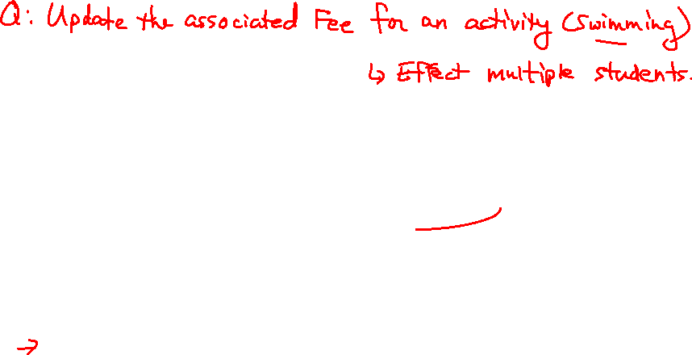
Update Anomaly
Notes:
Sample question: Update the associated Fee for an Activity (Swimming).
It would effect multiple students

Slide 20
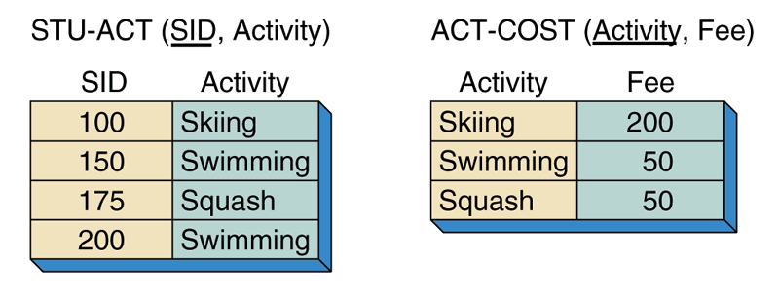
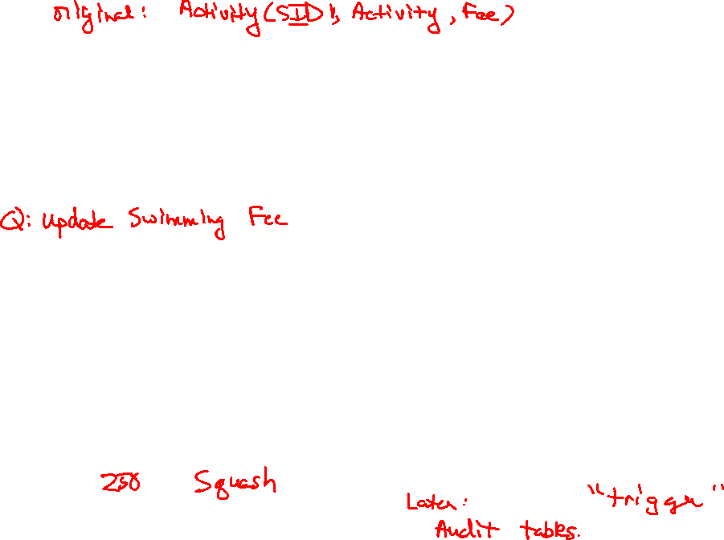
Solve the problem with anomalies
Divide the table into multiple, joining tables
Notes:
Now, there is only one Swimming record to update.

Slide 21
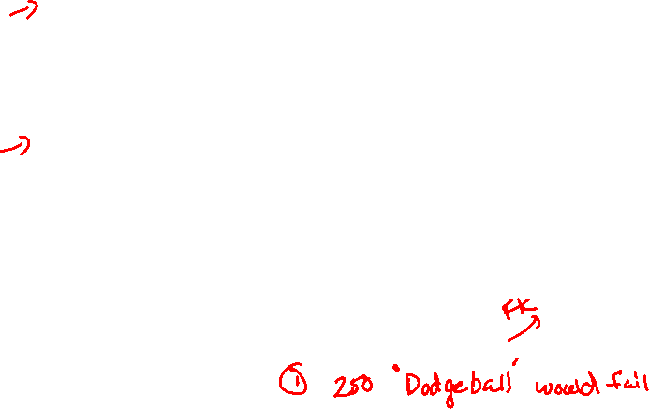
Referential Integrity Constraints
Suppose that activities can exist before any student enrolls in them, but no student may enroll in an activity that does not have a fee assigned to it.
We must check to make sure that the activity is present in the ACT-COST table before we can add it to the STU-ACT table. This constraint is called referential integrity.
Notes:
An RDBMS solves this with the use of constraints in foreign keys.
For example, we could enter a new record into STU-ACT for Dodgeball because the parent record for Dodgeball does not exist in ACT-COST

Slide 22
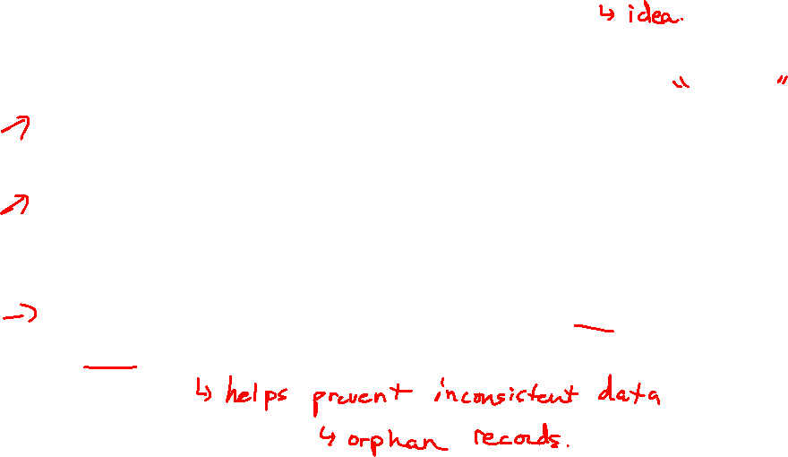
Essence of the normalization process
Every normalized relation should have a single theme.
Any relation having two or more themes should be broken into two or more relations each having a single theme.
When you break up a relation you need to check for and to record any resulting referential integrity constraints.

Slide 23
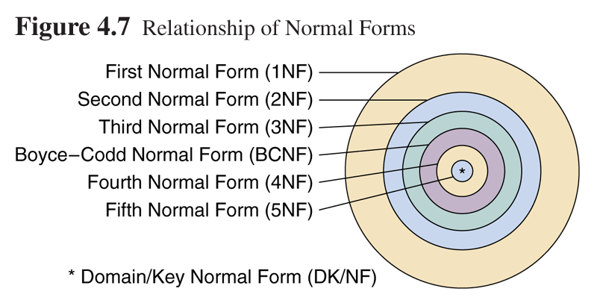
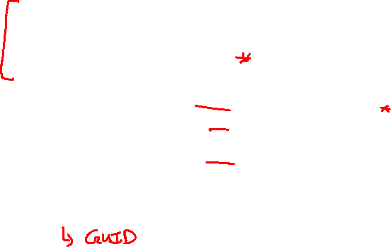
Relationship of Normal Forms

Slide 24
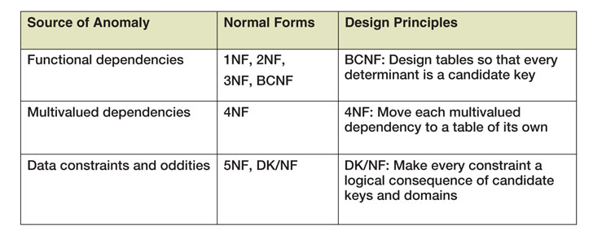
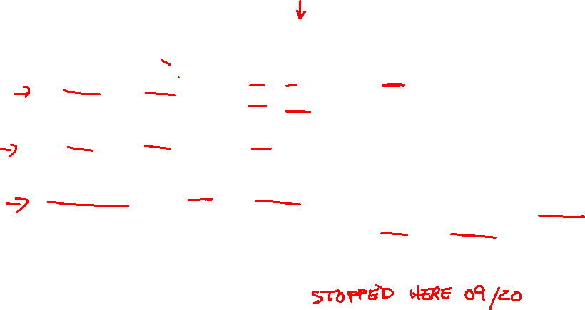
Normalization Categories

Slide 25
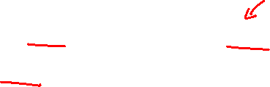
Normal Forms
The classes of relations and the techniques for preventing anomalies are called normal forms

Slide 26
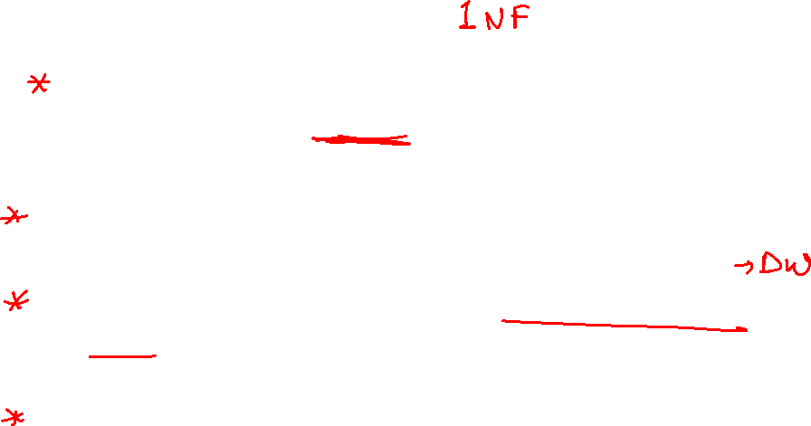
1st Normal Form
A table is in 1st Normal Form if it meets all the requirements of a relation.
1NF deals with the “shape” of a record type.
Under first normal form, all occurrences of a record type must contain the same number of fields.
Relational database theory does not deal with records having a variable number of fields.

Slide 27
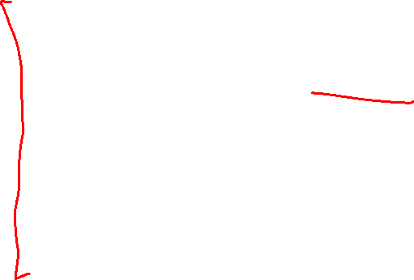
Characteristics of a relation
A relation is a two-dimensional table that has the characteristics listed below:
rows contain data about an entity
columns contain data about attributes of the entity
cells of the table hold a single value
all entries in a column are of the same kind
each column has a unique name
the order of the columns is unimportant
the order of the rows is unimportant
no two rows may be identical

Slide 28
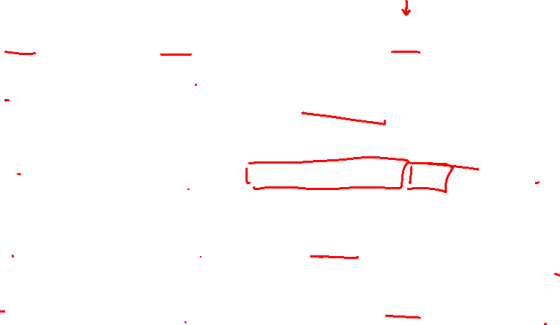
Unnormalized Table
Character | Animal | Info
Alex | Lion | Born into a life of privilege. Now lives at Central Park Zoo The star in the Greatest city on earth.
Gloria | Hippo | Born and raised in Central Park Zoo. Strikingly beautiful, smart & independent.
Melman | Giraffe | Born in San Diago Zoo & transferred to Central Park Zoo as a young adult. He is a hypochondriac.
Marty | Zebra | Born at the Central Park Zoo. He is a dreamer and an adventurer.

Slide 29
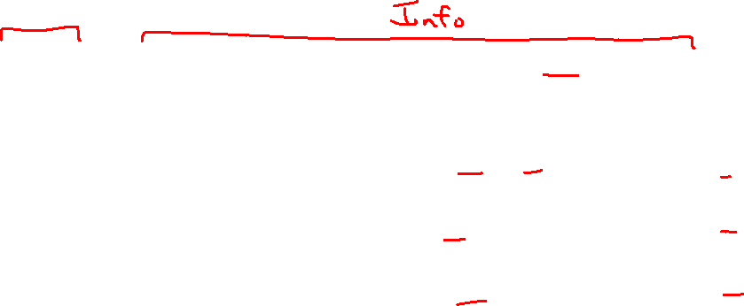
Relation
Character | Animal | PlaceBorn | CurrentResidence | CharacterTraits
Alex | Lion |  | Central Park Zoo | The star in the Greatest city on earth.
Gloria | Hippo | Central Park Zoo | Central Park Zoo | strikingly beautiful
Gloria | Hippo | Central Park Zoo | Central Park Zoo | smart
Gloria | Hippo | Central Park Zoo | Central Park Zoo | independent
Melman | Giraffe | San Diago Zoo | Central Park Zoo | hypochondriac
Marty | Zebra | Central Park Zoo |  | dreamer
Marty | Zebra | Central Park Zoo |  | adventurer

Slide 30
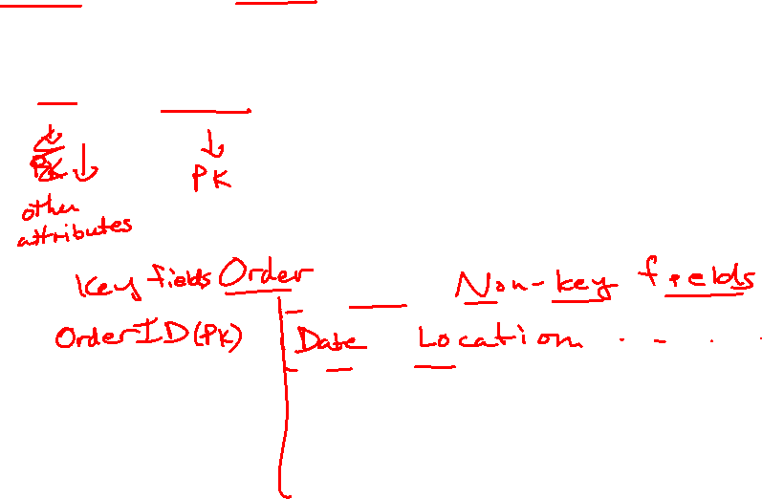
2NF and 3NF
2NF and 3NF deal with the relationship between non-key and key fields.

Slide 31
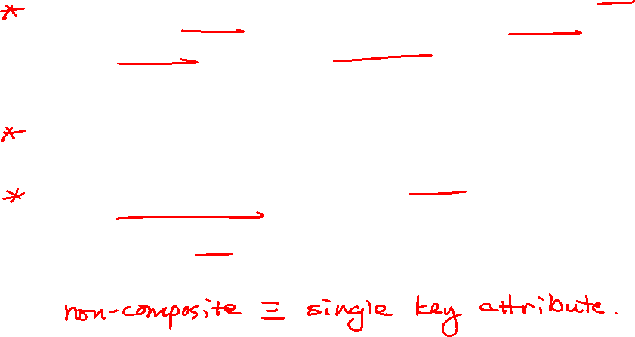
2nd Normal Form
A relation is in second normal form if it is in 1NF and every non-key attribute is fully dependent on the whole key, not just part of it.
2NF is designed to eliminate dependencies that involve only part of the key.
2NF is violated when a non-key field is determined by only part of the key.
There are no 2NF violations if the key is not composite.

Slide 32
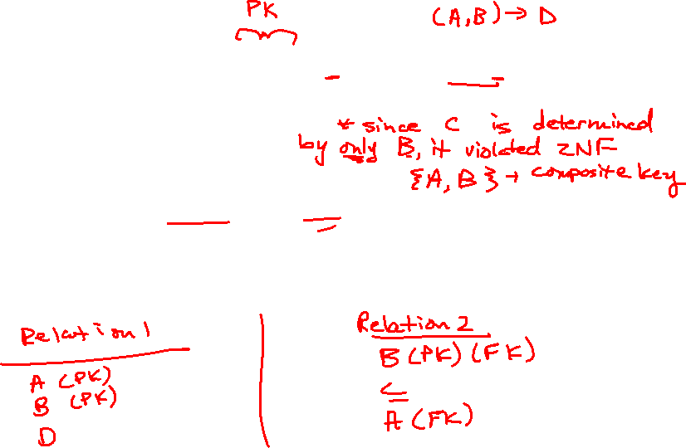
2NF
The relation Relation1(A,B,C,D) where B→C becomes Relation1(A,B,D) and Relation2(B,C)
To place the relation in 2NF:
remove the functional dependency involving only part of the key and place in a relation of its own. The determinate will become the PK of the new relation and the FK connection to the original relation

Slide 33
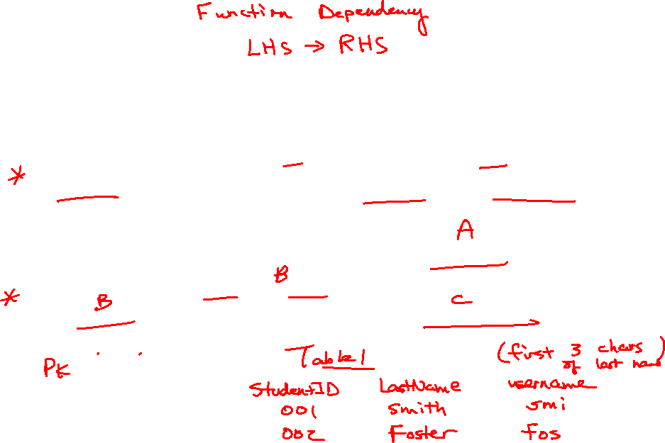

3rd Normal Form
For a table to be in 3NF it must be in 2NF and every non-key attribute has no transitive dependencies.
A transitive dependency is when a key attribute determines a non-key attribute and in turn this non-key attribute determines another non-key attribute, A→B→C

Slide 34
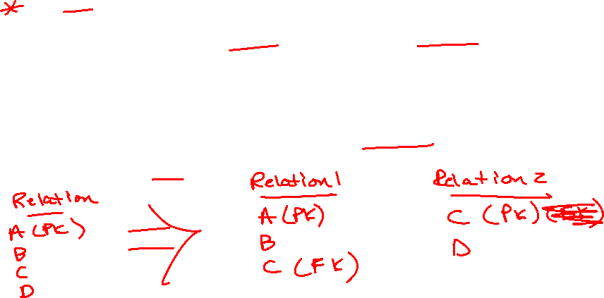
To place in 3NF
Move the non-key determinate and its dependant attributes to a new table and form a relationship between the original table and the new table.
The relation – Relation(A, B, C, D) where A→B, C, D and C→D becomes Relation1(A, B, C) and Relation2(C, D)

Slide 35
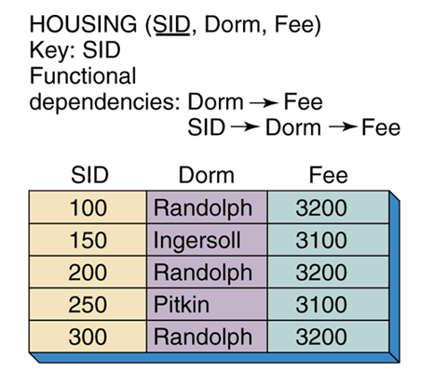
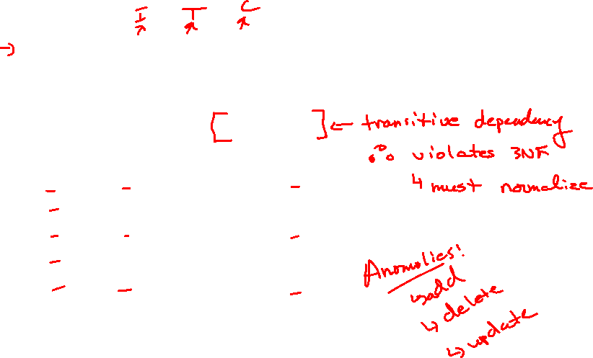
3NF Violation

Slide 36
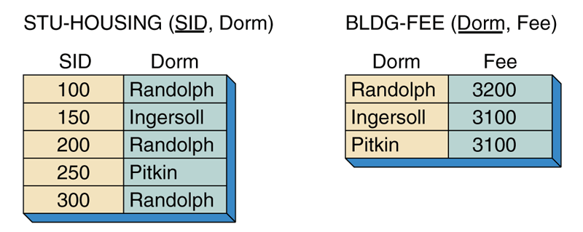
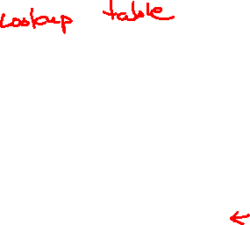
Relations in 3NF
Eliminate transitive dependencies

Slide 37
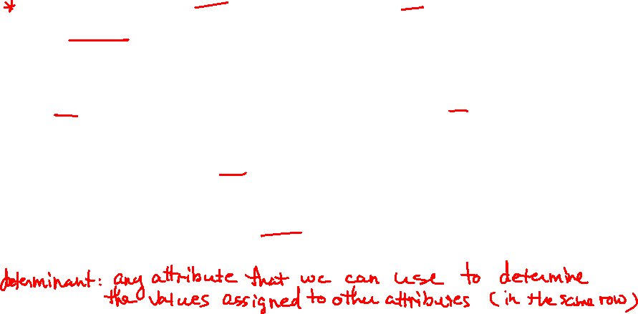
Boyce-Codd Normal Form
A relation in BCNF must be in 3NF and every determinant is a candidate key.
BCNF is a slightly stronger version of 3NF.
Only in rare cases does a 3NF table not meet the requirements of BCNF. A 3NF table which does not have multiple overlapping candidate keys is guaranteed to be in BCNF.
Notes:
https://www.javatpoint.com/dbms-boyce-codd-normal-form
Definition: A determinant in a database table is any attribute that you can use to determine the values assigned to other attribute(s) in the same row.
Examples: Consider a table with the attributes employee_id, first_name, last_name and date_of_birth. In this case, the field employee_id determines the remaining three fields. The name fields do not determine the employee_id because the firm may have more than one employee with the same first and/or last name. Similarly, the DOB field does not determine the employee_id or the name fields because more than one employee may share the same birthday.

Slide 38
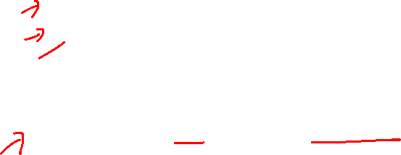
BCNF
BCNF covers 2 special cases not covered by 3NF
part of a key determines part of a key
a non-key attribute determines part of a key
These situations are only possible if there are multiple composite, candidate keys. Tables with multiple, composite candidate keys are not common.

Slide 39
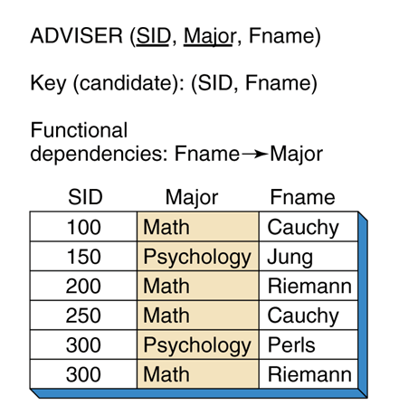

Violates BCNF

Slide 40


Relation in BCNF

Slide 41


Part of a key determines part of a key
StudentGrade
StudentID | CourseNo | StudentEmail | Grade
S1 | CDBM280 | joe@siast.sk.ca | 78
S1 | COSC287 | joe@siast.sk.ca | 87
S2 | CDBM280 | betty@siast.sk.ca | 80
S2 | COSC287 | betty@siast.sk.ca | 72
Notes:
(studentID, courseNo) -> Grade
(courseNo, StudentEmail) -> Grade
(studentID) <-> StudentEmail

Slide 42
BCNF
Relations in BCNF have no functional dependency anomalies. However there are anomalies that can rise from other situations other than functional dependencies

Slide 43
4thNF and 5thNF
4NF and 5NF deal with multivalued facts.
Multivalue dependency
A condition in a relation with three or more attributes in which independent attributes appear to have relationships they do not have.

Slide 44

4th Normal Form
A relation is in fourth normal form if it is in BCNF and has no multi-value dependencies (MVD).
A multi-value dependency exists when a relation has at least three attributes, two of them are multi-valued, and their values depend on only the third
4NF is designed to eliminate multiple sets of multi-valued dependencies attribute.

Slide 45


Relation with Multi-valued Dependencies

Slide 46


Insert Anomaly
To add the activity of Skiing to
SID 100 we must add 2 rows.

Slide 47


Elimination of Multi-valued Dependencies

Slide 48

4NF Example
 | Table that is 3NF but not in 4NF
 | Car | Colour | Engine
1 | Mustang | Red | F3.2L
2 | Mustang | Red | F4.5L
3 | Mustang | White | F3.2L
4 | Mustang | White | F4.5L
5 | Mustang | Blue | F3.2L
6 | Mustang | Blue | F4.5L
7 | Cirrus | Red | C2.1L
8 | Cirrus | Red | C3.0L
9 | Cirrus | Green | C2.1L
10 | Cirrus | Green | C3.0L
Each colour for each car is paired with each engine size for each car (and vice versa).
For every car all of its possible colours will be paired with all of its possible engines.

Slide 49

How to detect MVDs
Find any pair of rows that have the same value of [car]. To start, look at rows 1 and 6.
Exchange the values of [colour] in these two rows. Now you have [mustang, blue, F3.2L] and [mustang, red, F4.5L].
Verify that two other rows exist with these values. They do (rows 5 and 2).
Continue this for all other pairs of rows for which the value of [car] is the same.
Since car →→colour then it passes the test (as does car →→ engine). We have verified that this relation does contain MVDs.

Slide 50

Car relation in 4NF
Car Colour relation
Car | Colour
Mustang | Red
Mustang | White
Mustang | Blue
Cirrus | Red
Cirrus | Green
Car Engine relation
Car | Engine
Mustang | F3.2L
Mustang | F4.5L
Cirrus | C2.1L
Cirrus | C3.0L
With this table structure you can still determine, for example, that a red Mustang can have either an F3.2L or F4.5L engine. When you delete one piece of information (i.e., a car colour), you lose only that fact.

Slide 51

5th Normal Form
5NF deals with cases where information can be reconstructed from smaller pieces of information which can be maintained with less redundancy.
Eliminate cyclic dependencies. 5NF is also known as Projection Normal Form (PJNF)
2NF, 3NF and 4NF also serve this purpose, but 5NF generalizes to cases not covered by the others.

Slide 52
5NF Example
If agents represent companies, companies make products, and agents sell products, then we might want to keep a record of which agent sells which product for which company. This information could be kept in one record type with three fields.

Slide 53
Although agent Smith sells cars made by Ford and trucks made by GM, he does not sell Ford trucks or GM cars. Thus, we need the combination of all three fields to know which combinations are valid and which are not.
Agent | Company | Product
Smith | Ford | car
Smith | GM | truck

Slide 54

But suppose a certain rule is in effect – if an agent sells a certain product and he represents the company making that product, then he sells that product for that company.
Agent | Company | Product
Smith | Ford | car
Smith | Ford | truck
Smith | GM | car
Smith | GM | truck
Jones | Ford | car

Slide 55

In this case it turns out that we can reconstruct all the true facts from a normalization form consisting of three separate record types, each containing two fields.
Agent | Company
Smith | Ford
Smith | GM
Jones | Ford
Agent | Product
Smith | car
Smith | truck
Jones | car
Company | Product
Ford | car
Ford | truck
GM | car
GM | truck

Slide 56

These 3 record types are in 5NF. The three-field record is not.
5NF does not differ from 4NF unless there exists a symmetric constraint such as the rule about agents, companies and products. In the absence of such a constraint, the record type in 4NF is always in 5NF.

Slide 57

Domain Key Normal Form
Constraint: any rule governing static values of attributes that is precise enough so that we can ascertain whether the rule is true or not.
Key: a unique identifier of a row.
Domain: named set of possible values.
Definition of DK/NF: A relation is in DK/NF if every constraint on the relation is a logical consequence of the definition of keys and domains. Informally, a relation is in DK/NF if enforcing key and domain restrictions causes all of the constraints to be met.

Slide 58
DK/NF
If a relation is in DK/NF there will be no modification anomalies.
DKNF is the ultimate application of normalization and is more a measurement of conceptual state, as opposed to a transformation process in itself

Slide 59

Denormalizing Relations
An overly-normalized database may have many small tables
To combine the information from many tables involves a lot of extra overhead – more disk i/o and processing
There may be circumstances where denormalizing the design is desirable
The decision to store postal code with the address– SaskPoly doesn’t split out the postal code, but a mail-order company may find that it is important to have accurate addresses over the decrease in performance.

