Slide 1
“Coronary Heart Disease Predictor”
Presentation On
By
Jaydeep Kishor Sonawane
Yadnesh Vijay Kalal
Under the Guidance of Prof. P. D. Saraf
Department of Computer Engineering SES’s R. C. Patel Institute of Technology, Shirpur
Maharashtra State, India
2021-22

Slide 2
Heart Disease Prediction System
A major challenge facing healthcare organizations (hospitals, medical centers) is the provision of quality services at affordable costs. Quality service implies diagnosing patients correctly and administering treatments that are effective.
Poor clinical decisions can lead to disastrous consequences which are therefore unacceptable. Hospitals must also minimize the cost of clinical tests. They can achieve these results by employing appropriate computer-based information and/or decision support systems.

Slide 3
. Clinical decisions are often made based on doctors’ intuition and experience rather than on the knowledge rich data hidden in the database.
This practice leads to unwanted biases, errors and excessive medical costs which affects the quality of service provided to patients.
Most hospitals today employ some sort of hospital information systems to manage their healthcare or patient data. These systems are designed to support patient billing, inventory management and generation of simple statistics. Some hospitals use decision support systems, but they are largely limited.

Slide 4
Existing system :
Clinical decisions are often made based on doctors’ intuition and experience rather than on the knowledge rich data hidden in the database. This practice leads to unwanted biases, errors and excessive medical costs which affects the quality of service provided to patients. There are many ways that a medical misdiagnosis can present itself. Whether a doctor is at fault, or hospital staff, a misdiagnosis of a serious illness can have very extreme and harmful effects.
The National Patient Safety Foundation cites that 42% of medical patients feel they have had experienced a medical error or missed diagnosis. Patient safety is sometimes negligently given the back seat for other concerns, such as the cost of medical tests, drugs, and operations.

Slide 5
Medical Misdiagnoses are a serious risk to our healthcare profession. If they continue, then people will fear going to the hospital for treatment. We can put an end to medical misdiagnosis by informing the public and filing claims and suits against the medical practitioners at fault.

Slide 6
Proposed Systems:
This practice leads to unwanted biases, errors and excessive medical costs which affects the quality of service provided to patients.
Thus we proposed that integration of clinical decision support with computer based patient records could reduce medical errors, enhance patient safety, decrease unwanted practice variation, and improve patient outcome.
This suggestion is promising as data modeling and analysis tools, e.g., data mining, have the potential to generate a knowledge-rich environment which can help to significantly improve the quality of clinical decisions.

Slide 7
So its providing effective treatments, it also helps to reduce treatment costs. To enhance visualization and ease of interpretation.
The main objective of this research is to develop a prototype Intelligent Heart Disease Prediction System (IHDPS) using three data mining modeling techniques, namely, Decision Trees, Naïve Bayes and Neural Network.

Slide 8
Input attributes :
Gender (value 1: Male; value 0 : Female)
Chest Pain Type (value 1: typical type 1 angina, value 2: typical type angina, value 3: non-angina pain; value 4: asymptomatic)
Fasting Blood Sugar (value 1: > 120 mg/dl; value 0:< 120
mg/dl)
Restecg – resting electrographic results (value 0: normal; value 1: 1 having ST-T wave abnormality; value 2: showing probable or definite left ventricular hypertrophy)
Exang – exercise induced angina (value 1: yes; value 0: no)
Slope – the slope of the peak exercise ST segment (value 1: unsloping; value 2: flat; value 3: downsloping)

Slide 9
CA – number of major vessels colored by floursopy (value 0 – 3)
Thal (value 3: normal; value 6: fixed defect; value 7:reversible defect)
Trest Blood Pressure (mm Hg on admission to the hospital)
Serum Cholesterol (mg/dl)
Thalach – maximum heart rate achieved
Oldpeak – ST depression induced by exercise relative to rest
Age in Year
Height in cms
Weight in Kgs.

Slide 10
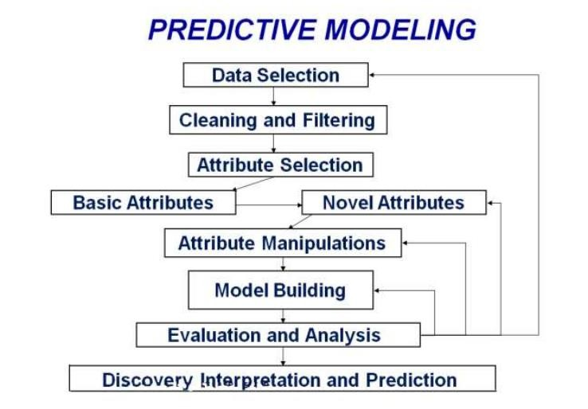

Slide 11
Conclusion
A prototype heart disease prediction system is developed using three data mining classification modeling techniques. The system extracts hidden knowledge from a historical heart disease database.
DMX query language and functions are used to build and access the models. The models are trained and validated against a test dataset.
Lift Chart and Classification Matrix methods are used to evaluate the effectiveness of the models.
All three models are able to extract patterns in response to the predictable state

Slide 12
References:
A. H. M. S. U. Marjia Sultana, "Analysis of Data Mining Techniques for Heart Disease Prediction," 2018.
M. I. K., A. I., S. Musfiq Ali, "Heart Disease Prediction Using Machine Learning Algorithms".
K. Bhanot, "towarddatascience.com," 13 Feb 2019. [Online]. Available: https://towardsdatascience.com/predicting-presence-of-heart-diseases- using-machinelearning-36f00f3edb2c.
[Online]. Available: https://www.kaggle.com/ronitf/heart-disease-
uci#heart.csv.
M. A. K. S. H. K. M. a. V. P. M Marimuthu, "A Review on Heart Disease Prediction using Machine Learning and Data Analytics Approach".
[Online] Prediction of heart disease and classifiers’ sensitivity analysis: https://bmcbioinformatics.biomedcentral.com/articles/10.1186/s12859-020- 03626-y.

Slide 13
Thank You!

