Slide 1
Group 17 demo
Members:
Jayden Abrahams – 23559322@sun.ac.za
Cindi-Ann Jeffery – 24695823@sun.ac.za
Konanani Mathoho – 24774898@sun.ac.za
Clinton Elves - 24007676@sun.ac.za
Langton Chikukwa – 23607769@sun.ac.za

Slide 2

What did we do?
-> Implemented a multithreaded client-server chat program
-> Programming language used was Java
-> Made a GUI for both client and server using Java Swing (widget toolkit)
-> Made use of socket programming

Slide 3
Server class
-> GUI was implemented
-> Server Socket
->Client Socket

Slide 4
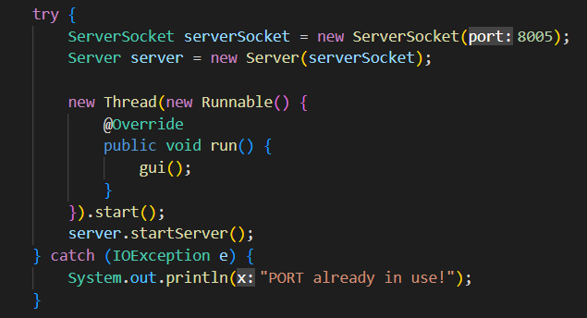
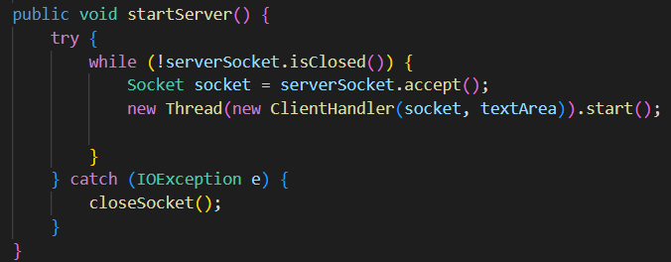
Server

Slide 5
Client CLASS
-> GUI was implemented

Slide 6
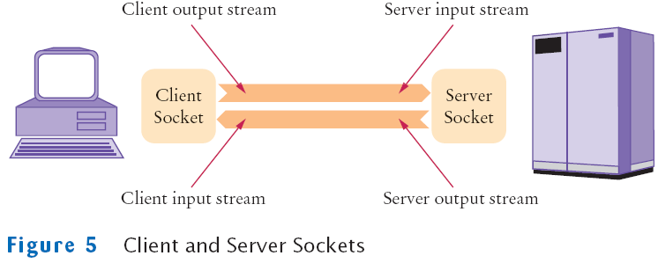
The Client class constructor takes a Socket object, a host, and a port number. It initializes the socket object, and sets up the ability to read from and write to the socket.
startUpWindow() method sets up the GUI for the client, which prompts the user to enter the server IP, port number, and username. Once the user enters these values and clicks the Connect button, the Client object is created and the listenForMessages() method is called to listen for incoming messages from the server.
chatWindow() method sets up the main GUI for the chat window. It includes a JTextArea to display chat messages, a JTextField to enter messages to send, and a JButton to send the messages. It also includes a JTextArea to display online users and a JButton to send special commands.

Slide 7
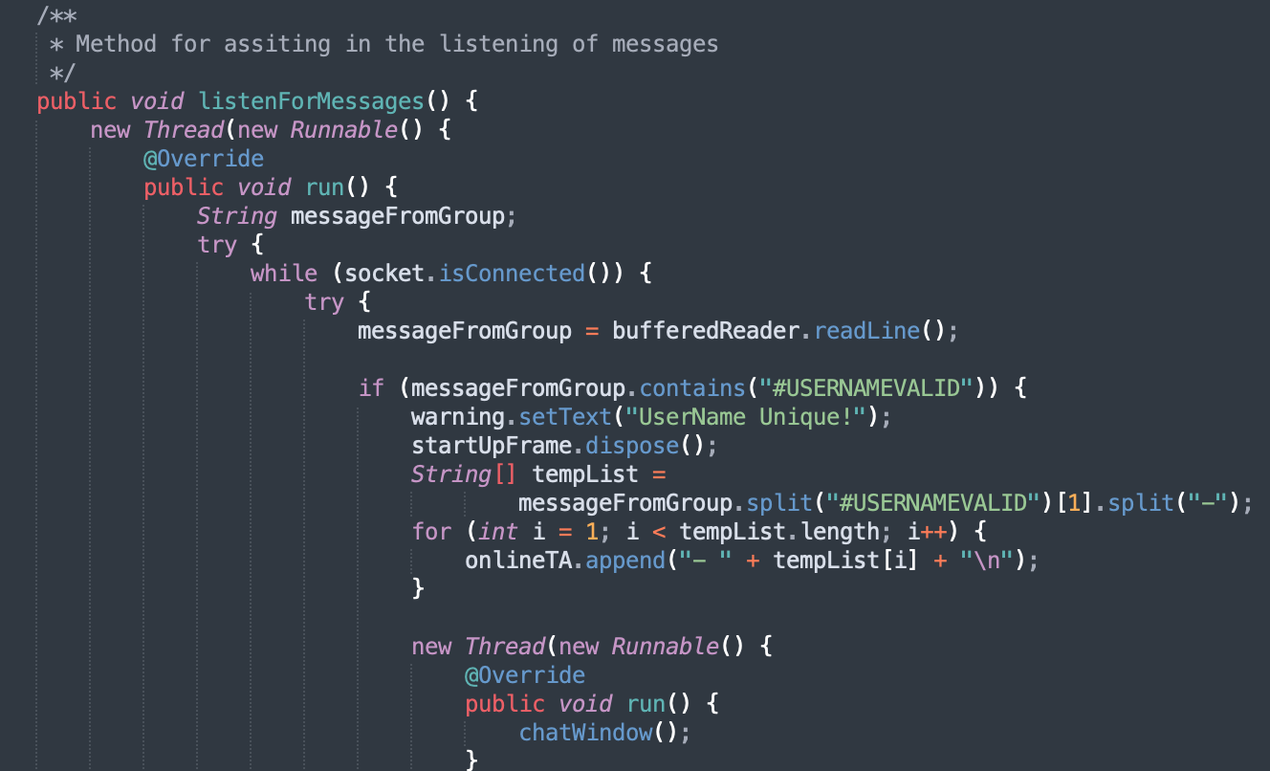
The listenForMessages() method is responsible for receiving and processing messages from the server. It runs on a separate thread to avoid blocking the main thread. It listens for incoming messages on the socket and then updates the chat window with the message.
The writer() method writes the user's username to the server to identify the client on the server side.
The killAll() method closes the socket and streams in case of any exception during the connection process.
The code also defines various components to handle the user input and display messages, such as action listeners for buttons, text fields, and labels.

Slide 8
Clienthandler class
-> Responsibility
-> Methods
->run() method

Slide 9
Methods and responsibility
The ClientHandler class is responsible for handling the clients' connections to the server
When a client connects, a new instance of the ClientHandler class is created for that client.
In the constructor, the Socket object is passed in, which represents the connection between the client and the server.
The isUserNameUnique method checks if the username is already taken by another client.
The broadcastMessage method sends a message to all connected clients except the sender.
The secretMessage method sends a private message to a specific client.
The getUserList method returns a list of all connected users.
The killAll method is called when a client's connection is closed unexpectedly. It removes the client from the list of connected clients and informs all other clients that the client has left the chat.

Slide 10
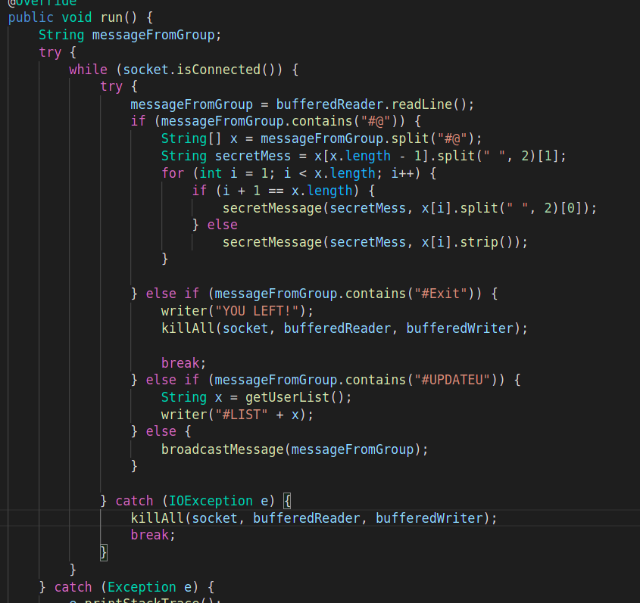
The run method runs in a loop as long as the socket is connected.
It reads messages sent by the client using the BufferedReader object and handles them accordingly.
If the message is a normal message, it is broadcast to all connected clients using the broadcastMessage method.
If the message is a private message, it is sent to the intended recipient using the secretMessage method.
If the message is the #Exit command, the client is informed that they have left the chat, and their connection is closed.

Slide 11
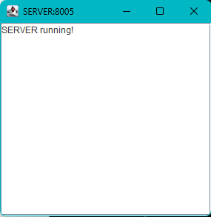
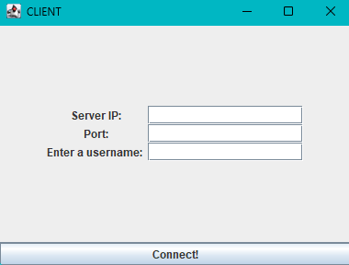
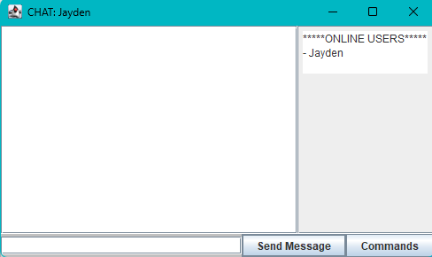
GUI
A walk through...
Notes:
Ok, so for this project we used Java swing for the GUI. Java swing is a user interface toolkit for creating graphic user interfaces.
For the client:
There’s a startUpWindow method that sets up the login GUI. This is just a general user interface where we require the user to enter the server’s ip address, port number and as well as them entering a unique username into the textfields.
As soon as the connect button is clicked, and the information provided is valid, the frame is then disposed of, and then the chat window is launched. The chatwindow consists of a main JPanel, side JPanel, as well as a bottom JPanel , all of which uses the GridBagLayout. GridBagLayout is a flexible layout manager in swing that allowed us to arrange the components in a grid format with the help of constraints.
For the server:
The GUI for the server just contains a JTextArea component, which is not editable. All client updates are written to the JTextArea.

Slide 12
GUI
SERVER

Slide 13
GUI
Login

Slide 14
GUI
Client

Slide 15




BYE
GROUP 17

