Slide 1
Right-Fit Homes
SDP UNIVERSITY HACKATHON 2026 · TOWNSHIP OF TOMORROW
Stop building what buyers tear out
Planet track: circular economy and waste
[Team name]
Notes:
Hi, we are [team name]. Our idea is Right-Fit Homes, for the Planet track. In one line: help Sime Darby Property stop building what buyers tear out.

Slide 2
Team Information
Team members
TEAM NAME
[Team name]
1
[Member name]
Data: simulated records, sourced carbon and cost figures
TEAM LEADER
[Leader's name]
2
Jayden Anthony
Buyer Advisor and the buyer flow
UNIVERSITY
[University]
3
[Member name]
AI tagging and Neighbour Match
EMAIL
[Team leader's email]
4
Zi Xuan
SDP dashboard, What-if, database and architecture
CONTACT NUMBER
[Member name]
[Phone number]
5
Pitch, proposal and questions for SDP mentors
Notes:
Fill in the team details in the brackets. Five of us, one part each: data, the buyer screens, AI tagging and Neighbour Match, the SDP dashboard and maths, and the pitch.

Slide 3



1. The Problem
Buyers tear out brand-new fittings soon after they get their keys
Buyers pay twice
Once for the fitting in the house price, then again to remove and replace it.
Usable materials go to landfill
Never-used kitchen cabinets, tops and wardrobes end up in skips.
Carbon is spent twice
Once making the original, and again making its replacement.
Double-storey terrace, simulated data for the demo. A pilot would use SDP's renovation applications.
Notes:
Many buyers renovate the moment they get their keys. In our simulated terrace data, 6 in 10 owners rip out the kitchen cabinets SDP just installed. The buyer pays twice, the materials go to landfill, and the carbon is spent twice.

Slide 4



2. Target User
Three groups lose today, and the same loop helps all three
Buyers moving in
Homeowners renovating
Sime Darby Property
New owners of SDP homes, before handover
Owners in the same township and house design
Sales, product design and sustainability teams
THEIR CHALLENGE
THEIR CHALLENGE
THEIR CHALLENGE
They pay for fittings they plan to rip out, then pay a contractor to remove them.
Usable fittings they remove have nowhere to go; neighbours buy the same item new.
It builds fittings buyers don't want, with no data on what owners remove.
WHAT THEY GET
WHAT THEY GET
WHAT THEY GET
Opt out for a credit, or upgrade, before anything is installed.
Give it to the nearest neighbour, where it fits exactly.
Lower build cost, upgrade sales, and data on what to stop installing.
Notes:
Three users. Buyers moving in, who pay for things they will rip out. Homeowners renovating, whose usable fittings have nowhere to go. And SDP, which builds what buyers don't want without knowing it. One loop helps all three.

Slide 5
3. Our Solution
One loop, four functions: stop the waste before it is built
1
2
2
3
4
Track
Advise
Match
Learn
What did owners remove?
Choose before it is built
Give it to a neighbour
Tell SDP what to change
AI sorts owners' messy notes into fittings; the app counts them into a rip-out index.
Buyers keep each fitting, opt out for a credit, or upgrade.
Anything still removed goes to the nearest owner with the same design.
"Stop installing item X in unit type B" for the next launch.
Each launch feeds the next: the rip-out index gets sharper every time
Step 2 is where waste is actually stopped. The other three give it better information each time.
Notes:
Right-Fit Homes is one loop with four functions. Track what owners remove. Advise the next buyers so they can say no before it is installed: that is where the waste is stopped. Match anything still removed with a neighbour who has the same house. Learn: tell SDP what to stop installing next launch.

Slide 6
4. Innovation
Most waste ideas clean up after the damage. This one prevents it
 | Usual approach | Right-Fit Homes
When | Recycle or resell after the fitting is ripped out | Stop it before it is built: buyers choose when they book
Reuse | Second-hand sites: measure, hope it fits, arrange a lorry | Same house design, same size: fits with no measuring, nearest neighbour first
Learning | Every launch repeats the same package | The rip-out index from real removals shapes the next launch
Owners' notes | Messy notes in renovation forms go unread | AI reads Malay, English and Manglish notes, with offline rules as backup
Carbon claims | Big totals, hidden assumptions | Counted only for fittings owners would really rip out, net of delivery trips, working shown
Notes:
What makes it different: it acts before the waste happens, not after. Same design means a removed wardrobe fits the neighbour's home exactly, so reuse actually works. The rip-out index makes every launch smarter. AI reads the messy notes owners already write. And our carbon numbers are deliberately conservative.

Slide 7
5. How it Works
A working web app runs the whole loop on one database
1
Owner writes a note
2
AI tagging
3
Rip-out index
In any language: "hak semua kabinet dapur, tukar quartz top"
Claude sorts the note into standard fittings; offline keyword rules are the backup
The share of owners who removed each fitting, per house design
4
Buyer Advisor
5
Neighbour Match
6
SDP dashboard
Keep, opt out for a credit, or upgrade, with money and carbon worked out live
Removed fittings go to the nearest same-design neighbour: map, chat, pick-up
"Stop installing X" advice, and What-if projections for a whole launch
UNDER THE HOOD
Flask · Python + pandas · SQLite (9 tables) · Plotly · three.js · Claude API, optional
Runs fully offline for the demo; every page reads and saves through one database, so each step feeds the next.
Notes:
Here is the loop as it runs in our app. An owner writes a messy note, AI tags it, and it updates the rip-out index. The next buyer sees that index in the Advisor and chooses. Anything still removed goes on Neighbour Match. And SDP's dashboard turns it all into advice. One database, so each step feeds the next.

Slide 8
6. Impact
Projected for a 100-home pilot: 84% of the rip-out waste never happens
46.6 t
RM148,199
RM411,590
36 homes
CO₂e never released
SDP's gain, after an RM80,000 running cost
Buyers keep: credits plus rip-out costs they skip
Until it pays for itself
100 terraces at the What-if page's defaults: buyers choose for 80% of would-be rip-outs, 40% of them upgrade, and Neighbour Match rehomes half of the rest (a pilot target; the demo data rehomes 3% so far). Simulated rip-out rates, public fitting figures; working in appendix B.
Notes:
We project that for a pilot of 100 terraces, of 71.6 tonnes that owners would rip out, 56 tonnes are never installed and 4 more are rehomed. That is 84%, if Neighbour Match rehomes half of what is still removed, our target for a pilot. 46.6 tonnes of CO2e never released. SDP gains about RM148,000 after running costs and pays back after 36 homes, and buyers keep RM411,000. Every input is shown, so you can question one number without rejecting the idea.

Slide 9



7. Feasibility
It fits SDP's current sales and renovation process, with no new equipment
Resources
Stakeholders
Deployment
Working prototype: web app, database and 500+ automated checks
Data SDP already gets: renovation applications and buyers' choices at booking
Public carbon and price data (ICE database, Malaysian price guides)
Sales offers the choice at booking
Product design drops low-value fittings next launch
Sustainability reports waste and carbon avoided
Legal confirms what the CCC and sales contract allow
A web app on SDP's network
SDP's login replaces the demo sign-in
A server database replaces SQLite: one file changes
AI tagging on SDP's own API key, rules as backup
To confirm with SDP before a pilot: kitchen sink and tap, bathroom wall tiles, doors and window frames, and bedroom floor finishes. Each is tied to the CCC, the sales contract or the bank's valuation, so the app keeps them out of buyers' choices for now.
Notes:
Can SDP really do this? Yes: it uses data SDP already receives, needs no new equipment, and the prototype already works. The people involved are sales, product design, sustainability and legal. The one thing to confirm is which fittings can legally be left out; the app already keeps four uncertain ones out of the choices.

Slide 10
8. Implementation
Start with one launch of one house design (about 100 homes), then scale
Month 1
Month 2
At booking
After handover
Next launch
1
2
3
4
5
Confirm
Track
Advise
Match
Learn and scale
Agree which fittings buyers may opt out of, the credit for each, and the launch to pilot.
Load past renovation applications to build that design's rip-out index.
Buyers keep, opt out or upgrade each fitting when they book.
Owners give still-usable removed fittings to neighbours with the same design.
Measure the results, change the next package, add more designs.
WHAT WE MEASURE IN THE PILOT
kg of waste never installed
kg CO₂e avoided
RM saved after credits
Upgrade revenue
Reuse rate: collected ÷ removed
Notes:
We would start small: one launch of one house design, about 100 homes. Month one, confirm the eligible fittings and credits. Then build the rip-out index from past renovation applications, offer the choices at booking, run Neighbour Match after handover, and measure five numbers before scaling to more designs.

Slide 11
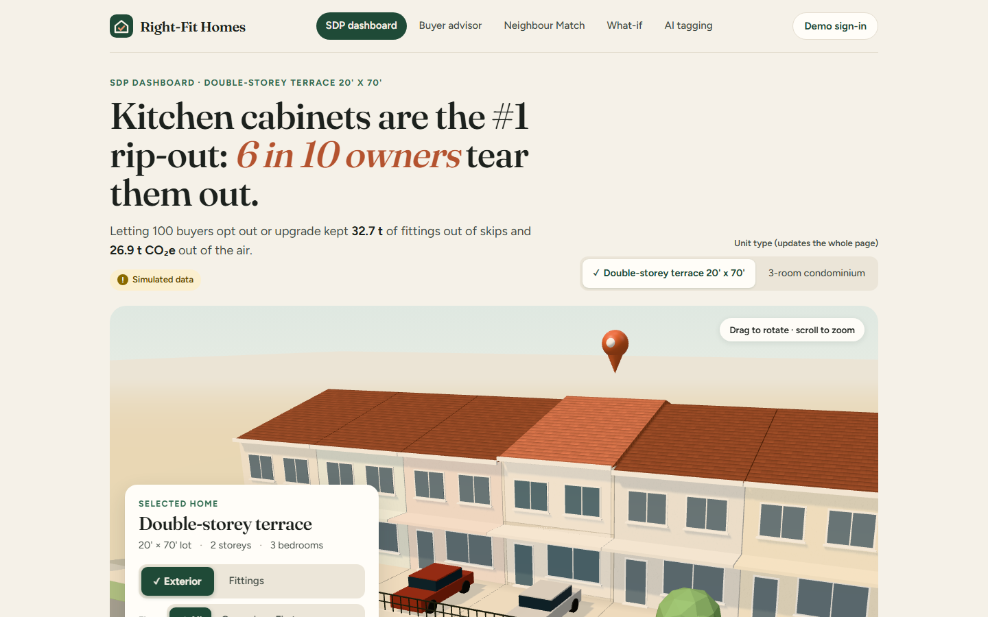
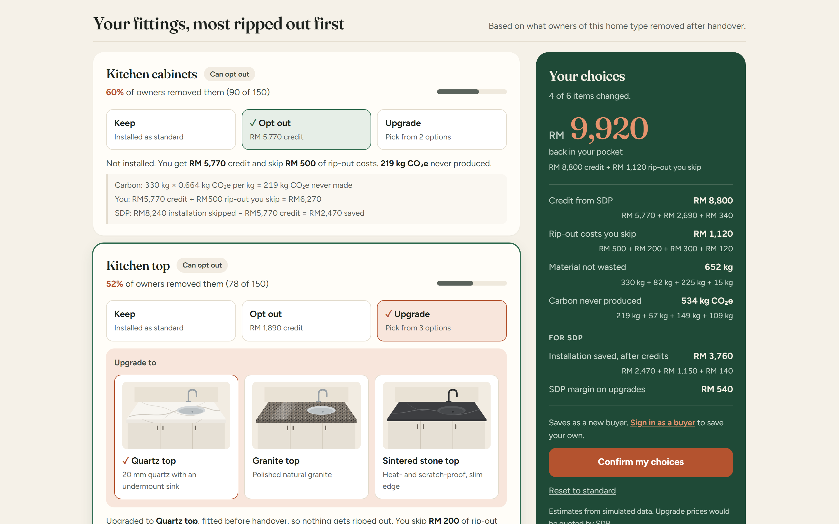
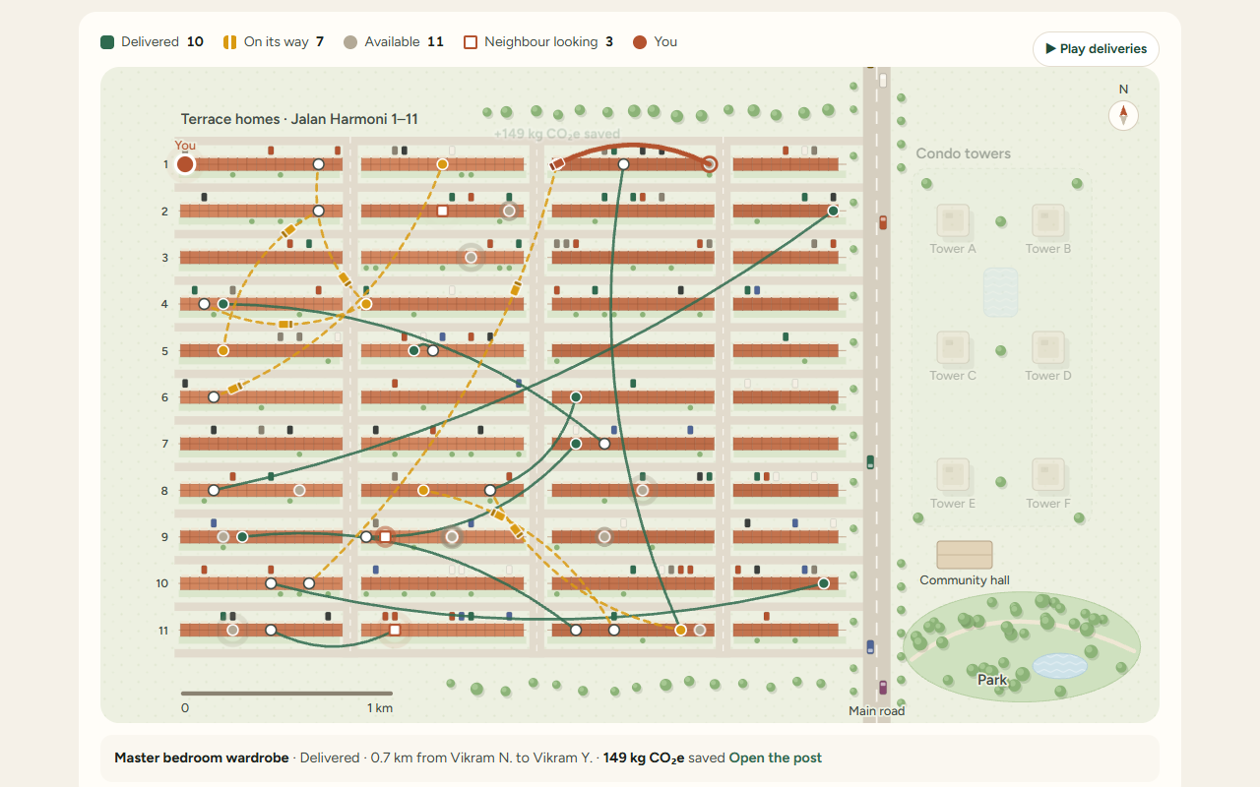
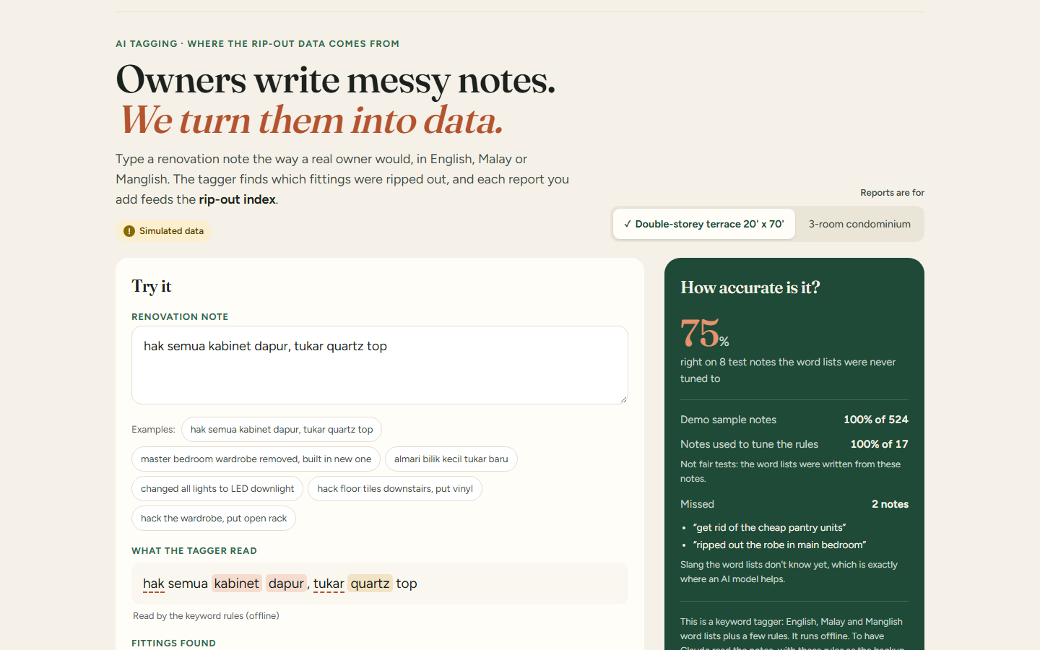
9. Visual Concept
SDP dashboard
Kitchen cabinets are the #1 rip-out; it says what to stop installing.
Buyer Advisor
Four choices give the buyer RM 9,920 back, with the working shown.
Neighbour Match
Removed fittings go to the nearest home with the same design.
AI tagging
A Malay note sorted into kitchen cabinets and kitchen top.
Notes:
These are real screens from our working prototype, not mock-ups: the SDP dashboard, the buyer Advisor, Neighbour Match on the township map, and AI tagging of a Malay note. The demo video walks through each one.

Slide 12
10. Why Our Team Should Win
Most waste ideas clean up after the damage.
Right-Fit Homes stops it before it is built, using renovation applications SDP already receives and no new equipment. It is a working app, not a mock-up: SDP staff, homeowners and buyers can each use the whole loop today. Our numbers are honest: carbon counts only where owners really remove a fitting, and every figure shows its working. AI reads owners' messy Malay and English notes, with offline rules as backup. Every launch makes the next one smarter, cutting SDP's build cost and carbon while buyers save.
Working app
The whole loop runs today, for SDP, owners and buyers
84%
of rip-out waste avoided, projected for a 100-home pilot
36 homes
to pay back the running cost
Notes:
Why us: we stop waste before it exists, using processes SDP already has. It is a working app, not slides. The numbers are honest and show their working. And it gets smarter with every launch. Thank you.

Slide 13
Thank You
Right-Fit Homes · Stop building what buyers tear out
Demo video: [link]
Code: github.com/Jayden-Jarred/Sime-Darby-Hackathon
Notes:
Thank you. The demo video and the code are linked here, and the appendix has the details behind every number.

Slide 14
Appendix A: what buyers can drop
SDP still needs to confirm the list; the app keeps uncertain items out
Group | Examples | Buyer can
Can opt out | Kitchen cabinets and tops, wardrobes, decorative lights | Keep, opt out for a credit, or upgrade
Upgrade only | Floor tiles | Keep or upgrade
Always installed | Toilets, basins, essential wiring and plumbing | Nothing to choose
To be confirmed | Kitchen sink and tap (plumbing checked for the CCC); bathroom wall tiles (waterproof wet areas, in the sales contract); doors and window frames (on the approved plans); bedroom floor finishes (in the sales contract; may lower the bank's valuation) | Nothing yet: the app shows "To be confirmed with SDP"
Notes:
Backup: which fittings a buyer can say no to, and the four we still need SDP to confirm.

Slide 15
Appendix B: the 100-home example
100 double-storey terraces at the What-if page's Pilot preset, step by step
Input or result | Value | How it is calculated
Fittings owners would rip out | 252 (71.6 t) | Each fitting's rip-out rate × 100 homes
Chosen before handover | 194: 108 opted out, 86 upgraded | Assumption: buyers choose for 80% of would-be rip-outs (basins and toilets are always installed); 40% upgrade, the rest opt out (tiles can only be upgraded)
Waste avoided | 60.3 t of 71.6 t (84%) | 56.2 t never installed + 4.0 t rehomed (target: Neighbour Match rehomes 50% of reusable fittings still removed; the demo data rehomes 3% so far)
Carbon never released | 46.6 t CO₂e | Weight × ICE carbon factor; rehomed items minus their delivery trips
SDP's gain | RM148,199 | RM132,144 installation saved after credits + RM96,055 upgrade margin − RM80,000 running cost (assumption)
Pays for itself after | 36 homes | RM80,000 running cost ÷ RM2,282 gain per home
Buyers save | RM411,590 | Credits plus the rip-out costs they skip
Simulated rip-out rates; fitting weights, carbon factors and prices from public sources (ICE database, Malaysian renovation price guides).
Notes:
Backup: every input and step behind the 100-home numbers, straight from the app's What-if page.

Slide 16
Appendix C: system architecture
Four layers, each talking only to the one below
FOR A REAL PILOT
Pages
Hosting: a WSGI server behind HTTPS on SDP's network
Every screen: HTML templates, three.js 3D home, Plotly charts. All bundled, runs offline
Web: Flask routes
SDP's own login replaces the demo sign-in
Every page and JSON API, the demo sign-in, request checks
Rules and maths
Claude API behind the tagger (optional; keyword rules as backup)
Impact and carbon maths, AI tagging, Neighbour Match, the township map
Data: SQLite
SDP's sales and renovation systems feed it; a server database can replace SQLite
9 tables with keys and checks; every save is all or nothing
Full diagrams: docs/ARCHITECTURE.md in the code repository.
Notes:
Backup: how the app is built. Four layers; pages never touch the database, and only one file knows the data is SQLite. The dashed boxes are what changes for a real pilot.

