Slide 1

STUDIO GROWTH ANALYSIS · SEPTEMBER 2026
Where Ballotté
Can Grow Next
Students, nearby markets and ballet competitors around
Ballotté Dance Academy #Puchong
Prepared by Jayden Kwong
Notes:
Title slide. This deck reviews who Ballotté's students are, where they live, where new students could come from, who the nearby ballet competitors are and how they market themselves, ending with recommendations.

Slide 2

OVERVIEW
What this analysis answers
OUR STUDENTS
OUR MARKET & COMPETITORS
1
What are the main age groups among current students?
6
Where could the next students come from?
2
Which areas or townships have the most students?
7
Which ballet schools nearby compete most directly?
3
How are students spread across the surrounding cities?
8
How do those competitors market themselves online?
4
What is the citizenship mix of the student base?
9
Where are competitors listed, and where could Ballotté be seen?
5
Which segments make up the school's main student base?
Ballotté Dance Academy #Puchong
2
Notes:
Questions 1 to 5 come from the original student analysis. Questions 6 to 9 extend it to nearby markets, competitors and online visibility.

Slide 3
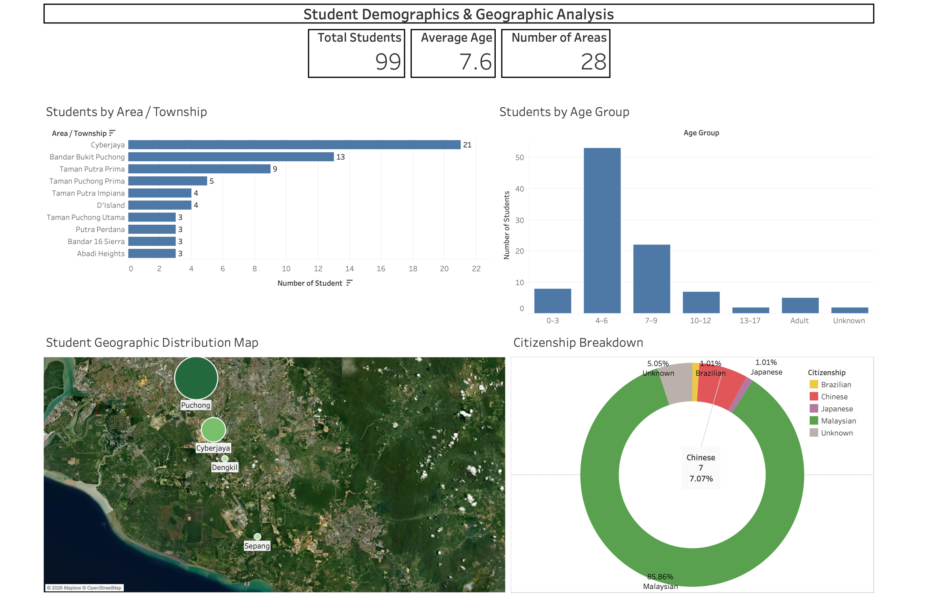
01 OUR STUDENTS
The student dashboard
Source: Ballotté student records, 99 students, updated 4 September 2026
Ballotté Dance Academy #Puchong
3
Notes:
The Tableau dashboard: total students, average age and number of areas at the top; students by township, age group, a map by city, and citizenship.

Slide 4
01 OUR STUDENTS
What the dashboard tells us
99
7.6
28
76%
students
average age
areas / townships
aged 4 to 9
1
Young learners lead. 53 students (54%) are aged 4–6 and 22 are aged 7–9. There are only 5 adults and 2 teenagers.
2
Two home bases. Puchong (69) and Cyberjaya (21) make up 91% of students. Cyberjaya is the single biggest area.
3
Almost all girls. 97 of the 99 students are female.
4
Mostly local families. 86% are Malaysian. Chinese nationals are the largest international group, with 7 students (7%).
Core student profile: young, female, Malaysian, and living around Puchong and Cyberjaya.
Ballotté Dance Academy #Puchong
4
Notes:
Findings from the dashboard. Ages 4 to 9 are three quarters of students. Puchong and Cyberjaya together are 91 percent.

Slide 5
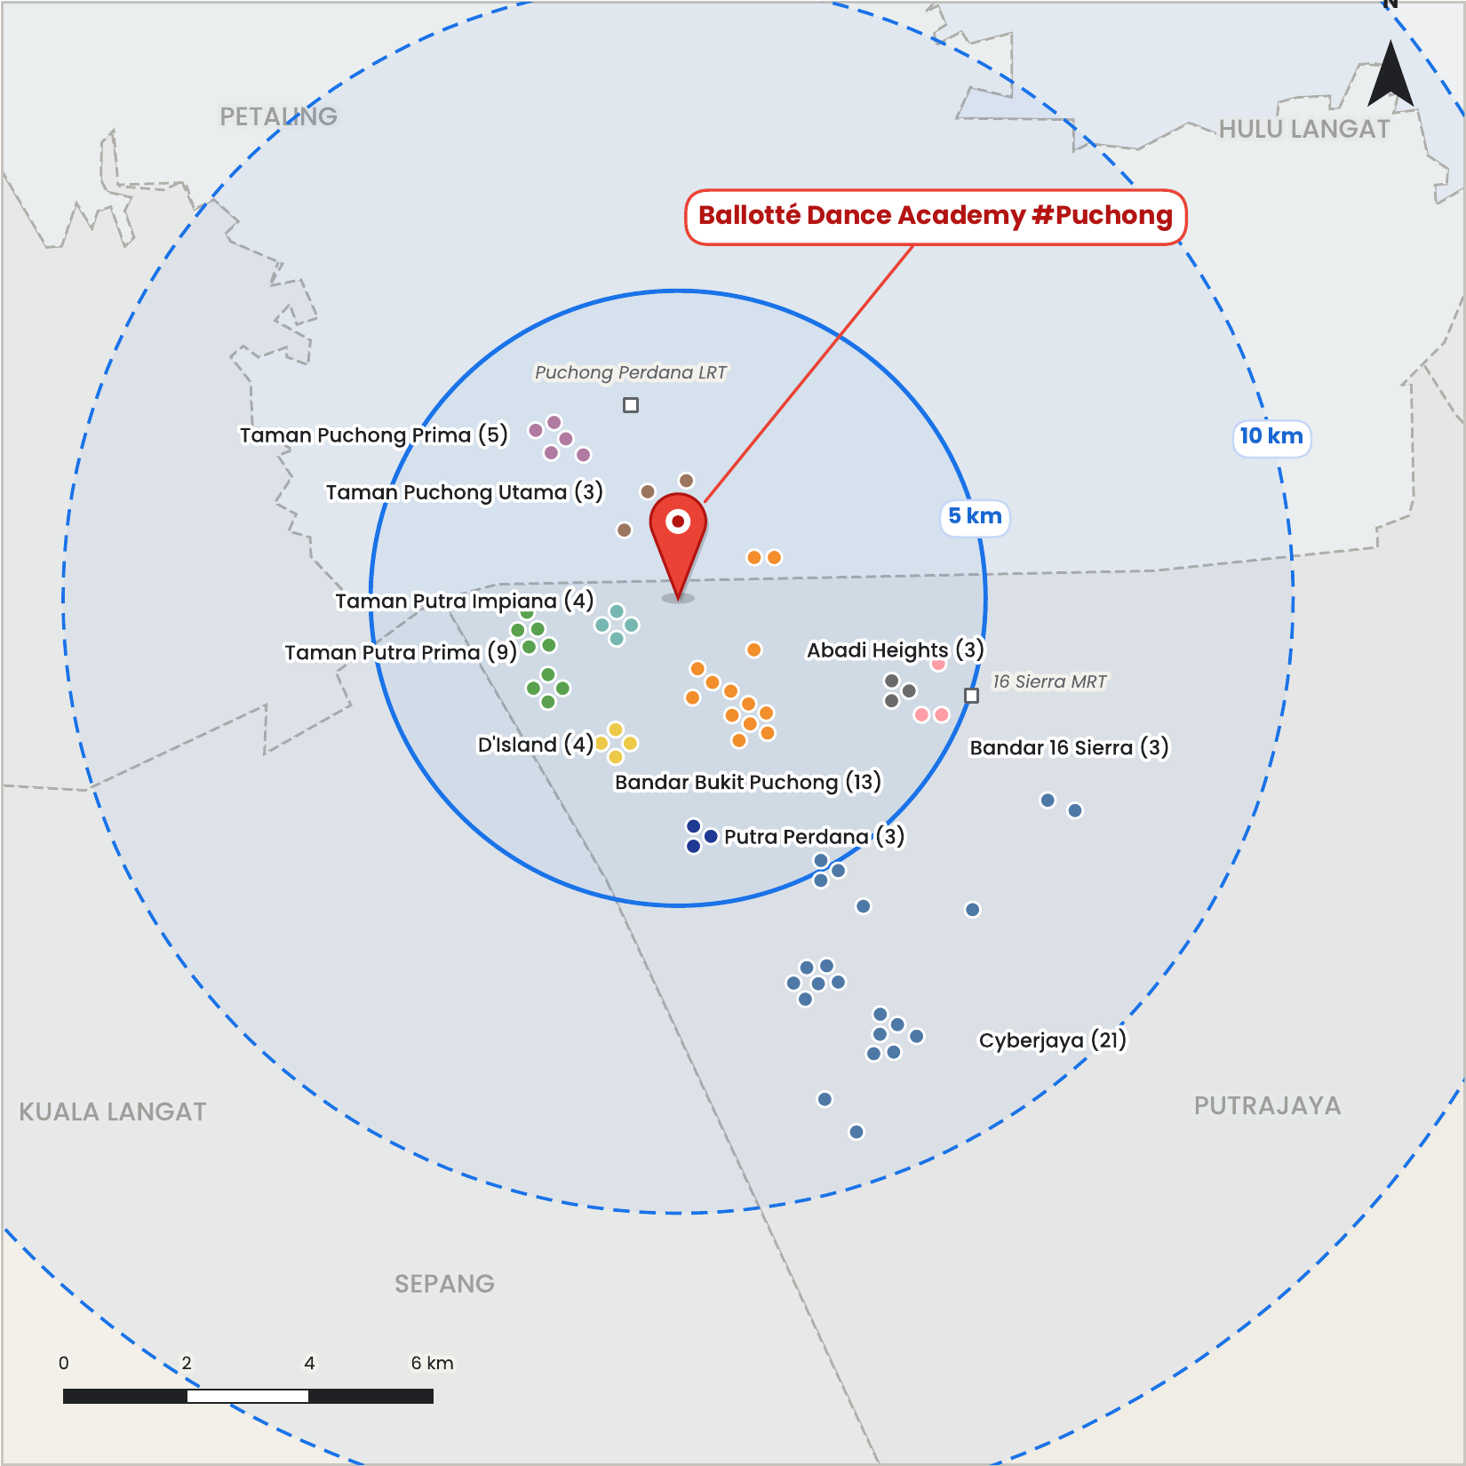
01 OUR STUDENTS
Where our students live
47 of 68
students from the top 10 areas live within 5 km of the studio
1
Puchong is on the doorstep. Every Puchong-side area is inside 5 km. The closest are Taman Putra Impiana (1.1 km), Taman Puchong Utama (1.6 km) and Bandar Bukit Puchong (1.9 km).
2
Cyberjaya families travel. All 21 Cyberjaya students live 5–10 km away, about 7 km on average.
3
A gap in Cyberjaya. We found no dedicated ballet school in Cyberjaya, which may be why these families make the trip.
4
Nobody is beyond 10 km. No student from the top 10 areas lives more than 10 km from the studio.
Dots sit at each student's condo, taman or street, not the exact house.
Ballotté Dance Academy #Puchong
5
Notes:
The map plots the 68 students from the dashboard's top 10 areas with circles every 5 km from the studio.
https://www.yelp.com/search?find_desc=Dance+Studios&find_loc=Cyberjaya%2C+Selangor

Slide 6
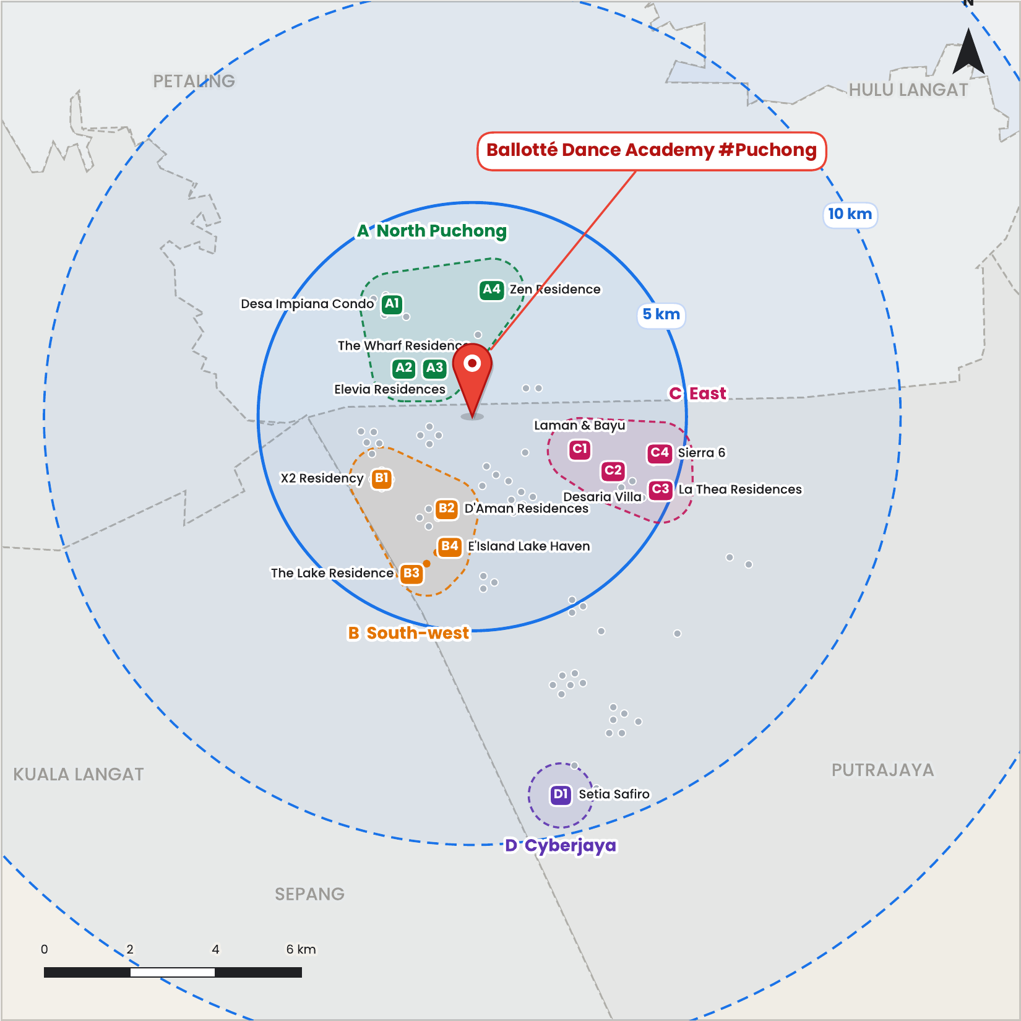
02 OUR MARKET
Where the next students could live
13
family developments in 4 groups, all inside the 10 km circle
Group | Developments | km
A North Puchong | Desa Impiana, The Wharf, Elevia, Zen Residence | 1.4–3.2
B South-west | X2, D'Aman, The Lake Residence, E'Island Lake Haven | 2.3–3.6
C East | Laman & Bayu, Desaria Villa, La Thea, Sierra 6 | 2.6–4.7
D Cyberjaya | Setia Safiro | 9.1
1
Referral targets. X2 Residency (4 students), Desa Impiana (1) and Elevia (1) already have Ballotté families. RM 50 referral to these condo.
2
Cyberjaya needed a target. Setia Safiro was added because Cyberjaya is the biggest student area (21) and had no target of its own.
3
One weaker fit. Desaria Villa houses many university students.
Ballotté Dance Academy #Puchong
6
Notes:
Twelve of the 13 developments are 1.4 to 4.7 km from the studio. Groups: A North Puchong, B South-west, C East, D Cyberjaya.

Slide 7
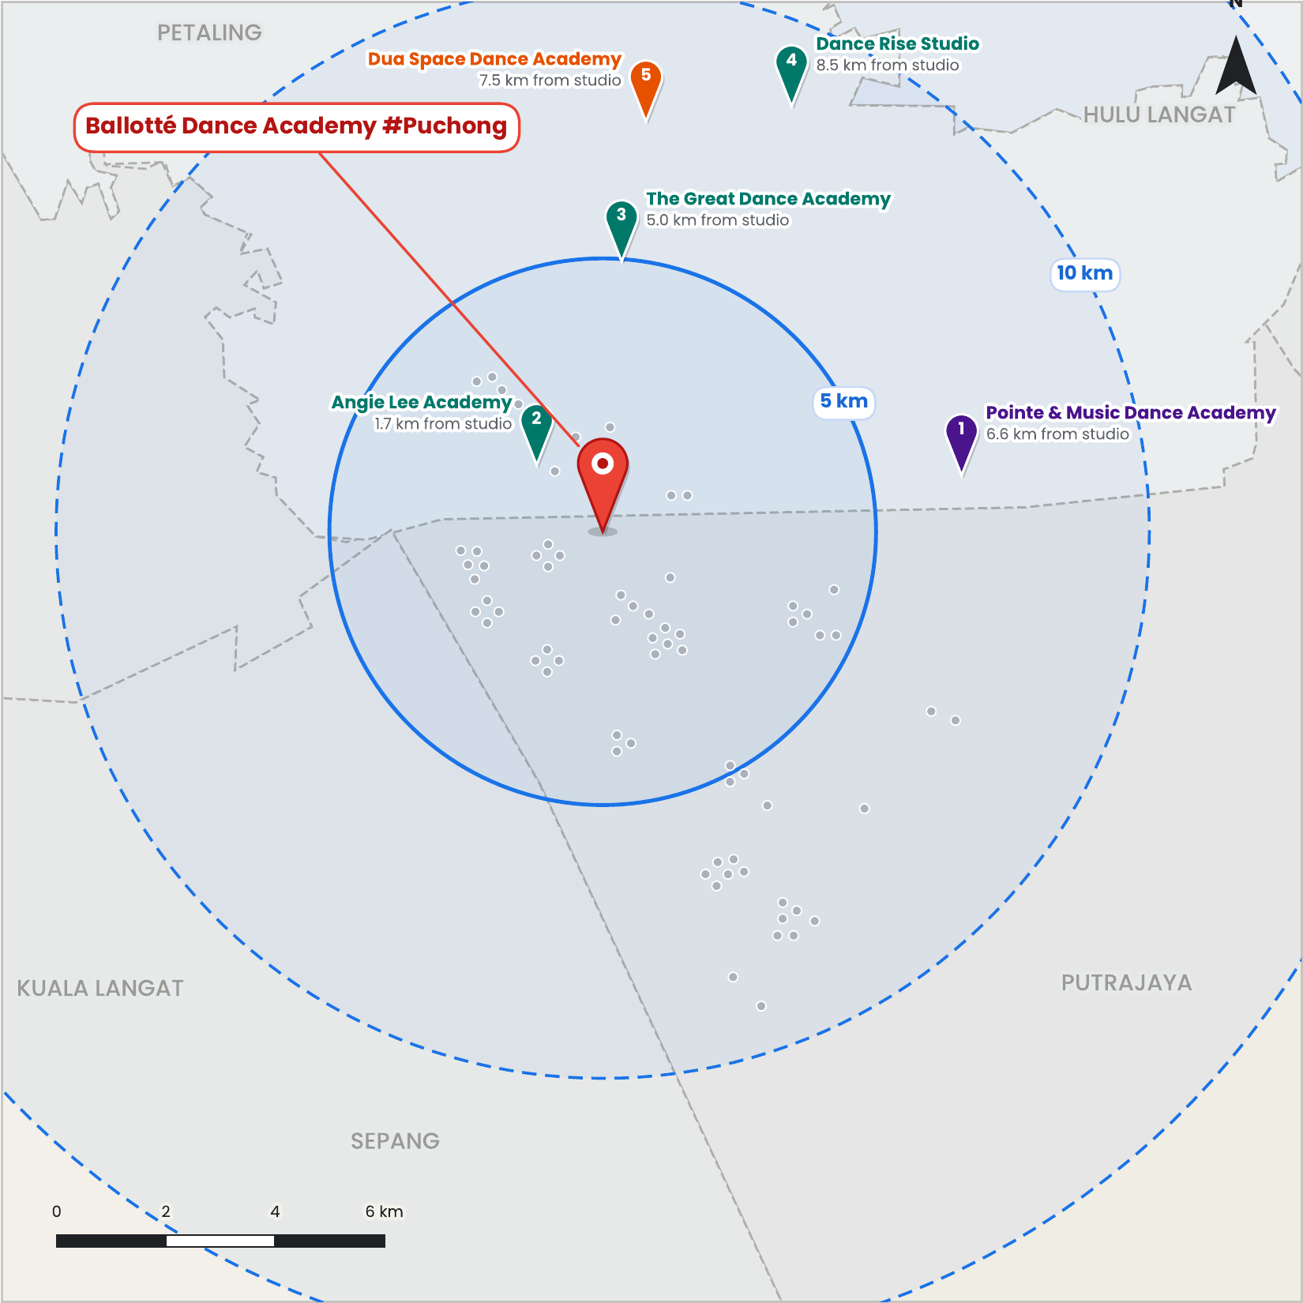
03 OUR COMPETITORS
Ballet competitors near the studio
5
confirmed ballet schools inside 10 km
1
One is on our doorstep. Angie Lee Academy is the only one inside 5 km (1.7 km), and 12 of our 68 mapped students live within 2 km of it.
2
The rest are north and east. The other four sit around Puchong town, Kinrara and Seri Kembangan. None of our mapped students live within 3 km of them.
3
Closest match. Pointe & Music teaches RAD, CSTD and Vaganova, the same three ballet syllabi as Ballotté.
4
Cyberjaya is open. No dedicated ballet school was found in Cyberjaya, where our largest group of students lives.
Pins are placed by shop block; distances are straight-line, not driving.
Ballotté Dance Academy #Puchong
7
Notes:
Five confirmed ballet competitors, coloured by how similar they are to Ballotté.

Slide 8
03 OUR COMPETITORS
Who they are
# | Studio | Area | Distance | What they teach | Similarity
1 | Pointe & Music Dance Academy | Taman Equine, Seri Kembangan | 6.6 km | RAD, CSTD and Vaganova ballet, contemporary, competitions | Very high
2 | Angie Lee Academy | Prima Biz Hub, Taman Tasik Prima | 1.7 km | RAD classical ballet, modern jazz, K-pop, adult ballet | High
3 | The Great Dance Academy | Jalan Puteri 1/4, Bandar Puteri | 5.0 km | RAD ballet from age 4, contemporary, exams, competitions | High
4 | Dance Rise Studio | Jalan BK5a/2, Bandar Kinrara | 8.5 km | Ballet-focused: kids' classical ballet plus adult barre | High
5 | Dua Space Dance Academy | Jalan Kenari 11, Bandar Puchong Jaya | 7.5 km | CSTD classical ballet; professional contemporary dance company | Medium-high
How similarity was judged: against what Ballotté teaches, which is RAD, CSTD and Vaganova ballet plus modern contemporary, with competition training. Studios where ballet is only a side class were left out.
Ballotté Dance Academy #Puchong
8
Notes:
Tone Color Academy, Wow Talent Academy and Dancing Art Solutions were excluded because ballet is a side class there.

Slide 9
04 ONLINE PRESENCE
How everyone shows up online
 | Ballotté | Pointe & Music | Angie Lee | Great Dance | Dance Rise | Dua Space
Website | Gambling site | ✓ | ✓ | ✓ | ✓ | ✓
Facebook followers | 406 | 3.6K | 1.1K | 1.9K | 169 | 135
Instagram followers | 2,164 | 2.2K | 700 | 777 | 184 | 200
Blog / news posts | – | ✓ | – | ✓ | – | –
Awards / results page | – | ✓ | – | ✓ | – | ✓
Online trial booking | ✓(Facebook (Jan)) | ✓ | – | WhatsApp | – | –
Phone / WhatsApp on Facebook | – | ✓ | ✓ | ✓ | ✓ | ✓
HiParents listing | ✓ | – | – | ✓ | ✓ | –
Paid Facebook / Instagram ads | None | None | None | None | None | None
✓ = found – = not found ? = not checked. Ballotté's website link on Google opens a gambling site (slide 12). Follower counts from Facebook and Instagram, September 2026.
Ballotté Dance Academy #Puchong
9
Notes:
Ballotté's column is highlighted. It is the only studio here without a website, and its Facebook page has no phone number or WhatsApp button.

Slide 10
04 ONLINE PRESENCE
Facebook reach compared
9×
Pointe & Music's Facebook following compared with Ballotté's (3.6K vs 406)
1
Instagram is Ballotté's strength. At 2,164 followers, Ballotté is level with Pointe (2.2K) and far ahead of Dua Space (200).
2
Facebook lags behind. Ballotté's page is the third smallest of the six and far behind its own Instagram.
3
No one pays for ads. None of the six studios runs Facebook or Instagram ads, so free channels decide who gets noticed.
Ballotté Dance Academy #Puchong
10
Notes:
Parents often check Facebook for reviews and contact details, so the gap there matters even though Ballotté's Instagram is strong.

Slide 11
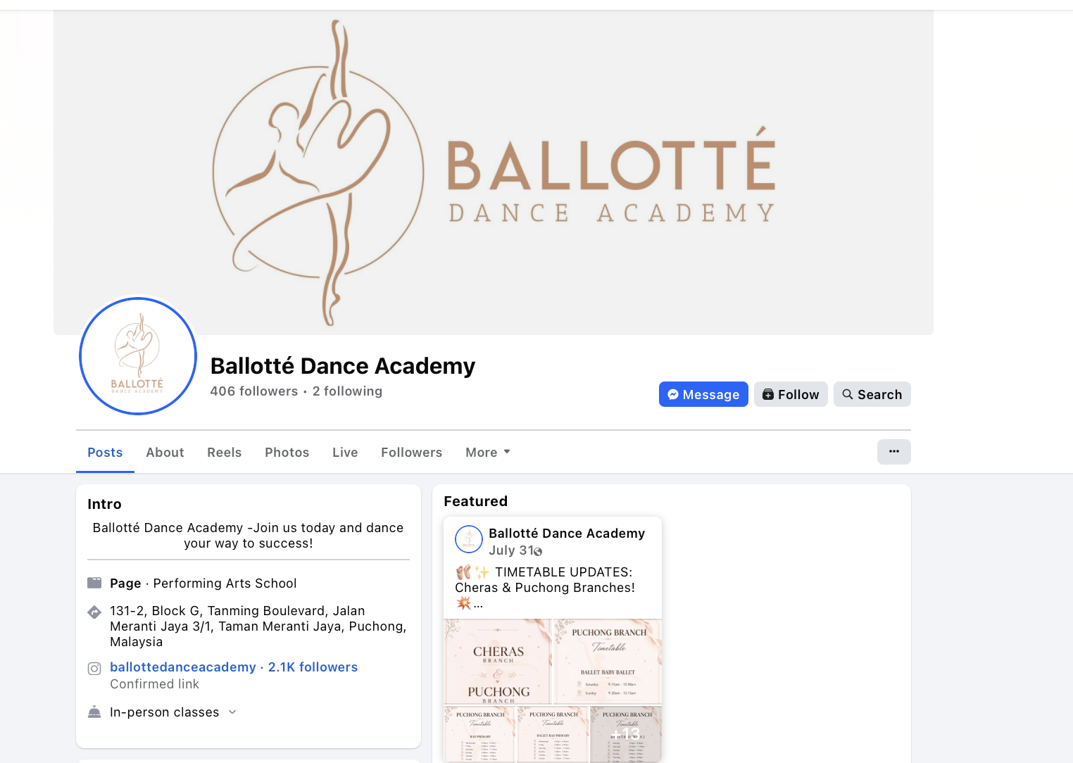

04 ONLINE PRESENCE
Ballotté online today
Instagram: 2,164 followers, with highlights for classes, competitions, camp and exams
1
Hard to contact. Parents who find the Facebook page have no quick way to call or message.
2
Great content, one place. Exam, camp and competition stories (MIBC'26, YPAC'25) live only in Instagram highlights.
Facebook: 406 followers, address and Instagram link, but no phone number or WhatsApp button
3
No working website. The ballottedance.com link on Google now opens a gambling site (next slide).
Ballotté Dance Academy #Puchong
11
Notes:
Ballotté already does exams, camps and competitions. The problem is visibility: the content is not reused on Facebook or a website, and there is no website to send Google searchers to.

Slide 12
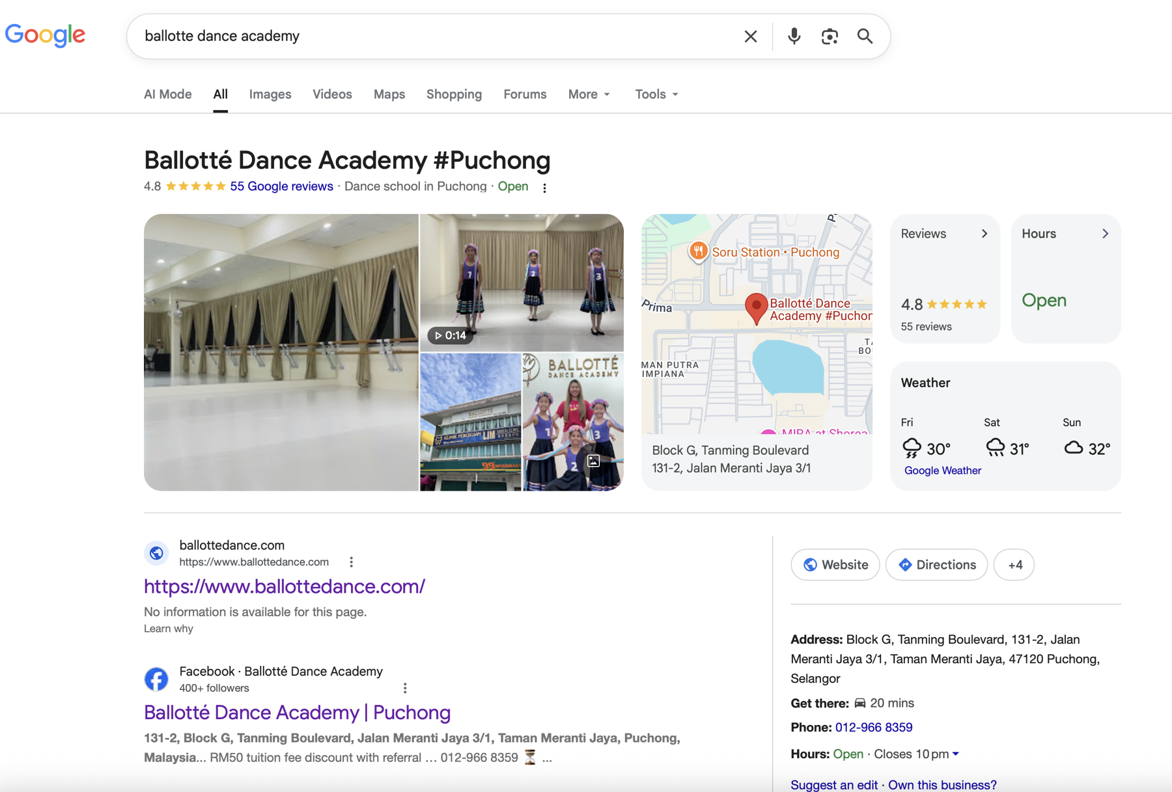
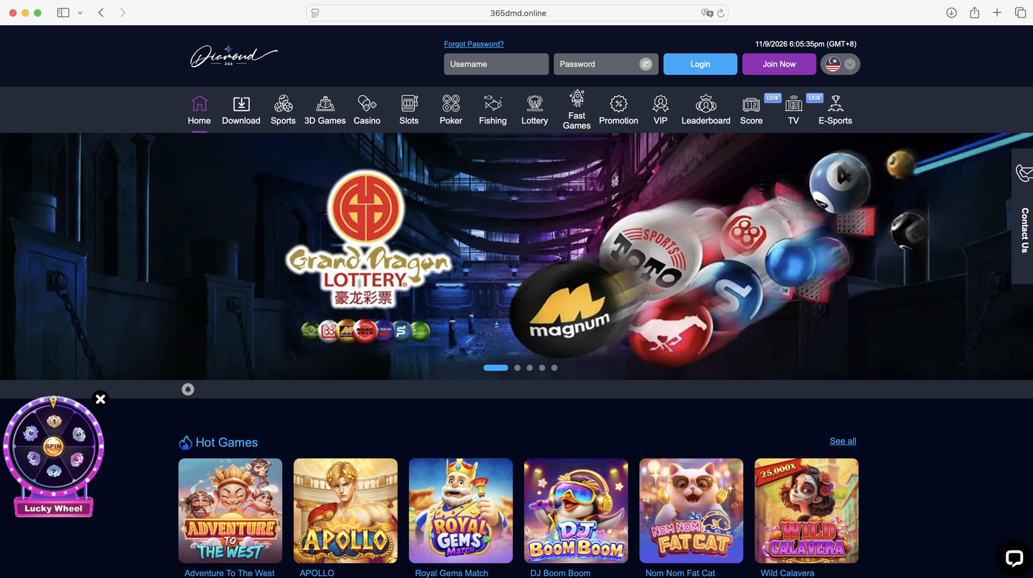
04 ONLINE PRESENCE
Ballotté on Google: a strength and a risk
Opens 365dmd.online
Google search for "ballotte dance academy", 11 Sep 2026
Where the Website link on Google leads: 365dmd.online, 11 Sep 2026
✓
Strong reviews. 4.8 stars from 55 Google reviews, with phone number, hours and directions all showing.
!
Website link goes to a gambling site. Parents who click it land on an online casino, which hurts trust in the studio.
Ballotté Dance Academy #Puchong
12
Notes:
Google shows Ballotté's profile with 4.8 stars from 55 reviews, far more reviews than competitors show on Facebook. But the Website button points to ballottedance.com, which now opens the gambling site 365dmd.online. This is bad for the studio's reputation and should be fixed first: remove or replace the website link on the Google profile and anywhere else it appears.

Slide 13
04 ONLINE PRESENCE
What competitors are doing
Studio | Events seen online | Marketing strategy
Pointe & Music | Competitions in 2025: Asia Open Dance Championship, Hong Kong Challenge Cup, CSTD 12th Malaysia Dance Competition | Monthly parent blog (e.g. "best age to start ballet") Awards page and online trial booking Website pages naming Puchong and Bukit Jalil for Google
Angie Lee | Celebrated MXDC 2025 competition winners Joint Open Day with Fusion Music Studio Puchong | Buro247 magazine feature Adult ballet for ages 18+ WhatsApp button and 4 Facebook reviews
Great Dance | 2026: International Ballet Grand Prix, Asian Elite Dance Competition, RAD exams Own Academy Day showcase | A news post for every event Email newsletter sign-up HiParents enrolment post; two branches
Dance Rise | None found online | Adult barre sold as fitness (toning, posture) HiParents listing and a free website
Dua Space | Ticketed stage shows sold on CloudJoi Silver Ballet 55+ launched August 2026 | Adult classes: pilates, yoga, Chinese dance, adult ballet Bilingual English and Chinese branding
Ballotté Dance Academy #Puchong
13
Notes:
The main tactics Ballotté does not use are Pointe's blog and trial booking, Great Dance's newsletter and event posts, and adult programmes at Angie Lee, Dance Rise and Dua Space.

Slide 14
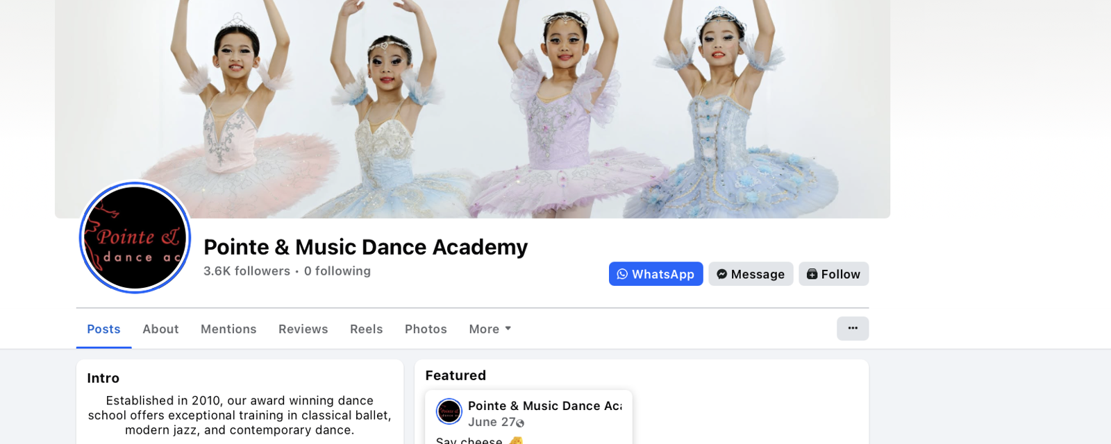
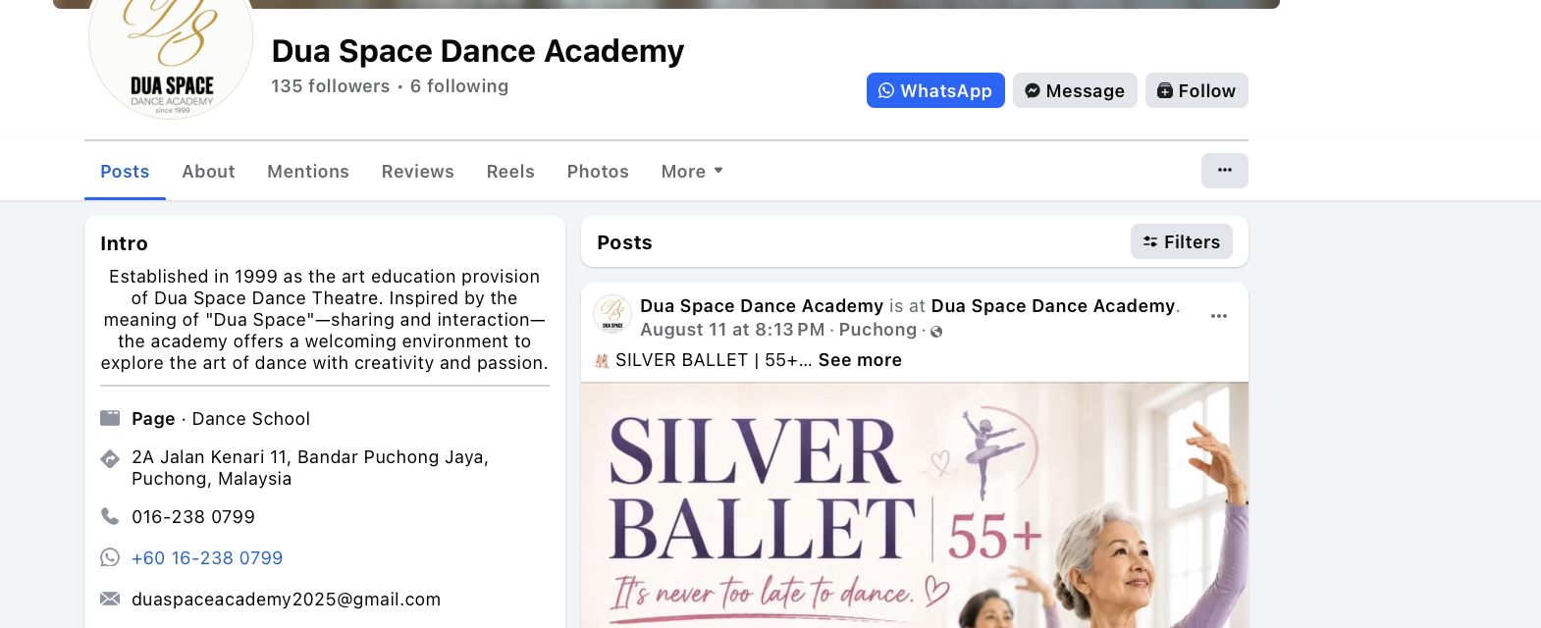
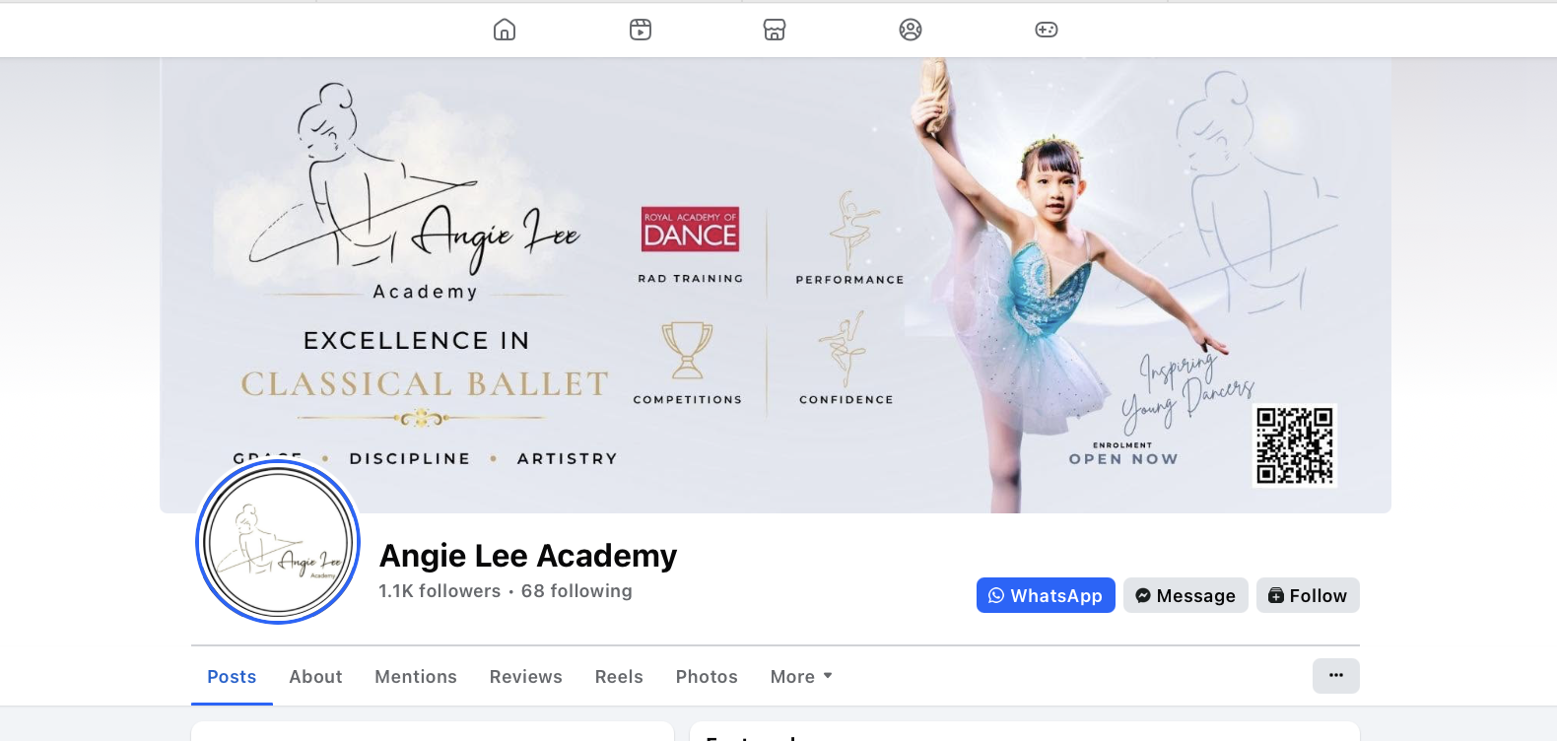
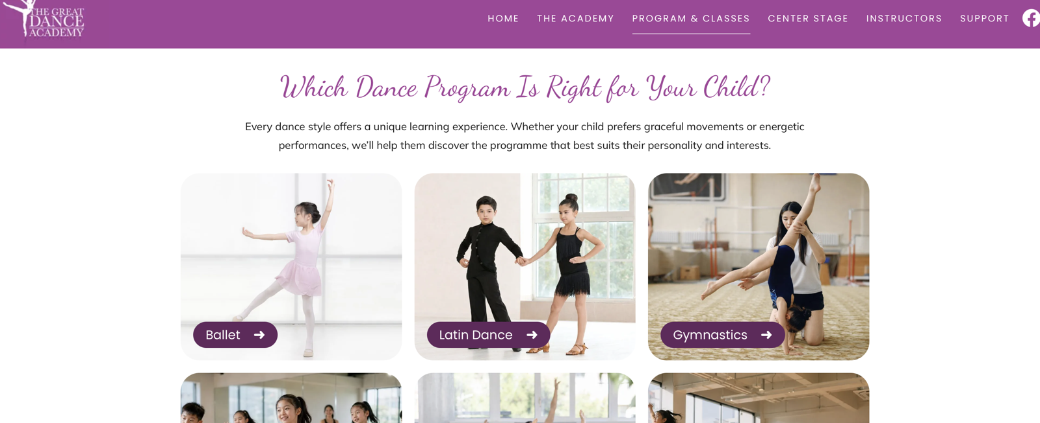
04 ONLINE PRESENCE
A look at their pages
Pointe & Music: 3.6K Facebook followers, 2.2K on Instagram, WhatsApp button
Dua Space: new Silver Ballet 55+ class for adults aged 55 and over
Angie Lee: "Excellence in Classical Ballet" banner and WhatsApp button
Great Dance: a website page for each class type
Ballotté Dance Academy #Puchong
14
Notes:
Screenshots from competitors' Facebook pages and websites, September 2026.

Slide 15
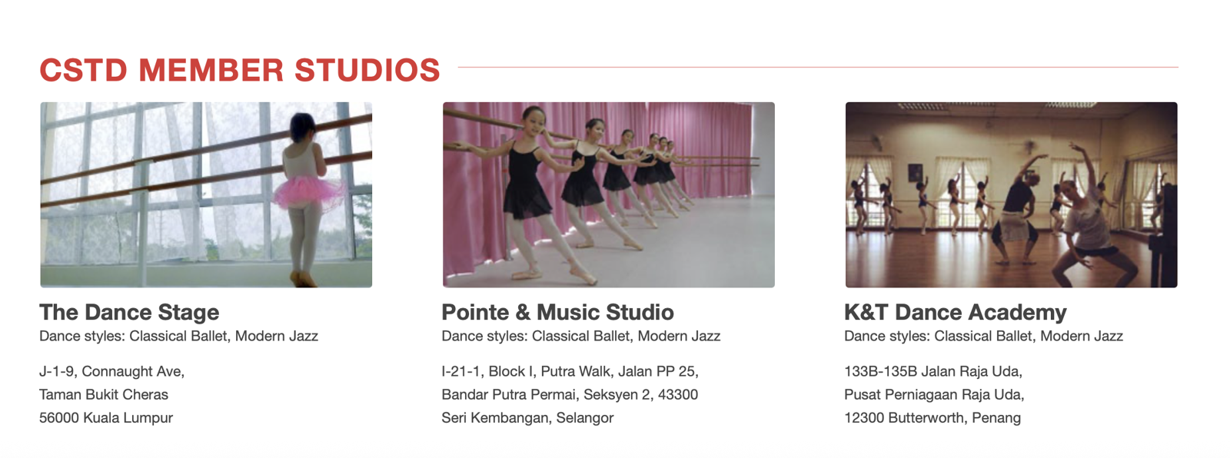

05 VISIBILITY
Where studios are listed
Studio | HiParents | CSTD Malaysia | Buro247 | CloudJoi | MyDance Alliance | Eksentrika | Pavilion Bukit Jalil
Ballotté | ✓ | – | – | – | – | – | Closed
Pointe & Music | – | ✓ | – | – | – | – | –
Angie Lee | – | – | ✓ | – | – | – | –
Great Dance | ✓ | – | – | – | – | – | –
Dance Rise | ✓ | – | – | – | – | – | –
Dua Space | – | ✓ | – | ✓ | ✓ | ✓ | –
CSTD's member studio list includes Pointe & Music
1
Ballotté appears on 2 of 7 sites; Dua Space appears on 4. Ballotté already teaches CSTD but isn't in CSTD's studio list.
2
One Ballotté-only listing: the Pavilion Bukit Jalil store directory, which mall shoppers see.
Dua Space sells show tickets on CloudJoi
Ballotté Dance Academy #Puchong
15
Notes:
Listing sites found for each studio during the research, September 2026.

Slide 16
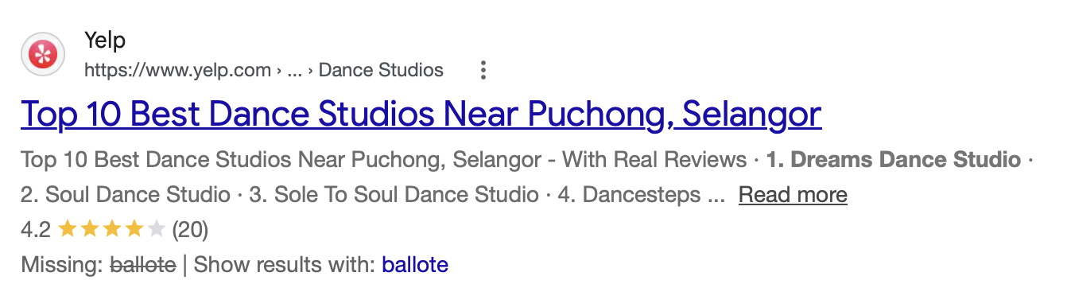
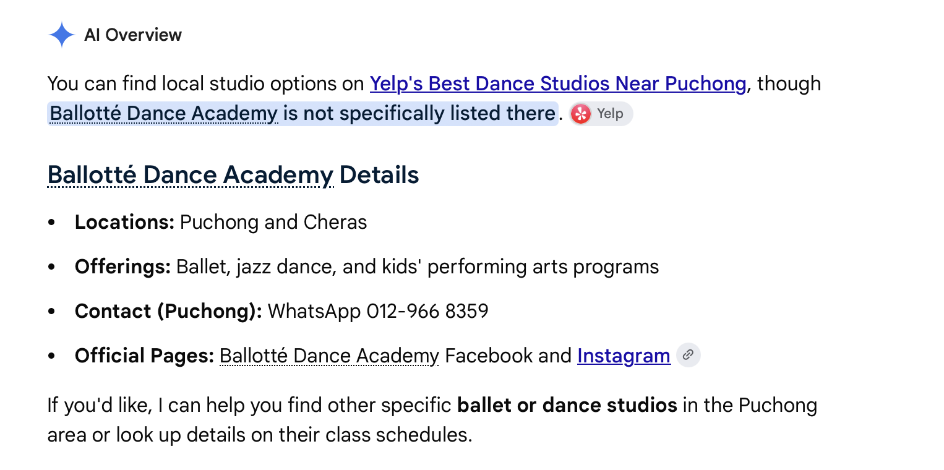
05 VISIBILITY
New places to get Ballotté seen
# | Website / article | What it is
1 | TallyPress | "Top 10 Ballet Studios in KL & Selangor" article, updated Oct 2025
2 | Little Steps Asia (KL) | Parenting guide: best dance classes for kids in KL
3 | Kiddy123 | Malaysian parenting directory of kids' classes by city
4 | Time Out Kuala Lumpur | City guide with kids' learning centre listings
5 | DTOL (Dance Teachers Online) | Directory of dance teachers and studios, Malaysia section
6 | MyPrivateTutor Malaysia | Class directory with a Klang Valley ballet page
7 | Yelp | Review site with dance studio listings
Google's AI overview points parents to Yelp's best dance studios near Puchong, and notes Ballotté isn't listed there.
1
Start with TallyPress and Kiddy123: a ballet-only list updated in 2025, and a directory parents can search by Puchong.
Ballotté Dance Academy #Puchong
16
Notes:
Seven places where parents or dance fans look for classes. Start with TallyPress and Kiddy123.

Slide 17
FINAL RECOMMENDATIONS
Nine moves to grow Ballotté
Win nearby families
Be easy to find
Grow new classes
1
Protect the home turf.
12 students live within 2 km of Angie Lee Academy. Keep them with sibling discounts and visible exam and competition results.
4
Fix the website link now.
Google's Website button opens a gambling site. Remove or replace it and add a phone number and WhatsApp button to Facebook. Remove Pavillion directory (misleading)
7
Centre on ages 4–9.
They are 76% of students. Show a clear path from baby ballet to graded exams to competitions.
2
Use referrals.
Push the existing RM50 referral discount in developments with Ballotté families (X2, Desa Impiana, Elevia), then offer demo classes at the 13 targets.
5
Launch a simple website.
Include trial-class booking, a results page and a monthly parent-tips post built from Instagram content.
8
Pilot adult barre.
Only 5 students are adults, while Angie Lee, Dance Rise and Dua Space all sell adult classes.
3
Win Cyberjaya.
Ask Cyberjaya parents why they travel, then target Setia Eco Glades, Verdi, Mutiara Ville, Sejati, Lakefront and Setia Safiro.
6
Get listed, show reviews.
Join the CSTD and RAD directories, fix the HiParents name (Ballott茅 Dance Academy), add TallyPress, Kiddy123 and Yelp, and show off the 4.8-star Google rating.
9
Put on a show.
Hold a yearly showcase or open day with a partner school and post in English and Chinese.
Notes:
Recommendations combine the original analysis (focus on Puchong and Cyberjaya, referrals, ages 4 to 9, investigating why Cyberjaya families travel) with the competitor and visibility findings.

