Slide 1
Testing Perch: FSM, Partition, Control Flow and Usage-Based Testing
Jayden Manyrath and Koen Gennis | CS 7314/5314, Fall 2026 | Prof. Jeff Tian
Project demo
Notes:
Perch is our Next.js + Supabase app that helps interns find sublets, friends and events. We applied four formal techniques and compared them against the existing test suite.

Slide 2
Each technique is matched to one kind of risk in Perch
FSM / BBT
PT / BBT
CFT / WBT
Markov-OP / UBST
Order of events
Input domains
Hidden branches
Real usage
Booking lifecycle and onboarding: approve twice, relist a taken place, two interns at once
Finance and verdict rules over salary, rent, dates, commute, safety flags
Fallback, expiry and error paths that black-box tests rarely reach
Random user sessions drawn from a usage profile, replayed in a browser
Baseline for comparison: the repository's existing 499-case Vitest suite, measured before we wrote anything.

Slide 3
The existing suite passed everything and found none of the defects
499
0 of 16
76.6%
existing test cases (baseline)
defects found by the baseline
branch coverage of the target modules
Never executed by the baseline: the listing-expiry cron route, the server-side booking transition, and the client's live-to-fixture fallback for bookings. That is where several of our defects were.

Slide 4
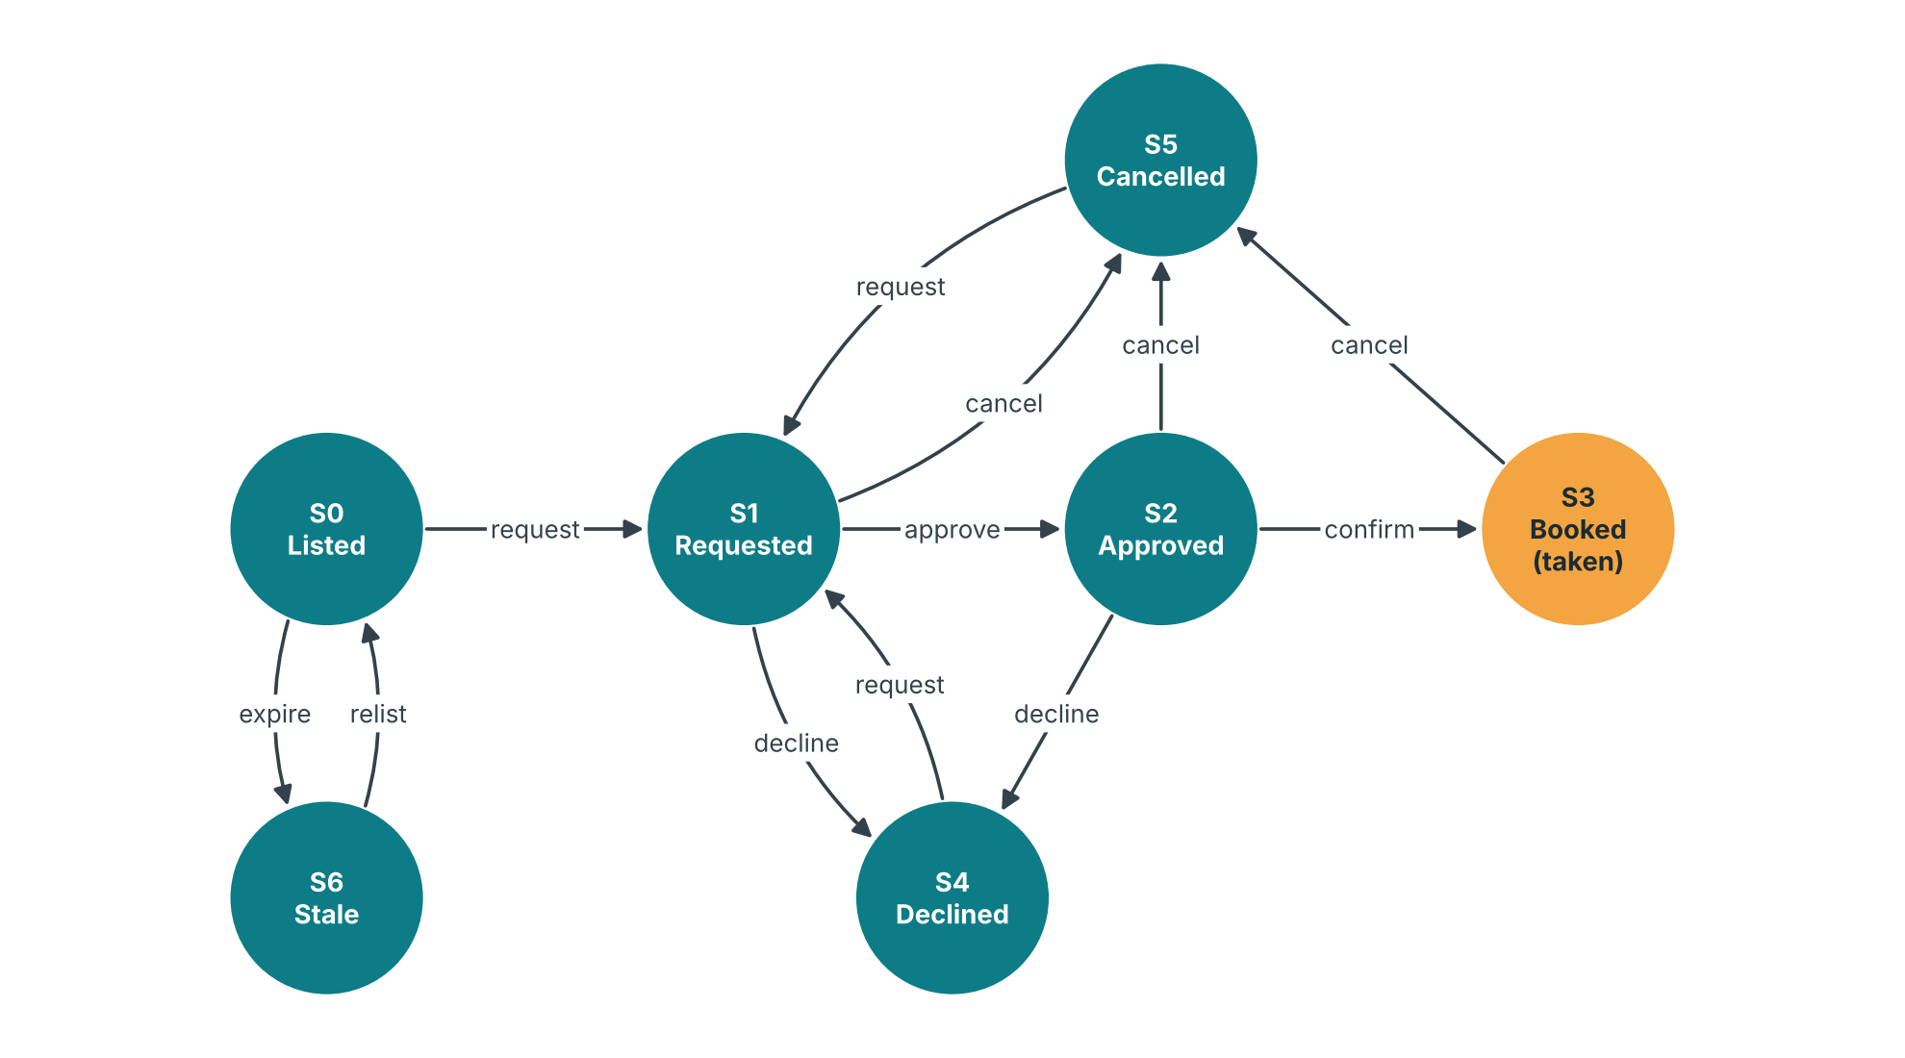
FSM: the booking state machine, tested against two implementations
13 + 18
74
valid + invalid transitions
FSM test cases
8
Taken listing could be relisted
Race loser got 500, not 409
Fixture re-approved booked stays
Onboarding accepted end < start
defects found
Demo: npm run demo:fsm | HEADED=1 npm run demo:fsm:onboarding

Slide 5
PT: partitions on salary, dates and budget found boundary defects
Pay period in the offer | Expected | Round 1
Annual "$145,000" | 145,000 | pass
Hourly "$45.00 per hour" | 93,600, flagged | 45 (D09)
Monthly "$8,000 per month" | 96,000, flagged | 8,000 (D09)
Stay dates inverted | rejected (400) | accepted (D11)
Budget below salary ceiling | stated budget used | ignored (D10)
78
partition test cases (7 inputs)
4
defects, incl. 1 high severity
All 19 hand-computed tax and rent values matched; the defects sat in the unusual classes.
Demo: npm run demo:pt

Slide 6
CFT: forcing every branch exposed a fake success on server refusals
Live mode?
Fetch
Response OK?
4xx refusal took the outage branch: fixture faked a booking (D13)
37 CFT cases over 6 control flow graphs. Fixed: a refusal now reaches the user; real outages still fall back.
Demo: npm run demo:cft

Slide 7
UBST: random user sessions from a Markov chain, replayed in a browser
1
Markov chain over 9 screens (projected profile)
2
Draw 60 random sessions per round
3
Executor replays each in Chromium
4
Oracle: wrong screen, page exception, 5xx, feature error
Demo: HEADED=1 npm run demo:ubst

Slide 8
Reliability grew from 0.83 to 1.00 after fixing what UBST found
Round 1
10 of 60 failed on the negotiate scouts (D15, no keys)
Round 2
D15 fixed; 1 failure: deck offers booking on a held listing (D16, open)
Round 3
0 of 60 failed (95% interval 0.94 to 1.00)
Sensitivity: booking or abandonment +/-50% moves R by < 0.01; negotiate use x0.5 / x1.5 moves it to 0.94 / 0.84. Two driver false positives excluded (raw numbers kept).

Slide 9
16 defects, and no defect was found by two techniques
Technique | Cases | Defects | High sev. | Kind of defect found
Baseline | 499 | 0 | 0 | -
FSM / BBT | 74 | 8 | 0 | Event order, two actors, missing transition
PT / BBT | 78 | 4 | 1 | Unusual and invalid input classes
CFT / WBT | 37 | 1 | 1 | Hidden fallback branch
Markov-OP / UBST | 180 sessions | 2 | 1 | Failures on common user paths
Walkthrough | - | 1 | 0 | Hard-coded stay dates
ODC types: Checking 8, Function 3, Algorithm 2, Assignment 2, Interface 1. 15 fixed and retested; D16 open (design decision). Course-suite failures: 25 in round 1, 0 now.

Slide 10
Live demo and next steps
npm run demo:summary prints every result on one screen.
Next: run the opt-in pilot (/pilot) with 10-15 volunteers to replace the projected profile, re-run UBST against live Supabase, and add data flow testing on the finance pipeline.

