Slide 1

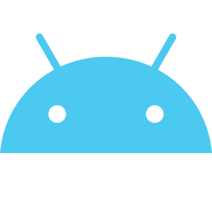
MovieTrack
Your Personal Android Cinema Companion
Android App • Kotlin + Jetpack Compose • 2025
Built for Android · Presented 2025

Slide 2




ABOUT
A modern Android app to discover, track, and review movies you love.
What is
MovieTrack?
Track Watchlist
Log movies watched, want to watch, and dropped.
Rate & Review
Give personal ratings and write quick reviews.
Stats & Insights
See your viewing habits visualised over time.
02

Slide 3




KEY FEATURES
Everything You Need
Discover Movies
Personal Watchlist
Browse trending titles, search by genre, release year, or rating using TMDB API.
Add movies to your personal list with custom status: Watched, Watching, or Planned.
Release Alerts
Statistics Dashboard
Get notified when tracked upcoming movies hit cinemas or streaming platforms.
Visual breakdowns of genres watched, ratings given, and monthly viewing activity.
03

Slide 4



APP SCREENS
Clean, Intuitive Interface
Home Feed
Movie Detail
My Watchlist
04

Slide 5
TECH STACK
Architecture
Built With Modern
Android Tools
UI Layer
ViewModel
Kotlin
Primary language
Repository
Jetpack Compose
Modern declarative UI
Data Sources
Retrofit + OkHttp
Networking & REST API
TMDB API / Room
Room Database
Local persistence layer
05

Slide 6
TRACTION & METRICS
By The Numbers
10K+
4.7★
500+
98%
Downloads
Play Store Rating
Movies in DB
Crash-Free Rate
Monthly Active Users (Jan–Jun 2025)
06

Slide 7
ROADMAP
What's Coming Next
v1.0 LIVE
✓ Shipped
v1.5 Q3 2025
v2.0 Q1 2026
v2.5 Future
→ Social sharing
→ TV Show tracker
→ AI recommendations
→ Custom lists
→ Streaming links
→ Widget
→ Dark/Light UI
→ Widgets
→ Wear OS
07

Slide 8

Let's Build the Future
of Movie Discovery
MovieTrack — Available on Google Play
github.com/yourhandle/movietrack · yourname@email.com
08

