Slide 1

SMART INDIA HACKATHON 2026
MausamSetu
Problem Statement ID: SIH26081
Problem Statement Title
Hybrid AI–NWP Multi-Model
Forecast Blending System
Theme: Disaster Management (confirm on portal)
PS Category: Software
Team ID: [Enter registered Team ID]
Team Name: HEXATECH
Notes:
Problem title corroborated against public SIH26081 listings. Official portal was unavailable during verification. Team ID and theme must match the team portal. Source template: user-supplied Problem Statement 2.pptx.

Slide 2
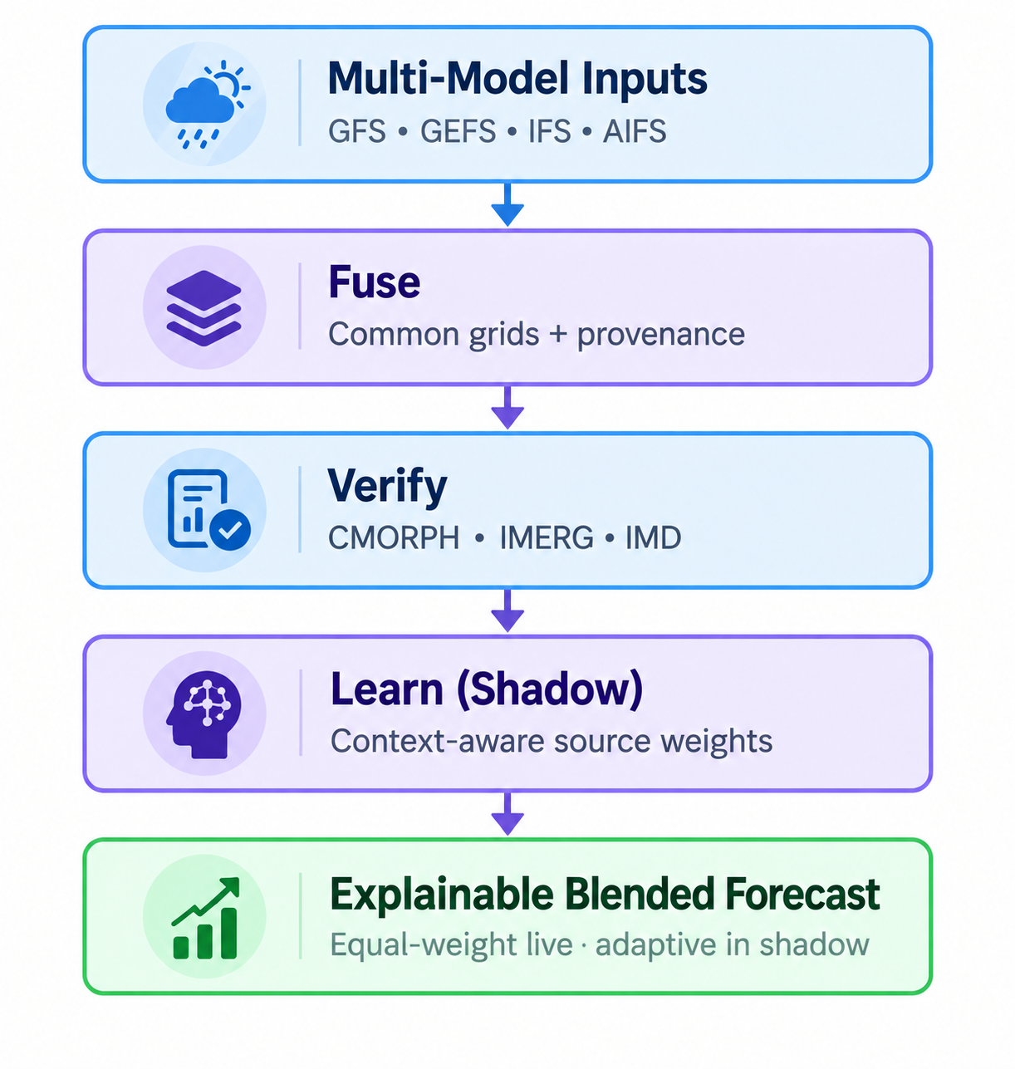
MausamSetu
HEXATECH
Proposed solution
Combine physical, ensemble and AI forecasts,
then verify which blend works for each context.
How it addresses the problem
GFS, GEFS, IFS and AIFS share consistent grids
and valid times. CMORPH, IMERG and IMD provide
separate verification scorecards.
Innovation and uniqueness
Learn context-dependent weights in a shadow workflow.
Handle unavailable sources explicitly. Preserve each
run, lead, unit and checksum for inspection.
Live: equal-weight baseline. Adaptive candidates await acceptance.
Notes:
Current architecture and scientific status: https://mausamsetu-mauve.vercel.app/sih . Live roster uses an equal-weight deterministic baseline. Backfilled data may count as historical evidence but never prospective evidence. Regime classifier and operational adaptive skill are not claimed as accepted. Original solution diagram retained from supplied deck.

Slide 3
TECHNICAL APPROACH
HEXATECH
Methodology and implementation
Stage | Implementation
Ingest and align | Validate run, lead, units and grids for GFS / GEFS / IFS / AIFS.
Verify independently | Compare exact valid windows with CMORPH, IMERG and IMD.
Learn in shadow | Train by chronology; test by event block, lead and variable.
Handle missing sources | Set unavailable-source weights to zero; renormalize valid weights.
Publish and inspect | Serve live baseline maps, source comparisons and provenance.
Technology stack
Python / FastAPI • PostgreSQL / PostGIS • xarray / ecCodes
Next.js / React / MapLibre • NumPy / SciPy • Docker Compose
Notes:
Implementation: repository outputs/mausamsetu and deployed service. References: https://nomads.ncep.noaa.gov/ ; https://www.ecmwf.int/en/forecasts/datasets/open-data ; https://gpm.nasa.gov/ ; https://imdpune.gov.in/ . The missing-source renormalization rule is a mechanism; its implementation does not imply scientific acceptance. GEFS published mean is not an individual-member distribution.

Slide 4
FEASIBILITY AND VIABILITY
HEXATECH
Feasibility demonstrated
Deployed: Vercel frontend and OCI API/workers. Four live forecast sources,
verification pipelines and MOSDAC rainfall context. Tailscale protects SSH.
9 IMD reports through 30 Sep 2026, 03:00 UTC. Adaptive acceptance remains pending.
Potential challenges and mitigation
Challenge / risk | Strategy
Late or missing model data | Track freshness and availability; expose degraded-source status.
Different grids and time windows | Normalize units and coordinates; verify matching accumulation windows.
Limited extreme-event evidence | Collect independent prospective cases; retain the baseline until gates pass.
NCUM / latest-cycle NEPS access | Use open sources now; integrate authorized Indian feeds when available.
Next: off-site restore drill, external alerts, institutional identity and scientific review.
Notes:
Observed deployment on 2026-09-28: Vercel frontend, OCI workers, public HTTPS gateway, private Tailscale SSH. MOSDAC 3SIMG_L2G_IMR contains satellite rain rates, not daily accumulations. Raw MOSDAC files stay private. OIDC and institutional distribution approvals remain external configuration. PostgreSQL is ordinary metadata storage, not a tamper-proof ledger. https://www.mosdac.gov.in/data-access-policy Update checked 2026-09-30: 9 IMD reports, latest window 2026-09-30T03:00:00+00:00. Source: https://api.140.245.4.200.sslip.io/public/status

Slide 5
IMPACT AND BENEFITS
HEXATECH
Potential impact on the target audience
Forecasters
Benefits of the solution
Inspect competing forecasts and evidence
by location, lead time and variable.
Social
Clear source provenance and accessible
preparedness resources.
Economic
Open-data prototype on modest hardware;
less manual comparison of model outputs.
Environmental
Potential support for flood, heat and wind
preparedness after local validation.
Disaster managers
Use traceable forecast context alongside
official warnings for preparedness.
Farmers and institutions
Support weather-sensitive planning
through reviewed, locally validated guidance.
Expected benefits; no measured reduction in losses or validated operational advantage claimed.
Notes:
Benefits are anticipated, not measured outcomes. Guidance remains experimental and does not replace official warnings. Current prototype: https://mausamsetu-mauve.vercel.app/ ; preparedness resources: https://mausamsetu-mauve.vercel.app/preparedness .

Slide 6
RESEARCH AND REFERENCES
HEXATECH
Historical temperature result: 10.9% lower CRPS
WeatherBench 2 IFS-HRES + Pangu against ERA5, India-region bounding box.
Adaptive 0.5494 °C vs equal mixture 0.6164 °C. 36 held-out 2022 initializations.
Retrospective temperature experiment. ERA5 is reanalysis. Results do not establish
operational rainfall, wind or extreme-event superiority.
Preliminary rainfall shadow evaluation: +24 h
GFS / GEFS / IFS / AIFS. CRPS against CMORPH: 1.737 vs 1.811 (4.1% lower).
IMERG cross-reference: 1.549 vs 1.630 (5.0% lower). Adaptive vs equal weighting.
Only 2 held-out event blocks. Experimental candidate, not deployed.
Lower CRPS indicates better probabilistic performance. Production gates remain unmet.
References: NOAA / ECMWF / WeatherBench 2 / CMORPH / NASA IMERG / IMD / MOSDAC
Full source links and methodology: https://mausamsetu-mauve.vercel.app/sih
Live prototype and evidence: https://mausamsetu-mauve.vercel.app/sih
Source code: https://github.com/Jaydeng75/mausamsetu
Notes:
Benchmark source: https://mausamsetu-mauve.vercel.app/data/learned-benchmark.json . Exact CRPS values: 0.5493621002156572 adaptive and 0.6164464643151205 equal mixture; relative reduction 10.88%. Calibration 2018; training 2019–2020; selection 2021; test 2022. 36 test initializations, 12 monthly bootstrap blocks. India bounding box includes adjacent countries and ocean. Upstream training not audited. Different source roster from live deployment; no production acceptance. Sources: https://weatherbench2.readthedocs.io/ ; https://cpc.ncep.noaa.gov/ ; https://gpm.nasa.gov/ ; https://imdpune.gov.in/ ; https://mosdac.gov.in/ ; https://rds.ncmrwf.gov.in/datasets ; https://ecds.ecmwf.int/ . Rainfall source: https://api.140.245.4.200.sslip.io/public/shadow-rain generated 2026-09-30T16:45:31.283148+00:00. CMORPH adaptive CRPS 1.737108844754547, equal 1.8110764331844271. IMERG adaptive 1.5490775850262901, equal 1.6303490958977416. 2 held-out blocks, 10 total, 2 prospective. Dedicated rainfall pipeline, distinct from multi-variable candidates. Not production accepted.

