Slide 1

Weather App
Presented by : JAYDEO SAHU

Slide 2
Problem Statement
I need to develop a weather Application that allows users to view weather forecast details for a particular city and save the cities to favorites/Wishlist. The application will fetch weather details by registering with the OpenWeatherMap API and get API Key required to call the API.

Slide 3
Objective
Objective of Weather App:
View weather forecast of a city
Search for a city
Add favorite city
View favorite cities

Slide 4
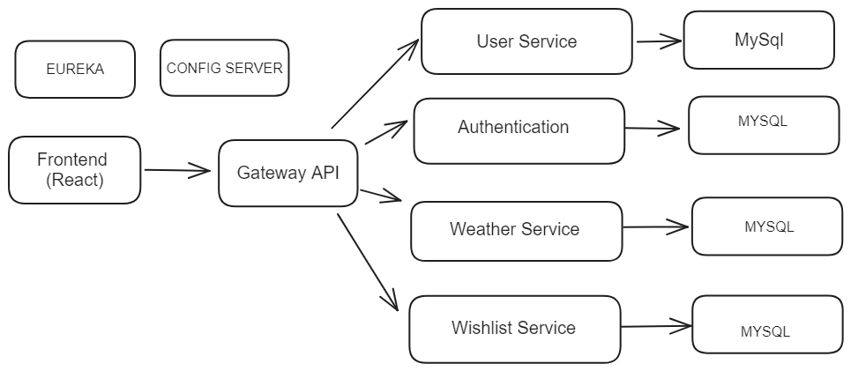
Application Architecture

Slide 5
OpenWeatherMap API
This is an external API provides weather detail
This API will provide location detail
According to location details responds with weather detail

Slide 6
User Service
It will register new user
It will validate the details sent by user

Slide 7
Authorization Server
It will perform login
It will validate credential
Provides JWT Token

Slide 8
Weather Service
Communicates with external API
Searching for city

Slide 9
Wishlist Service
As a user one can save city
Can view list of cities
Can delete saved cities

Slide 10
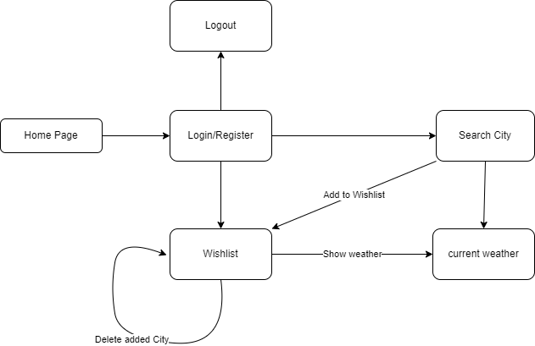
Flowchart

Slide 11
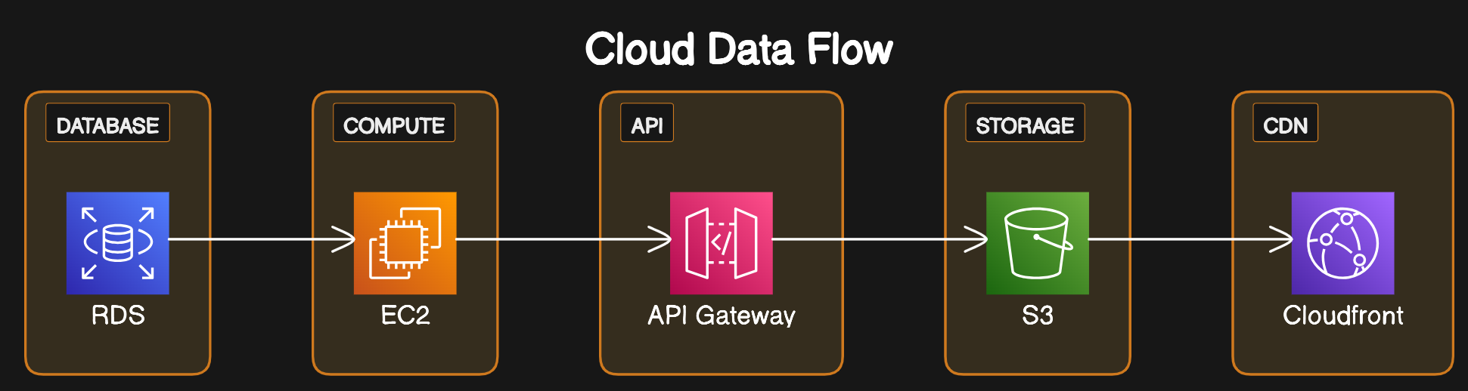
Cloud Diagram

Slide 12
Tools and Technology Used
React
Spring boot
Java
MySql
Visual Studio Code
Git
Lombok
Gitlab
Swagger
STS
Maven
JWT
Maven

Slide 13
Conclusion
The weather app will help in
checking weather online
Keeping track of selected cities
Can mark the favorite city
Keep a list of favorite city

