Slide 1
Project 1 - Group (30%)
Introduction to Artificial Intelligence 02
Book Recommendation Engine
Jaydip Dobariya
Bhavik Gajera
Vishalbhai Barvaliya
Ana Garcia

Slide 2
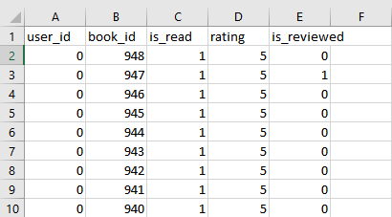
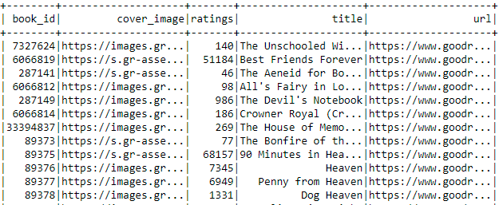
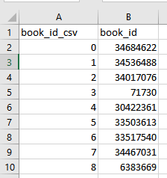
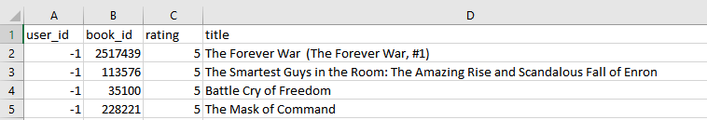
Goodreads Interactions
Goodreads_books
Book_id Map
Liked books

Slide 3
Goodreads_books
In this dataset we have all the information about all the books like book_id, title, ratings, url, image and all those things.
In this project we are loading this data into spark dataframe and cleaning it and again after cleaning this data we are stroring this data back to json file.

Slide 4
Goodreads_interactions
In this dataset we have all the rating given by users
Dataset contains fields like user_id, book_id, rating etc.
We use this dataset to get all the users who has rated same books which we like and after that we will get all the books rated by all these users and recommend these books after some optimization.

Slide 5
Book_id Map
In book_id map dataset we have mapped id to map book_id from goodreads_books to goodreads_interactions
We use this dataset to map book information between goodreads_books dataset and goodreads_interactions

Slide 6
Liked_books
In this dataset we have informations of all those books which we like
Based on this dataset we will get other users who have rated these books which we like and get recommended books.

Slide 7
Steps we have done in this project
Loading Data and cleaning it
After cleaning saving it into JSON data format for further use
Loading data of books which we like
Getting all the users who have rated books we have liked
Getting the books rated by users who have rated books which we like
Getting top books from those books
Recommending those books in a proper format

