Slide 1


MoBot
BIRLA VISHWAKARMA MAHAVIDYALAYA
A.Y:-2016-17
(UDP)
Team Members: Faculty Guide:
Eva Khakhkhar (130080116012) Prof. Chintan Mahant
Jaydip Gabani (130080116013)
Hit Kalariya (130080116016)
Manan Trivedi (130080116027)

Slide 2
Overview
Abstract
Many technologies are evolving day by day.
One such promising concept is Human – Machine Interface.
This novel application involve interaction between humans and robots where the robots must coordinate their efforts with their human owners.
The proposed technology will have no such limitation and will instead depend on gesture recognition technology.

Slide 3
Overview
Introduction
We will be using ARDUINO board and Accelerometer embedded with it.
This combination is used to read the movements of hand for moving the robot accordingly.
The open source ARDUINO Software IDE makes it easy to write code and upload it to the board.

Slide 4
Overview
Purpose
The purpose of the MoBot is for spying. User can get the live streaming of the situation without getting himself/herself physically involved.
User can control the robot with hand movements, there are no wires used for conection.

Slide 5
Overview
Scope
It can be used for military base for spying. It can be used for security of home. It can be used by anyone who is having knowledge of how to operate this robot.
It is very useful where humans can’t go physically at that time getting the live situation of particular place MoBot can be used.

Slide 6
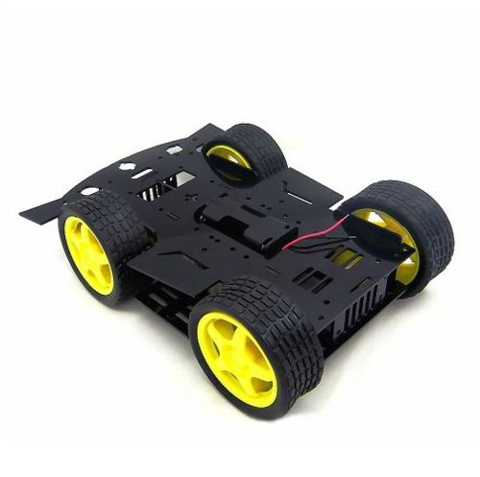
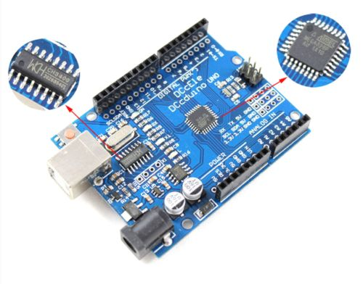
Modules
SEM-7: IMPLEMENTED
Robot Development
Robot Movement
Front
Back
Right
Left

Slide 7
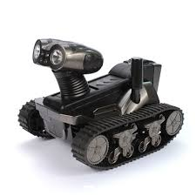
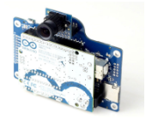
Modules
SEM-8:
Connection between Robot and Accelerometer
RF connection
Movement of robot through hand gestures
Spy Camera
Live streaming from robot to phone
TIME DURATION : 1 YEAR

Slide 8
Module Description
Connection between Robot and Acceleometer
The connection is done through RF-Transmitter and RF-Receiver. According to the movements of our hands, the accelerometer will calibrate and send the readings to the receiver side through RF-Transmitter.
The RF-Receiver will receive the readings and send it to the Arduino board. The Arduino board will then act according to the program written based on the readings and the movement of robot will be done.
Spy Camera and Live Feed
There will be a camera that will take videos and these will be transmitted to the phone or a computer.
This will work as live streaming in case of video.

Slide 9
SRS
Click Here For The SRS

Slide 10
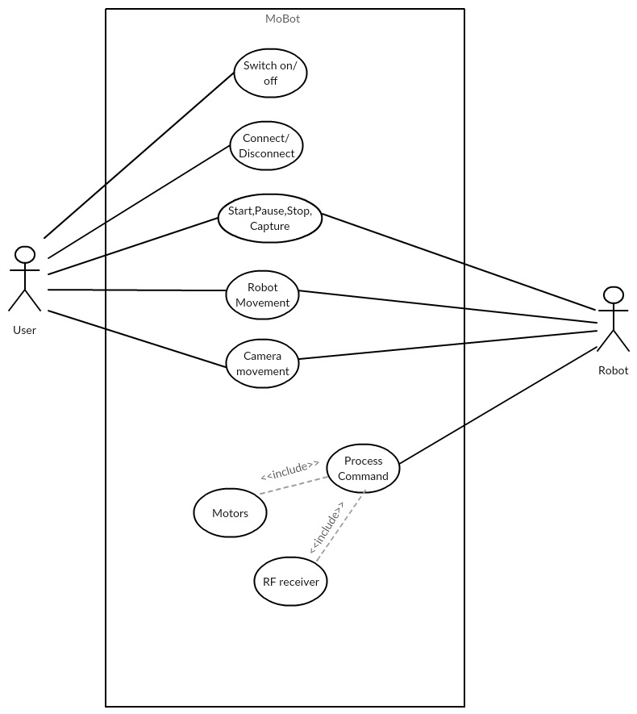
USECASE

Slide 11
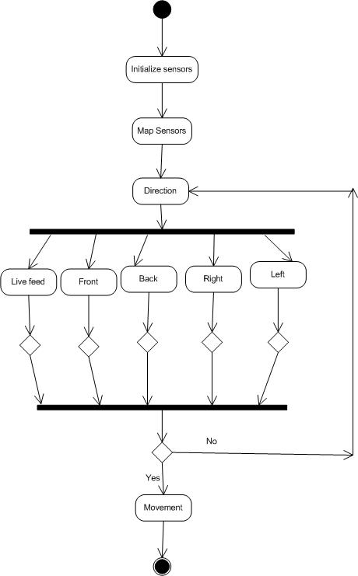
ACTIVITY

Slide 12
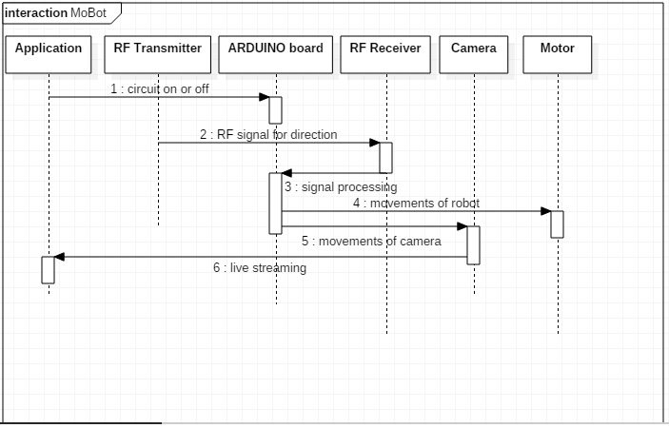
SEQUENCE

Slide 13
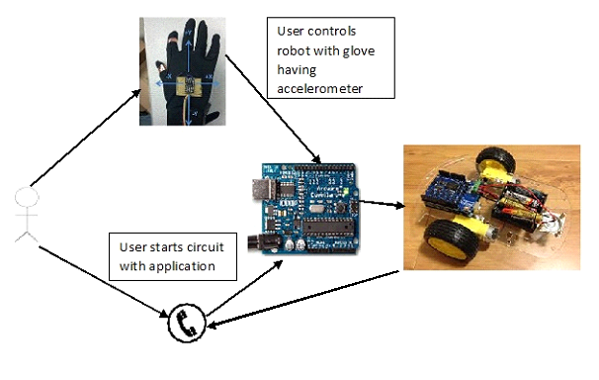
CIRCUIT DIAGRAM

Slide 14
Technologies
ARDUINO BOARD
ARDUINO IDE
OPEN C
ACCELEROMETER
ARDUINO WIFI SHIELD/BLUETOOTH

Slide 15
THANK YOU

