Slide 1
Municipality Management System
Jaydon Ellick
20230443
ADP631_FA1

Slide 2
System Overview
A web-based system for managing municipal services
Handles citizen management, service requests, staff management, and reports
Built with ASP.NET Core MVC and Entity Framework Core

Slide 3
Design Choices
Uses ASP.NET Core MVC for a structured web application
Implements Entity Framework Core for database interaction
xUnit For Unit Testing
In-Memory Database for testing
Responsive UI for accessibility across devices

Slide 4
Project Features
Citizen Management
Register/Edit/Delete/View Citizens
Service Requests
Submit, Update, View Services
Staff Management
Create/Edit/Delete And View Staff
Report
Citizens submit reviews and staff delete or update them.

Slide 5
Technical Implementation
Database: SQL Server with EF Core
Backend: ASP.NET Core Empty
Frontend: Razor Views with Bootstrap for styling
Testing: xUnit And In-Memory Database

Slide 6
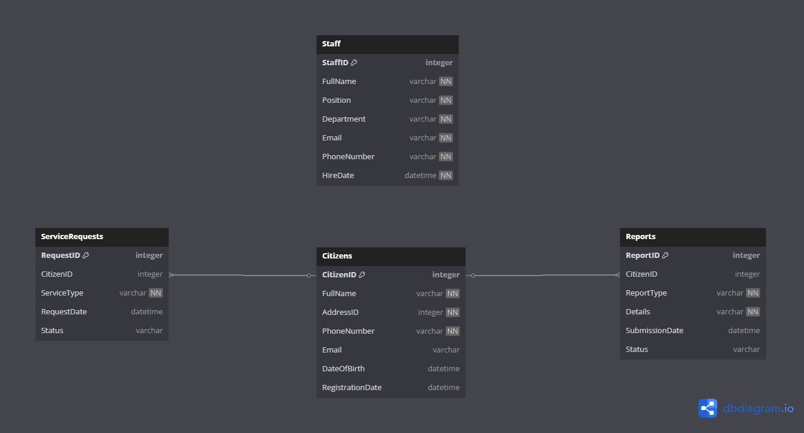
Database Design

Slide 7
User Experience Considerations
Intuitive navigation and responsive UI
Easy-to-use forms for submitting service requests and reports

Slide 8
Challenges Faced
Excessive document typing.
Learning how to do Unit Tests
The unit tests not working unless testing them one by one.
Routing errors

Slide 9
Conclusion
Municipality Management System simplifies municipal services
Provides an efficient, user-friendly to perform these task.
Ensures better communication between citizens and the municipality

