Slide 1
IDP REVIEW II
RESQ-Green
Predictive ambulance routing with just-in-time green corridors
A routing and signal-preemption platform that fuses city-scale traffic forecasts with what the ambulance itself can see, then clears only the intersections it will actually use.
Working prototype
180 recorded runs
Study area
21 automated tests passing
6 baselines x 6 scenarios
Thousand Lights, Chennai
Team: <Member 1> . <Member 2> . <Member 3> Guide: <Guide name>
Review II . 23 September 2026 . 10 minutes, presentation and panel Q&A
Notes:
Open with the one-line pitch: we route the ambulance on traffic predicted for the moment it arrives, and we turn the lights green only as late as is safe. Say up front that a working prototype runs today and can be shown live.

Slide 2
PROBLEM AND MOTIVATION
Minutes decide outcomes, and junctions eat the minutes
43%
1.87
2-5 min
Green on arrival
Stops per trip
Crowd data lag
An ambulance meets green at fewer than half the junctions in our no-system baseline runs (B0, 30 runs).
Every stop costs acceleration time in dense mixed traffic of cars, autos and two-wheelers.
Aggregated traffic describes the recent past, so a blockage that formed minutes ago is invisible to it.
Why existing answers fall short
The Chennai case
Optical and GPS preemption trigger at a fixed distance: too early when the road is clear, too late behind a long queue.
Navigation apps route on crowd-sourced traffic alone and cannot see the road in front of the vehicle.
Neither coordinates the signals along the route, nor repairs the cross-street queues it creates.
Study area: Thousand Lights, around Apollo Hospitals on Greams Road.
Dense signalised grid with parallel arterials, so a real routing choice exists.
Mixed, lane-less traffic: autos and two-wheelers dominate and generic detectors miss them.
Baseline figures are measured in our own prototype runs, not quoted from vendors.
Notes:
Frame the problem as timing, not detection. Detecting an ambulance was solved decades ago; deciding when to act, and on which route, is not.

Slide 3
REQUIREMENT ANALYSIS
Every requirement traces to a gap we found in the literature
Gap in current systems | Requirement it created | Module
Fixed-distance trigger wastes cross-street green | FR6 Trigger from queue-clearance time, not distance | corridor/
Crowd traffic data is minutes old | FR3 Detect queue and blockage within 150 m onboard | perception/
Two sources disagree and nothing arbitrates | FR4 Fuse both by confidence, not by preference | fusion/
Drivers deviate and reservations go stale | FR5 Replan continuously, cancel obsolete reservations | routing/
Cross traffic left disrupted after passage | FR7 Queue-debt recovery before normal coordination | corridor/
Learned models given direct control of lamps | NFR1 Deterministic safety kernel owns all transitions | corridor/
Vendor and simulator lock-in | NFR5 One schema, swappable SUMO, CARLA and Google adapters | adapters/
How we gathered them
Three generations of preemption: optical, GPS and cloud, standards-based V2X.
Eight commercial and municipal systems studied for architecture, not marketing claims.
Standards: NTCIP 1202 and 1211, SAE J2735 and J2945/B, IEEE 1609.2.
Academic work: queue-discharge preemption, EMVLight routing, EMGLight recovery.
Output: 8 functional and 6 non-functional requirements, each owned by one module.
Notes:
If asked how requirements were validated: each functional requirement has at least one automated test, and the safety requirement is asserted in every recorded run.

Slide 4
OBJECTIVES AND SCOPE
What the project must prove, and what it deliberately leaves out
Objectives
In scope
O1 Estimate and forecast per-road traffic from probe data, 5 to 30 minutes ahead.
O2 Detect queues and blockages from ambulance camera and LiDAR within 150 m.
O3 Fuse both sources by confidence and route on the traffic predicted at arrival time.
O4 Clear the next two or three junctions just in time, then repair the cross-street queues.
Full software stack: simulation, ML, fusion, routing, signal control, web app.
SUMO for traffic, CARLA for camera and LiDAR, Google Routes for a live map mode.
Seeded B0 to B5 evaluation with recorded, repeatable runs.
Research questions
Out of scope
Does fusing onboard perception with macro forecasts cut travel time when data is stale?
No physical hardware and no control of any public traffic signal.
No V2X radio stack or certificate authority; the message design allows it later.
No civilian mobile app; crowd probes are simulated or come from Google at run time.
RQ1
RQ2
Does just-in-time preemption beat fixed-distance on both ambulance and cross-street delay?
RQ3
How far does crowd-probe adoption (5, 10, 30 percent) change route quality?
Notes:
Stress that the out-of-scope list is a safety and honesty decision, not a shortcut. A student project must never drive a real signal head.

Slide 5
SYSTEM DESIGN AND ARCHITECTURE
Four stages, one contract, swappable data sources
INPUTS
UNDERSTAND
DECIDE
ACT AND SHOW
Crowd-GPS probes
Aggregator
Fusion engine
Signal control
adoption, GPS noise, dropout, upload lag
map-match probes to per-road speed
inverse-variance travel time and confidence
phases written only through the safety kernel
Google Routes API
>
Forecaster
>
Routing engine
>
Recorder
live duration against static duration
historical and graph baselines, 5 to 30 min
time-dependent path, hysteresis reroute
every run stored with its seed
Ambulance sensors
Perception
Corridor controller
Web app
CARLA camera and 32-channel LiDAR
tracks, blockage, 1 to 3 s prediction
JIT trigger and safety state machine
Live, Replay, Cab, Results
Adapter boundary
Simulator objects never cross schema/models.py. The decision modules cannot tell whether a road observation came from the built-in simulator, SUMO, CARLA or Google, so the code we evaluate is the code that would later be deployed. An adapter missing its dependency fails loudly instead of substituting invented data.
Notes:
The architecture answer the panel wants: one versioned contract, three interchangeable sources, and a deterministic controller at the end that machine learning can advise but never bypass.

Slide 6
CORE TECHNICAL IDEA
Two views of the same road, weighted by trust
Macro . whole city, minutes old
Onboard . next 150 m, seconds old
Probe vehicles report position and speed with noise, dropout and upload lag.
Adoption is a parameter, so accuracy can be measured at 5, 10 and 30 percent.
Google Routes supplies the same signal in live-map mode, at run time only.
Camera detections are tracked, so a vehicle stopped beyond three seconds becomes a queue.
LiDAR clusters confirm distance and the tail of the queue.
Short-horizon prediction answers whether a gap opens in the next one to three seconds.
t = ( t_macro / var_macro + t_onboard / var_onboard ) / ( 1 / var_macro + 1 / var_onboard )
Inverse-variance fusion: each source contributes in proportion to how certain it is.
Macro variance grows
Onboard variance grows
Hard override
with the forecast horizon and with the age of the feed
with distance ahead and with lower detection confidence
a blockage above 0.9 confidence marks the road near-closed
This is the part a navigation app cannot do: the 150 m in front of the ambulance is data nobody else has.
Notes:
If the panel asks why not simply trust the camera: it sees only the current road. The forecast covers the rest of the route, minutes before the ambulance gets there.

Slide 7
CONTROL ALGORITHM
Act as late as is safe, then give the cross streets their green back
T_clear = T_startup + Q / s + T_transition + T_margin act when T_ambulance <= T_clear
Q is the queue ahead in PCU from the fusion engine . s is the discharge rate . T_transition is amber plus all-red . T_margin is twice the ETA uncertainty
Extend
Early green
Pre-clear
No action
Already green for the ambulance: hold it, inside the maximum-green limit.
Conflicting phase running: end it through amber and all-red, then serve.
Long queue ahead: start early enough to empty it before arrival.
Arrival falls on a natural green. Knowing when not to intervene matters.
Deterministic safety state machine
NORMAL
>
REQUEST VALID
>
PRE-CLEAR
>
SAFE TRANSITION
>
EV SERVICE
>
EV PASSED
>
RECOVERY
Minimum green, amber and all-red are never shortened, in any state.
A reservation expires after 3 s unless renewed, and a watchdog ends any preemption that overruns.
Conflicting greens are impossible by construction, and every recorded run asserts it: 0 violations in 180 runs.
Machine learning proposes; the state machine disposes. No model writes a signal phase directly.
Notes:
This slide answers the safety question before it is asked. The formula decides when, the state machine decides whether it is legal.

Slide 8
COMPONENT AND TOOL SELECTION
Chosen for evidence and cost, not familiarity
Layer | Chosen | Also considered | Why this one
Traffic simulation | Eclipse SUMO with TraCI | VISSIM, Aimsun, MATSim | Free and scriptable, has an emergency-vehicle rescue-lane model, and a CARLA bridge.
Sensor simulation | CARLA 0.9.x | AirSim (retired), rendering inside SUMO | Real camera and LiDAR frames, co-simulates with SUMO, and fits our 8 GB GPU.
Detection | Ultralytics YOLO with ByteTrack | Faster R-CNN, RT-DETR | Real time on one GPU and straightforward to fine-tune on Indian classes.
Training data | India Driving Dataset | COCO, BDD100K | Contains autorickshaws and lane-less traffic, which western sets do not.
Forecasting | Graph WaveNet or STGCN | ARIMA, per-road LSTM | Congestion propagates along connected roads, which a graph model represents directly.
Backend | FastAPI with Pydantic | Flask, Django | Async WebSocket streaming and a typed schema shared with the browser.
Frontend | React with MapLibre GL | Google Maps JavaScript API | No licence cost or key in the browser, and vector layers render our own data.
Run store | SQLite with Parquet | PostgreSQL | Zero-setup reproducibility: every run carries its seed and baseline.
Every choice is free for academic use, runs on one laptop with an 8 GB GPU, and keeps the work reproducible by a reviewer.
Notes:
Be ready to defend two of these: SUMO over VISSIM on licence and scripting, and CARLA over pure SUMO because SUMO has no camera frames at all.

Slide 9
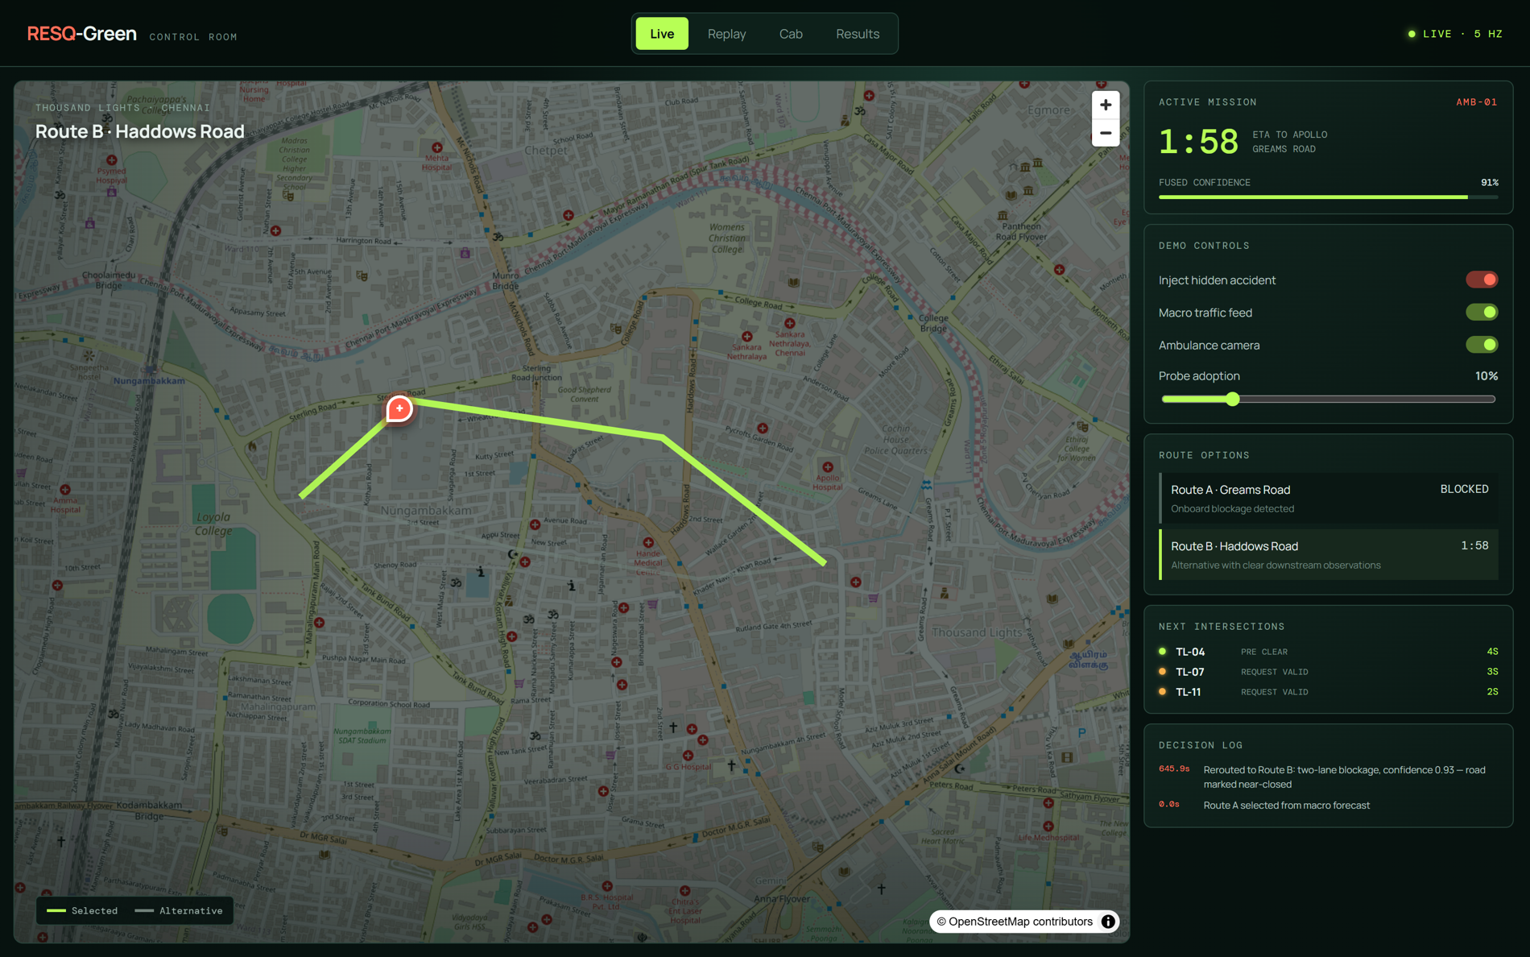
INITIAL PROTOTYPE
A vertical slice already runs end to end, not a set of stubs
Eleven Python modules plus a React app: simulation, probes, forecasting, perception, fusion, routing, corridor, recorder, adapters, API and experiments.
REST plus a 5 Hz WebSocket stream; the browser renders live routes, reservations and the decision log.
A seeded experiment runner writes every run to SQLite, so any result on screen can be reproduced.
SUMO, CARLA and Google adapters are written and report their own readiness instead of faking data.
21 automated tests pass, with lint and build wired into GitHub Actions.
2,240
21
lines of Python
tests passing
Live control room: fused speeds, route options with ETA, the next reservations, and the reason recorded for every decision.
4
180
web workspaces
recorded runs
The rubric asks for roughly 20 percent. We are past that: a walking skeleton of every module is live and tested.
Notes:
Show the running app here if the projector allows. Otherwise the screenshots carry the same evidence.

Slide 10

PROTOTYPE WALKTHROUGH
The hidden accident: when the map is wrong
1
Macro forecast picks Route A, and the corridor starts reserving junctions on it.
2
A two-lane blockage forms. The crowd feed still reports the road as clear.
3
Onboard perception sees stopped vehicles ahead, so fusion marks the road near-closed.
4
Route B is selected and the stale reservations on Route A are cancelled.
5
Junctions on Route B pre-clear their queues just before arrival.
Decision log, taken from the running app
"Rerouted to Route B: two-lane blockage, confidence 0.93 - road marked near-closed"
Measured reroute reaction time: 0.6 s from detection to a new route with the old reservations cancelled.
Notes:
This is the demo to run live if there is time. It is also the scenario that justifies the second input in one sentence.

Slide 11
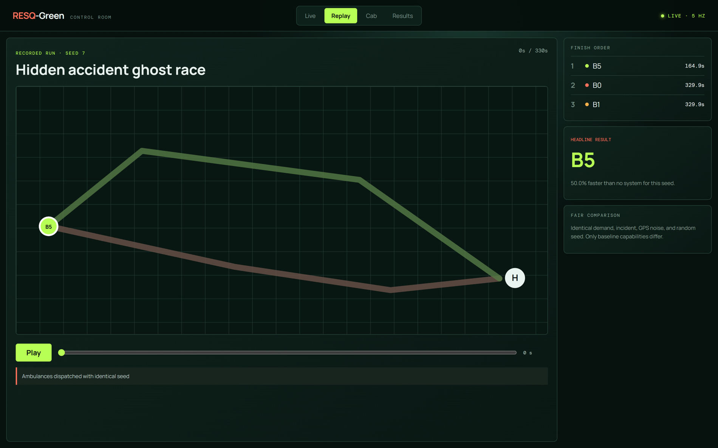
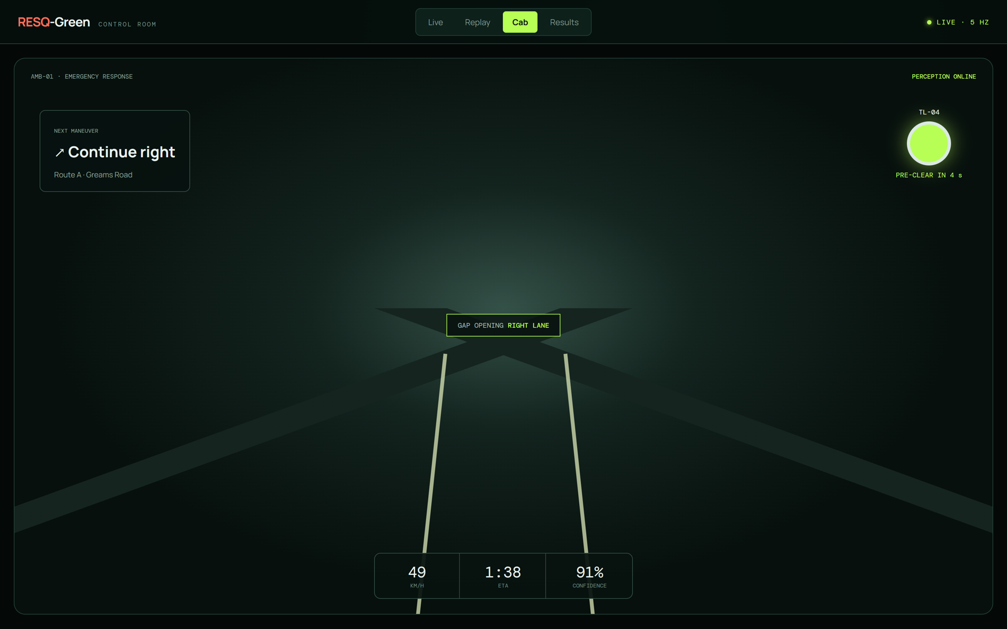
EVIDENCE WORKSPACES
Same seed, three systems, one honest comparison
Ghost race replay
Three ambulances, identical demand, incident and random seed.
Only the baseline capabilities differ, so the gap is the system, not luck.
Seed 7: B5 finishes in 164.9 s against 329.9 s with no system.
Ambulance cab view: next manoeuvre, next signal state, perception confidence and the gap-opening hint.
Notes:
The replay page exists because a live demo can go wrong. Every recorded run replays deterministically from its seed.

Slide 12
MEASURED RESULTS
180 seeded runs: six baselines across six scenarios
49%
Faster in the hidden-accident case
323.7 s with no system, 163.8 s with B5
43% to 96%
Green on arrival, B0 to B5
Stops per trip fall from 1.87 to 0.00
0
Cross-street delay caused by preemption: 112 s fixed-distance to 63 s just-in-time to 39 s with recovery
Conflicting-green events
Asserted in all 180 recorded runs
Measured on the built-in mesoscopic runner: 5 seeds x 6 scenarios x 6 baselines. Transport claims will be re-measured on the verified Chennai SUMO network with 20 or more seeds before Review III. Targets in the plan remain targets.
Notes:
Say plainly that these numbers validate software integration, not Chennai traffic. That distinction is what separates this from a project that over-claims.

Slide 13
INNOVATION AND FEASIBILITY
What is genuinely new, and why three people can finish it
Dimension | Typical student project | Commercial systems | ResQ
Trigger | Distance threshold | Distance or ETA based | Queue-clearance time, computed per junction
Traffic input | One source | Crowd or fleet data | Two sources fused by confidence
Fresh incident | No reaction | Waits for the feed to update | Onboard detection, reroute in 0.6 s
Cross traffic | Ignored | Returns to the normal plan | Queue-debt recovery, and it is measured
Role of ML | Drives the signal | Proprietary and opaque | Advisory only, safety kernel decides
Evidence | One demo run | Vendor aggregates | 180 seeded runs, each replayable
Feasibility
Cut lines if we fall behind
Hardware cost is zero: everything runs on one laptop with an 8 GB GPU.
All tools are free for academic use, and the core demo needs no API key.
The riskiest integration, CARLA with SUMO, has a built-in town map as fallback.
Drop the sequence-model rung of the forecaster ladder first.
Then Google live-map mode, then the second-hospital feature.
CARLA last: keep one showcase run rather than every scenario.
Notes:
Innovation claim in one line: we decide when to preempt from traffic physics, and we prove it with a seeded matrix instead of one lucky run.

Slide 14
PROJECT PLANNING
Thirty-six weeks, with the walking skeleton already standing
W1-3
W4-9
W10-16
W17-23
W24-29
W30-36
Foundations
Chennai twin
First loop
Corridor, CARLA
Showcase
Evidence
spec, schema, repo, CI
map clean-up, demand, probes
forecaster, routing, Live page
JIT, safety kernel, co-simulation
scenarios, replay, results pages
20-seed matrix, report, viva
Where we stand today
Next milestones
Foundations are complete, and a vertical slice of every later phase already runs.
The build order was deliberate: integrate first, then deepen each module in place.
The schema was frozen in week 3, so the three workstreams now move independently.
M3 W23
Verified Chennai SUMO network, CARLA frames feeding perception
M4 W29
Feature freeze: all six scenarios recorded and replayable
M5 W34
Twenty-seed matrix, ablations, report and paper draft
M6 W36
Final demo and viva
Notes:
If asked why the prototype exists so early: building the skeleton first removes integration risk, which is the usual reason student projects fail in the last month.

Slide 15
TEAMWORK AND INDIVIDUAL CONTRIBUTION
Three owners, disjoint modules, one shared contract
1
<Member 1>
2
<Member 2>
3
<Member 3>
Simulation and signals
Prediction and routing
Perception, CARLA and web
sim/ . corridor/ . experiments/
forecast/ . fusion/ . routing/ . api/
perception/ . adapters/ . web/
Chennai network and demand
Probe generator and virtual sensor
JIT trigger, safety kernel, recovery
Seeded experiment runner
Forecaster ladder and metrics
Inverse-variance fusion model
Time-dependent routing and hysteresis
FastAPI services and schema
Detection, tracking, blockage logic
CARLA sensor rig and co-simulation
Live, Replay, Cab and Results pages
Recorded demo runs
Shared discipline: weekly integration session . one versioned schema . every module has tests . each member presents and defends their own modules today
Notes:
Replace the placeholders with real names before the review. Each member should answer questions about their own modules, which is what the individual mark rewards.

Slide 16
From here to Review III
Verify the Chennai network
Check every junction, signal timing and turn restriction by hand, then calibrate demand.
Thank you
Train the real models
Questions welcome. Each member answers for the modules they own.
Graph forecaster on benchmark data plus simulated history, detector fine-tuned on Indian classes.
Bring CARLA into the loop
Rendered camera and LiDAR feeding the same perception code, recorded for the showcase.
Live demo ready
Live, Replay, Cab and Results, with the hidden-accident control on the Live page.
Run the full matrix
Twenty seeds per cell, ablations with fusion off, and the adoption sweep for RQ3.
ResQ . IDP Review II . 23 September 2026
Notes:
Close on the next-steps list so the panel sees a project with momentum, then offer the live demo.

Slide 17
BACKUP SLIDE
Questions we expect, and the short answers
How is this different from Google Maps?
Is 5 to 10 percent probe adoption enough?
Google cannot see the road ahead of the ambulance, cannot forecast per road for the arrival moment, and cannot hold a signal.
Speed, not vehicle count, is the estimator, and adoption is a measured parameter in the matrix. That is RQ3.
What if the camera is wrong?
Could this run on a real junction?
Confidence weighting limits its influence, the macro forecast still covers the route, and the safety kernel is unaffected.
Not by us. Deployment needs an approved controller interface, road-authority permission and a shadow-mode trial first.
Why not reinforcement learning end to end?
How do you know the results are real?
It cannot be safety-assured. RL may later tune recovery timing inside the limits the state machine enforces.
Every run carries a seed and a baseline, all 180 are stored, and the replay reproduces them exactly.
Notes:
Do not present this slide. Jump to it only if the matching question comes up.

Slide 18
BACKUP SLIDE
Mean ambulance travel time by scenario, in seconds, 5 seeds each
Scenario | B0 none | B1 macro | B2 fixed | B3 fused + fixed | B4 JIT | B5 JIT + recovery
Off-peak | 132.9 | 134.4 | 100.8 | 98.1 | 95.1 | 95.1
Evening peak | 183.7 | 186.0 | 152.4 | 148.9 | 145.9 | 145.9
Saturated | 229.7 | 229.7 | 196.0 | 194.8 | 191.8 | 191.8
Hidden accident | 323.7 | 323.7 | 293.5 | 167.1 | 163.8 | 163.8
Stale macro feed | 234.1 | 234.1 | 203.9 | 176.7 | 173.5 | 173.5
Camera degraded | 183.7 | 186.0 | 152.4 | 148.9 | 145.9 | 145.9
All scenarios | 214.6 | 215.6 | 183.2 | 155.7 | 152.7 | 152.7
B4 and B5 share a travel time by design: recovery repairs cross traffic after the ambulance has passed, and cross-street delay falls from 63 s to 39 s.
B1 tracks B0 because macro-only routing cannot see an incident the feed has not yet reported.
Camera-degraded currently mirrors evening peak in the built-in runner; separating its parameters is a Phase-2 task.
Source: runs/resq_green.sqlite3, 180 recorded runs, regenerated with: uv run python -m experiments.runner
Notes:
Use this table if the panel asks for the numbers behind the chart.

