Slide 1
IDP REVIEW II
RESQ-Green
Predictive ambulance routing with just-in-time green corridors
We route the ambulance on the traffic predicted for the moment it will arrive, and turn the signals green only as late as is safe.
Working prototype
180 recorded runs
Study area
21 automated tests passing
6 baselines x 6 scenarios
Thousand Lights, Chennai
Team: <Member 1> . <Member 2> . <Member 3> Guide: <Guide name>
Review II . 23 September 2026
Notes:
One-line pitch, then say a working prototype runs today and can be shown live. Agenda in one breath: the problem, our fix, what is built, what comes next.

Slide 2
THE PROBLEM
Ambulances lose minutes at junctions
1
Junctions, not distance, cost the time
2
Traffic apps are minutes late
In our no-system runs an ambulance meets green at only 43% of junctions and stops 1.87 times per trip.
Crowd-sourced traffic describes the last 2 to 5 minutes, so a blockage that just formed is invisible, and an app cannot hold a signal anyway.
3
Preemption fires at a fixed distance
4
Nobody repairs the damage
Switching at a set distance is too early when the road is clear, which needlessly blocks cross traffic, and too late behind a long queue.
Side streets held on red keep their queues long after the ambulance has gone, because existing systems simply resume the normal plan.
Study area: Thousand Lights, Chennai, around Apollo Hospitals on Greams Road. Dense signalised grid, parallel arterials, mixed lane-less traffic of autos and two-wheelers.
The 43% and 1.87 figures are measured in our own prototype runs, not quoted from vendors.
Notes:
Frame it as a timing problem, not a detection problem. Detecting an ambulance was solved decades ago; deciding when to act, and on which route, was not.

Slide 3
OUR PLAN
Four moves, and a safety kernel that can veto all of them
1
2
3
4
See the road two ways
Route on future traffic
Clear junctions just in time
Give the green back
A city-wide forecast covers the whole route minutes ahead. The ambulance camera and LiDAR cover the next 150 m seconds ahead. Both are fused by confidence, so the fresher source wins where it can see.
Each road is costed at the time the ambulance will actually enter it, and the route is re-planned continuously with hysteresis so it does not flip-flop.
Instead of a fixed distance, each junction computes how long its queue needs to clear and acts only then, reserving just the next two or three junctions.
A queue-debt recovery controller serves the starved approaches first, so cross traffic recovers instead of being left jammed.
T_clear = T_startup + Q / s + T_transition + T_margin act when T_ambulance <= T_clear
Q is the queue ahead from the fusion engine . s is the discharge rate . T_transition is amber plus all-red . T_margin is twice the ETA uncertainty
Safety rule: machine learning only advises. A deterministic state machine owns every signal change, never shortens minimum green, amber or all-red, and has recorded zero conflicting-green events in 180 runs.
Notes:
If the panel asks only one technical question, it will be about safety. Point at the last line: the learned parts propose, the state machine disposes.

Slide 4
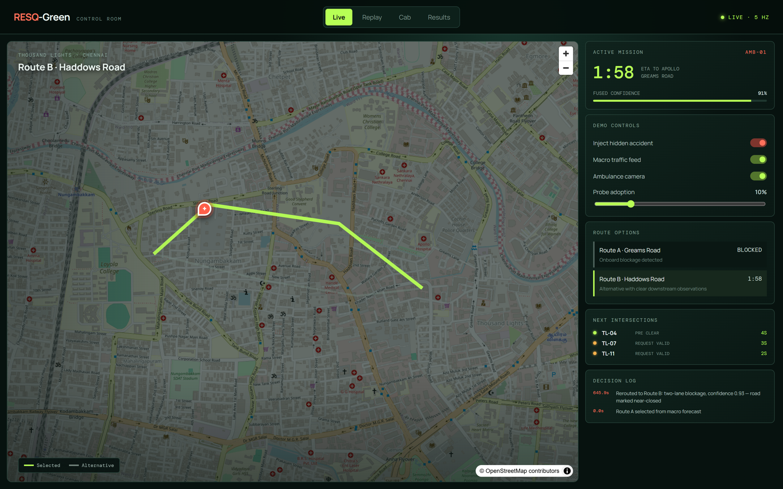
WHAT WE HAVE DONE SO FAR
A vertical slice already runs end to end, not a set of stubs
Eleven Python modules and a React control room: simulation, probes, forecasting, perception, fusion, routing, corridor, recorder, adapters, API and experiments.
REST plus a 5 Hz WebSocket stream; the browser shows live routes, reservations and the reason behind every decision.
A seeded experiment runner stores every run in SQLite, so any number we show can be reproduced.
SUMO, CARLA and Google adapters are written and report their own readiness instead of faking data.
21 automated tests pass, with lint and build wired into GitHub Actions.
2,240
21
lines of Python
tests passing
Live control room: fused speeds, route options with ETA, the next reservations, and the reason recorded for every decision.
4
180
web workspaces
recorded runs
The rubric asks for roughly 20 percent. A walking skeleton of every module is live and tested, and we can demo it now.
Notes:
Offer the live demo here. If the projector cooperates, switch to the browser for thirty seconds and inject the accident.

Slide 5

WHAT WE HAVE DONE SO FAR
The hidden accident: when the map is wrong
1
The forecast picks Route A and junctions on it are reserved.
2
A two-lane blockage forms. The crowd feed still calls the road clear.
3
The ambulance camera sees stopped vehicles, so fusion marks the road near-closed.
4
Route B is chosen and the stale reservations are cancelled.
5
Junctions on Route B pre-clear their queues just before arrival.
Decision log, taken from the running app
"Rerouted to Route B: two-lane blockage, confidence 0.93 - road marked near-closed"
Measured reroute reaction time: 0.6 s from detection to a new route with the old reservations cancelled.
Notes:
This single scenario justifies the whole design: the second input exists precisely because the first one is stale.

Slide 6
WHAT WE HAVE DONE SO FAR
Measured across 180 seeded runs: six baselines, six scenarios
49%
Faster in the hidden-accident case
323.7 s with no system, 163.8 s with ours
43% to 96%
Green on arrival
Stops per trip fall from 1.87 to 0.00
0
Cross-street delay caused by preemption: 112 s fixed-distance to 63 s just-in-time to 39 s with recovery
Conflicting-green events
Asserted in all 180 recorded runs
Measured on our built-in mesoscopic runner: 5 seeds x 6 scenarios x 6 baselines. These validate the software, not Chennai traffic; transport claims will be re-measured on the verified Chennai SUMO network with 20 or more seeds.
Notes:
Say the caveat out loud. Claiming Chennai results we have not measured is the fastest way to lose credibility with a panel.

Slide 7
WHAT WE PLAN TO DO NEXT
Deepen each module in place, then measure it properly
Verify the Chennai network
Train the real models
Bring CARLA into the loop
Run the full matrix
Check every junction, signal timing and turn restriction by hand, then calibrate demand against real travel times.
Graph forecaster on benchmark data plus simulated history, detector fine-tuned on the India Driving Dataset.
Rendered camera and LiDAR feeding the same perception code, recorded for the final showcase.
Twenty seeds per cell, ablations with fusion switched off, and the adoption sweep at 5, 10 and 30 percent.
Milestones
Who owns what
W23
Verified Chennai network, CARLA frames feeding perception
<Member 1>
Simulation and signals
sim/ . corridor/ . experiments/
W29
Feature freeze: all six scenarios recorded and replayable
<Member 2>
Prediction and routing
forecast/ . fusion/ . routing/ . api/
W34
Twenty-seed matrix, ablations, report and paper draft
W36
Final demo and viva
<Member 3>
Perception, CARLA and web
perception/ . adapters/ . web/
Notes:
Close by naming who owns which modules, so the panel knows whom to question. Each member answers only for their own area.

Slide 8
Thank you
Questions welcome. Each member answers for the modules they own.
The problem
Ambulances lose minutes at junctions; traffic data is stale and preemption fires at the wrong moment.
Live demo ready
Live, Replay, Cab and Results pages, with the hidden-accident control on the Live page.
Our fix
Fuse a city forecast with onboard sensing, route on future traffic, clear junctions just in time, then repair cross traffic.
Done so far
Full software slice running: 11 modules, 4 web workspaces, 21 tests, 180 recorded runs.
Next
Verified Chennai network, trained models, CARLA in the loop, twenty-seed evaluation.
RESQ-Green . IDP Review II . 23 September 2026
Notes:
Leave this slide up during questions. The recap column is a prompt for anything the panel asks you to repeat.

Slide 9
BACKUP SLIDE
Questions we expect, and the short answers
How is this different from Google Maps?
What if the camera is wrong?
Google cannot see the road ahead of the ambulance, cannot forecast per road for the arrival moment, and cannot hold a signal.
Confidence weighting limits its influence, the forecast still covers the route, and the safety kernel is unaffected.
Why not reinforcement learning end to end?
Could this run on a real junction?
It cannot be safety-assured. RL may later tune recovery timing inside the limits the state machine enforces.
Not by us. That needs an approved controller interface, road-authority permission and a shadow-mode trial first.
Is 5 to 10 percent probe adoption enough?
How do you know the results are real?
Speed, not vehicle count, is the estimator, and adoption is a measured parameter in our matrix.
Every run carries a seed and a baseline, all 180 are stored, and the replay reproduces them exactly.
Notes:
Do not present this slide. Jump to it only if the matching question comes up.

