Slide 1
PAYROLL MANAGEMENT SYSTEM
PAYROLL SYSTEM

Slide 2
WHOA!
PAYROLL SYSTEM
Jayed Alam Mansur
B.Tech Ai (i/ii)
jayedalamsigningoff@gmail.com

Slide 3
PAYROLL SYSTEM
Acknowledgement
I would like express my deep gratitude to
Department of AI for providing me the opportunity to present in front of you all on the topic
"Payroll Management System (PMS)"

Slide 4
TABLE OF CONTENTS
PAYROLL SYSTEM
INTRODUCTION
METHODOLOGY
PMS
EXPECTED OUTCOME
APPROACH
CONCLUSION

Slide 5
INTRODUCTION
PAYROLL SYSTEM
A software designed to organize all the tasks of employee payment and filing of their taxes
These tasks can include keeping track of hours
Calculating wages, withholding taxes and deductions, printing and delivering checks and paying employment taxes to the government

Slide 6
METHODOLOGY
PAYROLL SYSTEM
Problem Identification
Implemen-
tation
Algorithms
& Logic
Testing &
Debugging
Loops and String functions
Test and fix any bugs or errors
Overcome Manual Labour
Using Switch Statement
01
02
03
04

Slide 7
eXPEcTED OUTCOMES
PAYROLL SYSTEM
Annual services connected to payroll processing and social security administration
Full range of Social Insurance management
Recurring payroll services
Payroll disbursement services
Tasks related to newcomers and departing employees

Slide 8
PAYROLL SYSTEM
Class
APPROACH
01
login() function
to make the program secure by requesting password from admin
Loop
04
Pay-Slip
05
system("PAUSE")
to pause the screen
03
Bubble Sort
to sort the employees in ascending order
02
Menu
Functions

Slide 9
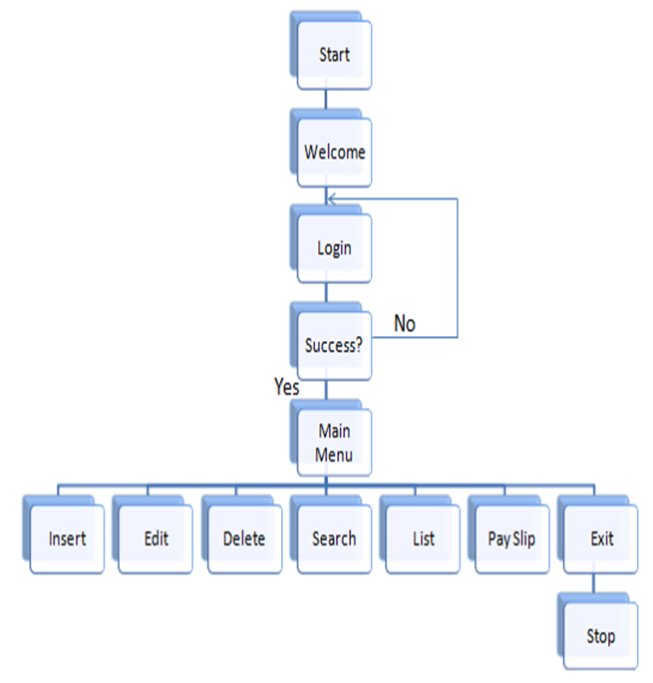
PAYROLL SYSTEM
FLOWCHART

Slide 10
conclusion
PAYROLL SYSTEM
Software designed to achieve maximum efficiency and reduce the time taken to handle the payroll activity
Designed to replace an existing manual record system to reduce time taken for calculations and storing data

Slide 11
—Steve jobs
quote
“Computer themselves, and software
yet to be developed, will
revolutionalize the way we learn.”

Slide 12


Slide 13
References
methodology
"Geeksforgeeks," [Online]. Available: https://www.geeksforgeeks.org/data-structure-and-algorithm/ [Accessed 25 04 2024].
"OpenAI," Open AI, 24 April 2024. [Online]. Available: https://chat.openai.com. [Accessed 24 04 2024]

