Slide 1
HP
HARIT PATHSALA — हरित पाठशाला
Can We Trust
the Eco-Score?
A mathematical audit of the number we show students — and why 9.19% of a school
was being told their effort was worth nothing.
Jayed Alam Mansur
B.Tech Artificial Intelligence, Year 3 · Kathmandu University
Supervised by [Mathematics Teacher] · Sandesh Thakuri
Notes:
Open here. 'This is the number our app gives students. Nobody had ever checked it.'

Slide 2
CHAPTER 1 · WHERE THIS STARTED
One number, used to judge people
Harit Pathsala began at the Nepal Climate Hackathon 2025. A student answers five questions about daily life — commute, home electricity, cooking gas, waste, stationery — and receives one number out of 100.
Teachers show it to students. Students compare it with each other. A dashboard averages it across a class.
YOUR ECO-SCORE
41
1.976 kg CO₂ / day
"The number stopped being a readout and started
being a judgement."
bus · 2 km · 90 kWh
1 cylinder · 0.6 kg · Rs 200
Notes:
Establish stakes before method. The score is used to judge students.

Slide 3
CHAPTER 2 · THREE PROBLEMS HIDDEN INSIDE THE FORMULA
Visible from the shape alone
The rule is a straight line between two chosen boundaries: 0.5 kg/day scores 100, 3.0 scores 0, everything outside is clamped.
1
2
3
A floor that swallows people
A ceiling nobody reaches
Boundaries from the wrong scale
Above 3.0 kg/day everyone scores 0 — the student just over the line and the heaviest emitter in the school, reported identically.
The top of the scale is unreachable in practice, so the reward end of the range is wasted and the score can never say "excellent".
0.5 and 3.0 were chosen a priori, not derived from what these emission factors actually produce on a Nepali household.
Notes:
Three claims. Each gets measured later — problems 1 and 2 in chapter 7, problem 3 by the household baseline.

Slide 4
CHAPTER 3 · BUILDING THE MODEL
Five activities, five constants
Transport
0.016 / 0.066 / 0.19
kg CO₂ per km
fuel ÷ efficiency ÷ passengers · bus splits its fuel 40 ways
Electricity
0.23
kg CO₂ per kWh
Nepal grid ≈ 82% hydro / 18% thermal · NEA 2022/23
Cooking
21.442
kg CO₂ per cylinder
14.2 kg × 1.51 · IPCC 2006 (carbon × 44/12)
Waste
0.827
kg CO₂e per kg
landfill decomposition to CH₄ + CO₂ · IPCC 2006 Vol.5
Stationery
0.001728
kg CO₂e per NPR
spend-based supply chain · GHG Protocol
TEACHER'S QUESTION 1
What were the fixed constants for each activity?
Not one was fitted or tuned. They come from the organiser's Emission_factors.xlsx, and the notebook re-derives the worked example from them on every run — halting if any disagrees.
Notes:
Q1. The credibility move: prove you can reproduce the app before criticising it.

Slide 5
CHAPTER 3 · THE MODEL IN TWO LINES
A linear sum, then a clamp
F = Σ θᵢ xᵢ (i = 1 … 5)
Linear in the activities → every derivative is a constant. Linear in the factors → uncertainty propagates exactly.
S(F) = clamp( 0, 100, 100 − ((F − 0.5) / 2.5) × 100 )
dS/dF = −40 for 0.5 ≤ F ≤ 3.0 ← the score responds
dS/dF = 0 otherwise ← the score is deaf
That second line is the entire subject of this research.
Notes:
The piecewise derivative is the whole finding in one symbol.

Slide 6
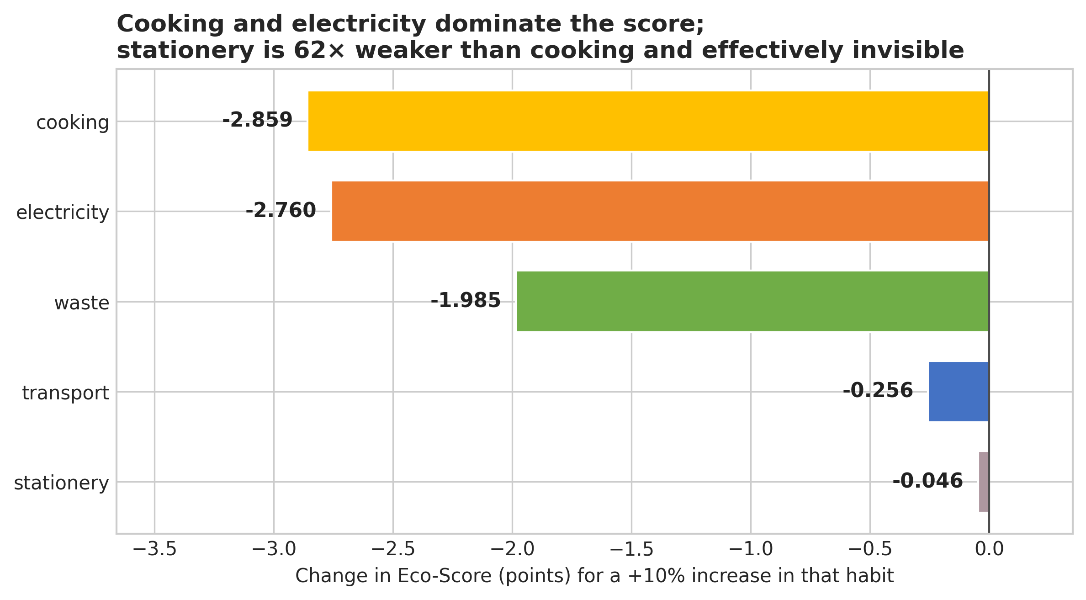
CHAPTER 5 · WHICH HABIT ACTUALLY MATTERS
Cooking moves the score 62× more than stationery
Cooking
-2.859
Electricity
-2.76
Waste
-1.985
Transport
-0.256
Stationery
-0.046
score points per +10% in that habit
A student could stop buying notebooks
for a whole year and move less than a point.
Notes:
∂S/∂xᵢ = −40·θᵢ — the ranking is fixed by the constants, identical for every student.

Slide 7
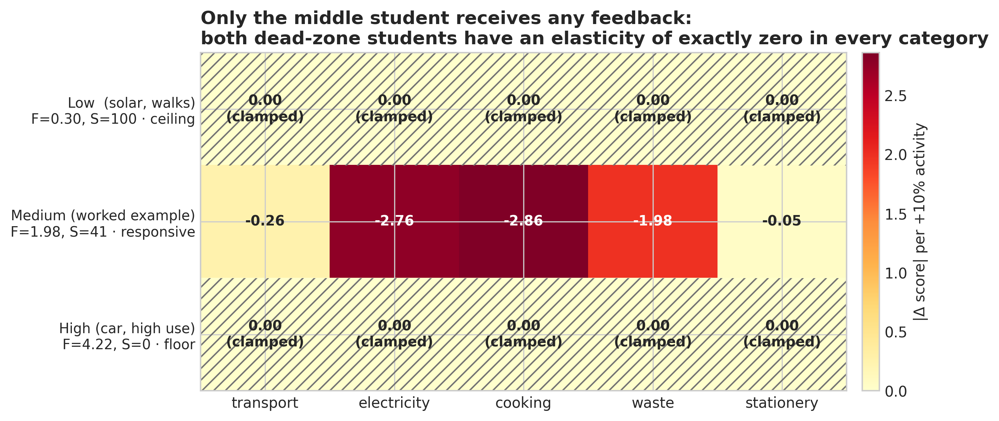
CHAPTER 5 · THE STUDENTS THE SCORE CANNOT HEAR
In a dead zone, every derivative is exactly zero
Very low footprint — 0.30 kg CO₂/day
Very high footprint — 4.22 kg CO₂/day
Walks, rooftop solar, minimal gas. Scores 100. Halve it again and it is still 100 — and the app cannot tell them apart from someone at three times their emissions.
Car, high electricity, heavy cooking and waste. Scores 0. Halve their waste tomorrow and the score changes by 0.000 points.
Notes:
Not small — zero. Both students are told their effort is worthless by a system working as designed.

Slide 8
CHAPTER 4 · FROM FORMULA TO SIMULATION
The constants are estimates, not facts
TEACHER'S QUESTION 2
Which model was used before? Why Monte Carlo now?
BEFORE — deterministic
Five answers in, five constants treated as exact, one score out. Run it a thousand times, get the same score a thousand times. No notion that it could have been different.
NOW — each constant is a random variable
Normal(published value, its real spread), clipped positive. The question changes from "what is the score" to "how well do we know the score".
±15%
±20%
±25%
±10%
±5%
Grid electricity
Waste composition
Stationery supply chain
Bus passenger load
LPG fill weight
Notes:
Q2. The grid factor moves ±15% between NEA reports — that is the world, not our algorithm.

Slide 9
CHAPTER 4 · ALTERNATIVES CONSIDERED
Why not one of these instead?
TEACHER'S QUESTION 3
What other methods could we have used?
METHOD
VERDICT
REASON
Interval arithmetic
Rejected
Worst-case bounds assume every factor is wrong in the same direction at once — too pessimistic to use.
Latin hypercube sampling
Not needed
Better coverage per draw, but with five inputs and 10,000 draws plain Monte Carlo has already converged.
Bootstrap resampling
Impossible
Resamples observed data — and there is no observed student data to resample yet.
Bayesian posterior (MCMC)
Overkill
Needs defensible priors on every factor, and adds little to a variance we can compute exactly.
Inside the responsive region the algebra alone is enough. What earns Monte Carlo its place is the boundary.
Notes:
Q3. Show you chose the tool rather than copied it.

Slide 10
CHAPTER 4 · THE QUESTION FROM CLASS
Same name. Opposite purpose.
TEACHER'S QUESTION 4
Is this the same Monte Carlo as in DAA?
In algorithms
In this research
The problem is deterministic. Whether 561 is prime is a fixed fact; Miller–Rabin flips coins only to reach it faster than trial division.
The randomness lives in the method — never in the problem.
The randomness IS the problem. The grid factor genuinely differs year to year — a fact about the physical world.
We are not approximating something computable; we are describing a spread that exists.
They share a name and a random number generator, and nothing else.
Notes:
Q4. Most likely question from the maths supervisor — answer it before it is asked.

Slide 11
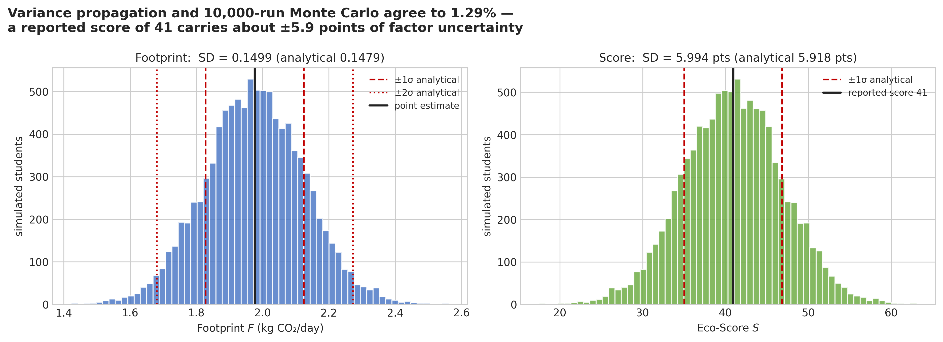
CHAPTER 4 · HOW PRECISE IS ONE SCORE?
Two methods, one answer
±5.92
±5.99
1.29%
ANALYTICAL
variance propagation, exact
MONTE CARLO
10,000 simulated worlds
DIFFERENCE
between the two methods
A reported score of 41 is really
somewhere in 29 – 53.
Two students less than ~12 points apart cannot honestly be ranked.
Notes:
Two independent methods agreeing is the most persuasive structure in applied maths.

Slide 12
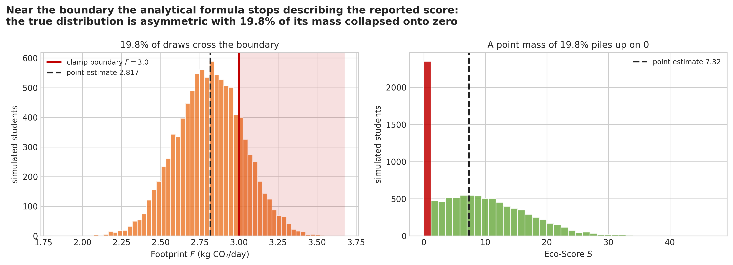
CHAPTER 4 · WHERE THE ALGEBRA STOPS WORKING
A score of 7 that displays as 0 in 19.6% of worlds
A student at 2.817 kg CO₂/day sits just below the floor.
The clamp is not linear, so the variance formula stops describing what the app shows: part of the distribution is squashed onto the boundary. The mean shifts, the shape turns asymmetric, and a spike appears at exactly zero.
No closed form tells you that. This is what simulation was for.
19.6% of plausible
worlds report 0, not 7
Notes:
The strongest single beat. Give it room.

Slide 13
CHAPTER 6 · BUILDING A POPULATION
10,000 students, because there were none
TEACHER'S QUESTION 5
Why 10,000 synthetic students? What happened to the old data?
There is no old data. No structured student survey had been collected — there is no dataset I chose not to use. That is a real limitation, and it decides exactly what this chapter can prove.
VARIABLE
DISTRIBUTION
Transport mode
bus 0.4 · motorbike 0.25 · walk 0.2 · cycle 0.1 · car 0.05
Commute
log-normal, mean 3.0 km, σ=0.8
Electricity
Normal(90.0, 35.0) kWh/month
Synthetic is not fake: every distribution is sourced, and all of them were fixed BEFORE any score was computed — so nothing could be tuned to produce a flattering answer. Seed 42, fully reproducible.
Rooftop solar
Bernoulli(0.05)
LPG
Normal(1.2, 0.4) cylinders/month
Waste
[0.3, 0.6, 1.2] kg/day, p=[0.3, 0.5, 0.2]
Stationery
Normal(200.0, 80.0) NPR/month
Notes:
Q5. Say plainly there was no data. Then say what synthetic can and cannot establish.

Slide 14
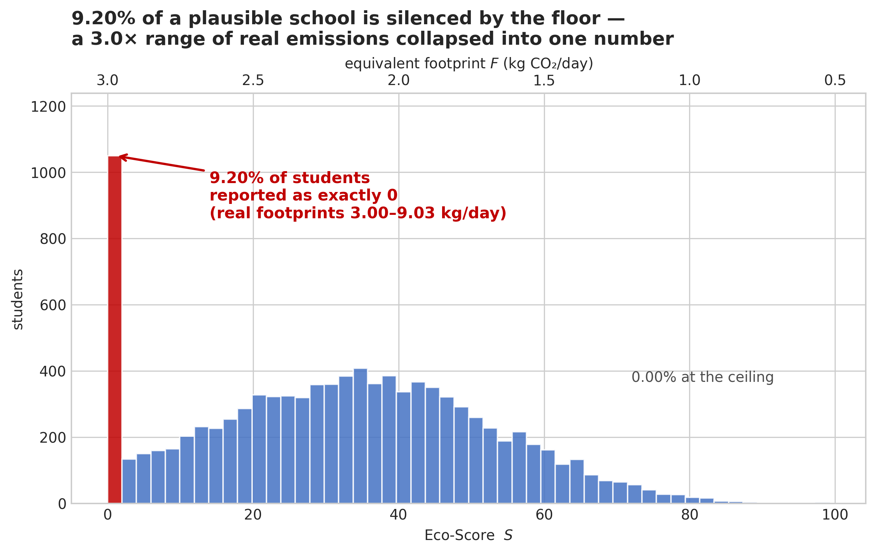
CHAPTER 7 · WHAT THE POPULATION REVEALED
9.19% of a school is silenced
9.19%
score exactly 0 — and their gradient is exactly zero in all five categories
0.0%
reach 100 — not one student in ten thousand
Their real footprints run
2.99 → 8.91 kg CO₂/day.
A 3× difference, one number.
Notes:
Pause here for two seconds. This is the climax.

Slide 15
CHAPTER 7 · COMPARATIVE RESULTS
Before and after this research
TEACHER'S QUESTION 6
Comparative results — before vs after our research?
BEFORE
AFTER
Emission factors
assumed exact
random variables with quantified spread
Score precision
unknown — no error bar
±5.92 points (1σ), confirmed two ways
Which habits matter
five questions, implicitly equal
ranked — 62× spread first to last
Behaviour across a school
never tested
tested on 10,000 students
Students given no feedback
unknown
9.19% scoring exactly 0
Diagnosis
—
formula sound; the clamp is the fault
Notes:
Q6. The single table the supervisor will photograph.

Slide 16
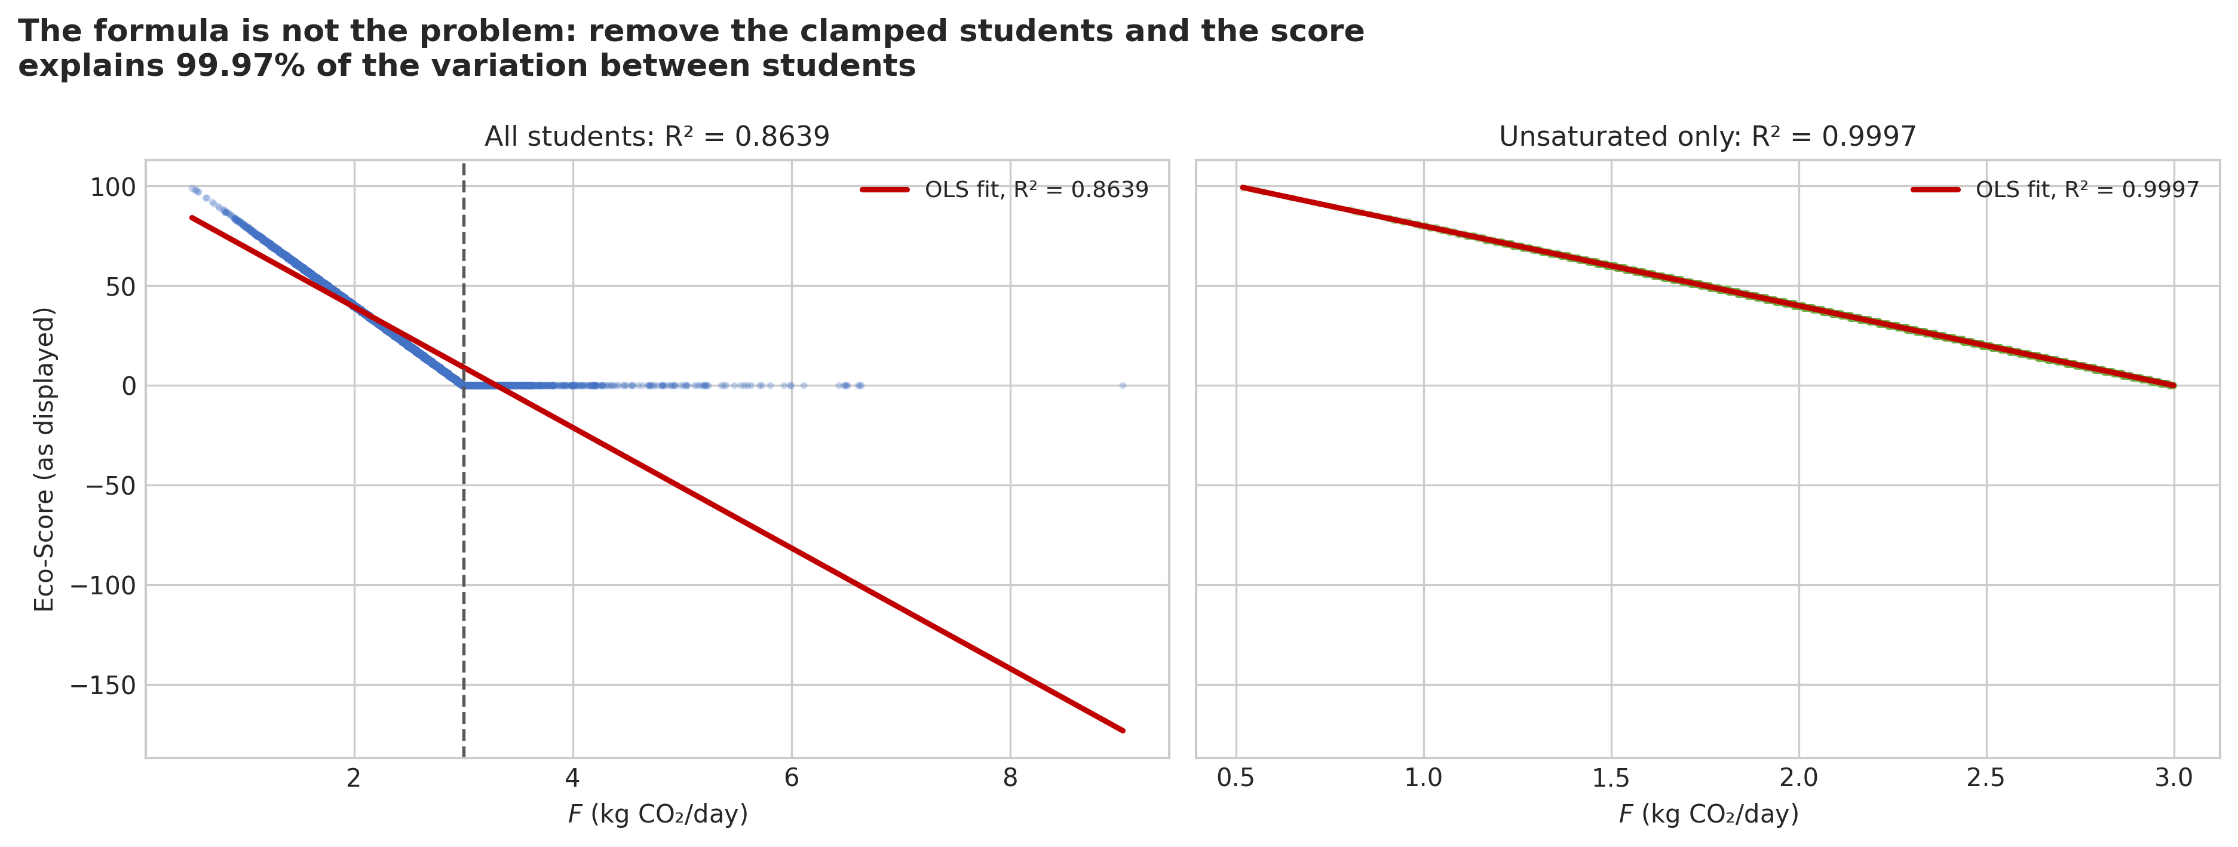
CHAPTER 7 · WHOSE FAULT IS IT?
The formula is not broken. The clamp is.
0.8639
0.9997
The missing 0.03% is not model error either — it is exactly the variance of rounding the score to a whole number for display.
There is nothing left to improve in the arithmetic.
R² ACROSS ALL 10,000 STUDENTS
the score misses ~14% of what happens
R² WITH THE FLOORED STUDENTS REMOVED
99.97% of the variation explained
Household baseline
2.048 kg/day
is already 82% of the way to the floor.
Notes:
This turn is what makes the fix small instead of a rewrite.

Slide 17
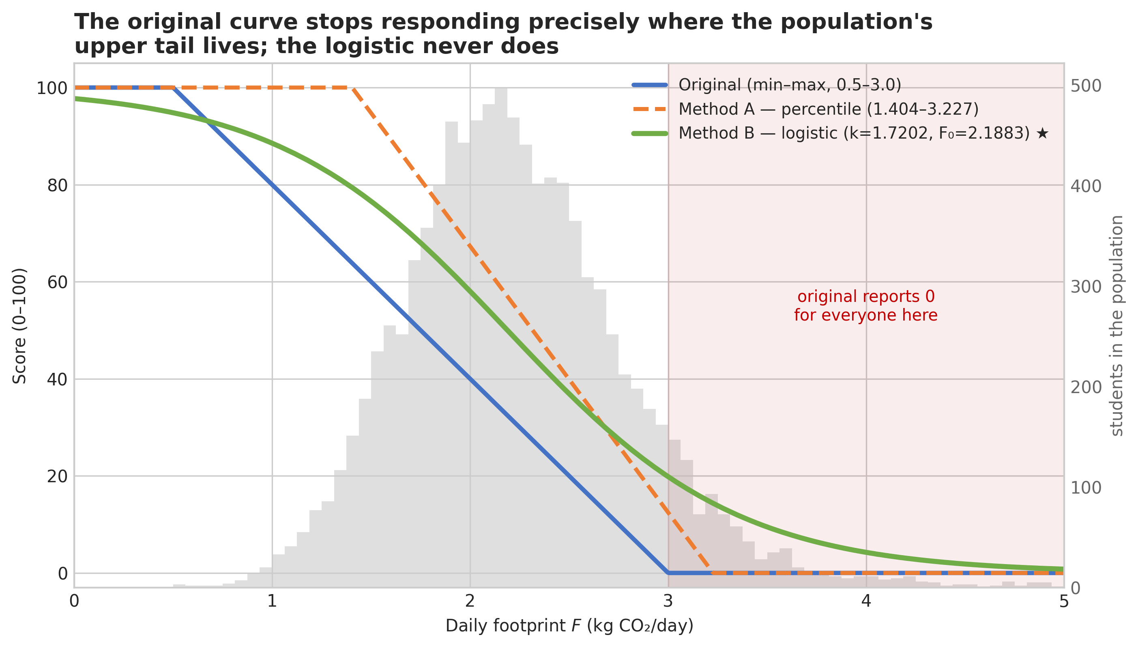
CHAPTER 8 · FIXING THE BOUNDARIES
Replace the clamp. Change nothing else.
Method A — percentile
Boundaries from the population: 1.404 and 3.227 kg/day.
Highest entropy — but still clamps, and now saturates 10.27%.
Method B — logistic ★
S = 100 / (1 + e^(k(F − F₀)))
k = 1.7202, F₀ = 2.1883 (the population median).
Never goes flat — there is always somewhere left to go.
Notes:
Emission factors, footprint, questions all unchanged. Only the final mapping.

Slide 18
CHAPTER 8 · SIDE BY SIDE
Why the logistic wins
CRITERION
ORIGINAL
PERCENTILE
LOGISTIC ★
Students given no feedback
9.19%
10.27%
0.3%
Information content (nats, max 2.996)
2.644
2.931
2.765
Preserves the true ranking
no — ties at 0
no — ties at both ends
yes, ρ = 1.000000
Agrees where the old score works
—
partly
r = 0.9972
Ever saturates
yes
yes
no
The trade-off: the logistic scale is population-relative. F₀ is a median, so 50 means "typical for this group". Refit when the population changes — and keep kg CO₂/day on screen.
Notes:
The decisive row is ranking. A score that ties hundreds of students fails at its only job.

Slide 19
THE WEB APPLICATION
Everything above, as something you can click
A four-page Streamlit app sharing one formula module with the notebook — so the app and the paper can never quote different numbers.
🏠
📊
🎓
📁
Calculator
Research Findings
Understanding the Math
About This Project
Score any student three ways at once, with live uncertainty
The five findings, each with its figure and plain-English reading
Derivatives, Monte Carlo convergence, why the logistic — interactive
The story, the limitations, and a class simulator with CSV export
Deployed on Streamlit Community Cloud · rebuilds automatically on every push to main
Notes:
Transition: 'Let me show you the same research as a tool you can use.'

Slide 20
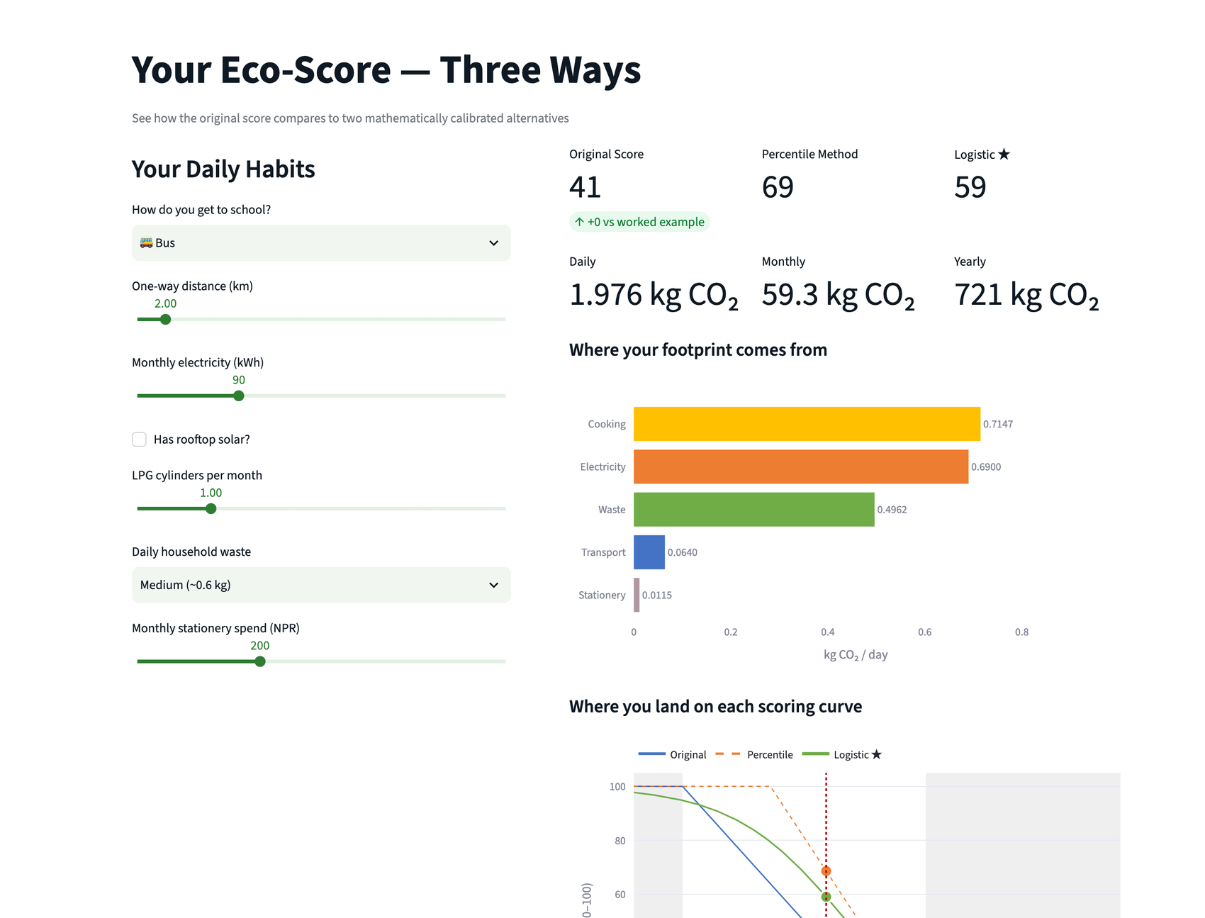
WEB APP · PAGE 1
Calculator — one student, three scores
Move any slider and all three scores update at once.
The worked example is the default: bus, 2 km, 90 kWh, 1 cylinder, medium waste, Rs 200 → 1.976 kg CO₂/day.
The breakdown bars use the same five category colours as every figure in the paper.
Below, the three scoring curves with your position marked on each.
Notes:
Show the defaults reproduce 41 exactly — the app is verified against the docs.

Slide 21
WEB APP · THE LIVE DEMO
Drag the commute from 7 km to 3 km
DISTANCE
FOOTPRINT
ORIGINAL
LOGISTIC ★
The student cuts their commute by more than half — a real, hard change — and the original score says nothing, five times in a row.
7 km
4.57 kg/day
0
2
6 km
4.19 kg/day
0
3
5 km
3.81 kg/day
0
6
4 km
3.43 kg/day
0
11
The logistic sees every step: 2 → 3 → 6 → 11 → 18.
That is the whole project, in one slider.
3 km
3.05 kg/day
0
18
Stay inside 7 → 3 km. Beyond ~8 km the logistic also rounds to 0 on the tile; below 2.6 km the original wakes up. This window is where the contrast is visible.
Notes:
If you only have two minutes, do THIS slide live and skip the rest.

Slide 22
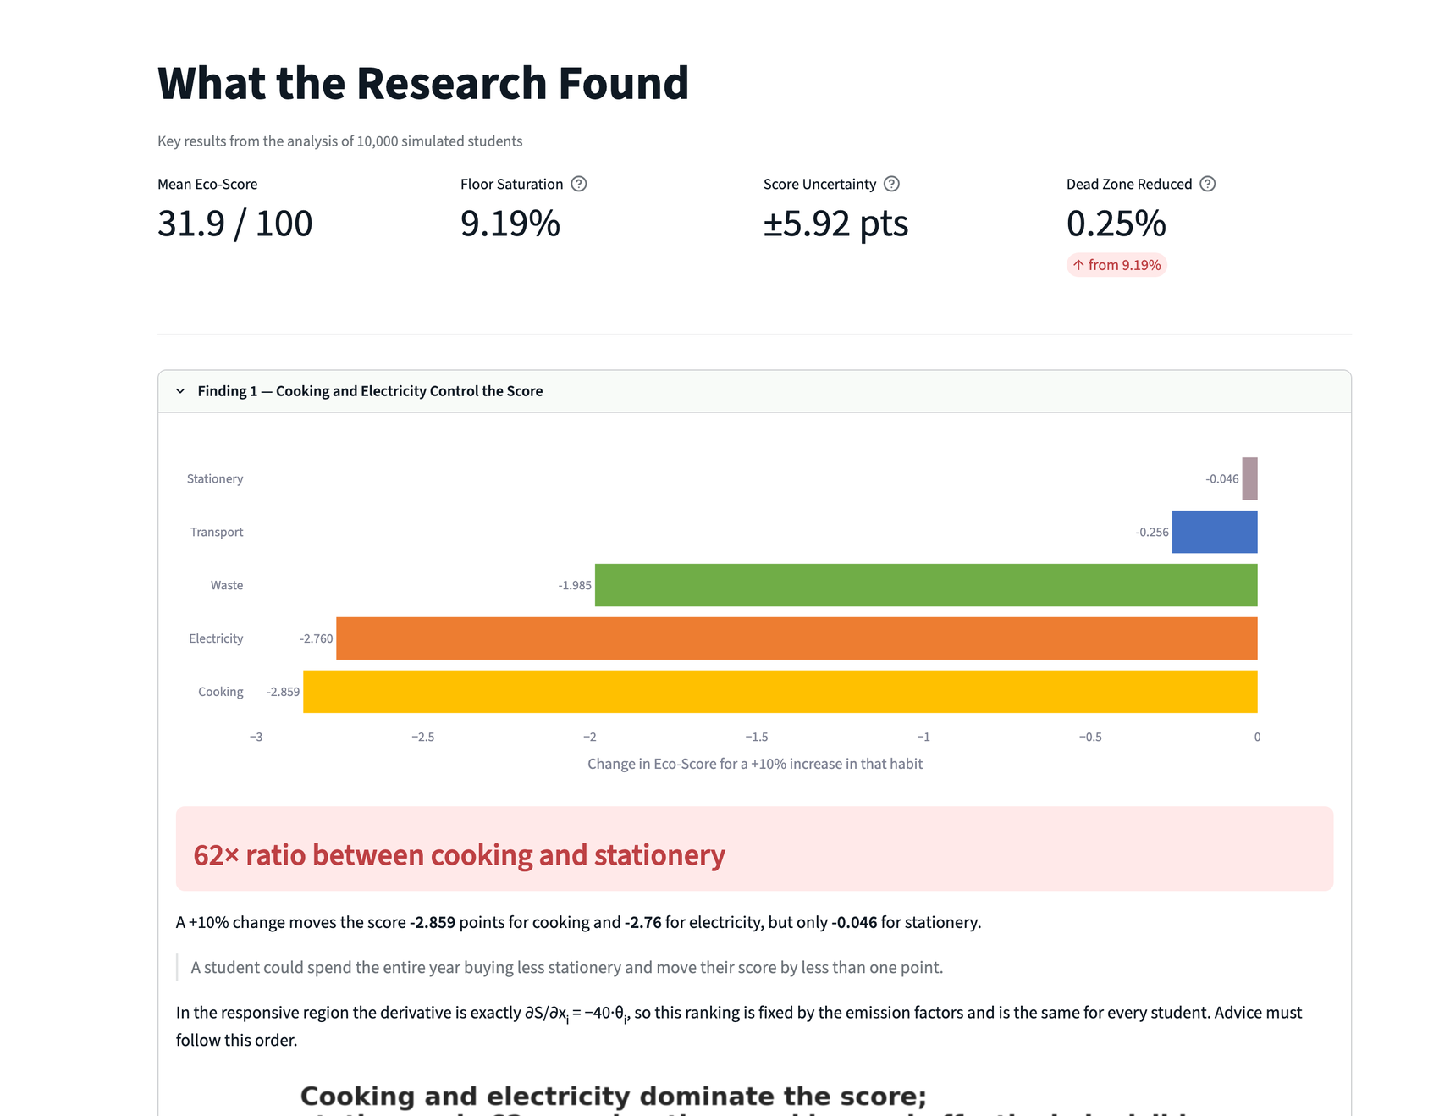
WEB APP · PAGE 2
Research Findings — the evidence, expandable
Four headline tiles, then five findings as expandable sections:
1 · cooking and electricity control the score
2 · a 41 could mean 29 to 53
3 · 9.19% of students are silenced
4 · the formula is perfect, the clamp is broken
5 · two better alternatives
Each carries the notebook's own figure, so nothing is redrawn by hand.
Notes:
Every number here is read from key_results.json, not typed into the app.

Slide 23
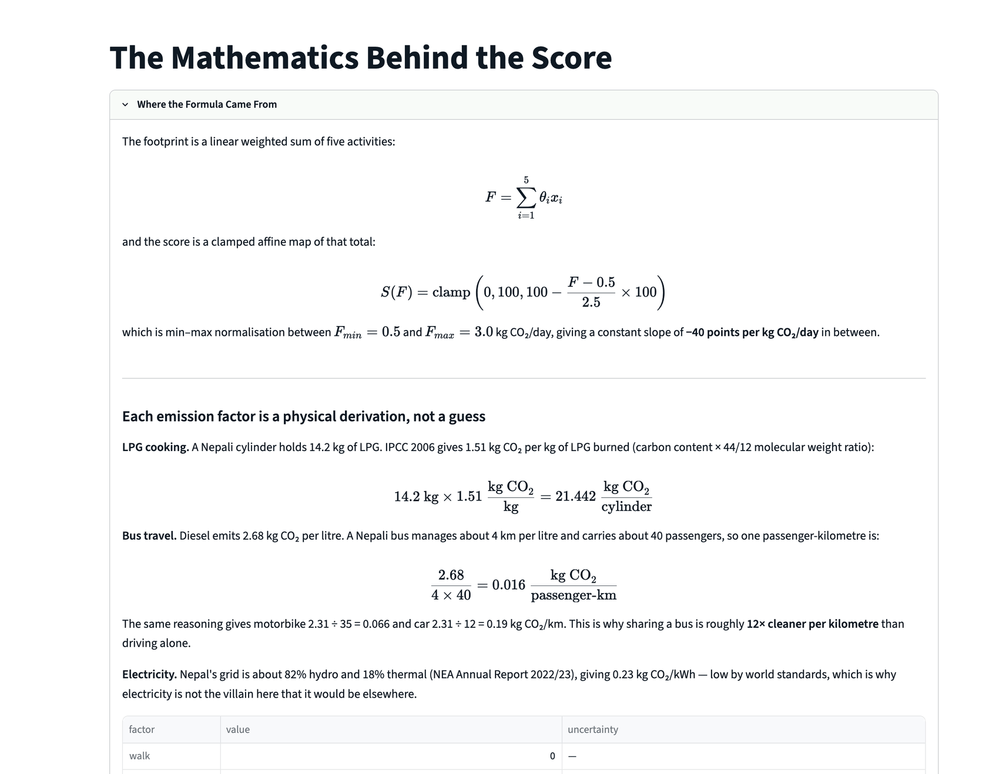
WEB APP · PAGE 3
Understanding the Math — for the reader who asks why
Four expandable explainers:
· where each emission factor comes from, with the LPG and bus derivations
· what a sensitivity analysis is — with a slider that sweeps one habit 0–200%
· what Monte Carlo is, answering the DAA question directly — with a slider showing the estimate converge as N grows
· why the logistic, with the entropy comparison
Notes:
The convergence slider is the best teaching moment in the app — 1/√N made visual.

Slide 24
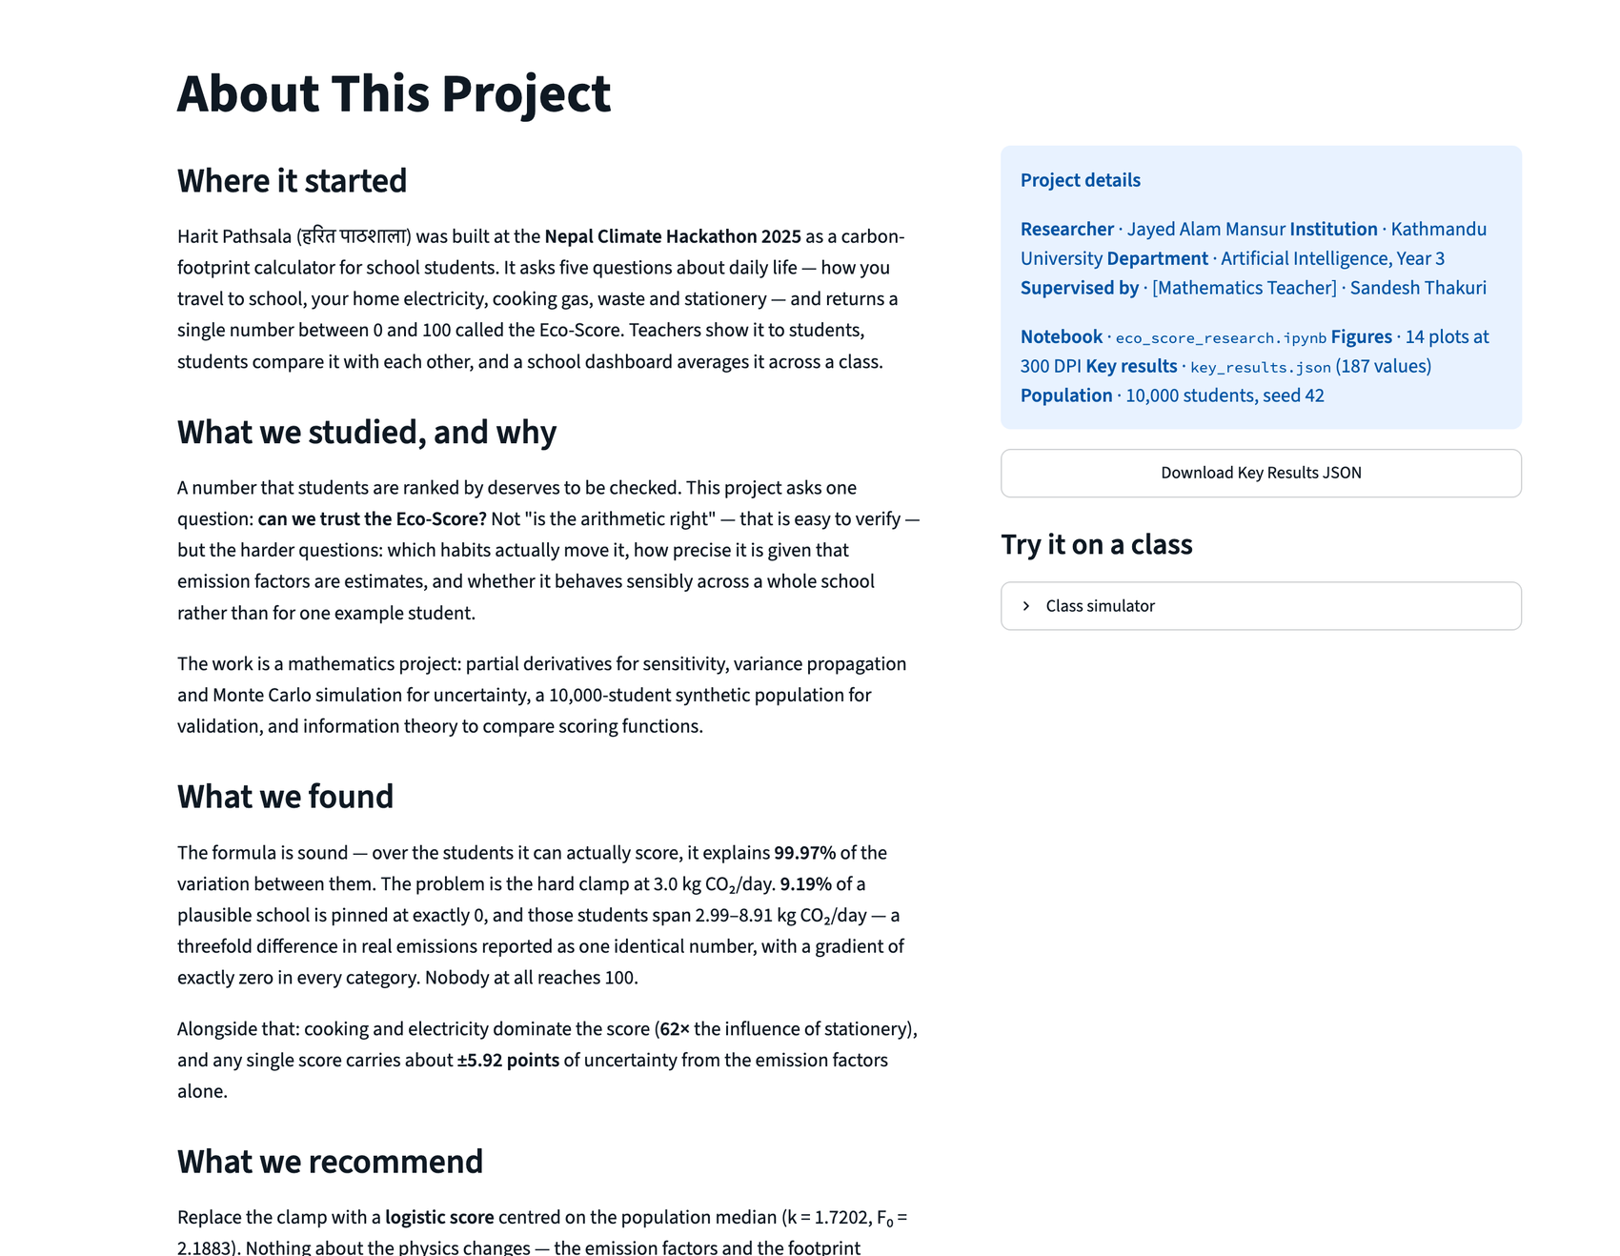
WEB APP · PAGE 4
About — the story, the limits, and a class simulator
The project narrative and, deliberately, the limitations.
The class simulator generates any number of students from the same distributions and scores them three ways side by side — mean, spread, % at floor and ceiling — then exports the class as CSV.
A teacher can try their own class size before anyone changes the real app.
Notes:
Good place to hand the laptop over and let them play.

Slide 25
CHAPTER 9 · WHAT HAPPENS NEXT
Five stages before anything reaches a student
TEACHER'S QUESTION 7
What is the full process after generating the data?
1
Collect real survey responses
seven questions, 3 minutes, no PII, English and Nepali — CSV columns already match the generator
2
Refit the scale on that data
recompute the percentiles, re-fit k and F₀ on the real median · needs ≥100 responses
3
Re-validate every finding
re-run the notebook; the floor percentage will move, the flat region will not
4
Change one function in the app
edit the scoring function in src/logic.js and nothing else · show kg CO₂/day beside the score
5
Re-audit on a schedule
a population-relative scale drifts · refit annually and repeat the saturation check
Notes:
Q7. Nothing reaches a student until it has been checked against reality.

Slide 26
CHAPTER 9 · SCOPE OF THE CHANGE
One function moves. Everything else stays.
What stays
What changes
All five emission factors, unchanged
One function: kilograms → score
The footprint formula F = Σ θᵢxᵢ
Advice ordered by real sensitivity
The five questions students answer
Scores shown with their uncertainty
The daily kg CO₂ figure
A score that never stops responding
The existing app, UI and game
Constants refitted as data arrives
Notes:
Reassures the hackathon team: this is an extension, not a repudiation.

Slide 27
CHAPTER 10 · THREE QUESTIONS, THREE ANSWERS
What this research was, in three branches of maths
Mathematical Modelling
Sensitivity Analysis
Statistical Calibration
What IS the model?
Which inputs matter?
Is the output trustworthy?
A linear weighted sum, then a clamped affine map. Linearity makes the derivatives constant and the variance exact; the clamp makes the derivative vanish. Every finding follows from those two facts.
Partial derivatives as a +10% change. Cooking -2.859 and electricity -2.76 dominate; stationery -0.046 is 62× weaker. In the clamped regions all five are exactly zero.
±5.92 points of uncertainty, confirmed to 1.29% by simulation. The mapping saturates 9.19% of a school; the logistic reduces that to 0.3% while preserving the ranking exactly.
Notes:
The recap slide. Three branches, one question each.

Slide 28
HONESTY
What I am not claiming
The population is simulated, not surveyed
9.19% is what these factors produce on a plausible school — not a measured fact about a real one. What is robust is structural: a scoring function with a zero gradient over a region where real students live.
The logistic scale is population-relative
50 means "typical for this group", not a fixed number of kilograms. It must be refitted when the population changes, and two schools cannot compare scores unless k and F₀ are pinned.
The emission factors are assumed independent
They probably are not. Positive correlation would make the true uncertainty LARGER than ±5.92 points — so that figure is a lower bound, not a final answer.
Every limitation named here is a question the examiner cannot ask.
Notes:
Volunteering weaknesses is strategy, not modesty.

Slide 29
MAIN FINDING
The formula was always correct.
The boundaries were always the problem.
Harit Pathsala — Eco-Score research · Jayed Alam Mansur · Kathmandu University
10,000 simulated students, seed 42 · 10,000 Monte Carlo draws · 14 figures at 300 DPI
Every number generated by eco_score_research.ipynb and read from key_results.json
Notes:
Close on the pull-quote. Then take questions.

