Slide 1
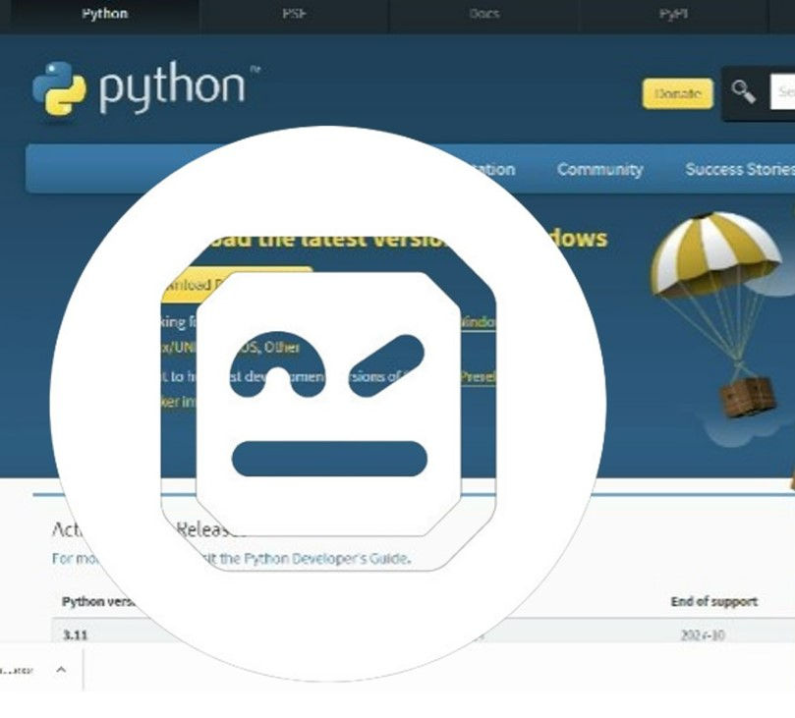
1. Python 2. Visual Studio Code 3. Python extension for VS Code 4. Python Virtual Environment Tool 'pipenv’ 5. robotframework and robotframework-seleniumlibrary 6. Search by 'robocorp' and install two extensions 7. Chromedriver
Prerequisites of ROBOT FRAMEWORK

Slide 2

1. Test Suite Setup -Done 2. Test Suite Teardown - Done 3. Library for reading excel file - Done 4. Another function call - Done 5. Import python file - Done
ROBOT FRAMEWORK TUTORIAL: PART2

