Slide 1

Fair Compensation Prediction Model
Leveraging Data-Driven Insights to Boost Fairness and Engagement
Jayeesha Chakraborty, 10th Jan 25
Linkedin : www.linkedin.com/in/jayeesha-chakraborty

Slide 2
Outline
Introduction & Context
Recent Progress
Goals & Objectives
Data Exploration
Model Development & Evaluation
Key Takeaways
Business Recommendations

Slide 3
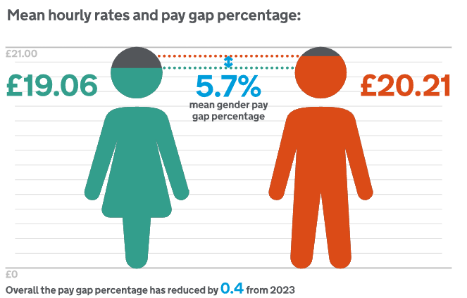
The Cost of Unequal Pay: Beyond Numbers
Employee disengagement → Increased attrition
Higher business costs due to turnover and lost productivity
Source: https://www.gov.uk/

Slide 4
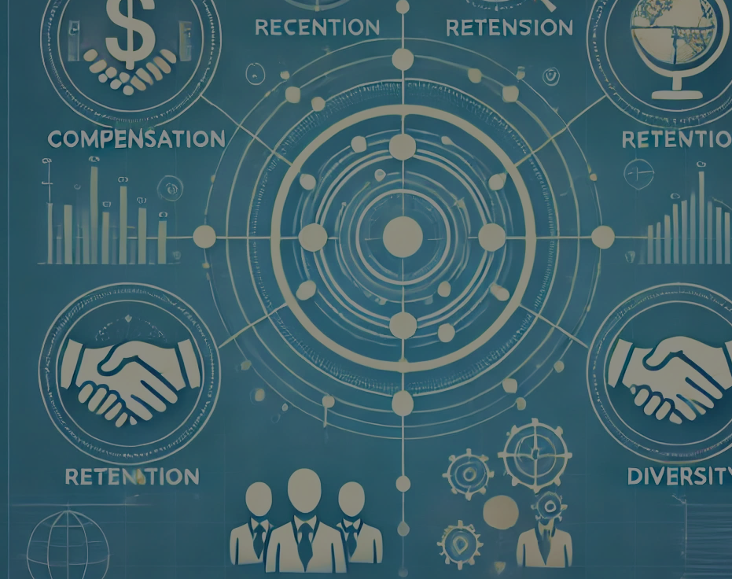
Revolutionizing Compensation: The Scope of Predictive Analytics
Compensation Optimization:
$100M saved by addressing disparities.
Retention Analytics:
Reduced Retention bonus by $20M
Halved attrition with training and recognition strategies.
Mentorship Insights:
Cut “flight risk” by 40% with coaching programs.
Broader Applications:
Talent acquisition, diversity, and skill development.

Slide 5
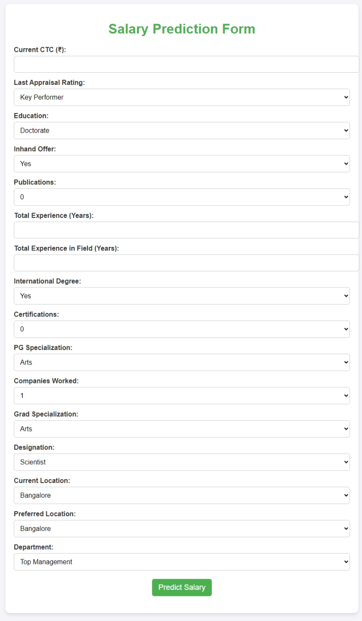
Goals & Objectives
Determine Key factors to compensation based on past data
Build a model for fair compensation
Eliminate manual bias
Foster employee trust and equity
Ensure sustainable business practices
Employee Salary Prediction

Slide 6
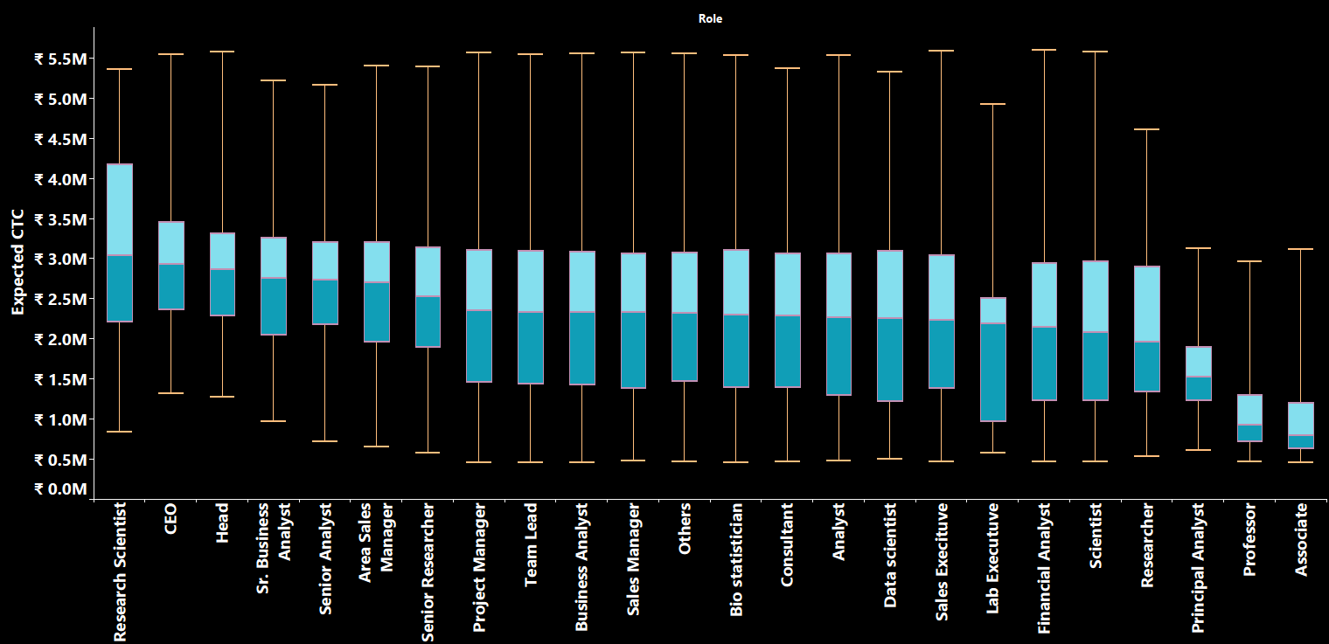
Data Insights : Role vs CTC
Senior roles average a salary of ₹3M, significantly outpacing freshers' average salary of ₹0.8M.
Fig: Role vs CTC

Slide 7
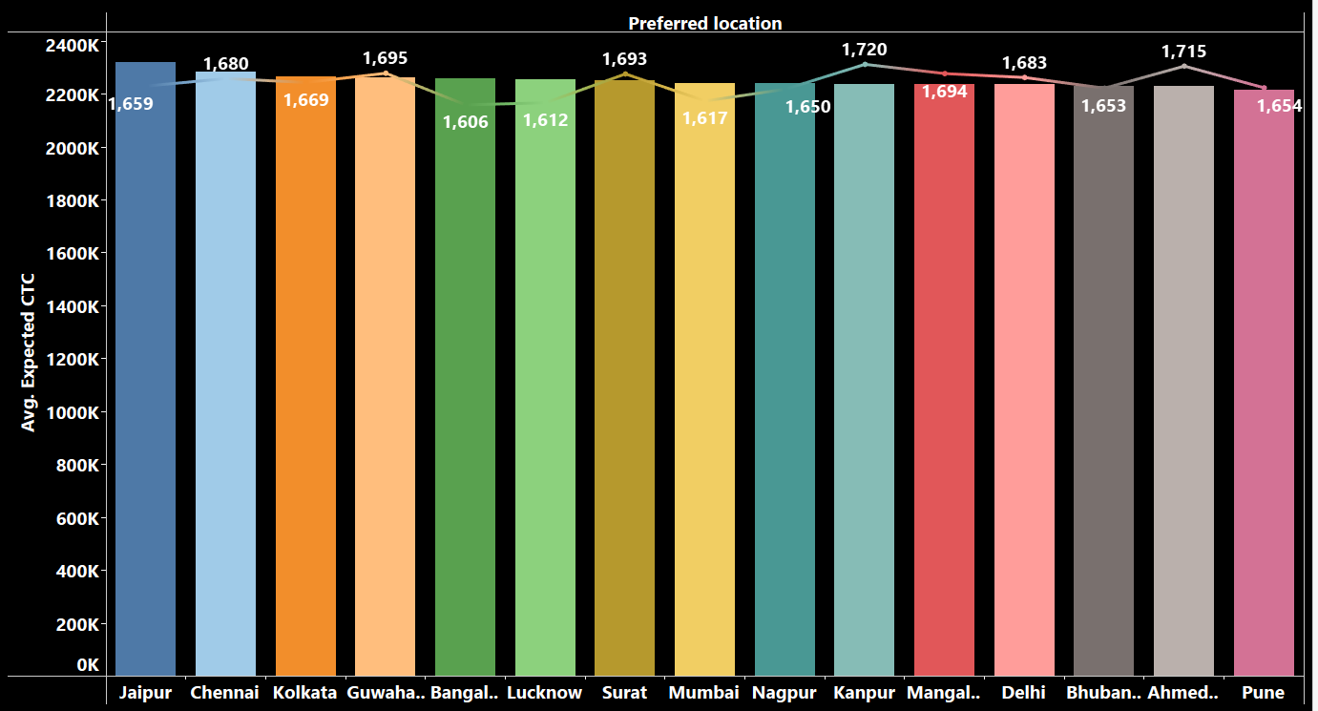
Data Insights : Location Preference vs CTC
Applicants are evenly distributed across all locations, with a consistent salary structure observed.
Fig: Location Preference vs CTC

Slide 8
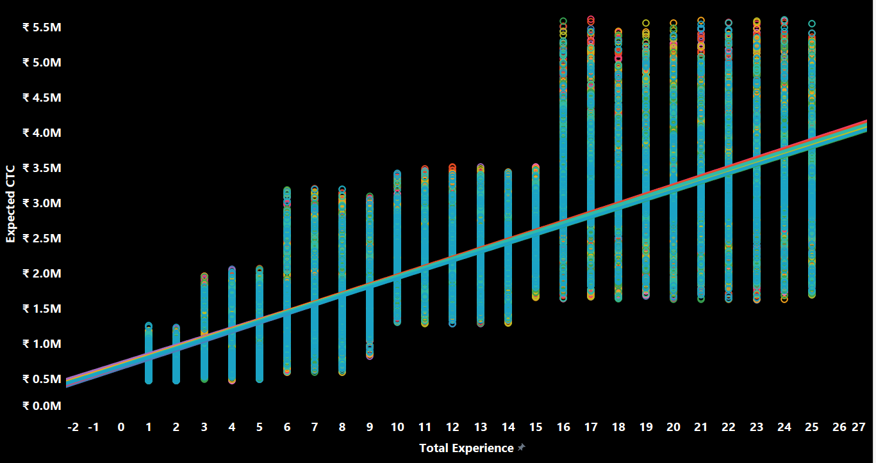
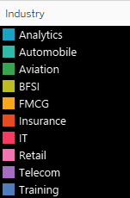
Data Insights : Experience vs CTC
Applicants' experience accounts for over 60% of the variability in expected compensation across industries
Fig: Experience vs CTC

Slide 9
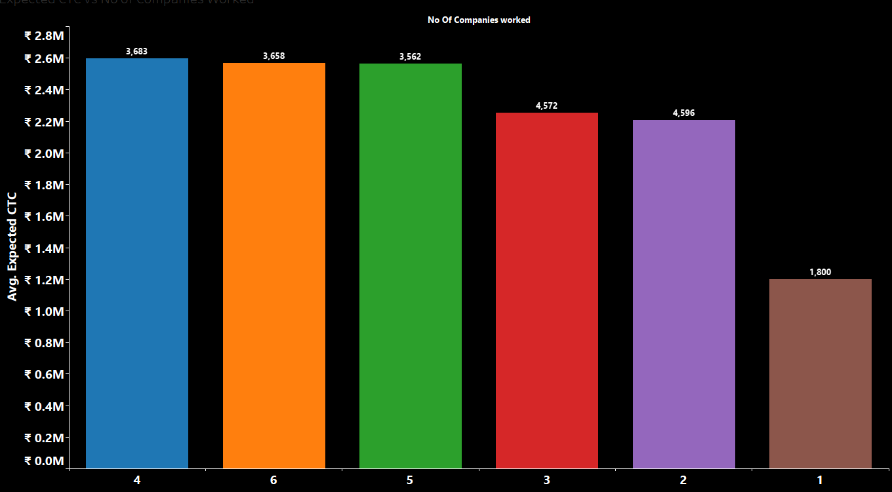
Data Insights : No of Companied Worked Vs CTC
Moderate career stability (2–5 companies) correlates with better compensation.
Fig: No of Companies Worked vs CTC

Slide 10
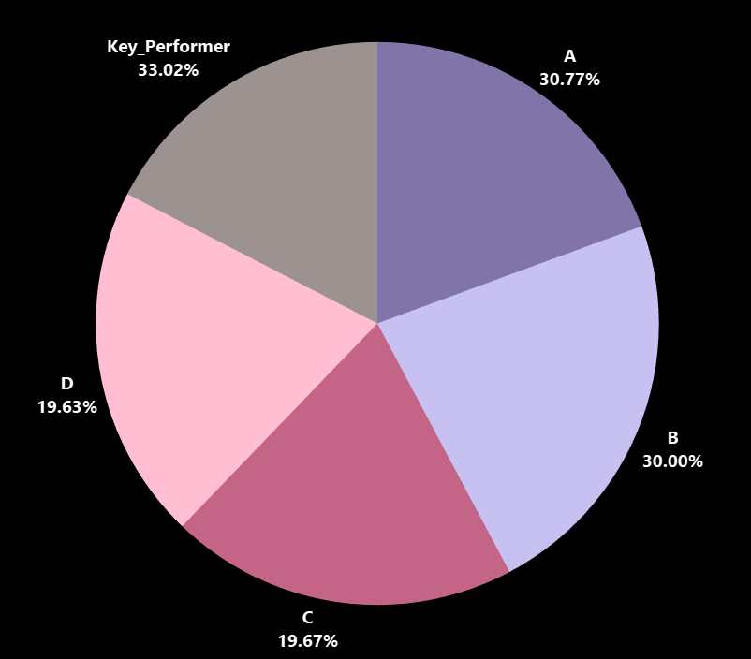
Data Insights : Last Appraisal vs CTC Hike %
Applicants are evenly distributed across appraisal ratings, with Key Performers enjoying a 33% salary hike
Fig: Appraisal Rating vs CTC

Slide 11
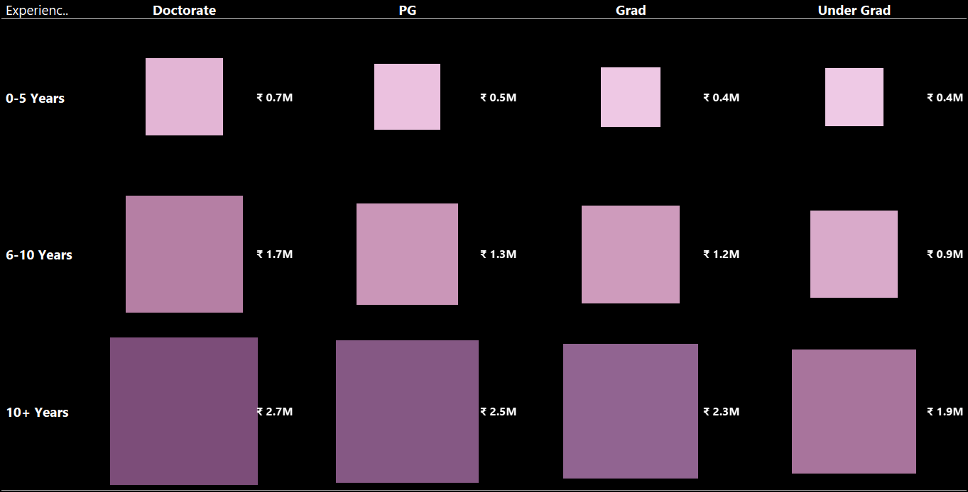
Data Insights : Education & Experience on CTC
More Knowledge + Relevant Experience = Higher pay.
Fig: Education + Experience = CTC

Slide 12
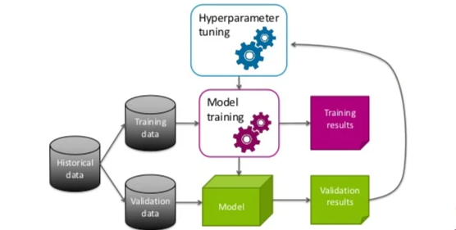
From Data to Decisions: Crafting the Perfect Model
Linear Regression (statsmodel)
Linear Regression (skitlearn)
Decision Tree
Ensemble Models
Optimized Models
Source: https://www.slideshare.net/

Slide 13
From Data to Decisions: Crafting the Perfect Model
Linear Regression Model (statsmodel)
Initial baseline model to understand relationships.
University PG, PG Specialization, Current CTC and Total Experience removed due to multicollinearity
Poor generalization to test data (R² = 38%).
Data Set | R-Squared | MAE | MSE | RMSE | MAPE
Train | 84.9% | 0.13 | 0.028 | 0.17 | 89.8%
Test | 39.3% | 0.13 | 0.029 | 0.17 | 54.9%
Table: Linear Regression Performance

Slide 14
From Data to Decisions: Crafting the Perfect Model
Linear Regression Model (skitlearn)
Improved accuracy with better handling of training/test splits.
R² = 97.9% with consistent error metrics.
Data Set | R-Squared | MAE | MSE | RMSE | MAPE
Train | 97.9% | 0.0224 | 0.00093 | 0.03 | 49.9%
Test | 97.8% | 0.0228 | 0.00098 | 0.03 | 12.6%
Table: Linear Regression Performance

Slide 15
From Data to Decisions: Crafting the Perfect Model
Decision Tree Regressor
Excellent Performance in both training and test datasets.
Extremely low errors indicate high accuracy in predictions.
Overfits the train data
Data Set | R-Squared | MAE | MSE | RMSE | MAPE
Train | 100% | 0 | 0 | 0 | 0%
Test | 99.8% | 0.0029 | 5.7e-05 | 0.0075 | 42.4%
Table: Decision Tree Performance

Slide 16
From Data to Decisions: Crafting the Perfect Model
Ensemble Model – Random Forest Regression
Highly accurate predictions: Explains almost all variance with minimal errors across datasets.
Generalizes well: Slightly higher test errors confirm reliable performance on unseen data.
Potential overfitting indication: Similar train and test results suggest the need for further validation.
Data Set | R-Squared | MAE | MSE | RMSE | MAPE
Train | 99.9% | 0.0009 | 0 | 0.0021 | 12.3%
Test | 99.9% | 0.0026 | 0 | 0.0061 | 2.18%
Table: Random Forest Performance

Slide 17
From Data to Decisions: Crafting the Perfect Model
Decision Tree – Optimized Model
Optimized Parameters: Tuned max_depth, min_samples_split, min_samples_leaf
Extensive Validation with 3-fold cross-validation, evaluating 432 fits to ensure robustness.
Prediction Error % (MAPE) is too high
Data Set | R-Squared | MAE | MSE | RMSE | MAPE
Train | 99.9% | 0.0024 | 0 | 0.0048 | 12.1%
Test | 99.9% | 0.0035 | 0.0001 | 0.0071 | 51.2%
Table: Optimized Decision Tree Performance

Slide 18
From Data to Decisions: Crafting the Perfect Model
Random Forest – Optimized Model
Optimized Parameters: Tuned n_estimators, max_depth, min_samples_split, min_samples_leaf, and
max_features
Extensive Validation with 5-fold cross-validation, evaluating 1620 fits to ensure robustness.
Very Low Prediction Error
Data Set | R-Squared | MAE | MSE | RMSE | MAPE
Train | 99.9% | 0.001 | 6.3e-06 | 0.0025 | 14.46%
Test | 99.9% | 0.0026 | 3.6e-05 | 0.006 | 2.2%
Table: Optimized Random Forest Performance

Slide 19
Finding out the Best Fit Model
Model | R2 – Train | R2- Test | RMSE - Train | RMSE-Test | MAPE-Train | MAPE - Test | Light Weight | Overfit / Underfit | Self-Explanatory
Linear Regression (statsmodel) | 84.9% | 39.3% | 0.17 | 0.17 | 89.8% | 54.9% | Yes | Underfit | Yes
Linear Regression (skitlearn) | 97.9% | 97.8% | 0.03 | 0.03 | 49.9% | 12.6% | Yes | Underfit | Yes
Decision Tree | 100 % | 99.8% | 0 | 0.0075 | 0% | 42.4% | No | Overfit | Yes
Random Forest | 99.9% | 99.9% | 0.0021 | 0.0061 | 12.3% | 2.2% | No | Balanced | No
Decision Tree- Optimized | 99.9% | 99.9% | 0.0048 | 0.0071 | 12.1% | 51.2% | No | Balanced | Yes
Random Forest - Optimized | 99.9% | 99.9% | 0.0025 | 0.006 | 14.5% | 2.2% | No | Balanced | No
Table: Model Comparison

Slide 20

Key Insights
Total experience - seniority, Current CTC strongly influence current salaries
Advanced education, particularly Doctorates, leads to higher pay
High performers and employees with balanced career stability (2–5 companies) earn more
Industry, location preferences, and publications have minimal impact on salary predictions
Random Forest Model: Achieved R² = 99.9%, ensuring precise and reliable salary predictions

Slide 21
Business Recommendation
Adopt predictive models for fair and unbiased salary decisions.
Benchmark salaries to address pay gaps and ensure equity.
Focus on key drivers: experience, education, and performance ratings.
Offer competitive salaries to enhance retention and trust.
Promote upskilling through certifications and mentorship programs.
Align budgets with predictive insights for effective workforce planning.

Slide 22
THANK YOU
Acknowledgement : Great Learning, Codebasics, ChatGPT

