Slide 1

PREDICTING CUSTOMER BUYING BEHAVIOUR

Slide 2
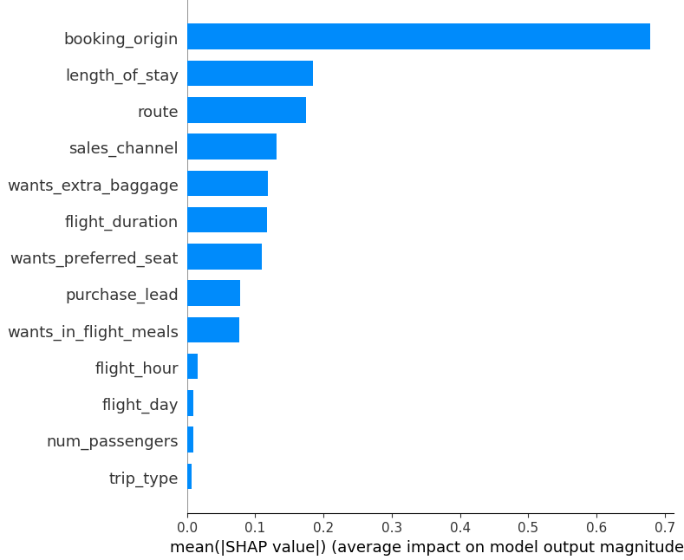
We have trained the data set with Random forest classifier model and received
ACCURACY: 85.33
booking_origin
length_of_stay
route
sales_channel
wants_extra_baggage
are the top 5 features which influence
Customer booking behavior

