Slide 1
Runtime-adaptive scratchpad buffering
RTL implementation and controlled performance study
University VLSI laboratory review • 14 functional tests • 129 simulations
01 / 24

Slide 2
Research questions
When does deeper multi-bank buffering outperform fixed two-bank ping-pong?
Can a runtime bank limit retain fixed four-bank performance with fewer eligible banks?
02 / 24

Slide 3
Memory-induced MAC stalls
Tile source
Transfer interface
Scratchpad banks
MAC engine
The MAC waits whenever no completed tile is READY.
03 / 24

Slide 4
Scratchpad model and tiling
Each tile contains activation and weight pairs; the MAC verifies their product sum.
Synchronous behavioral RAM represents an RTL scratchpad architecture.
Effective tile transfer cycles abstract slower memory latency; no physical SRAM or DRAM protocol is modeled.
04 / 24

Slide 5
Relevant prior accelerator work
Eyeriss: distributed local storage and row-stationary reuse.
TPU: large software-controlled on-chip memory with systolic compute.
Eyeriss v2: flexible network for varying layer shapes and sparse data.
05 / 24
Notes:
Sources: https://doi.org/10.1109/JSSC.2016.2616357 ; https://arxiv.org/abs/1704.04760 ; https://doi.org/10.1109/JETCAS.2019.2910232

Slide 6
Published results: conditions matter
Paper | Workload and platform | Published metric
Eyeriss | AlexNet conv., batch 4, ASIC | 35 frames/s; 0.0029 DRAM accesses/MAC
TPU | Production datacenter inference, ASIC | ~15–30× vs its CPU/GPU
Eyeriss v2 | Sparse MobileNet, batch 1, 65 nm | 1470.6 inferences/s; 12.6× vs Eyeriss
06 / 24
Notes:
Source values: IEEE JSSC Eyeriss DOI 10.1109/JSSC.2016.2616357; TPU ISCA DOI 10.1145/3079856.3080246; Eyeriss v2 JETCAS DOI 10.1109/JETCAS.2019.2910232. All comparisons here qualitative.

Slide 7
Cross-paper comparability
Our measured unit is cycles to complete a specified synthetic tile stream.
Published frame rates, inference rates, energy, and speedups use different workloads and hardware.
Therefore the published comparison is QUALITATIVE; controlled RTL baselines answer the scheduling question.
07 / 24
Notes:
Same primary sources as slide 6. The published metrics and baselines cannot be converted to our tile-cycle metric.

Slide 8
Single-buffer baseline
LOAD tile
COMPUTE tile
LOAD next tile
A bank cannot load while its tile is computing.
08 / 24

Slide 9
Fixed two-bank ping-pong
LOAD A
COMPUTE A + LOAD B
COMPUTE B + LOAD A
Tile IDs alternate between A and B.
09 / 24

Slide 10
Fixed four-bank availability baseline
EMPTY search
READY queue
MAC dispatch
Four banks are always eligible for new tile allocation.
10 / 24

Slide 11
Static cyclic multi-bank proxy
A tile's bank is fixed by tile ID modulo four; compute dispatch stays in tile order.
This is a generic literature-inspired RTL scheduling proxy, not an exact reproduction of a published accelerator.
It shares the same RAM, MAC, workload, and simulator as the proposed policy.
11 / 24

Slide 12
Limitation of fixed buffering depth
Stable compute-bound workloads often need only two eligible banks.
A fixed four-bank controller offers no extra cycle benefit in the measured steady 8/8 and 8/20 cases.
The new mechanism changes allocation eligibility according to observed starvation.
12 / 24

Slide 13
Runtime depth architecture
Stall statistics
Hysteresis control
Limit 2 / 3 / 4
Existing scheduler
Four physical banks remain. A lower limit blocks new allocation only; in-flight tiles drain.
13 / 24

Slide 14
Bank state machine
EMPTY
LOADING
READY
COMPUTING
MAC completion returns a bank to EMPTY.
14 / 24

Slide 15
Hysteresis and starvation observation
Observation window: 32 clocks. A stall event requires unfinished work, an available MAC, and no READY bank.
Stalls ≥ 8: 2→3→4. Stalls ≤ 2: 4→3→2. Other windows keep the current mode.
Integer comparisons avoid RTL division. Average limit is an effective buffering-depth metric, not measured power.
15 / 24

Slide 16
Verification record
Gate | Observed result
Functional correctness | 14 / 14 PASS; every tile MAC and ID checked
Performance sweep | 129 / 129 STATUS=PASS
Regression preservation | 103 old runs: seven core metrics unchanged
Analytical checks | 129 cycle/accounting checks; 6 VCD transitions
16 / 24
Notes:
Source: results/raw/*.log; scripts/analyze_results.py; docs/analytical_checks.md.

Slide 17
Fixed latency: buffering overlaps work
17 / 24
Notes:
Source: results/csv/fixed_latency_results.csv, 32 tiles, tile size 4, base 8/8.

Slide 18
Variable latency: a third bank helps
Fixed four-bank speedup over ping-pong: 539 / 497 = 1.0845×
18 / 24
Notes:
Source: results/csv/variable_latency_results.csv; 32 tiles; deterministic base 8/8 pattern.

Slide 19
Bank scaling saturates at three
19 / 24
Notes:
Source: results/csv/bank_scaling_results.csv; 32 tiles; variable base 8/8.

Slide 20
Stable workloads retain fixed-four timing
Runtime average limit: 2.022 and 2.045 banks
20 / 24
Notes:
Source: results/csv/adaptation_results.csv; 64 tiles; compute 8/20 and balanced 8/8.

Slide 21
Variable timing exposes a tradeoff
Runtime: 4.27% more cycles than fixed 4; average limit 2.50
21 / 24
Notes:
Source: results/csv/adaptation_results.csv; 64 tiles, deterministic variable base 8/8.

Slide 22
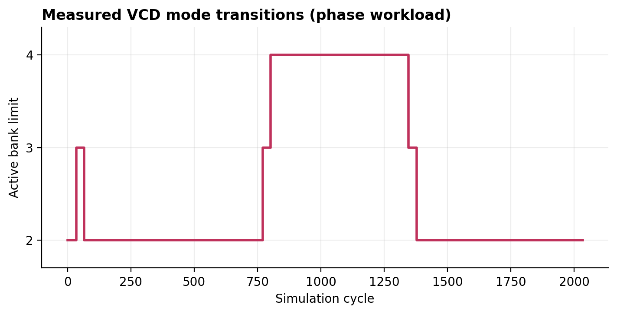
Phase change: measured mode waveform
2033 runtime vs 1991 fixed-four cycles; average limit 2.582 banks
22 / 24
Notes:
Source: results/waveforms/adapt_phase_runtime_adaptive.vcd, parsed by scripts/analyze_results.py. The image is waveform-derived, while quantitative bar charts elsewhere remain native editable objects.

Slide 23
Equal physical word count
Scenario (16 total RAM words) | Ping-pong 2×8 | Fixed 4×4 | Runtime 4×4
Variable, 64 tiles | 1072 | 983 | 1025
Phase, 96 tiles | 2054 | 1991 | 2033
23 / 24
Notes:
Source: results/csv/equal_storage_results.csv. Extra ping-pong words cannot hold another tile in the implemented controller.

Slide 24
Measured conclusion and limits
Four-bank capacity helps under the tested variable timing; the static four-bank proxy matches availability scheduling here.
Runtime depth matches fixed-four time in stable cases and averages near two eligible banks.
Under changing timing it averages 2.50–2.58 banks with 2.11–4.27% more cycles. No physical power benefit was measured.
24 / 24

