Slide 1

Fake news prediction using machine learning - Jayesh raj

Slide 2


introducTION
Today, the increased amount of information sources on internet creates the problem of information overflow. Filtering the relevant and genuine information is another challenge social media facing now.
Mobile phones and other electronic gadgets became quite common through which people get up-to-date information.
Verifying the authenticity of news needs to have prime importance though a difficult task. This helps to eliminate the rumors from spreading through social platforms.
By using the web scraping method, we assemble the news content related to the news posted for checking. The news prediction is done by implementing techniques like TF-IDF, Bag of words and Natural language processing.

Slide 3
TF-IDF
TF–IDF, short for term frequency–inverse document frequency, is a numerical statistic that is intended to reflect how important a word is to a document in a collection.
It is often used as a weighting factor in searches of information retrieval, text mining, and user modelling.
The tf–idf value increases proportionally to the number of times a word appears in the document and is offset by the number of documents in the corpus that contain the word, which helps to adjust for the fact that some words appear more frequently in general.
The tf–idf is one of the most popular term-weighting schemes today. A survey conducted in 2015 showed that 83% of text-based recommender systems in digital libraries use tf–idf.

Slide 4
Passive Aggressive Classifiers
The Passive-Aggressive algorithms are a family of Machine learning algorithms that are not very well known by beginners and even intermediate Machine Learning enthusiasts. However, they can be very useful and efficient for certain applications.
Passive-Aggressive algorithms are generally used for large-scale learning. It is one of the few ‘online-learning algorithms‘. In online machine learning algorithms, the input data comes in sequential order and the machine learning model is updated step-by-step, as opposed to batch learning, where the entire training dataset is used at once.
This is very useful in situations where there is a huge amount of data and it is computationally infeasible to train the entire dataset because of the sheer size of the data. We can simply say that an online-learning algorithm will get a training example, update the classifier, and then throw away the example.

Slide 5
WORKING OF THE MODEL
Flask is a Python-based micro framework used for developing small-scale websites. Flask is very easy to make Restful APIs using python. As of now, we have developed a model i.e model.pkl , which can predict a class of the data based on various attributes of the data.
Flask script : Before starting with the coding part, we need to download flask and some other libraries. Here, we make use of a virtual environment, where all the libraries are managed which makes both the development and deployment job easier.
Here we import the libraries, then using app=Flask(__name__) we create an instance of flask. @app.route(‘/’) is used to tell flask what URL should trigger the function index() and in the function index, we use render_template(‘index.html’) to display the script index.html in the browser.
In this way we use the flask to connect our model from frontend part to machine learning part so as to make the work more efficient.

Slide 6
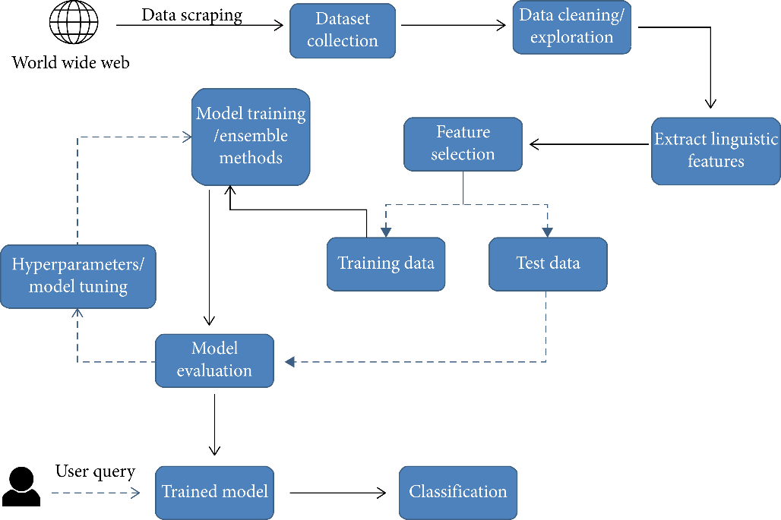
Workflow diagram

Slide 7
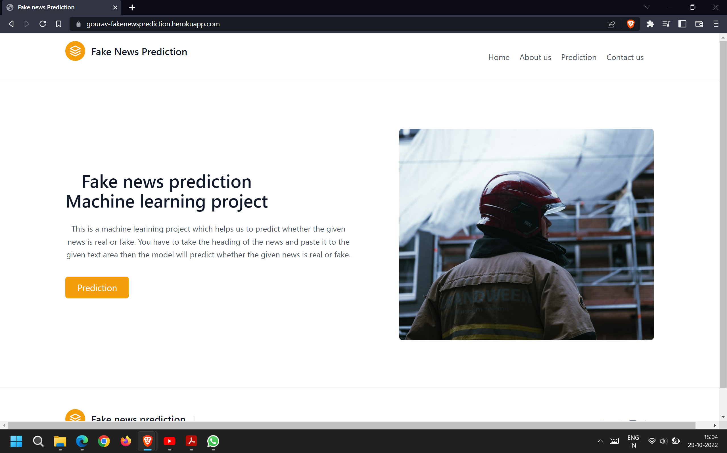

Slide 8
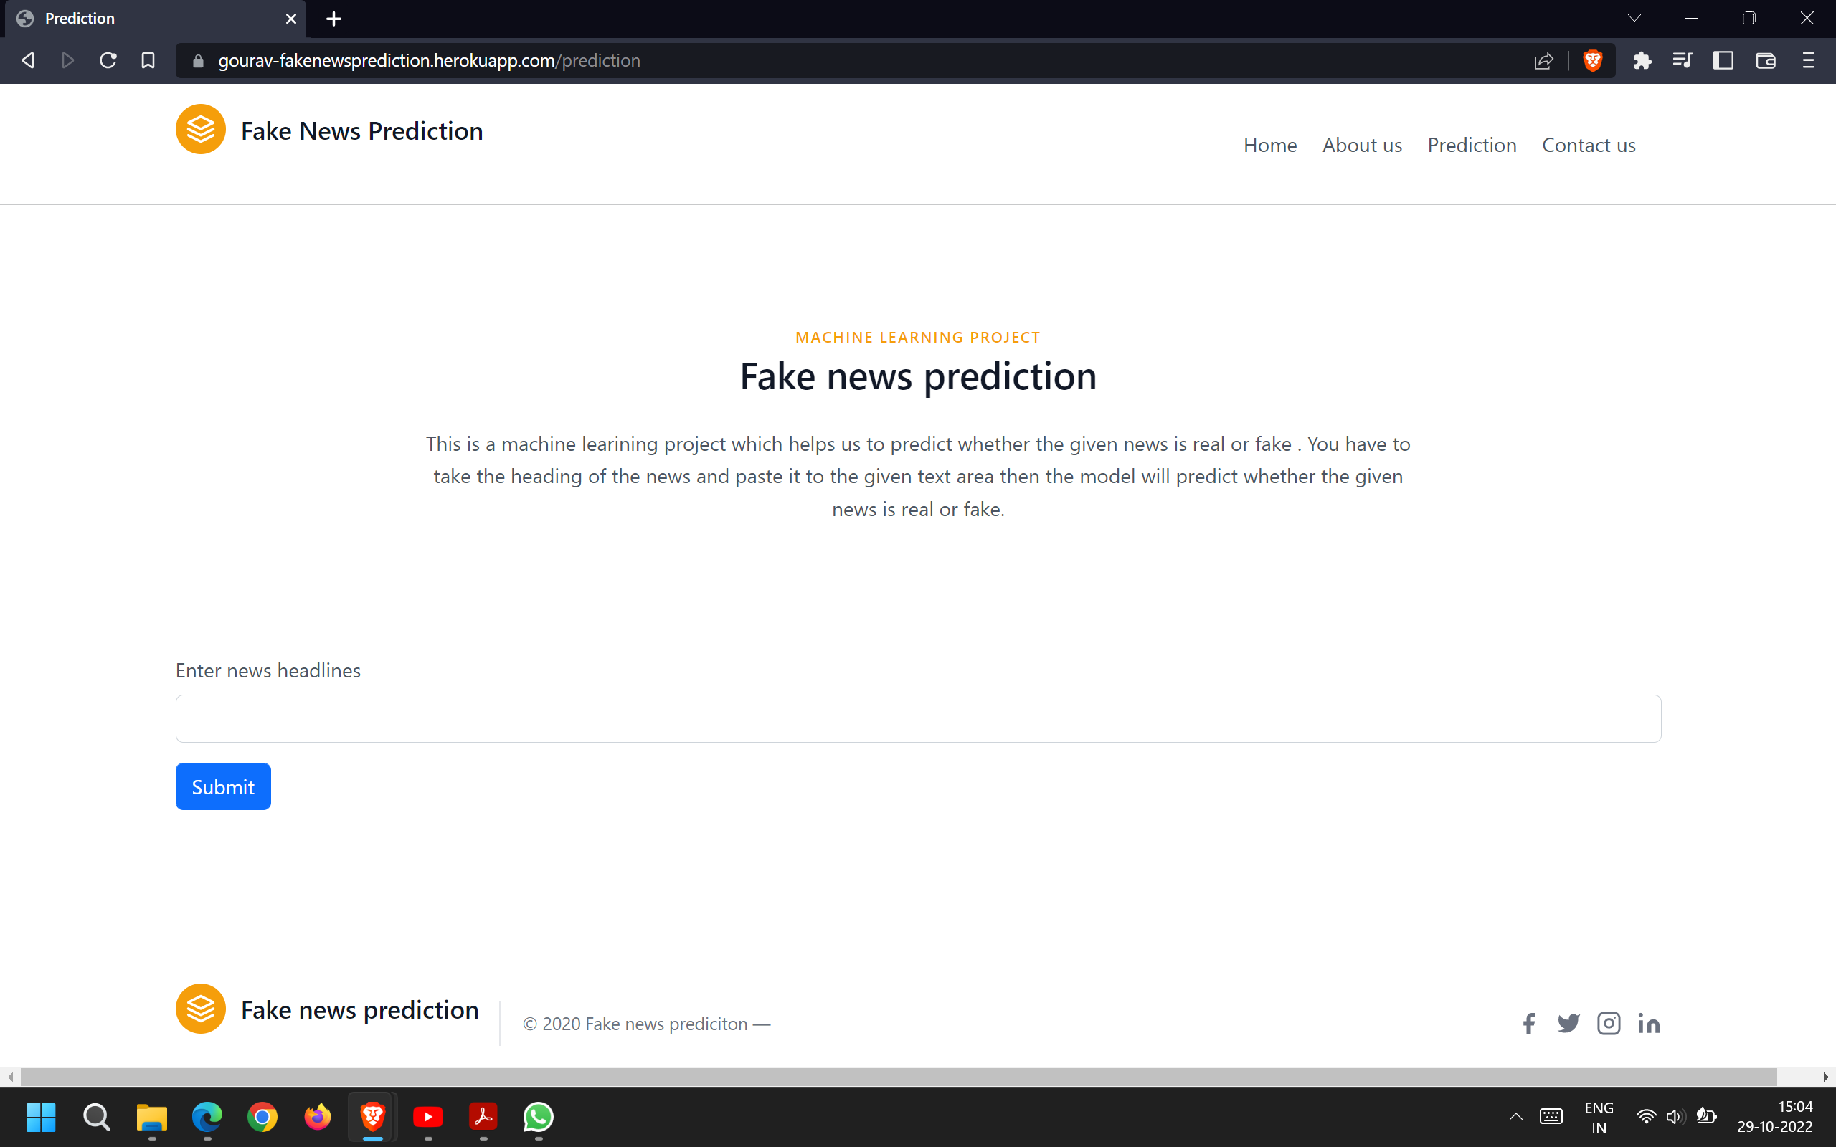

Slide 9
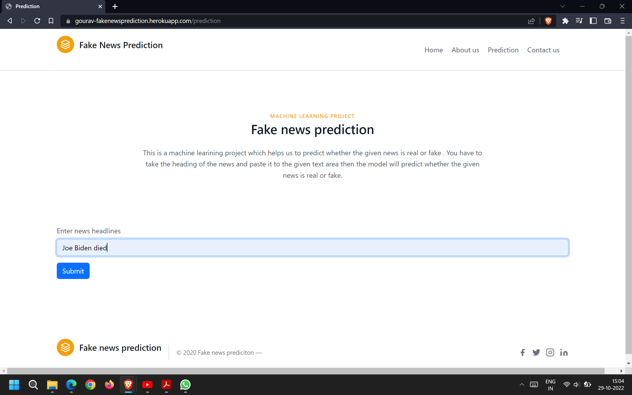

Slide 10
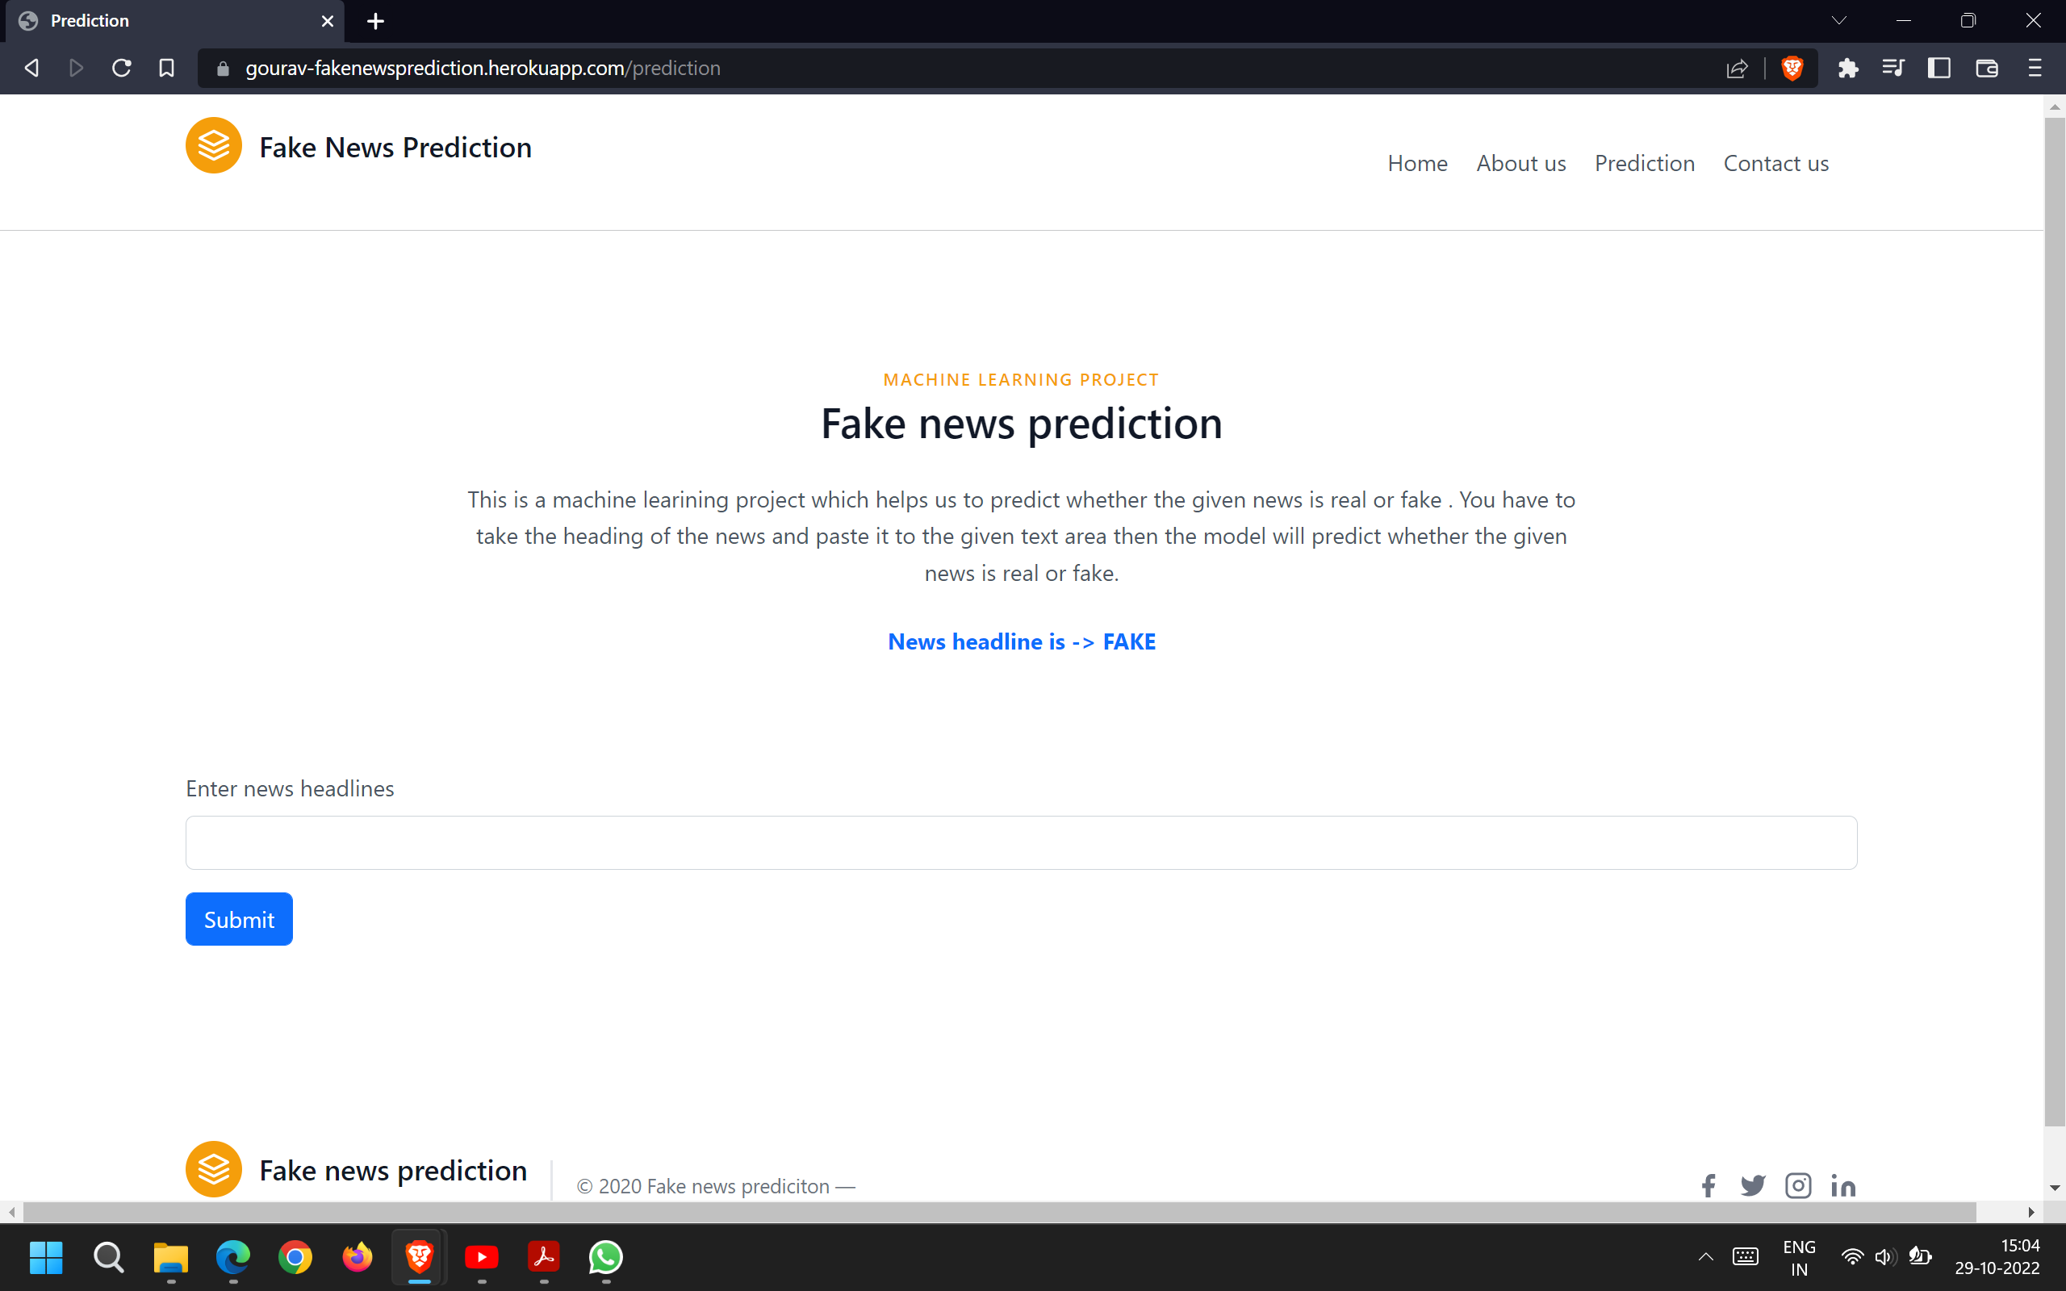

Slide 11
Conclusion
Prior to believe in bogus news and sharing it through web-based media, we should discover the reality behind it.
Here, we use a text similarity finding algorithm for predicting whether the news is fake or accurate. We use five search engines, initially, we use only one search engine for scraping, even though the accuracy of prediction is not so great.
Our work has led us to the conclusion that including more search engines it improves the system to get better results.
The findings of this study indicate that the system achieved accuracy of up to 90% in detecting news as fake or real
Hence, future studies on the current topic are therefore needed to improve the accuracy of the system by adding some more search engines for scraping, fetching more data from social media, and using another text similarity checking algorithm.

