Slide 1
DevOps

Slide 2
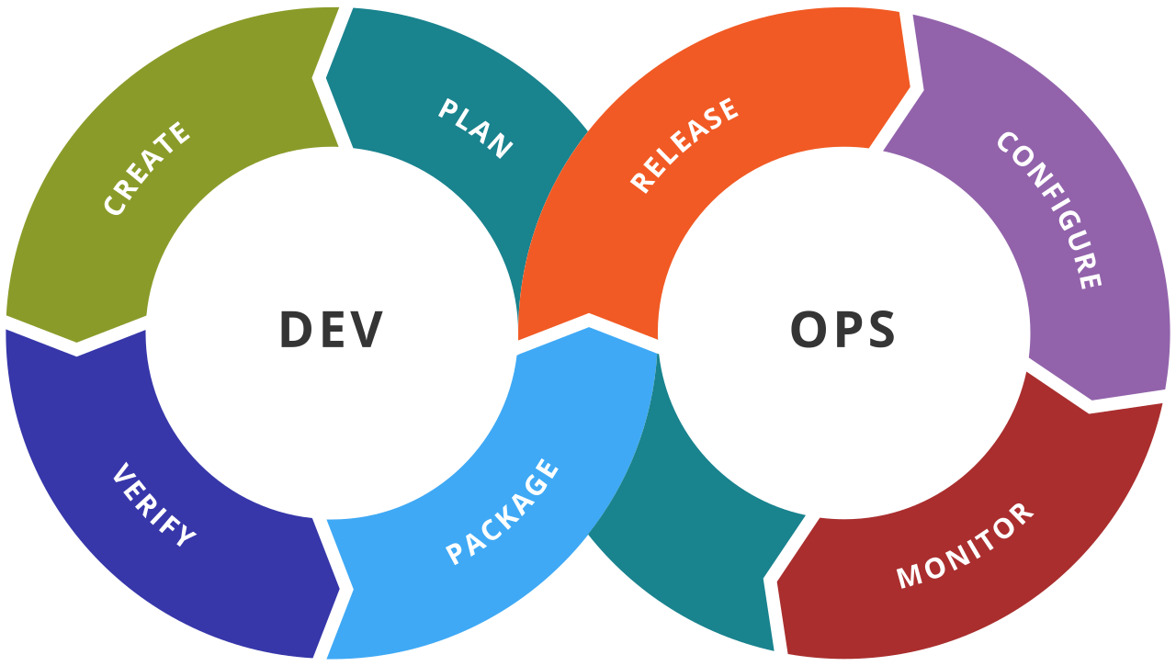
What is DevOps?

Slide 3
DevOps Ecosystem
Container creation: Docker
Version control: Git, Jira
Build: Maven, Gradle
Testing: Junit, Selenium
Deployment: Jenkins
Orchestration: Kubernetes

Slide 4
Containerisation

Slide 5
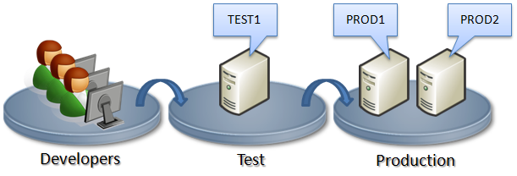
Background
The same code works on Developers machines, but not on Test/Production servers!

Slide 6
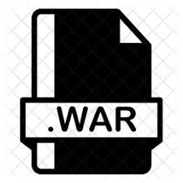
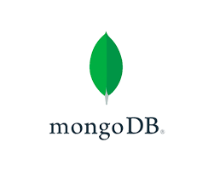

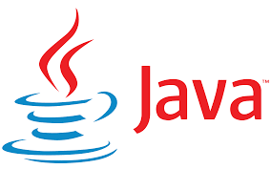
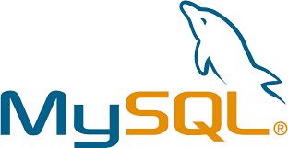

How to use Container Technology
Developers develop and test code (e.g. bank.war)
We do not give the WAR file to the customer now
We bundle all the dependencies of our WAR file with it: Java, MySQL, Tomcat, Spring Boot, MongoDB, …
How?

Slide 7
How to use Container Technology
Create a Docker Image (docker build command)
Docker Image
Take anywhere and run – it will always work and will always produce consistent output

Slide 8
How to use Container Technology
Execute the built Docker Image (docker run command)
Docker Image
Docker Container

Slide 9
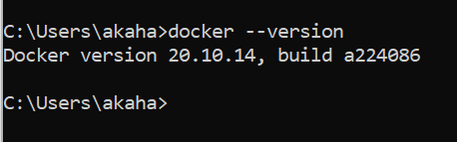
Docker Installation on Windows – 1
Install: https://docs.docker.com/desktop/windows/install/
(Docker Desktop is actually a hidden VM containing Linux)
If you get this error: ‘Docker WSL 2 installation is incomplete’
Download the package (Step 4 in the link): https://docs.microsoft.com/en-us/windows/wsl/install-manual#step-4---download-the-linux-kernel-update-package
Restart docker

Slide 10
Problems?
First enable WSL so you can run a command in Administrator PowerShell:
dism.exe /online /enable-feature /featurename:Microsoft-Windows-Subsystem-Linux /all /norestart
Update to the WSL2 by this command in PowerShell:
dism.exe /online /enable-feature /featurename:VirtualMachinePlatform /all /norestart
Also see this: https://www.c-sharpcorner.com/article/how-to-install-docker-desktop-and-troubleshoot-issues-in-windows-machine/

Slide 11
‘Hello World’ in Docker

Slide 12
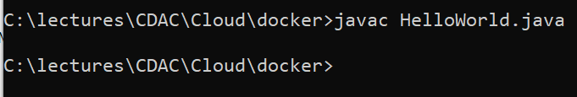
‘Hello World’ in Java using Docker
Create HelloWorld.java in C:\lectures\CDAC\Cloud\docker\hello-world-java\HelloWorld.java
public class HelloWorld {
public static void main(String[] args) {
System.out.println("Hello, World");
}
}
Compile: javac HelloWorld.java
Test: java HelloWorld

Slide 13
Create Dockerfile
C:\lectures\CDAC\Cloud\docker\hello-world-java\Dockerfile
# Use the official OpenJDK image as a parent image
FROM openjdk:latest
# Set the working directory to /app
WORKDIR /app
# Copy the current directory contents into the container at /app
COPY . /app
# Compile the Java code
RUN javac HelloWorld.java
# Run the program when the container starts
CMD ["java", "HelloWorld"]
These will be created/added because of the commands in Dockerfile
HelloWorld.class
.app folder
We want JDK, but it comes with Oracle Linux User Space (not Kernel)
OpenJDK
Oracle Linux
Docker (VM with a Linux Kernel)
These two are already there
Our OS (Host)

Slide 14
End Result
These will be created/added because of the commands in Dockerfile
HelloWorld.class
.app folder
HelloWorld.class
Layer 4
We want JDK, but it comes with Oracle Linux User Space (not Kernel)
OpenJDK
.app folder
Layer 3
OpenJDK
Layer 2
Oracle Linux
Oracle Linux
Layer 1
Docker (VM with a Linux Kernel)
Resulting Docker Image
These two are already there
Our OS (Host)

Slide 15
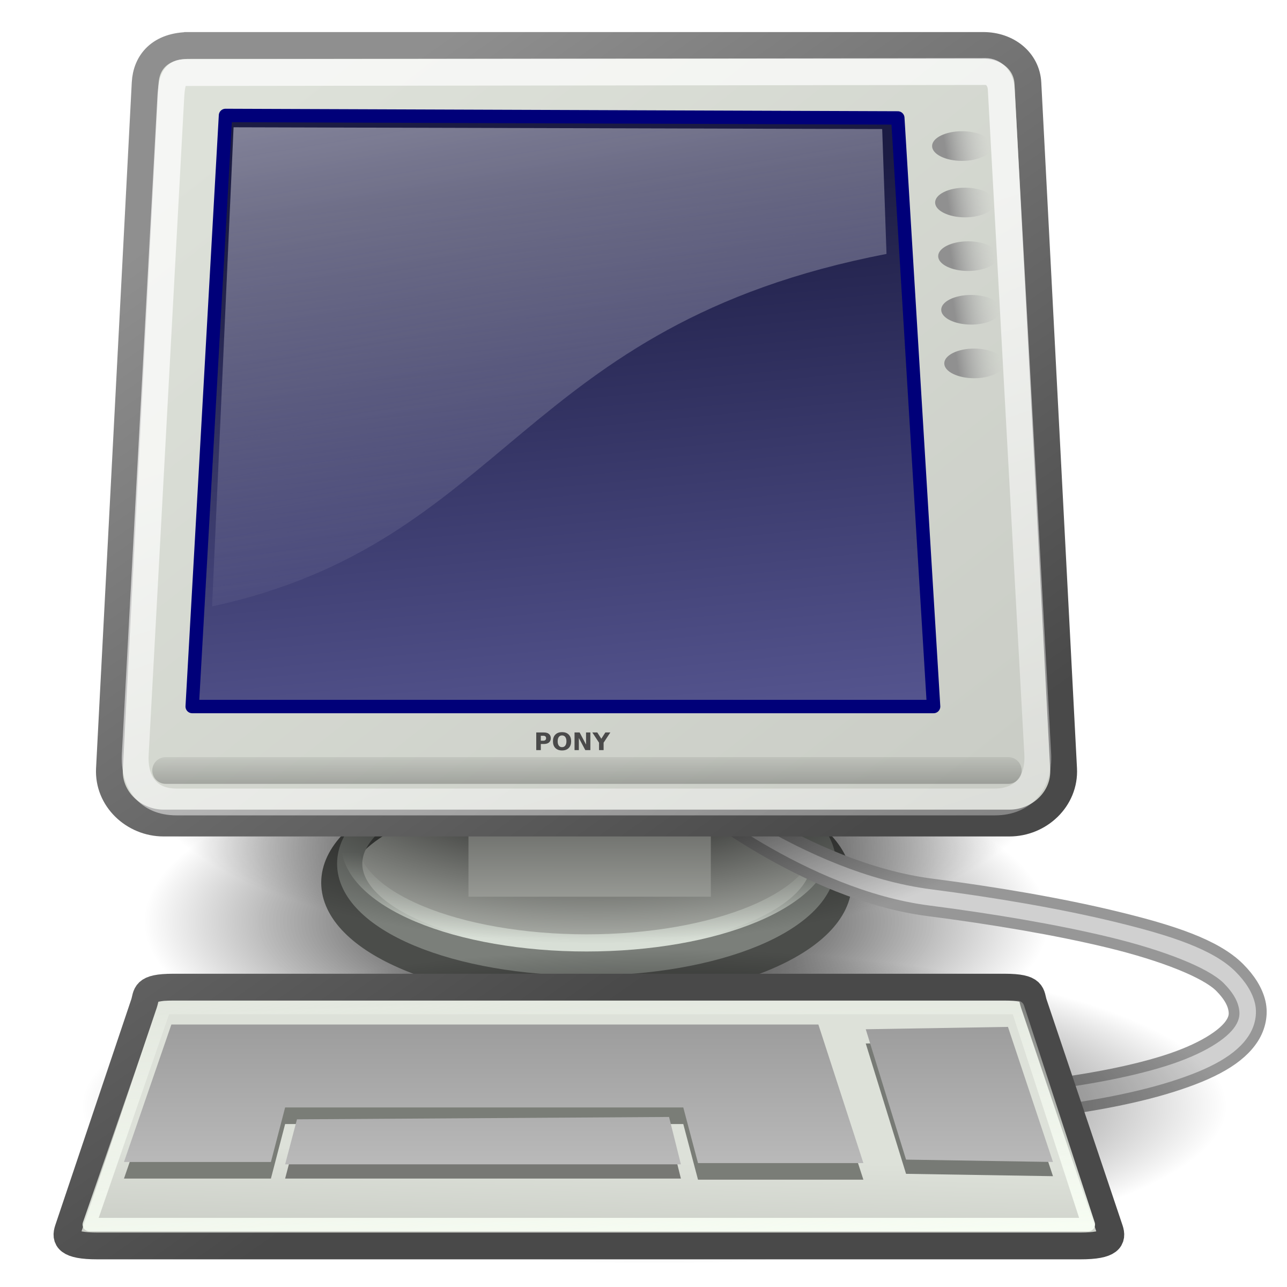
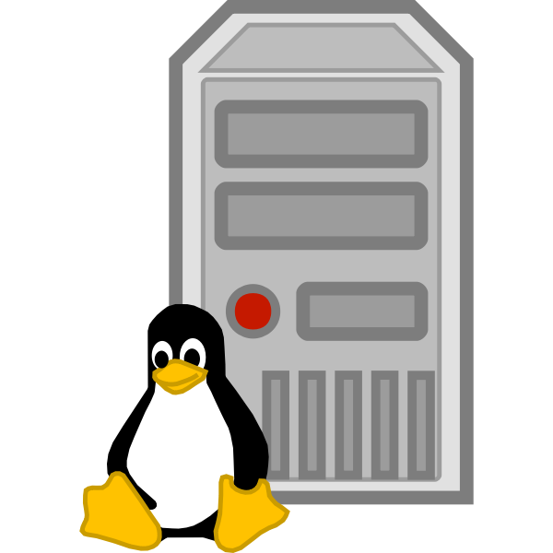
Using this Image Anywhere
HelloWorld.class
Layer 4
.app folder
Layer 3
OpenJDK
Layer 2
Oracle Linux User Space
Layer 1
Resulting Docker Image
Docker (VM with a Linux Kernel)
Docker (VM with a Linux Kernel)
Windows (Host)
Ubuntu Linux (Host)

Slide 16
Deployment Option 1: Traditional Deployment
Application
Libraries and Frameworks
Operating System
Hardware

Slide 17
Deployment Option 2: Virtualized Deployment
Virtual Machine
Virtual Machine
Virtual Machine
Application
Application
Application
Libraries and Frameworks
Libraries and Frameworks
Libraries and Frameworks
Operating System
Operating System
Operating System
Hypervisor
Operating System
Hardware

Slide 18
Deployment Option 3: Containerized Applications
Container
Container
Container
Application
Application
Application
Frameworks
Frameworks
Frameworks
Libraries
Libraries
Libraries
Docker
Operating System
Hardware

Slide 19
Deployment Option 4: Container Orchestration
Kubernetes
Container
Container
Container
Application
Application
Application
Frameworks
Frameworks
Frameworks
Libraries
Libraries
Libraries
Docker
Operating System
Hardware

Slide 20
Important points to avoid confusion!
We will see other examples where we have RUN and CMD commands in a Dockerfile – they are different
RUN command is used as a step in building a Docker image. Example below:
RUN javac Main.java
This step will help us in compiling a Java program, which we next want to execute
Now we can use the CMD command:
CMD ["java", "Main"]
To execute the Dockerfile: docker run …
So, RUN is an intermediate command, and a Dockerfile can have multiple RUN commands
Also, RUN inside Dockerfile and docker run are different commands with different purposes
CMD is the command that finally runs the file that we want to execute when we use a docker run command

Slide 21
Build and Execute
# Build the Docker image
docker build -t java-hello-world .
# Run the Docker container
docker run java-hello-world

Slide 22
Dockerfile Commands
FROM - specifies the base image for the Docker image.
RUN - executes a command in the Docker image during the build process.
COPY - copies files or directories from the host file system into the Docker image.
ADD - similar to COPY, but can also handle URLs and can extract tar files.
WORKDIR - sets the working directory for any RUN, CMD, ENTRYPOINT, COPY, or ADD commands that follow it.
ENV - sets environment variables in the Docker image.

Slide 23
Docker Management Commands
pull – To pull images from the DockerHub repository
Example: docker pull ubuntu
build – To build a docker image using Dockerfile
Example: docker build -t HelloWorld .
run – To execute a docker container from docker (it: Interactive terminal)
Example: docker run -it HelloWorld
ps or container list – To list containers
Example: docker ps or docker container list

Slide 24
Docker Commands – Build Commands
docker build -t imagename/tag: Builds and tags an image for easier tracking
Example: docker build –t my-java-app:1.0 .

Slide 25
Docker Commands – Cleanup Commands
docker image prune: Clears all unused images
docker system prune: Removes all stopped containers, all networks not used by containers, all dangling images, and all build cache
docker image rm image: Removes an image
docker rm container: Removes a running container
docker kill $ (docker ps -q): Stops all running containers
docker rm $(docker ps -a -q): Removes all stopped containers

Slide 26
Docker Commands – Container Interaction Commands
docker start container: Starts a new container
docker stop container: Stops a container
docker pause container: Pauses a container
docker restart container: Restarts a container
docker export container: Exports container contents to a tar archive
docker exec -it container: Runs a command in a container

Slide 27
Docker Commands – Run Command
docker run (options) image (command) (arg...)
Main options
--detach , -d: Runs a container in the background and prints the container ID
--env , -e: Sets environment variables
--name: Assigns a name to a container
--network: Connects a container to a network
--rm: Removes container when it stops

Slide 28
Docker Commands – Container Inspection Commands
docker ps (OR docker container list): Lists all running containers
docker -ps –a: Lists all containers
docker inspect <container id>: Displays low-level information about a container
docker logs <container id>: Gathers the logs for a container
docker stats <container id>: Shows container resource usage statistics

Slide 29
Docker Commands – Image Commands
docker image ls (OR docker image list): Lists images
docker image rm <image id>: Removes an image
docker inspect <image id>: Displays low-level information about an image

Slide 30
Docker Commands – Registry Commands
docker login: Logs in to a registry (Docker Hub)
docker logout: Logs out from a registry
docker pull mysql: Pulls an image from a registry
docker push cdac/my-java-project:2.0 Pushes an image to a registry

Slide 31
Docker Commands – Network Commands
docker network create <network name>: Creates a new network
docker network rm <network name>: Removes a specified network
docker network ls: Lists all networks
docker network connect <network name> <container>: Connects a container to a network
docker network disconnect <network name> <container>: Disconnects a container from a network
docker network inspect <network name>: Displays detailed information about a network

Slide 32
Docker Management Commands
stop – To stop a running container
Example: docker stop <container id>
rm – To remove a running container
Example: docker rm <container id>
list – To list docker images
Example: docker images or docker image ls or docker images list
rmi – To remove an image
Example: docker rmi <image id>
docker kill * OR docker ps –q: Stop all the containers
docker rm * OR docker ps –a -q: Remove all stopped containers

Slide 33
Java Application with User Input

Slide 34
Create PrimeNumber.java (C:\lectures\CDAC\Cloud\docker\javainputdocker)
import java.util.Scanner;
public class PrimeNumber {
public static void main(String[] args) {
Scanner sc = new Scanner(System.in);
System.out.println("Prime number check ... Please enter a number: ");
int num = sc.nextInt();
boolean isPrime = true;
for(int i = 2; i < num/2; i++) {
if(num % i == 0) {
isPrime = false;
break;
}
}
if(isPrime)
System.out.println(num + " is a prime number");
else
System.out.println(num + " is not a prime number");
sc.close();
}
}

Slide 35
Dockerfile (C:\lectures\CDAC\Cloud\docker\javainputdocker)
FROM openjdk:12-alpine
COPY . /usr/src/myjavaapp
WORKDIR /usr/src/myjavaapp
RUN javac PrimeNumber.java
CMD ["java", "PrimeNumber"]

Slide 36
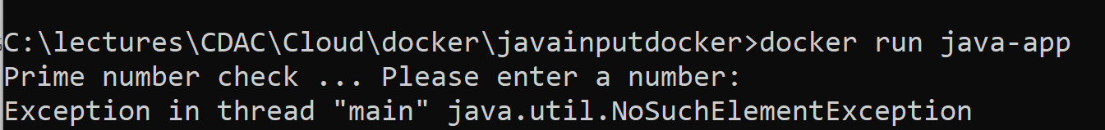
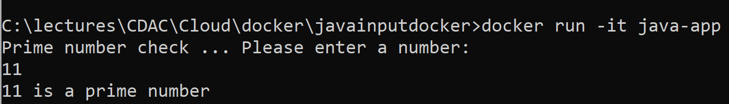
Build image and run
docker build -t java-app .
docker run java-app
To resolve: docker run -it java-app

Slide 37
Running Tomcat using an Interactive Terminal

Slide 38
Steps
Pull the latest tomcat server:
docker pull tomcat:latest
docker run command with –it option to start the container:
docker run -it --name tomcat-container -p 8080:8080 tomcat:latest /bin/bash
Connect to the interactive terminal
docker exec -it tomcat-container /bin/bash
Run any command, e.g. start tomcat
cd /usr/local/tomcat/bin
./catalina.sh run
Try accessing it on localhost:8080

Slide 39
Tomcat using Docker

Slide 40
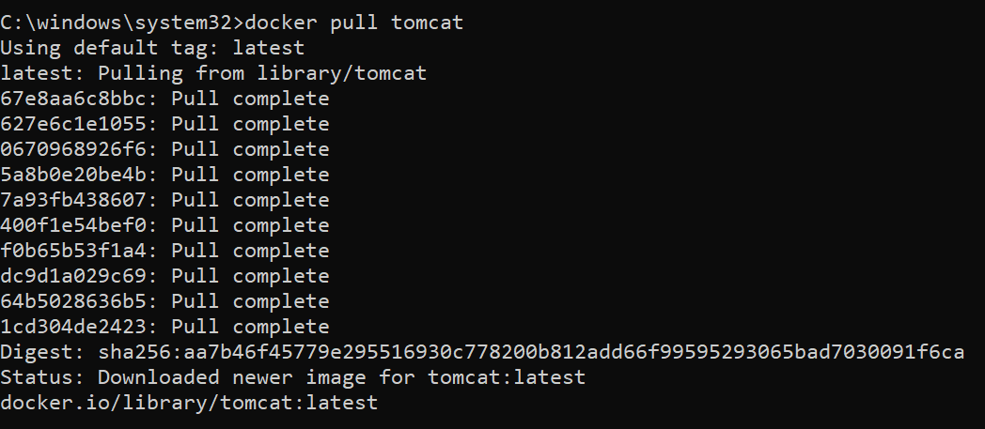
Downloading Tomcat Image
docker pull tomcat

Slide 41

Run the Tomcat Container and Test
docker container run –d –p 9999:8080 tomcat
Note: d means run in detached (background) mode
If you get a 404 error for localhost:9999, see next slide

Slide 42
Solving the Tomcat 404 Error – 1
docker container stop 3f
docker container rm 3f
docker container prune -> Delete all the stopped containers
docker container run -d --name mytomcat -p 9999:8080 tomcat

Slide 43
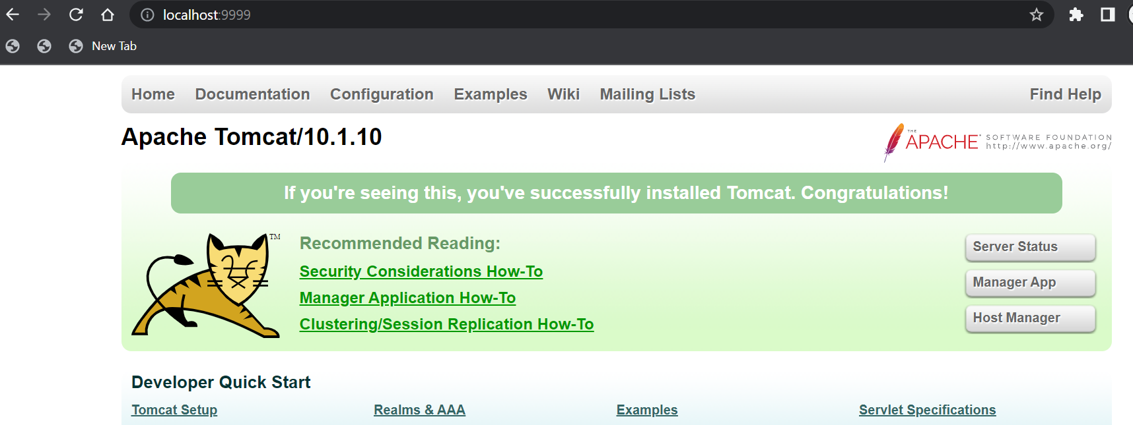
Solving the Tomcat 404 Error – 2
docker exec -it mytomcat /bin/bash
root@3ac9336e730d:/usr/local/tomcat# mv webapps webapps2
root@3ac9336e730d:/usr/local/tomcat# mv webapps.dist/ webapps
root@3ac9336e730d:/usr/local/tomcat# exit
exit

Slide 44
What was the Problem?
The webapps folder is moved to the webapps.dist folder.
So, the webapps folder is empty and there are no files to serve on the browser.
That is when you saw the error message The origin server did not find a current representation for the target resource or is not willing to disclose that one exists.
To re-enable the webapps, we need to move the files from webapps.dist to webapps.

Slide 45
To Create cdac Directory
While in the terminal:
apt-get update
apt install nano
Then create WEB-INF, web.xml etc

Slide 46
Assignment
Create a Java program to display all the records from student table and display them on the screen
Data in the student table will be come from MySQL
Student table will have three columns: PRN, Name, Course
Output format is not important
The Java program will run on the command prompt and MySQL should run in its own Docker container

