Slide 1
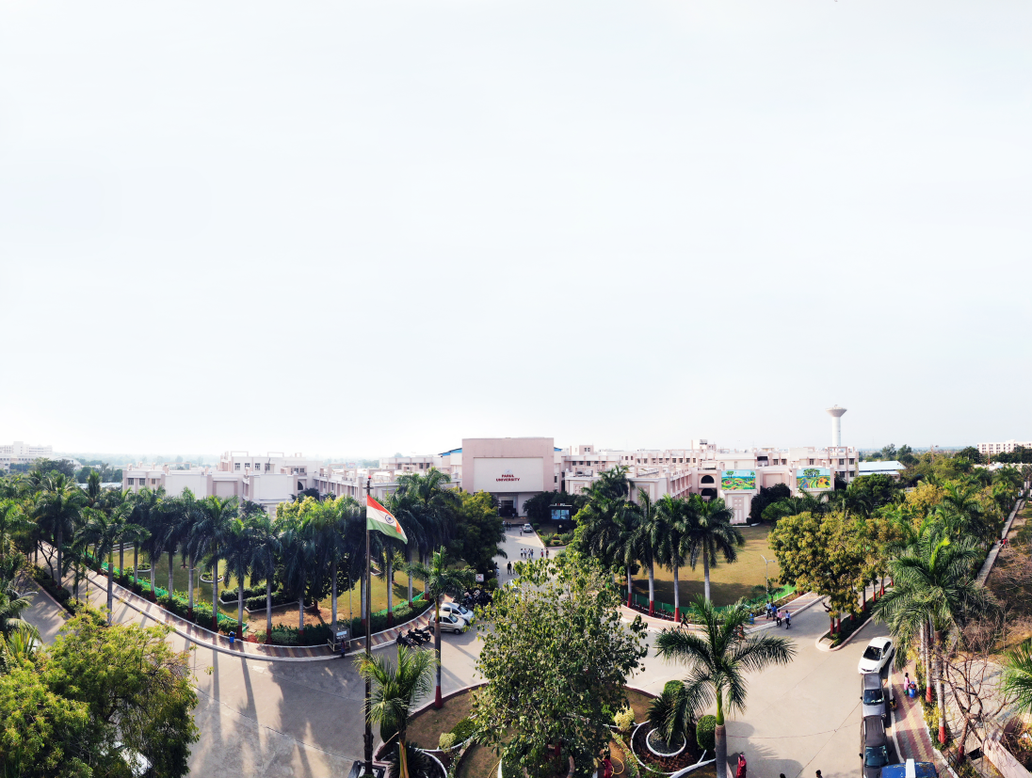


Distributed Computing
Prof. Yassir Farooqui, Assistant Professor
Computer Science & Engineering

Slide 2
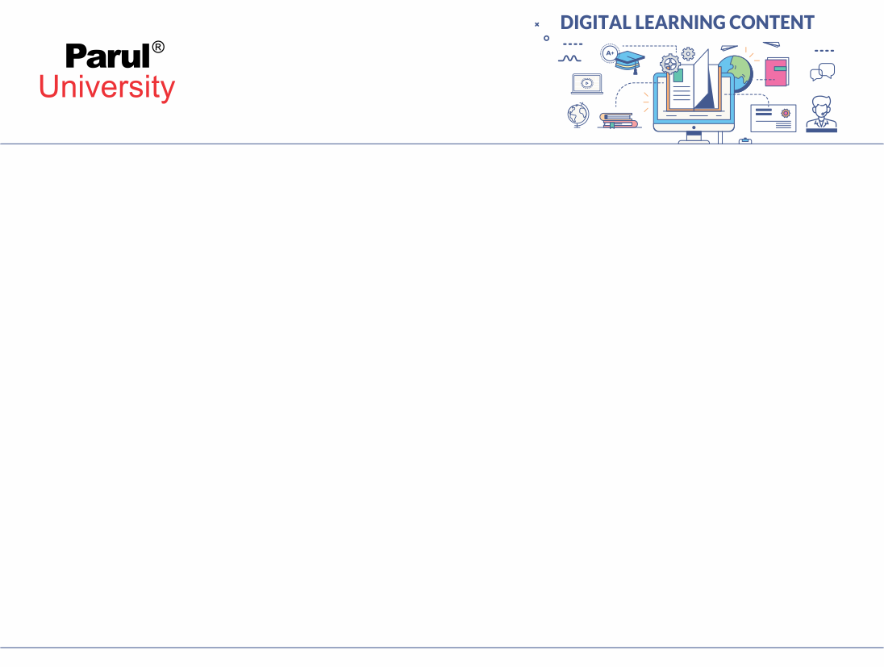

Characteristics of Distributed Systems
Examples of distributed systems
Resource sharing and the web
Architectural models
Fundamental model
Image source: Google

Slide 3
GOALS:COMMON CHARACTERISTICS
Making resources accessible
Openness
Transparency
Security
Scalability
Failure Handling
Concurrency
Heterogeneity

Slide 4
Making resources accessible
The main goal of a distributed system is to make it easy for the users (and applications) to access remote resources, and to share them in a controlled and efficient way.
Resources can be just about anything, but typical examples include things like printers, computers, storage facilities, data, files, Web pages, and networks,

Slide 5
OPENNESS
An open distributed system is a system that offers services according to standard rules that describe the syntax and semantics of those services.
Detailed interfaces of components need to be published.
New components have to be integrated with existing components. An open distributed system should also be extensible.
Differences in data representation of interface types on different processors (of different vendors) have to be resolved.

Slide 6
TRANSPARENCY
Distributed systems should be perceived by users and application programmers as a whole rather than as a collection of cooperating components.
Ability to hide the fact that process and resources are distributed .
Transparency has different aspects.
These represent various properties that distributed systems should have.

Slide 7
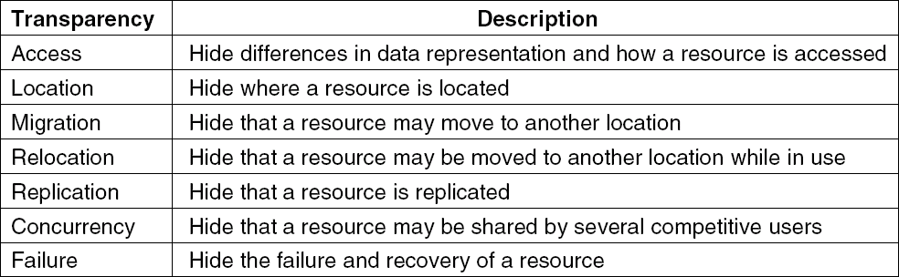
Transparency in a Distributed System

Slide 8
ACCESS TRANSPARENCY
Enables local and remote information objects to be
accessed using identical operations.
Example: File system operations in NFS.
Example: Navigation in the Web.
Example: SQL Queries

Slide 9
CONCURRENCY TRANSPARENCY
Enables information objects to be accessed
without knowledge of their location.
Example: File system operations in NFS
Example: Pages in the Web
Example: Tables in distributed databases

Slide 10
REPLICATION TRANSPARENCY
Enables multiple instances of information objects to be used to increase reliability and performance without knowledge of the replicas by users or application programs
Example: Distributed DBMS
Example: Mirroring Web Pages.

Slide 11
FAILURE TRANSPARENCY
Enables the concealment of faults
Allows users and applications to complete their tasks despite the failure of other components.
Partial failure transparency is achievable but complete failure transparency is not possible
Example: Database Management System

Slide 12
MIGRATION TRANSPARENCY
Allows the movement of information objects within a system without affecting the operations of users or application programs
Relocation Transparency:
Situation in which resources can be relocated while they are being accessed without the user or application noticing anything. In such cases, the system is said to support relocation transparency.

Slide 13
PERFORMANCE TRANSPARENCY
Allows the system to be reconfigured to improve performance as loads vary.
Load should be evenly distributed among all the machines.

Slide 14
SCALING TRANSPARENCY
Allows the system and applications to expand in scale without change to the system structure or the application algorithms.
Example: World-Wide-Web
Example: Distributed Database

Slide 15
SCALING TRANSPARENCY
Allows the system and applications to expand in scale without change to the system structure or the application algorithms.
Example: World-Wide-Web
Example: Distributed Database

Slide 16
HETEROGENEITY
Variety and differences in
Networks
Computer hardware
Operating systems
Programming languages
Implementations by different developers

Slide 17
Examples of distributed systems
Google File System (GFS): GFS is a distributed file system developed by Google to store and manage large amounts of data across multiple servers. It provides fault tolerance, scalability, and high-performance access to files.
Apache Hadoop: Hadoop is an open-source framework that enables the distributed processing of large datasets across clusters of computers. It consists of the Hadoop Distributed File System (HDFS) for storage and the MapReduce programming model for processing data in parallel.
Amazon DynamoDB: DynamoDB is a fully managed NoSQL database service provided by Amazon Web Services (AWS). It is designed to scale horizontally and distribute data across multiple servers to provide high availability and low latency.

Slide 18
Examples of distributed systems
4. Bitcoin Blockchain: The Bitcoin blockchain is a decentralized distributed ledger that maintains a record of all Bitcoin transactions. It is distributed across a network of computers (nodes) and ensures the security and integrity of the cryptocurrency system.
5. Twitter: Twitter is a social media platform that relies on a distributed system architecture to handle its massive user base and high traffic. It utilizes sharding, replication, and load balancing techniques to distribute user tweets and handle interactions in real-time.
6. Dropbox: Dropbox is a cloud storage and file synchronization service that utilizes a distributed system to store and replicate user data across multiple servers. It ensures data availability, redundancy, and efficient file synchronization across devices.

Slide 19
Resource Sharing & web
Distributed computing: the use of interconnected computers to solve complex problems or perform tasks.
Resource sharing: the practice of sharing computing resources across multiple devices or systems.
The relationship between resource sharing and the web in distributecomputing.
Resource sharing involves the sharing of various computing resources, such as processing power, storage, and software.
Sharing resources allows for efficient utilization and cost optimization.
Examples of shared resources: CPUs, memory, disk space, network bandwidth, and software libraries.

Slide 20
Architectural Model
Architectural Model is a type of system model in distributed system which has various hardware and software architectures exist that are usually used for distributed computing.
Architectural Model deals with organization of components across the network and their interrelationship.
This architectural model can be discussed at lower level and upper level.
At lower level architectural model interconnect multiple CPUs and at upper level it interconnect processes running on those CPUs.

Slide 21
Architectural Model
1. Client Server Architectural Model
Client Server Model is the most popular and most widely used distributed system architecture.
Client Server architecture is also known as request-response architecture.
In this architectural model the client makes a request to the server and the server will fulfill the response.
Client and server roles are assigned and changeable.

Slide 22
Architectural Model
Advantages of Client Server Model
Centralized system where all the data can be stored in a single place.
Requires less maintenance cost and entire system is maintained by the server.
Increases the speed of the resource sharing.
Disadvantages of Client Server Model
Prone to attacks like Denial of Service and viruses in the server.
In case of server failure the entire system will fail.
Spoofing and modification of data packets can be done during transmission.

Slide 23
Architectural Model
2. Peer to Peer Architectural Model
Unlike client-server model, Peer to Peer Model (P2P) does not distinguish between client and server instead each node can either be a client or server depending on whether the node is requesting or providing the services.

Slide 24
Architectural Model
Advantages of P2P Model
Setup and maintenance of network is easy.
Cost efficient as each node in this model acts as a server.
Each node is independent of each other so if one node stops working it won't affect other node.
Disadvantages of P2P Model
No backup of data can be done as there is no central server.
Security issues because each node is independent and hence difficult to secure the complete network.

Slide 25
Architectural Model
Difference Between Client Server vs Peer to Peer Model
Client Server Model | Peer to Peer Model
Asymmetric Data Flow | Symmetric Data Flow
Different network software for client and server | Same network software for client and server
Client is in active role and server is in passive role | Any node can be active or passive

Slide 26
Fundamental Model
Description of properties that are present in all distributed architectures.
Interaction Models – Issues dealing with the interaction of process such as performance and timing of events.
Failure Models – Specification of faults that can be exhibited by processes and communication channels.
Security Models – Threats to processes and communication channels

Slide 27
Fundamental Model
Description of properties that are present in all distributed architectures.
Interaction Models – Issues dealing with the interaction of process such as performance and timing of events.
Failure Models – Specification of faults that can be exhibited by processes and communication channels.
Security Models – Threats to processes and communication channels

Slide 28
Performance Considerations
Latency – delay between the transmission start of a message and its receipt.
Time taken by the actual message transmission will vary with load of message traffic and time required by OS services to process messages.
Bandwidth – amount of information that can be transmitted over a computer network in a given amount of time.

Slide 29
Two Interaction Model Flavours
Synchronous Model
Boundaries known for time to execute step, message transmission and clock drift rate.
Timeouts typically used to detect failures
Ineffective resource sharing
Asynchronous Model
No assumptions made on process time, message transmission or clock drift.
Event ordering cannot be dependent on time
More opportunity for resource sharing, but much more complex design

Slide 30
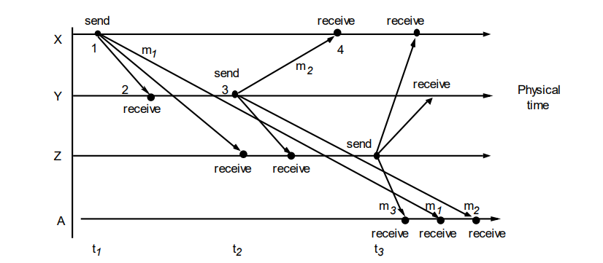
Real-time ordering of events
Delivery time of messages cannot be predicted since clocks cannot be perfectly synchronized across a distributed system
• Logical ordering – uses logical time to provide an order among events generated by separate processes without depending on clocks

Slide 31
Importance Of Information
A distributed system is (Tannenbaum):
A collection of independent computers that appears to its users as a single coherent system.

Slide 32
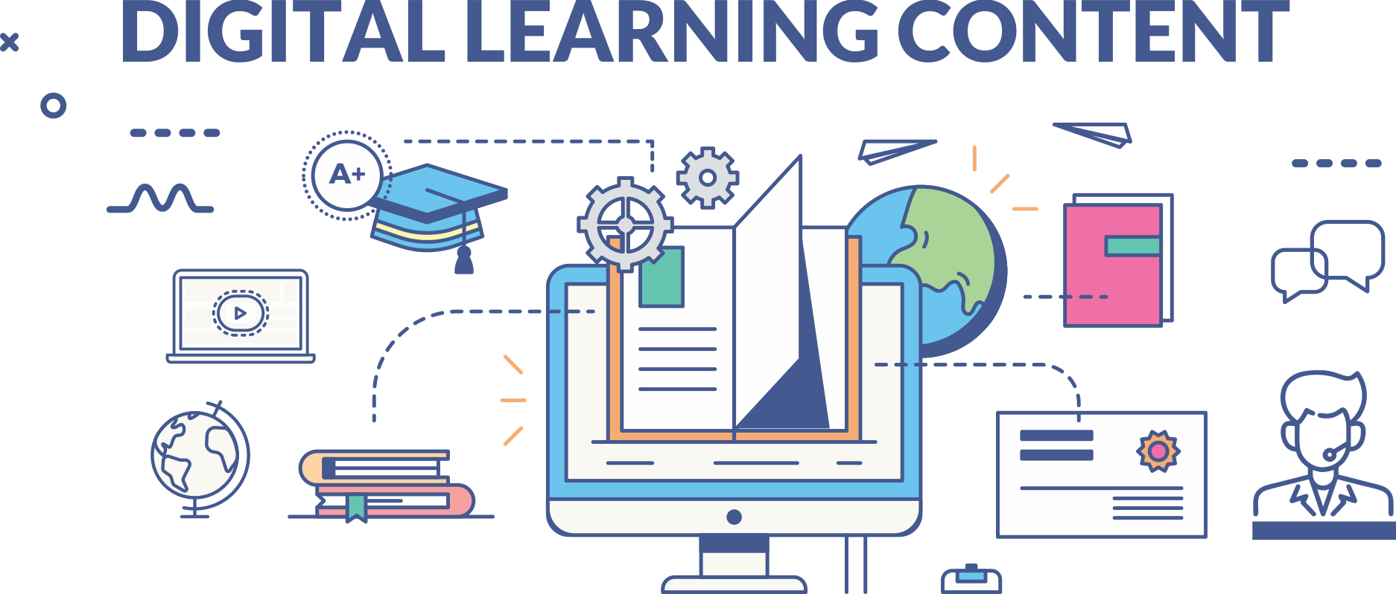

www.paruluniversity.ac.in

