Slide 1



Enterprise Programming
Amir Hussain
IT Trainer

Slide 2
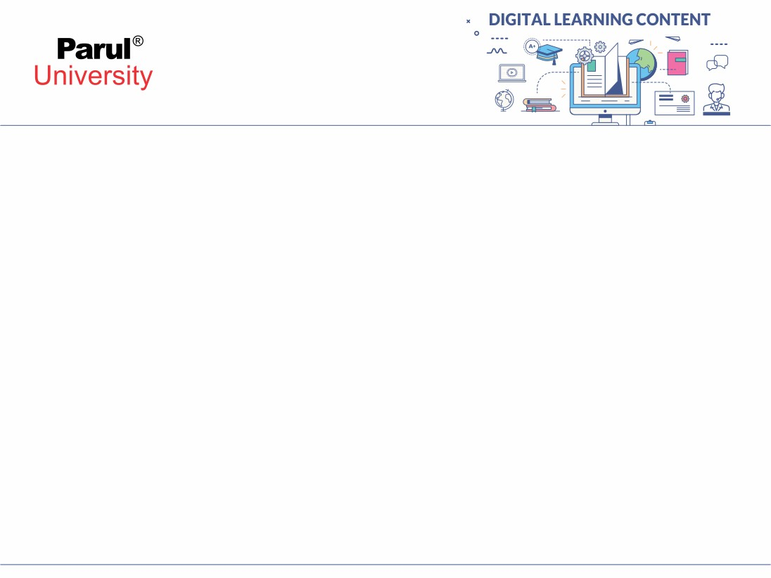

CHAPTER-1
Foundation of Enterprise Programming:

Slide 3
XML:
XML stands for eXtensible Markup Language.
• In XML we use tag or marks.
•In XML you can use your own tags. Tags are not limited and not predefined.
We are informing to browse that we are using HTML by
<!DOCTYPE html>
We are informing to browse that we are using XML by
<?xml version= “1.0” encoding= “UTF-8”?>
XML was designed to store and transport data.
XML was designed to be both human and machine readable.

Slide 4
XML
Rule for XML
There is only one root Tag.
XML is case sensitive.
Every opening tag needs a closing tag.
Every attribute value is inside double quote.
Two Types of XML
Structure (DTD - Document Type Definition).
Content (XSD – XML Schema Definition).

Slide 5
XML
Web Services (SOAP) simple object access protocol: XML is the base format for SOAP web services, allowing different applications (written in different languages) to communicate.
ACID
Data Interchange: Used in systems like banking, healthcare, etc., where reliable, platform-independent data transfer is needed.

Slide 6
XML
Ex:
<?xml version="1.0"?>
<result>
<student1 id="1">
<name>Rohit</name>
<maths>75</maths>
<physics>56</physics>
</student1>
<student2 id="2">
<name>Ravi</name>
<maths>72</maths>
<physics>58</physics>
</student2>
</result>

Slide 7
JDBC
JDBC stands for “Java DataBase Connectivity”.
JDBC is a specification for developing database applications with Java programming language.
Database Application:
An application that communicates with database is known as database application.
Application:
An application is a program in which we interact with on the desktop.

Slide 8
JDBC
JDBC is an API provided by Java that allows Java applications to connect to relational databases like MySQL, Oracle, SQL Server, etc.
It helps Java developers:
Connect to a database
SQL queries
Retrieve and process results
Think of JDBC as a bridge between your Java code and a database.

Slide 9
JDBC Components
DriverManager: Manages a list of database drivers.
Driver: Interface that handles communication with the database.
Connection: Interface for opening and managing a connection to the database.
Statement / PreparedStatement: Used to execute SQL queries.
ResultSet: Holds the result returned by an SQL query.

Slide 10
JDBC workflow
1. Load the JDBC driver
2. Establish connection with the database
3. Create statement to execute queries
4. Execute query
5. Process the results
6. Close the connection

Slide 11
JDBC
Database:
A database is software and it is an organised collection of data.
Data organized in a database in the form of tables.
Each table contains fields and records.
Application is a front end & database is a back end.
The term “front-end” refers to the user interface, while “back-end” means the server, application and database that work behind the scenes to deliver information to the user
Application uses SQL to communicate with database

Slide 12
JDBC
Client:
A client is software that sends the request to server to get the response.
Server:
A server is software that receives request from the client, process the request, constructs the response and sends the response back to a client.
Driver:
A driver is software and it is used to connect application & database.
Specification:
A specification is a set of rules & guidelines that are used to develop environments & applications.
JDBC specification used by vendors to develop drivers.(ORACLE, MYSQL)
JDBC specification also used by Java programmers to develop database applications.

Slide 13
JDBC
Connection con = DriverManager.getConnection("jdbc:mysql://localhost:3306/mydb", "user", "pass");
Statement stmt = con.createStatement();
ResultSet rs = stmt.executeQuery("SELECT * FROM students");

Slide 14
JDBC
There are four types of JDBC drivers:
Type-I Driver (JDBC ODBC Bridge Driver)
Type-II Driver (JDBC Native API Driver)
Type-III Driver(JDBC Network Protocol Driver)
Type-IV Driver(JDBC 100% Pure Java Driver)
Type - I Driver (JDBC ODBC Bridge Driver):
Java code uses the JDBC API.
Type-I driver translates JDBC calls into ODBC function calls.
The ODBC driver then connects to the actual database.
Driver Class Name:
sun.jdbc.odbc.JdbcOdbcDriver
Driver Location:
rt.jar file in JDK 1.7 & below versions.
Note: This driver removed from JDK1.8 & above versions.
rt=> Run Time jar=> Java ARchive JDK=> Java Development Kit(It is a Java Software)
---earlier most databases use ODBC, slower and less secure

Slide 15
JAR file location:
C:\Program Files\Java\jdk1.7\jre\lib
Driver Vendor: Sun Microsystems
Uniform Resource Locator (URL) to access the driver:
jdbc:odbc:dsn
jdbc=> protocol odbc=> sub protocol dsn=> data source name
Note: Type-I Driver developed in C language

Slide 16
Type - I Driver Functionality:
It converts Java instructions into odbc understandable format.
Advantages of Type-I Driver:
It is very easy to connect
Only one driver that supports all ODBC enabled databases.
Disadvantages of Type-I Driver:
Performance overhead since Java calls should go through via jdbc & odbc drivers.
DSN creation required. (data source name).
Database client software needs to be installed on local system
It is not suitable for applets because applet has the following security restrictions:
Applets cannot read data from local disk
Applets cannot write data to local disk
Applets cannot open new network connection otherthan the server from which it is loaded
Applets are small Java programs that were originally designed to run inside a web browser. They are embedded in HTML pages and executed by the Java Virtual Machine (JVM) on the client side.

Slide 17
Type - II Driver (JDBC Native API Driver):
Type - II Driver is also called as Partial Java Driver (or) Partly Java-Partly Native Driver
Type - II Drivers are developed in Java language and native languages.
Type - II Driver Class Name for Oracle Database:
oracle.jdbc.driver.OracleDriver Driver Vendor: Oracle Corporation Driver Location:
ojdbc14.jar file in Oracle 10g Express Edition
ojdbc6_g.jar file in Oracle 11g Express Edition
URL to access Type-II Driver:
jdbc:oracle:oci8:@service-id
jdbc → Protocol
oracle → Subprotocol (Oracle-specific)
oci8 → Uses Oracle Call Interface (OCI) library for communication
@service-id → Identifies the specific database service
To get service-id, use the following SQL query:
SQL> select * from global_name;

Slide 18
Type - II Driver Functionality:
It converts Java calls into native calls.
Advantages:
It is little bit fast as compared to type - 1 driver
DSN is not required
Disadvantages:
Separate driver required for every database.
All databases are not having type-2 drivers.
Database software needs to be installed on system.
It is also not suitable for applets
Steps to develop database application:
Loading a specific JDBC driver.
Establishing a connection.
Performing the task.
Closing a connection.
JDBC API:
JDBC API is a Java API, that can access any kind of tabular data and data especially stored in RDBMS.
java.sql package 2) javax.sql package

Slide 19
Interfaces
Driver
Connection
Statement
PreparedStatement
CallableStatement
ResultSet
ResultSetMetaData
DatabaseMetaData
Blob
Clob

Slide 20
Program to establish the connection between Java application and Oracle Database by using Type-2 Driver:
import java.sql.*;
class ConnectionDemo
{
public static void main(String args[])
{
try
{
Class c=Class.forName("oracle.jdbc.driver.OracleDriver");
Connection con=DriverManager.getConnection( "jdbc:oracle:oci8:@xe","system","manager"); System.out.println("Connection Established Successfully: "+con);
}
catch(Exception e)
{
System.err.println(e);
}
}
}

Slide 21
Type-III: Network Protocol Driver (Middleware Driver)
Working: JDBC calls are sent over the network to a middleware server, which then communicates with the database.
Fully Java-based
Advantages:
No need for native libraries
Suitable for internet applications
Supports many databases via the same driver
Disadvantages:
Requires a separate middleware component
Complex setup

Slide 22
Type - IV Driver (JDBC 100% Pure Java Driver):
It is also called as JDBC Native Protocol Driver (or) Thin Driver
Type - IV Driver Class Name for Oracle Database:
oracle.jdbc.driver.OracleDriver
URL to access driver:
jdbc:oracle:thin:@domain-name:port-no:service-id
Type - IV Driver Functionality:
It passes the java instructions directly to a database.
Advantages:
It is a highest performance driver as compared to all other drivers.
DSN not required.
Database not needed on same system.
It is suitable for applets.
Disadvantages:
Separate driver required for every database.

Slide 23
JDBC Architecture
Java Application
↓
JDBC API (Interfaces)
↓
JDBC Driver Manager
↓
JDBC Driver (Vendor-specific)
↓
Database (e.g., MySQL, Oracle)

Slide 24
SQL:
SQL stands for Structured Query Language.
Database software contains two parts:
Database Application (Example: SQLPlus)
Database (Example: Oracle)
List of databases:
Oracle: Oracle Corporation, banking, ERP systems. ACID-compliant
MySQL: Originally MySQL AB. RDBMS, Web apps, widely used with PHP
MS-SQL Server: Microsoft, RDBMS, Windows-based enterprise apps, Tightly integrated with .NET
MS-Access: Microsoft, RDBMS, Small-scale or personal database apps, GUI-based, easy for beginners
DB2: IBM, Enterprise applications, finance, High-performance, supports SQL and NoSQL, ACID-compliant
.

Slide 25
SQL:
Derby: Apache Software Foundation, Lightweight, Java-based RDBMS, Embedded databases in Java applications
Sybase: Financial, telecommunication
Dbase: File-based (.dbf), simple structure, used in 1980s and early 1990s
Visual FoxPro .. etc.,
Application is called as client and Database is called as server.

Slide 26
JDBC with MySQL:
Install MySQL:
use zip or installer.
start mysql server
2. Setup MySQL Database
create Database and tables.
3. JDBC + MySQL Program (Java)
Add MySQL Connector JAR
jdbc:mysql://localhost:3306/college
4. Sample.
SELECT query using statement.
INSERT using Prepared Statement.
UPDATE and DELETE
Handling SQL Exception

Slide 27
JDBC with ORACLE:
Install Oracle Database:
Install Oracle 18c/21c XE.
Create tables
2. Download and Add Oracle JDBC Driver
ojdbc8.jar
3. JDBC + Oracle Program (Java)
Load Oracle Driver
Class.forName("oracle.jdbc.driver.OracleDriver");
Connection String
jdbc:oracle:thin:@localhost:1521:xe
Use Oracle if:
You're working with high-security, enterprise or mission-critical systems
You need advanced features, high performance, and reliable support

Slide 28
Maven
Maven is mainly used to build and manage Java projects, especially large-scale ones. It simplifies packaging, testing, and deploying Java applications. With Maven, developers can manage complex projects more easily using predefined lifecycles and project structures.
Maven integration primarily revolves around using Maven as a build automation tool for Java projects,
simplifying dependency management, compilation, testing, and deployment.
It achieves this through a Project Object Model (POM) file, which defines project configuration and dependencies, and a standardized directory structure.
Maven also integrates with source control systems and provides a lifecycle for managing the build process.

Slide 29
Key Aspects of Maven Integration
1. Dependency Management:
Maven excels at managing project dependencies, automatically downloading necessary JAR files from repositories like the central repository, ensuring consistent builds across different environments.
2. Build Lifecycle:
Maven defines a standard build lifecycle with phases like compile, test, package, and deploy. Executing a phase triggers all preceding phases in the sequence.
3. POM (Project Object Model):
The pom.xml file is the heart of a Maven project, outlining project metadata, dependencies, plugins, and build configurations

Slide 30
Key Aspects of Maven Integration
4. Integration with IDEs:
Maven seamlessly integrates with popular IDEs like IntelliJ IDEA, Eclipse, and Visual Studio Code, providing features like project creation, dependency management, and build execution within the IDE.
5. Source Control Integration:
Maven can be easily integrated with source control systems like Git and Subversion, enabling version control and collaborative development
6. Continuous Integration:
Maven integrates with CI/CD tools like Jenkins, facilitating automated builds, testing, and deployments in a continuous integration pipeline.

Slide 31
Maven Lifecycle
Validate – Check if project is correct
Compile – Compile the source code
Test – Run unit tests
Package – Package code into JAR
Install – Put package into local repository
Deploy – Share package with remote repo

Slide 32
Maven Integration
my-app/
├── src/
│ ├── main/
│ │ └── java/
│ └── test/
├── target/
└── pom.xml
/src/main/java – Application code
/src/test/java – Test code
/target – Compiled files
pom.xml – Configuration

Slide 33
Installation
Download Maven
Extract the ZIP
Set Environment Variables

Slide 34
Mavan integration with IDEs
IntelliJ IDEA
Create or Import Maven Project
Open IntelliJ → New Project → Select Maven
OR: Open an existing project with pom.xml
Enable Maven Integration
IntelliJ detects pom.xml and auto-configures project
Click Load Maven Project if prompted

Slide 35
Thank you!

Slide 36


www.paruluniversity.ac.in

