Slide 1



Distributed Systems(203105393)
Prof. Yassir Farooqui Assistant Professor
Computer Science & Engineering

Slide 2
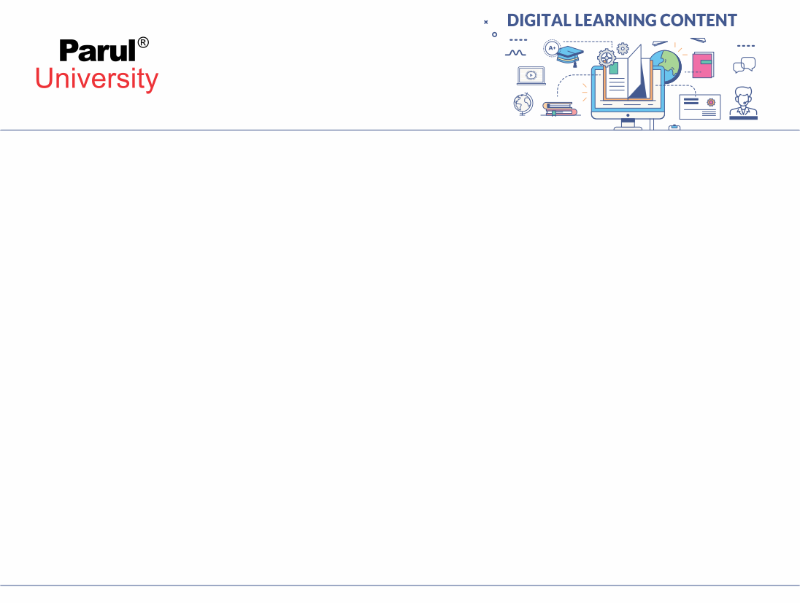



CHAPTER-3
Inter process Communication & Synchronization

Slide 3

Inter process Communication & Synchronization - Outline
API for Internet protocol
Data Representation & Marshalling
Group Communication
Client server Communication
RPC Mechanism
Synchronization
Election Algorithms
Image source : Google

Slide 4
Introduction - Inter process Communication & Synchronization
The mechanism given by the operating system that enables processes to communicate with each other is inter process communication.
This communication require a process that tells another process that some event has taken place or the transferring of data from one process to another.
Synchronization is necessary component of interprocess communication. It is either provided by system of interprocess control or managed by communicating processes. (eg. Semaphore, Mutual exclusion, barrier, spinlock)
Image source : Google

Slide 5
Introduction - Inter process Communication & Synchronization
Characteristics of Interprocess communication
Two message transmission operations, send and receive, described in terms of destinations and messages, can support message passing between a pair of processes.
To communicate, one process sends a message (a series of bytes) to a destination and the message is received by another process at the destination.
The communication of data from the transmitting process to the receiving process requires this operation and can require the synchronization of the two processes.
Image source : Google

Slide 6
Introduction - Inter process Communication & Synchronization
IPC Primitives
send (destination, &msg);
receive (source, &buf);
Destination and source can be process id or port number (single receiver) Or mailbox (multiple receivers) typically, (IP, port#) pair.
Use sockets as API for UDP and TCP implementation.
Socket: One endpoint of a two-way communication link between two programs running on the network. A socket is bind on a port number so that the TCP layer can identify the application that data is destined. A combination of an IP address and a port number is an endpoint.
Image source : Google

Slide 7
API for internet protocols – Types of communication
Synchronous communication
Synchronize sending and receiving processes on every message.
Both send and receive blocking to synchronize communication.
whenever a send is issued, blocks until corresponding receive is issued. whenever a receive is issued, blocks until message arrives.
Asynchronous communication
Sending from the client is non-blocking, proceeds as soon as the client copied the message to a local buffer.
Receive could be non-blocking or blocking, the latter has no Disadvantages in multithreading programming environment much like java.
Non-blocking receive is not really useful (can’t proceed without message)

Slide 8
API for internet protocols - Process
Blocking Process
Advantages: Ease of use and low overhead of implementation
Disadvantage: low concurrency
Non-blocking Process
Advantages: Flexibility, parallel operations
Disadvantages: 1) Programming tricky.
2) Program is timing dependent.
3) Irreproducible Execution because Interrupt can occur at an
arbitrary time.

Slide 9
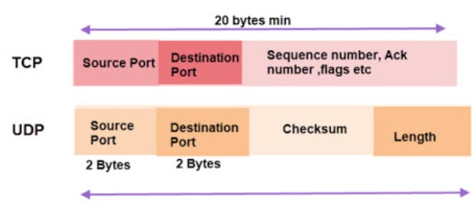
API for internet protocols
UDP (User Datagram Protocol): offers no guarantee ofdelivery, a datagram protocol
TCP (Transmission Control Protocol): reliable connection-oriented protocol, establishment of bidirectional communication channel
API (Application programming interface) : It is a set of definitions and protocols for building and integrating application software.

Slide 10
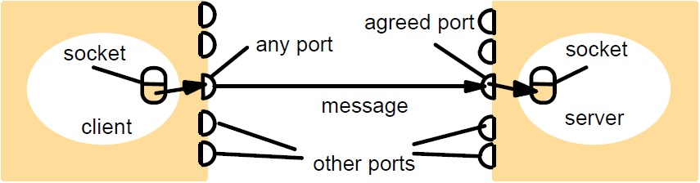
API for internet protocols - Sockets
Provide an abstraction of both TCP and UDP contact endpoints.
Inter-process communication involves the transmission of a message between a socket in one process and socket in another process.
A socket must be bound to an IP address and a local port.
The same socket can be used by processes to send and receive messages.
A specific protocol, like TCP or UDP is associated with sockets.

Slide 11
API for internet protocols – Java API (UDP Communication) communication
Steps
Client finds an available UDP link port.
Client connects the port to the local IP (obtained from the InetAddress.getByName(DNS)).
Server finds a specified port, publish it to clients, and connects it to Local IP.
Several processes issue a receive method and get the IP and port of Sender (client) along with the message.
Issues
Message size – receiver needs to specify a buffer of certain size to receive a massage. If message too big, truncated on arrival.
Blocking – send is non-blocking, returns when the message gets the UDP and IP layers; receive is blocking until a datagram is received or timeout.
Timeouts – reasonably large time interval can be set on receiver sockets to avoid indefinite blocking if required by program
Unknown source – no specification of sources (senders)

Slide 12
API for internet protocols – Java API (UDP Communication) communication
import java.net.*; import java.io.*; //defines stream-related classes
public class UDPClient{
public static void main(String args[]){ // args give message contents and server hostname
DatagramSocket aSocket = null;
try {
aSocket = new DatagramSocket();
byte [] m = args[0].getBytes();
InetAddress aHost = InetAddress.getByName(args[1]);
int serverPort = 6789;
DatagramPacket request = new DatagramPacket(m, args[0].length(), aHost, serverPort);
aSocket.send(request);
byte[] buffer = new byte[1000];
DatagramPacket reply = new DatagramPacket(buffer, buffer.length);
aSocket.receive(reply);
System.out.println("Reply: " + new String(reply.getData()));
} catch (SocketException e) {System.out.println("Socket: " + e.getMessage());
} catch (IOException e) {System.out.println("IO: " + e.getMessage());}
} finally { if(aSocket != null) aSocket.close();}
}
}
UDP client sends a message to the server & gets a reply

Slide 13
API for internet protocols – Java API (UDP Communication) communication
import java.net.*; import java.io.*;
public class UDPServer{
public static void main(String args[]) {
DatagramSocket aSocket = null;
try{
aSocket = new DatagramSocket(6789);
byte[] buffer = new byte[1000];
while(true){
DatagramPacket request = new DatagramPacket(buffer, buffer.length);
aSocket.receive(request);
DatagramPacket reply = new DatagramPacket(request.getData(),
request.getLength(), request.getAddress(), request.getPort());
aSocket.send(reply);
}
}catch (SocketException e){System.out.println("Socket: " + e.getMessage());
}catch (IOException e) {System.out.println("IO: " + e.getMessage());}
}finally {if(aSocket != null) aSocket.close();}
}
}
UDP server repeatedly receives a request and sends it back to the client

Slide 14
API for internet protocols – Java API (UDP Failure Model) communication
Omission failure: due to omission of sending or receiving messages (either erroneous checksum or no buffer space available at source or destination).
Ordering failure: due to out-of-order delivery of messages.
Lack of Built in Checks : Applications using UDP are left to provide their own checks to achieve the quality of reliable communication they require. It can be modeled by implementing an ACK mechanism.

Slide 15
API for internet protocols – Java API (TCP Communication) communication
Issues
Message sizes – user application has various optional size to choose how much data it require to writes to a stream or reads from it.
Message duplication and ordering – difficult to reject duplicates or re-order messages as message identifiers are associated with each IP packet so as for recipient to detect.
Message destinations – a connection is established first. Once established, no IP addresses in packets needed
To establish a connection, client sends connect request to server, then server sends accept request to client.
Could be a overhead for a single Client-Server request and reply.
Matching of data items: client and server must agreed on same data types in the stream.
Threads – server creates a separate thread in accepting a connection for each client. It can block thread if required by program.

Slide 16
API for internet protocols – Java API (TCP Communication) communication
import java.net.*; import java.io.*; //Defines stream-related classes
public class TCPClient {
public static void main (String args[]) { // arguments supply message and hostname of destination
Socket s = null;
try{
int serverPort = 7896;
s = new Socket(args[1], serverPort);
DataInputStream in = new DataInputStream( s.getInputStream());
DataOutputStream out = new DataOutputStream( s.getOutputStream());
out.writeUTF(args[0]); // UTF is a string encoding see Sn 4.3
String data = in.readUTF();
System.out.println("Received: "+ data) ;
}catch (UnknownHostException e){
System.out.println("Sock:"+e.getMessage());
}catch (EOFException e){System.out.println("EOF:"+e.getMessage());
}catch (IOException e){System.out.println("IO:"+e.getMessage());}
}finally {if(s!=null) try {s.close();}catch (IOException e){System.out.println("close:"+e.getMessage());}}
}
}
TCP client makes connection to server, sends request and receives reply

Slide 17
API for internet protocols – Java API (TCP Communication) communication
import java.net.*;
import java.io.*;
public class TCPServer {
public static void main (String args[]) {
try{
int serverPort = 7896;
ServerSocket listenSocket = new ServerSocket(serverPort);
while(true) {
Socket clientSocket = listenSocket.accept();
Connection c = new Connection(clientSocket);
}
} catch(IOException e) {System.out.println("Listen :"+e.getMessage());}
}
}
TCP server makes a connection for each client and then echoes the client’s request

Slide 18
API for internet protocols – Java API (TCP Communication) communication
class Connection extends Thread {
DataInputStream in; DataOutputStream out; Socket clientSocket;
public Connection (Socket aClientSocket) {
try {
clientSocket = aClientSocket;
in = new DataInputStream( clientSocket.getInputStream());
out =new DataOutputStream( clientSocket.getOutputStream());
this.start();
} catch(IOException e) {System.out.println("Connection:"+e.getMessage());}
}
public void run(){
try { // an echo server
String data = in.readUTF();
out.writeUTF(data);
} catch(EOFException e) {System.out.println("EOF:"+e.getMessage());
} catch(IOException e) {System.out.println("IO:"+e.getMessage());}
} finally{ try {clientSocket.close();}catch (IOException e){/*close failed*/}}
}
}
TCP server makes a connection for each client and then echoes the client’s request

Slide 19
API for internet protocols – Java API (TCP Failure Model) communication
Common failure in TCP Communication:
Integrity:
Uses checksums for detection or rejection of corrupted data.
Sequence no. for detection or rejection of duplicate messages.
Validity:
Uses timeout with retransmission techniques to avoid of loss of packets.
Difficult to synchronize clock for each client.

Slide 20
External data representation and marshalling - Introduction
External Data Representation is standard of agreement for data structures and primitive values to be represented.
In running programs, the information stored is interpreted as data structures, while the information in messages consists of byte sequences. Regardless of the mode of communication used the data structure must be translated before transmission to a sequence of bytes and reconstructed upon arrival.
Marshalling is the method of taking and assembling a series of data items into a form suitable for message transmission.
Unmarshalling is the method of disassembling a data collection on arrival to create an equivalent data collection at the destination.
Marshalling and unmarshalling operations are typically performed by the middleware layer automatically.

Slide 21
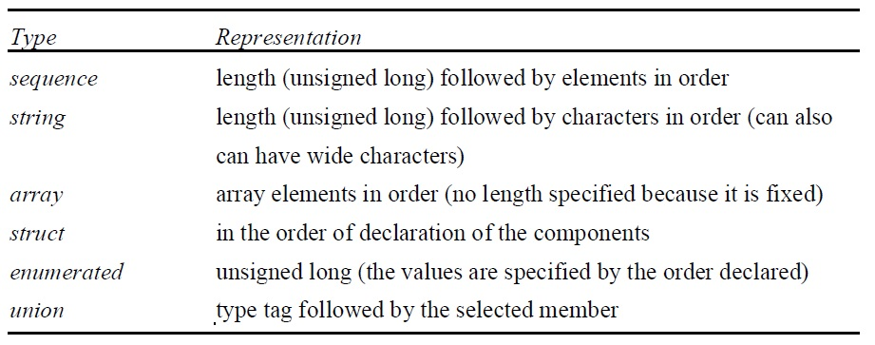
External data representation and marshalling – Approaches
Three approaches to external data representation and marshalling are:
CORBA 2) Java object serialization 3)XML
CORBA Common Data Representation (CDR)
Primitive types: short, long, unsigned short, unsigned long, float, double, char, boolean, octet.
Constructed types: sequence, string, array, struct, enum and union.
Composite type:

Slide 22
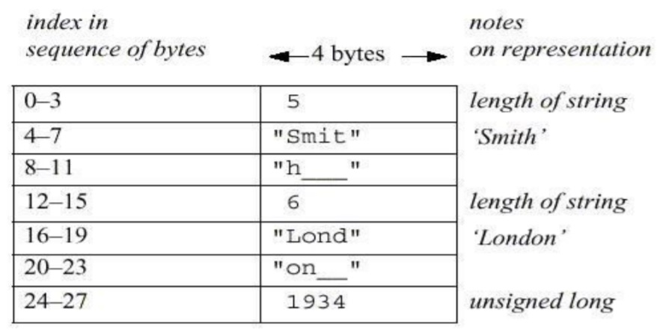
CORBA CDR (Common Data Representation) - Example
Struct Person {
string name;
string place;
unsigned long year;
};

Slide 23
Java object serialization
It can be pass both objects and primitive data values as arguments and results of invoked method.
The serializable interface provided in the java.io package enables instances to be serialized.
public class Person implements Serializable {
private String name;
private String place;
private int year;
public Person(String aName, String aPlace, int aYear) {
name = aName;
place = aPlace;
year = aYear;
}
// followed by methods for accessing the instance variables
}
The given java class is equivalent to Person struct.

Slide 24
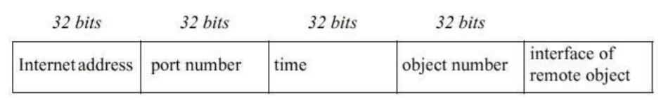
Java object serialization - Remote Object References
Java objects can contain references to other objects. When a client invokes an object that is stored on a remote server, remote object references are required. In the message invocation, a remote object reference is passed to determine which object will be invoked.
Over time and space, remote object references must be unique. In general, several processes can host remote objects, so referencing remote objects must be unique to all the processes of various computers on a distributed system.
Generic format of Remote object references

Slide 25
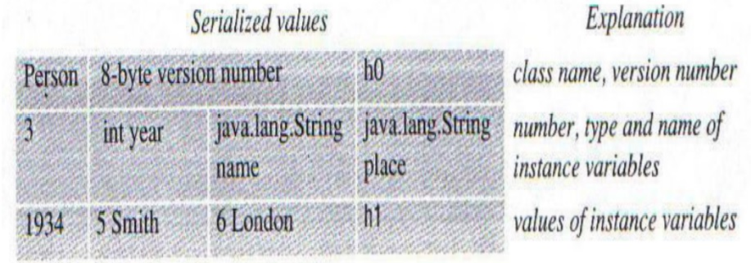
Java object serialization - Remote Object References
To serialize an object:
(1) class info : name, version number
(2) types and names of instance variables
- If an instance variable belongs to new class, Recursively new class info must be written out.
- Each class is given a handle
(3) Instance variables values
Example: Person p = new Person(“Smith”, “London”, 1934);

Slide 26
XML - Extensible Markup Language
XML is used to allow clients to interact with web services and to describe web services' interfaces and other properties.
XML was designed for the web to write structured documents. It is now also used in web services by clients and servers to represent data sent in messages exchanged.
XML is extensible in the sense that its own tags may be specified by the user. If more than one application is intended to use an XML document, then the names of tags must be agreed between them.

Slide 27
XML - Extensible Markup Language
XML elements and attributes:
Elements: A part of character data that is surrounded by matching start and end tags.
Attributes: Optionally, a start tag can include associated attribute name pairs and values such as id='123456789’.
Example:
<person id="123456789">
<name>Smith</name>
<place>London</place>
<year>1984</year>
<!-- a comment -->
</person >

Slide 28
Group Communication - Multicast
Multicast : data transmission is addressed to a group of destination computers simultaneously. Message sent to a specified group of recipients. Multicast distribution can be one-to-many or many-to-many.
Fault tolerance based on replicated services
- requests multicast to servers, some may fail, the client will be served
Discovering services
- multicast to find out who has the services
Better performance through replicated data
- multicast updates
event notification
- new items arrived, advertising services
Image source : Google

Slide 29
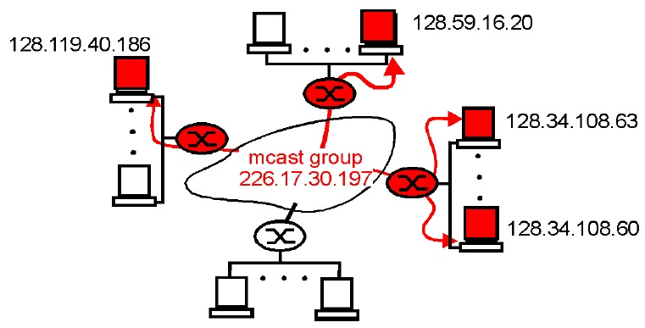
Group Communication - Multicast
Multicast groups are defined by a class D IP address and a port number (multicast address). It is available only for UDP (datagram network).
To restrict the propagation distance of a multicast datagram, The sender may specify the number of routers that the time to live, or TTL for short, is permitted to transfer.
Image source : Google

Slide 30
Group Communication - Multicast
IP packets can be multicast both on local network and on the wider Internet.
The Java API offers an IP multicast datagram interface through the Multicast Socket class, which is a subset of Datagram Socket with additional feature to be able to join multicast groups.
The class MulticastSocket provides two alternative constructors ,enabling socket to be able to use either a specified local port, or any free local port.
Image source : Google

Slide 31
Group Communication – Multicast (Java program)
Multicast peer joins a group and sends and receives datagrams
import java.net.*;
import java.io.*;
public class MulticastPeer{
public static void main(String args[]){ // args give message contents & // destination multicast group (e.g. "228.5.6.7")
MulticastSocket s = null;
try {
InetAddress group = InetAddress.getByName(args[0]);
s = new MulticastSocket(6789);
s.setTimeToLive(255); //TTL of messages
s.joinGroup(group);
byte [] m = args[0].getBytes();
DatagramPacket messageOut =
new DatagramPacket(m, m.length, group, 6789);
s.send(messageOut);
Image source : Google

Slide 32
Group Communication – Multicast (Java program)
// get messages from others in group
byte[] buffer = new byte[1000];
for(int i=0; i< 3; i++) {
DatagramPacket messageIn =
new DatagramPacket(buffer, buffer.length);
s.receive(messageIn);
System.out.println("Received:" +
new String(messageIn.getData()));
}
s.leaveGroup(group);
} catch (SocketException e)
{System.out.println("Socket: " + e.getMessage());
}catch (IOException e)
{System.out.println("IO: " + e.getMessage());}
}finally {if(s != null) s.close();}
}}
Image source : Google

Slide 33
Client-Server Communication – Request reply communication communication
Client-server communication is designed to facilitate the exchange of roles and messages in normal interactions between clients and servers.
In the normal case, request-reply communication is synchronous because the client process blocks until the reply arrives from the server. An alternative approach that is beneficial in asynchronous request-reply communication where clients may afford to retrieve responses later.
The client-server protocol consists of request/response pairs, so no transport layer acknowledgement is required. It avoid connection establishment overhead and no need for flow control because of small amounts of data are transferred.
The request-reply protocol is based on following communication primitives:
doOperation, getRequest, and sendReply .
Image source : Google

Slide 34
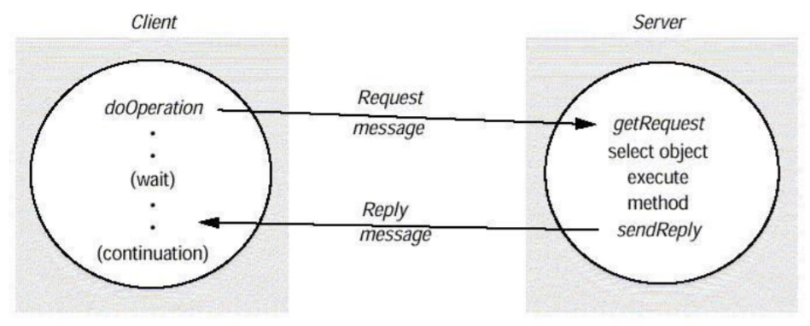
Request reply communication
doOperation() : sends a request message to the remote object and returns the reply. The arguments specify the remote object, the method to be invoked and the arguments of that method.
getRequest(): acquires a client request via the server port.
sendReply(): sends the reply message reply to the client at its Internet address and port.
Image source : Google

Slide 35
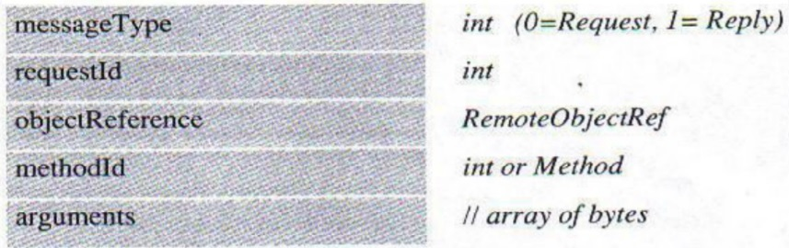
Request reply communication – Message structure
messageType: indicates whether the message is a request or a reply message.
requestId: message identifier.
objectReference: name of remote object reference.
methodId: identifier for the method to be invoked.
Image source : Google

Slide 36
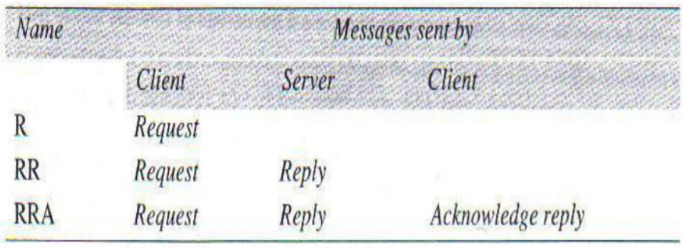
RPC Implementing
Three protocols are used for implementing various types of RPC (Remote Procedure Call)
Request (R) protocol.
Request-reply (RR) protocol.
Request-reply-acknowledge (RRA) protocol.

Slide 37
RPC (Remote Procedure Call) model
It is commonly used procedure call model.
Working of model
The caller places arguments in order to render a procedure call, In a well- specified location for the operation.
Control is then passed to the sequence of instructions that constitutes the body of the procedure.
In a newly created environment for execution, the process body is executed that requires copies of the arguments provided in the instruction for calling.
After the execution of the procedure is over, power returns to the point of call and return a result.

Slide 38
RPC (Remote Procedure Call) model
The RPC allows a call to a process to be made that does not reside in the calling method address space.
Since the caller and the processes of the callee have disjoint addresses The remote procedure does not have access to data variables and space, in the callers environment.
A message-passing method is used by the RPC facility for data exchange of processes between the caller and the callee.
When the request message arrives, the server processes the server,
extracts the parameters of the procedure,
calculates the result
Sends the reply message
await for next call message.

Slide 39
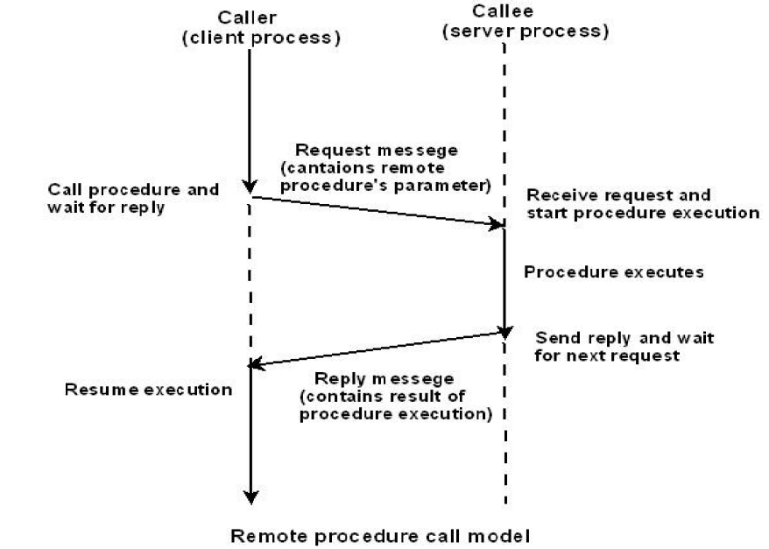
RPC (Remote Procedure Call) model

Slide 40
RPC – HTTP Protocol (example)
HTTP is a request-reply protocol for the communication between web clients and web servers of network resources.
HTTP uses Persistent connections that remain open over a sequence of exchanges of request-reply between client and server.
HTTP protocol steps:
Create a connection between the client and the server at the default server port or port defined in the URL.
Client sends a request to server.
Server sends a reply to client.
Connection closure

Slide 41
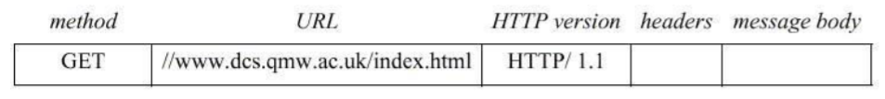
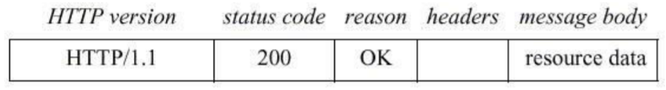
HTTP Methods
GET
Requests the resource that is defined as an argument by URL. The web server responds by returning the data if the URL refers to the data. If the URL refers to a program, then the program is run by the web server and Returns output to the client.
HTTP Request message
HTTP Reply message

Slide 42
HTTP Methods
HEAD
This method is similar to GET, but only the resource meta data is returned (such as last modification date, form and size).
POST
Specifies a resource URL (for example, a server program) that can handle the data provided with the request.
PUT
The supplied data is to be stored as its identifier in the provided URL.
DELETE
Server deletes the identified resource from the server with the URL provided.

Slide 43
Implementing RPC mechanism
In order to achieve semantic transparency, The concept of stubs is the foundation of the RPC mechanism.
Stubs
Provide the abstraction of a standard / local procedure call by Concealing the RPC process underlying it.
A different stub process is associated with both the client and the client- server processes.
To hide the underlying communication network, RPC communication RPC Runtime is used on both the sides.
RPC Runtime handles transmission of messages across the network between Client and the server machine.

Slide 44
Implementing RPC mechanism
The implementation of the RPC therefore incorporates the five elements of Program
Client
Client Stub
RPC Runtime
Server stub
Server
The client, the client stub, and one instance of RPCRuntime execute on the client machine.
The server, the server stub, and one instance of RPCRuntime execute on the server machine.

Slide 45
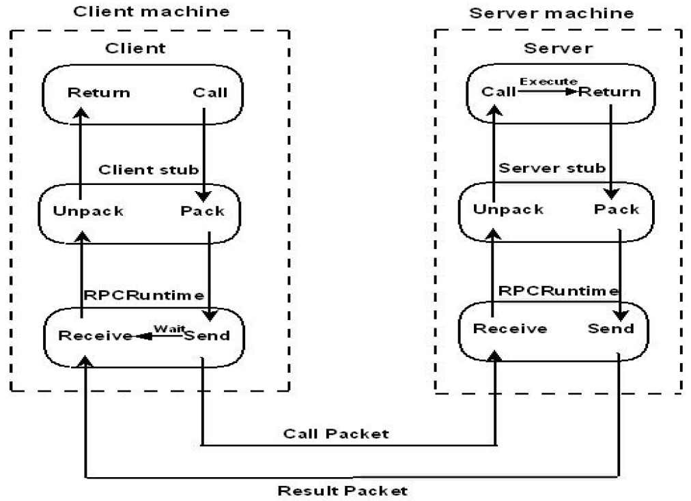
Implementing RPC mechanism

Slide 46
Client Stub
It is responsible for the two activities that follow:
Upon receipt of a call request from the client, It includes the requirements of the target procedure and the arguments in a message and asks the local RPC Runtime to send it to the server stub.
On receipt of the results of execution of the procedure, it unpacks the output and passes it to the client.

Slide 47
Server Stub
It is responsible for the following two activities:
On receipt of a call request from the local RPC Runtime, it unpacks it and makes a perfectly normal call to invoke the appropriate procedure in the server.
On receipt of the result of the execution of the procedure from the server, the output is unpacked into a message and then asked to the local RPC Runtime and send it to the client stub.

Slide 48
Stub Generation
Export the interface
A server program that implements procedures in the interface.
Import the interface
A client program that calls procedures from an interface.
The interface definition is compiled by the IDL(Interface Definition Language)
IDL Compiler generate
components that can be combined with client and server programs, without making any changes to the existing compilers.
Client stub and server stub procedures and the appropriate marshaling and unmarshaling operations. It create header file that supports the data types.

Slide 49
RPC Messages
The RPC system is distinct from transport protocols and it is not concerned about how a message is Passed from one to another process.
Types of message used in implementation of RPC system:
Call messages
Reply messages

Slide 50
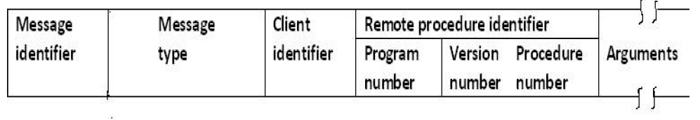
Call Messages
Components in call message are
The id. Information of the remote procedure to be executed.
Necessary arguments for the execution.
Message Identification field which consists of a sequence
Number of identifying lost and duplicate messages.
Message Type field: call or reply messages.
Client Identification Field
Call message format

Slide 51
Reply Messages
Sent to the client by the server to return the result of remote procedure execution.
Conditions for unsuccessful message
The server discover that the call message is not intelligible to it.
Client is unauthorized to use the service.
Missing Remote procedure identifier.
The remote procedure is unable to decode the supplied arguments.
Occurrence of exception condition.

Slide 52
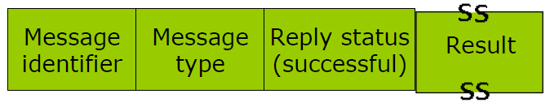
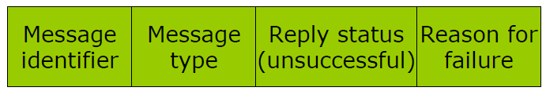
Reply message formats
Successful reply
Unsuccessful reply

Slide 53


www.paruluniversity.ac.in

