Slide 1


Overview of compilation
Kanniappan, Assistant Professor
Computer Science & Engineering

Slide 2
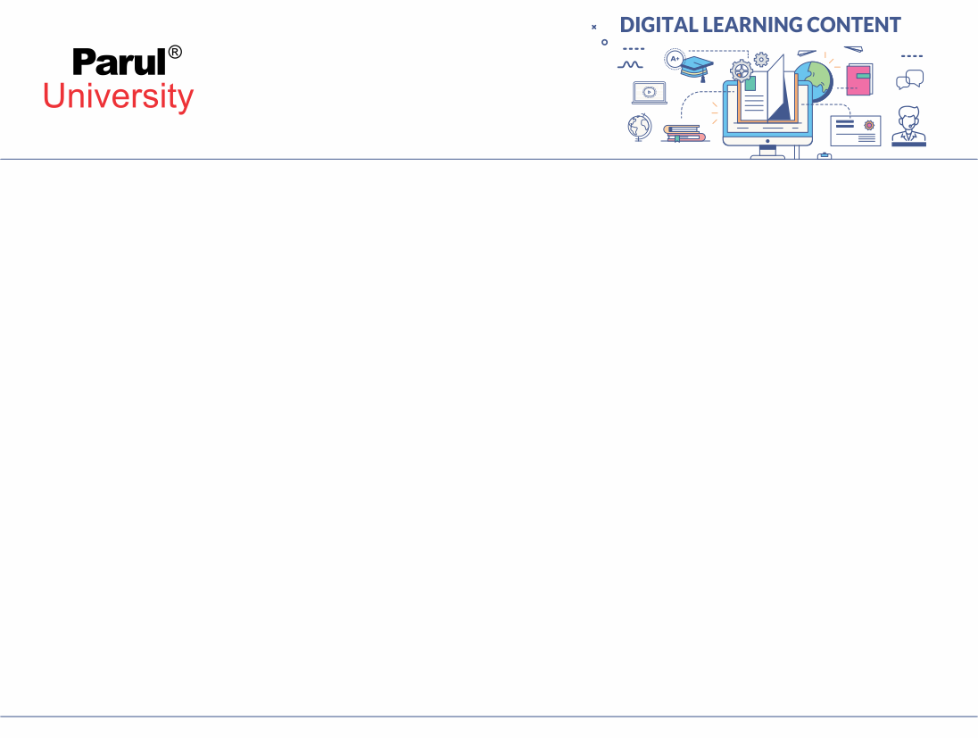

CHAPTER-1
Introduction: TOC
Alphabet, languages and grammars, productions and derivation, Chomsky hierarchy of languages

Slide 3
1. Alphabet, Languages and Grammars
An alphabet (denoted by Σ) is a finite, non-empty set of symbols.
These symbols are used to construct strings.
For example:
If Σ = {a, b}, then valid strings over Σ include: a, ab, bba, ε (the empty string), etc.
Example
∑ = {a.b.c………z}
∑ = {0,1}
∑ = {1}
The set of all possible strings over Σ is denoted Σ*.
The alphabet forms the basic building block for defining languages, grammars, and computational models.

Slide 4
Grammar
A grammar is defined formally as a 4-tuple:
G = (V, Σ, P, S)
Where:
V is a finite set of variables (non-terminal symbols),
Σ is a finite set of terminal symbols, disjoint from V,
P is a finite set of productions (or production rules),
S is a special start symbol, with S ∈ V.
Each production in P is a rule of the form:
α → β
where α and β are strings composed of symbols from V ∪ Σ,
and α must contain at least one non-terminal (from V). This ensures that productions can actually be used to generate terminal strings.

Slide 5
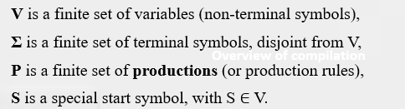
Grammar
The purpose of a grammar is to generate strings that belong to a particular language.
Derivations start from the start symbol S and apply production rules to eventually produce a string composed only of terminal symbols (i.e., a string in the language).
The structure and form of productions define the type of grammar, such as:
Regular (Type 3)
Context-Free (Type 2)
Context-Sensitive (Type 1)
Unrestricted (Type 0)
Overview of compilation
Example Grammar : // G = (V, Σ, P, S)
G = ({S}, {a, b}, P, S)
P:
S → aSb
S → ε
This grammar generates all strings of the form aⁿbⁿ for n ≥ 0
(e.g., "", "ab", "aabb", "aaabbb", etc.).
ab (n=1)
aabb (n=2)
aaabbb (n=3)

Slide 6
What is a Language?
A language is any set of strings formed from an alphabet Σ.
In formal terms, if Σ is an alphabet, then Σ* (called the Kleene star) is the set of all possible strings (including the empty string ε) that can be formed using symbols from Σ.
A language L is then any subset of Σ*
Example:
Let Σ = {a, b}. Then examples of languages over Σ include:
L₁ = {a, ab, abb} A finite language with 3 strings.
L₂ = {w ∈ Σ* | w ends with b} An infinite language of all strings ending in b.
L₃ = {aⁿbⁿ | n ≥ 0} = {ε, ab, aabb, aaabbb, ...} A classic context-free language.
L₄ = ∅ The empty language (contains no strings).
L₅ = Σ* The set of all possible strings over the alphabet {a, b}.

Slide 7
Productions and Derivation
A production rule (or just "production") describes how a symbol or string can be replaced.
A production is a rule used to replace a part of a string (specifically, a non-terminal) with another string of terminals and/or non-terminals.
Consider the following grammar-
S → aB / bA
S → aS / bAA / a
B → bS / aBB / b
(Unambiguous Grammar)
Overview of compilation
Let us consider a string w = aaabbabbba
Now, let us derive the string w using leftmost derivation.

Slide 8
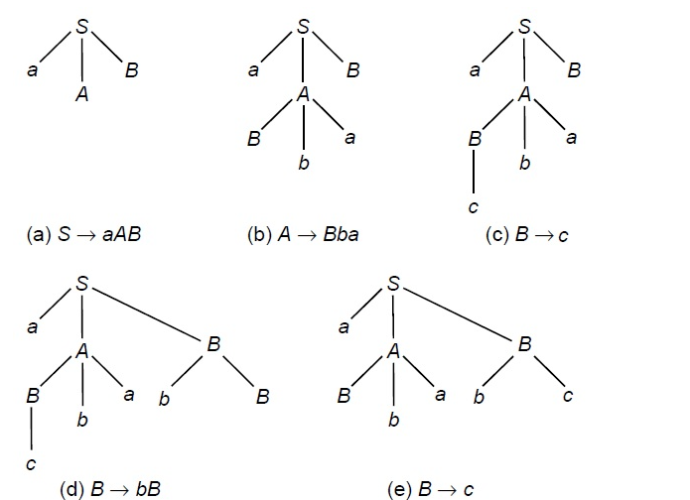
End
Compute the string w = ‘acbabc’ with left most derivation.
S ⇒ aAB (Rule: 1) ⇒ aBbaB (Rule: 2) ⇒ acbaB (Rule: 4) ⇒ acbabB (Rule: 3) ⇒ acbabc (Rule: 4)
S → aAB (Rule: 1) A → Bba (Rule: 2) B → bB (Rule: 3) B → c (Rule: 4)

Slide 9
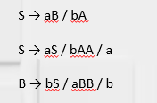
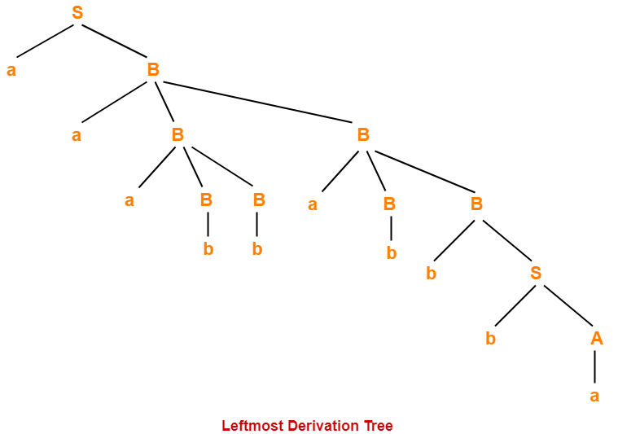
Example
Result : aaabbabbba
S → aB
→ aaBB (Using B → aBB)
→ aaaBBB (Using B → aBB)
→ aaabBB (Using B → b)
→ aaabbB (Using B → b)
→ aaabbaBB (Using B → aBB)
→ aaabbabB (Using B → b)
→ aaabbabbS (Using B → bS)
→ aaabbabbbA (Using S → bA)
→ aaabbabbba (Using A → a)
Overview of compilation

Slide 10
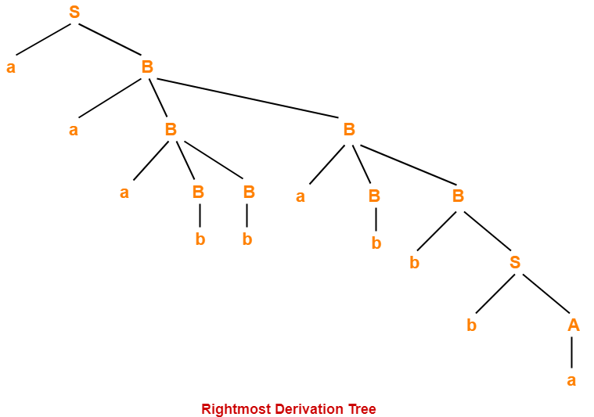
Example
Result : aaabbabbba
S → aB
→ aaBB (Using B → aBB)
→ aaBaBB (Using B → aBB)
→ aaBaBbS (Using B → bS)
→ aaBaBbbA (Using S → bA)
→ aaBaBbba (Using A → a)
→ aaBabbba (Using B → b)
→ aaaBBabbba (Using B → aBB)
→ aaaBbabbba (Using B → b)
→ aaabbabbba (Using B → b)

Slide 11
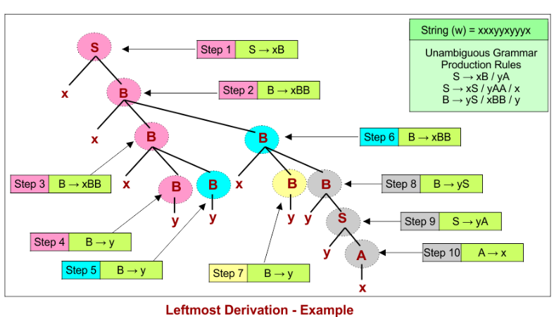
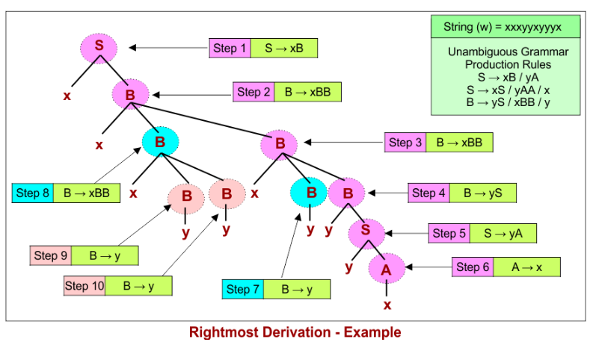
Example

Slide 12
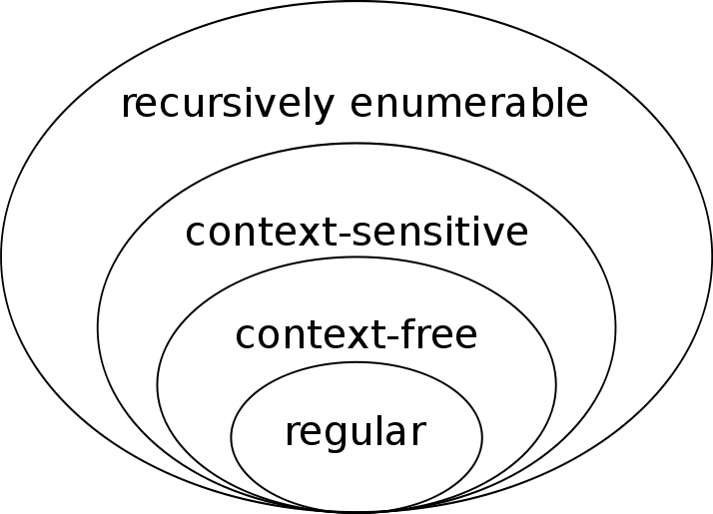
Chomsky hierarchy of languages
The Chomsky hierarchy is used in the Theory of Computation (ToC) primarily to categorize languages and grammars by their generative power and structural complexity, and to align each category with a corresponding computational model.
Structured Classification of Languages
2. Mapping to Computational Models
3. Understanding Computational Power & Limits
4. Practical & Theoretical Utility

Slide 13
Chomsky hierarchy of languages
Structured Classification of Languages
The hierarchy divides formal languages into four types (Type 0 to Type 3), with each type having specific restrictions on grammar rules and varying expressive power .
Regular (Type 3) — simplest
Context Free (Type 2) — supports nesting
Context Sensitive (Type 1) — allows context-dependent productions
Recursively Enumerable (Type 0) — most general
Overview of compilation
2. Mapping to Computational Models
Each language type exactly corresponds to a class of automata:
Type 3 → Finite Automata
Type 2 → Pushdown Automata
Type 1 → Linear-Bounded Automata
Type 0 → General Turing Machines

Slide 14
Chomsky hierarchy of languages
3. Understanding Computational Power & Limits
By showing strict inclusion:
Regular ⊂ Context Free ⊂ Context Sensitive ⊂ Recursively Enumerable
we understand that each higher level can express strictly more complex languages than those below . This illustrates both what can and what cannot be computed in each class, and guides us in choosing the simplest language class sufficient for a given problem.
4. Practical & Theoretical Utility
• Compiler design & parsing: Most programming languages are context-free, so ToC teaches tools like CFGs and PDAs essential to syntax analysis.
• Pattern matching & lexing: Regular languages and FSAs underlie regex engines and lexical analyzers.
• Decidability insights: When exploring Type 0 languages, students encounter undecidable problems and limits of computation—an essential theoretical milestone.

Slide 15
Regular Languages
Regular Languages
Regular languages are the simplest and most basic type of languages. They can be recognized using finite automata, which are machines with no memory. These machines process input strings one symbol at a time and change states accordingly. Regular languages include patterns that can be described using regular expressions.
For example, a language that accepts strings with only 0s and 1s, or strings that contain an even number of 0s, can be classified as regular.
Regular languages are very useful in real life. They are commonly used in search engines, text editors, and lexical analyzers in compilers. However, they have limitations. They cannot count or match pairs like parentheses, which means they can't handle nested structures.

Slide 16
2. Context-Free Languages
Context-Free Languages (CFLs) are more powerful than regular languages. They are recognized using pushdown automata, which are like finite automata but with an additional stack for memory. This stack helps in keeping track of things like opening and closing brackets or matching function calls in a program.
The rules for context-free grammars allow for more flexibility.
For example, a language that contains strings like a^n b^n (equal number of a’s followed by b’s) is context-free but not regular.
Context-free languages are heavily used in syntax analysis of programming languages during compilation, where matching patterns and nested structures are very common.
Overview of compilation

Slide 17
3. Context-Sensitive Languages
Context-Sensitive Languages (CSLs) are even more powerful than context-free languages. These languages can be recognized by a linear bounded automaton, which is like a Turing machine but with limited memory (bounded to the length of the input). Unlike regular and context-free languages, context-sensitive languages allow rules that depend on the surrounding symbols, meaning the production rules depend on context.
A typical example of a context-sensitive language is the set of strings like a^n b^n c^n, where the number of a’s, b’s, and c’s must all be equal. This is more complex than what a stack can handle. CSLs are useful in type checking in compilers, where a variable’s type depends on the context in which it is used.
Overview of compilation

Slide 18
4. Recursively Enumerable Languages
Recursively Enumerable Languages (RELs) are the most powerful in the Chomsky hierarchy. They can be recognized by a Turing machine, which is a theoretical model of computation that has unlimited memory and can perform any algorithm. These languages include all problems that can be solved by any computer if given unlimited time and memory.
However, Turing machines may not always halt or give an answer, especially for problems that are undecidable (i.e., no algorithm can guarantee a solution). An example of this is the halting problem, which asks whether a given program will stop or run forever.
These languages are important in theoretical computer science and artificial intelligence, where we deal with highly complex problems that may or may not have solutions.
Overview of compilation
What is a Turing Machine?
A Turing Machine is a theoretical model of a computer created by Alan Turing in 1936. It is used in Theory of Computation to define what can be computed. Despite its simplicity, it can simulate any modern computer algorithm.

Slide 19
End
Thanks

