Slide 1


Overview of compilation
Kanniappan, Assistant Professor
Computer Science & Engineering

Slide 2
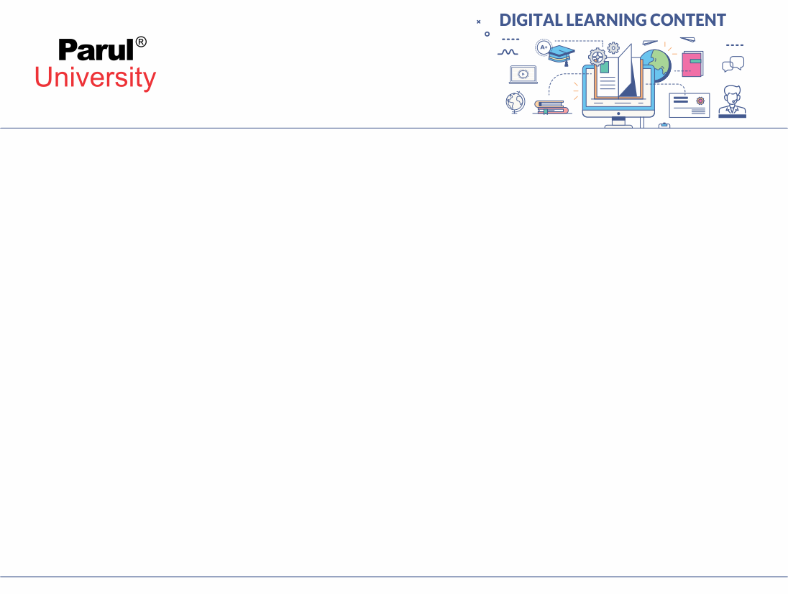

CHAPTER-2
Overview of Automata

Slide 3
Chapter-2 _ Syllabus
Regular languages and finite automata:
Regular Expressions And Languages
Deterministic Finite Automata -(DFA) And Equivalence With Regular Expressions
Moore Machines And Mealy Machines
Conversion From Mealy To Moore And Vice Versa,
Nondeterministic Finite Automata (NFA) And Equivalence With DFA,
Regular Grammars And Equivalence With Finite Automata,
Properties Of Regular Languages,
Pumping Lemma For Regular Languages, Minimization Of Finite Automata.

Slide 4
What is Regular Expression?
A regular expression is a sequence of characters that defines a pattern for matching strings within a formal language
An expression which is constructed over alphabet ∑ using the operators * , . , + is called as regular expression.
For every regular language we can construct an equivalent R.E.
Regular Operator
The operators * , . , + are called regular operators
* is kleen closure operator
. is concatenation operator
+ is union operator
Operator precedence
Kleen closure > Concatenation > Union

Slide 5
Types of Regular Expression
The Regular expression is classified in to three types
Restricted Regular Expression(* , . , +) or standard R.E.
Semi Restricted Regular Expression (* , . , + , ∩)
Unrestricted (* , . , + , ∩ , ~)

Slide 6
Some identities of Regular Expression
If r is any regular expression then following identities follows
r* is also an regular expression
r⁺ is also an regular expression
If r = ф then r* = € and r⁺ = ф
If r = € then r* = € and r⁺ = €
r* + r⁺ = r*
r* . r = r⁺
(r*)* = r*
Let r1 and r2 are two R.E. then (r1+r2)* is also a R.E.
(r1+r2)* = (r1* + r2*)*
(r1+r2)* = (r1 + r2*)*
(r1+r2)* = (r1* + r2)* = (r1* . r2*)* = (r2* . r1*)*

Slide 7

Regular Expression for some regular languages
If r is any regular expression then L(r) is regular language generated byregular expression r.
Regular Expression | Regular Languages
r = ф | L = {}
r = € | L = {€}
r = a | L = {a}
r = ab | L = {ab}
r = (a+b) | L = {a,b}
r = (a+b+c) | L = {a , b , c}
r = w1+w2+w3…+wn | L = {w1,w2,w3,…wn}

Slide 8
Deterministic Finite Automata
Definition (DFA)
• It is finite state automata which is used to accept or reject a sequence of string
• In DFA, for each input symbol, there must be only one state. Hence, it is called Deterministic Automaton.
As it has a finite number of states, the machine is called Deterministic Finite Machine or Deterministic Finite Automaton.

Slide 9
Formal Definition of DFA
A DFA can be represented by a 5-tuple (Q, ∑, δ, q₀, F) where −
Q is a finite set of states.
∑ is a finite set of symbols called the alphabet.
δ is the transition function where δ: Q × ∑ → Q {only one state}
q₀ is the initial state from where any input is processed (q₀ ∈ Q).
F is a set of final state/states of Q (F ⊆ Q).

Slide 10
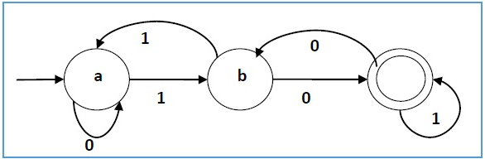
Graphical Representation of a DFA
A DFA is represented by digraphs called state diagram.
The vertices represent the states.
The arcs labeled with an input alphabet show the transitions.
The initial state is denoted by an empty single incoming arc.
The final state is indicated by double circles.

Slide 11
Equivalence of DFA and Regular Expression
If a language is accepted by DFA then L is denoted by a Regular expression.
Regular expression and Finite Automata , both have the same computational power.
For each and every regular expression we can design DFA such that L(R)=L(F).
L(R)= Language accepted by regular expression
L(F)= Language accepted by finite automata

Slide 12
Acceptability by DFA and NDFA
A string is accepted by a DFA/NDFA iff the DFA/NDFA starting at the initial state ends in an accepting state (any of the final states) after reading the string wholly.
A string S is accepted by a DFA/NDFA (Q, ∑, δ, q₀, F), iff
δ*(q₀, S) ∈ F
The language L accepted by DFA/NDFA is
{S | S ∈ ∑* and δ*(q₀, S) ∈ F}
A string S′ is not accepted by a DFA/NDFA (Q, ∑, δ, q₀, F), iff
δ*(q₀, S′) ∉ F
The language L′ not accepted by DFA/NDFA (Complement of accepted language L) is
{S | S ∈ ∑* and δ*(q₀, S) ∉ F}

Slide 13
Construction of DFA
Rules for construction of DFA
Step 1:- Recognize language.
Step 2:- Find Minimum string using language.
Step 3:- Create a DFA which accepts or satisfy minimum string.
Step 4:- Satisfy each input symbol at every state.
NOTE:- Designed DFA will be minimal DFA

Slide 14
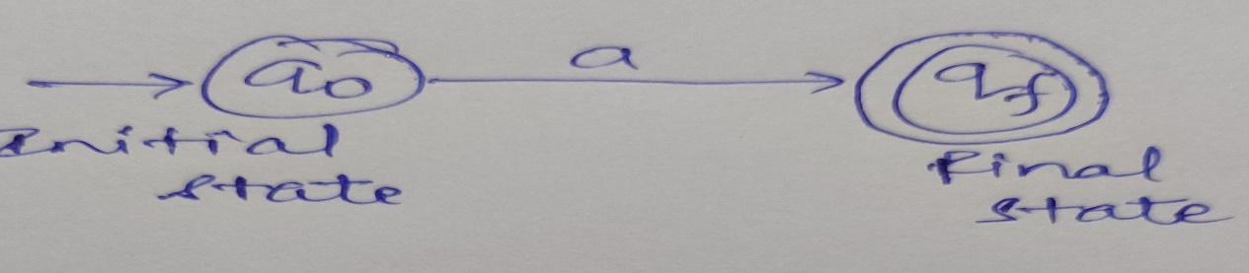
Construction of DFA (Example)
Construct DFA which starts with “a”, given input symbol {a , b}
DFA which must Start with “a” but necessarily not with “b” i.e. If string will start from “b” then input symbol “b” will move to dead state or trap state.
So, L={a,ab,abb,aab….}
Minimal string = a

Slide 15
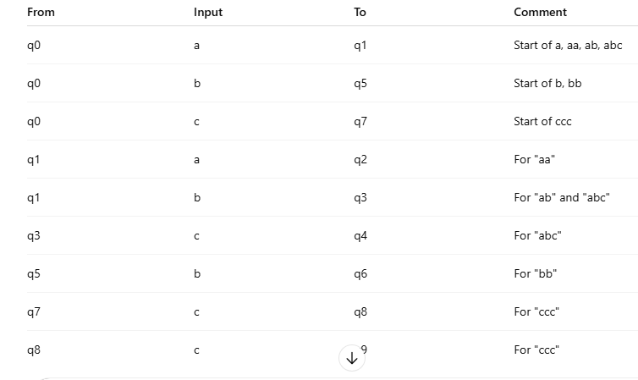
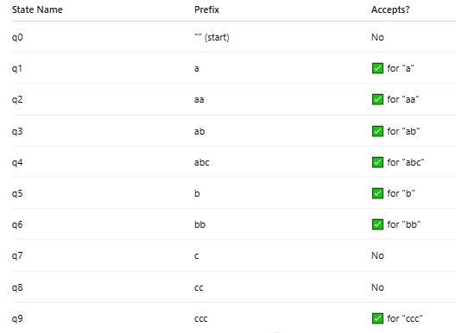
Finite Automata
L = {a, aa, b, bb, abc, ab, ccc}

Slide 16
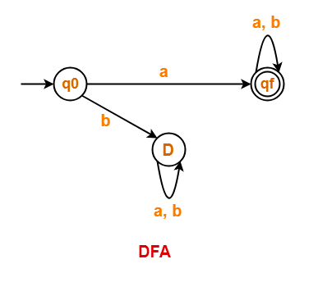
Finite Automata
Construct DFA which starts with “a”, given input symbol {a , b} (Continued)
Now we will satisfy all state with every input and then we will get

Slide 17
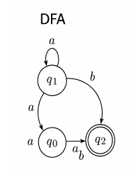
Finite Automata
DFA Example
Language:
L = { w | w ends with "ab" } over Σ = {a, b}
DFA Definition (5-tuple):
Q = {q0, q1, q2}
Σ = {a, b}
δ = transition function (see below)
q0 = start state
F = {q2} (final state)
Example Input:
Input string: aaab
Transition Table (δ):
Current State | Input | Next State
q0 | a | q1
q0 | b | q0
q1 | a | q1
q1 | b | q2
q2 | a | q1
q2 | b | q0
Transition Sequence:
Start at q0
Read 'a' → q1
Read 'a' → q1
Read 'a' → q1
Read 'b' → q2 (final state )

Slide 18
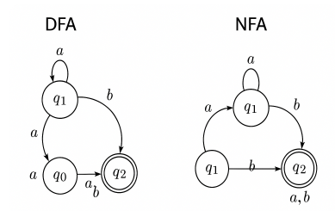
NFA Example
q0 --(b)--> q0
q0 --(a)--> q0, q1
From q0:
--(a)--> q0, q1
From q1:
--(b)--> q2
Language:
L = { w | w contains "ab" as a substring } over Σ = {a, b}
NFA Definition:
Q = {q0, q1, q2}
Σ = {a, b}
δ = transition function
q0 = start state
F = {q2} (Final State)
Example Input:
Input string: baab
Current State | Input | Next State(s)
q0 | a | {q0, q1}
q0 | b | {q0}
q1 | b | {q2}
q1 | a | ∅
q2 | a,b | {q2}

Slide 19
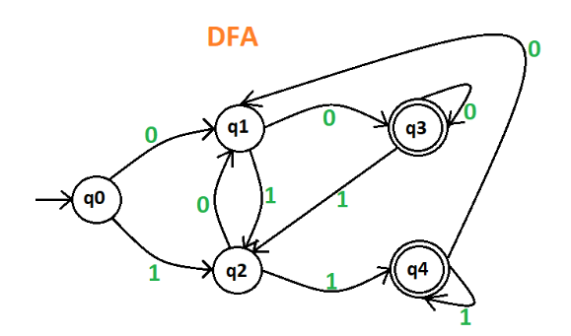
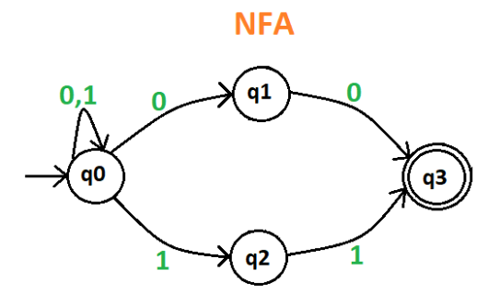
NFA_1
Draw a deterministic and non-deterministic finite automate which accept 00 and 11 at the end of a string containing 0, 1 in it, e.g., 01010100 but not 000111010.

Slide 20
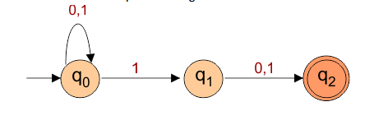
NFA_2
L= {10, 010, 000010, 11, 101011……..}
Transition Table for the above Non-Deterministic Finite Automata is
Transition function δ is defined as
δ (q0, 0) = q0
δ (q0, 1) = q0,q1
δ (q1, 0) = q2
δ (q1, 1) = q2
δ (q2, 0) = ϕ
δ (q2, 1) = ϕ
States | 0 | 1
q0 | q0,q1 | q0
q1 | – | q2
q2 | – | –

Slide 21
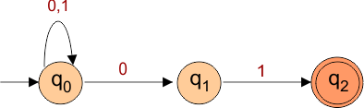
NFA_3
The language generated by this example will include all strings that end with 01.
L= {01, 0101, 0000101, 101, 101001……..}
Transition Table for the above Non-Deterministic Finite Automata is
Transition function δ is defined as
δ (q0, 0) = q0,q1
δ (q0, 1) = q0
δ (q1, 0) = fi
δ (q1, 1) = q2
δ (q2, 0) = ϕ
δ (q2, 1) = ϕ
States | 0 | 1
q0 | q0,q1 | q0
q1 | – | q2
q2 | – | –

Slide 22
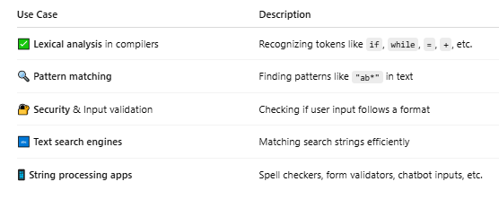
Finite Automata

Slide 23
Moore Machine
Moore Machine
A Moore Machine is a type of Finite State Machine (FSM) used in Theory of Computation. It is a model of computation that takes input symbols and gives output based on the current state only.
Key Points:
It has a finite number of states.
The output depends only on the current state, not on the input.
Each state has a fixed output.
When the machine changes from one state to another, it outputs the value assigned to the new state.
Components of Moore Machine
A Moore machine is defined by six things:
M=(Q,Σ,Δ,δ,λ,q 0​ )

Slide 24
Moore Machine
1. Circuit Design
• Sequential Circuits: Moore machines are commonly used in the design of synchronous sequential circuits such as counters, registers, or control units.
• FSM-based Controllers: In embedded systems, Moore machines are used in designing controllers where the output must remain stable and depend only on the state.
2. Lexical Analyzers (Compilers)
• In compiler design, lexical analyzers (scanners) can be implemented using finite state machines, where a Moore machine can be used when the output (token type) depends only on the final state after reading an input stream

Slide 25
Moore Machine
3. Protocol Design (Network Systems)
Communication Protocols: Moore machines model states of a protocol, especially where output actions (like ACK, NACK(Negative Acknowledgement) depend on the current state.
Example: TCP state transitions (CLOSED, LISTEN, SYN_SENT, etc.)
4. Software Modeling and Simulation
UML State Diagrams: In software engineering, UML state machines can be based on Moore machine principles, where actions (outputs) are tied to states.
Model Checking: Used in tools like SPIN or NuSMV to verify state-based properties.

Slide 26
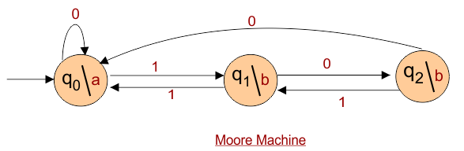
Moore Machine Example _1
Where: 6 tuples (Q, q0, ∑, δ, O, λ)
Q: a finite set of states
q0: initial state of machine
∑: a finite set of input symbols
O: output alphabet
δ: transition function where Q × ∑ → Q
λ: output function where Q → O
if the input “101001” is given to the above Moore machine, the output will be “abbbbab”.
a=1, b=0
there is no final state in a Moore Machine.

Slide 27
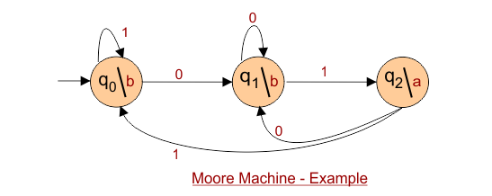
Moore Machine
Moore Machine to print “a” whenever the sequence “01” is encountered
Construct an Automata Moore Machine that prints “a” whenever the sequence “01” is encountered in any input binary string.

Slide 28
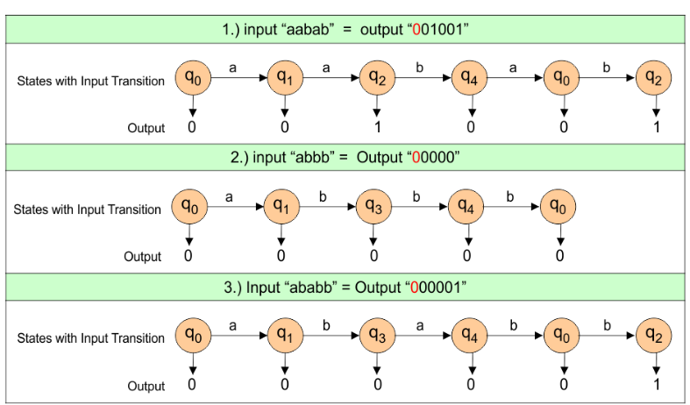
Moore Machine

Slide 29
Mealy Machine
A Mealy machine is a type of finite-state transducer. It is similar to a finite automaton but with an important difference: it produces output values based on transitions, not just on states. The output in a Mealy machine is determined by both the current state and the current input symbol.
Formal Definition
A Mealy machine is a 6-tuple:
M = (Q, Σ, Δ, δ, λ, q₀) where:
Q is a finite set of states.
Σ is the input alphabet.
Δ is the output alphabet.
δ: Q × Σ → Q is the transition function.
λ: Q × Σ → Δ is the output function.
q₀ ∈ Q is the initial state.

Slide 30
Mealy Machine
Working Principle
In a Mealy machine:
Output is associated with transitions (state-input pairs).
For every transition (q, a), the output λ(q, a) is produced.
The output is generated immediately on reading an input symbol.
This is in contrast with a Moore machine, where the output is associated with states, not transitions.
Example
Suppose a Mealy machine detects whether the number of 1s seen so far in a binary string is even or odd
When the number of 1s is even, it outputs 0.
When odd, it outputs 1.

Slide 31
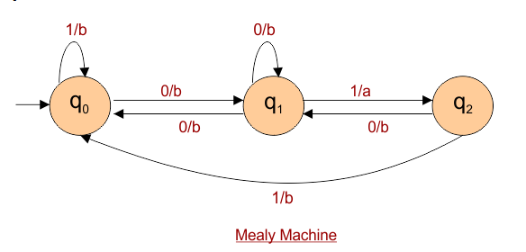
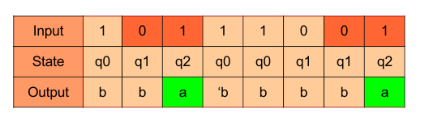
Mealy Machine
Applications
Digital circuit design
Text processing
Protocol design (e.g., in networking)
Control systems where outputs need immediate reaction to inputs
Input: 10111001
The requirement is that whenever the “01” appears in the string, the output must end with “a”.

Slide 32
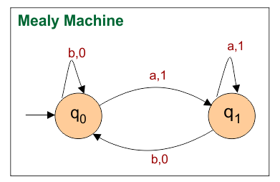
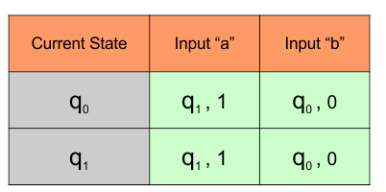
Mealy Machine
Mealy Machine that takes all the strings of a’s and b’s as input and counts the number of a’s in the input string in terms of 1

Slide 33
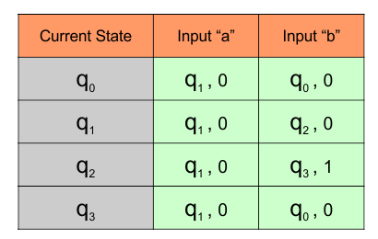
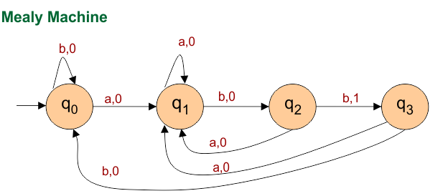
Mealy Machine
Mealy automata machine, to count the occurrences of the sequence “abb” In any input string , is given below

Slide 34
Comparison Table
Feature | DFA | NFA | Moore Machine | Mealy Machine
Determinism | ✅ Yes | ❌ No | ✅ Yes | ✅ Yes
ε-transitions | ❌ No | ✅ Yes | ❌ No | ❌ No
Multiple transitions | ❌ No | ✅ Yes | ❌ No | ❌ No
Output | ❌ None | ❌ None | ✅ On state entry | ✅ On transitions
Output depends on | — | — | Current state | State + input
Output on start | ❌ No | ❌ No | ✅ Yes | ❌ No
Use case | Pattern matching | Regex engines | Compilers, FSM circuits | Real-time response systems

Slide 35
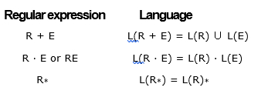
pumping lemma
The Pumping Lemma provides a property that all regular languages must satisfy. It is primarily used to prove that certain languages are not regular.
Regular language is a formal language that can be described by a regular expression or recognized by a finite automaton (FA)
Operators in Regular Expression
There are two binary operations on regular expressions (+ and ·) and one unary operator (*)

Slide 36
pumping lemma
Feature / Model | Pumping Lemma | DFA (Deterministic FA) | NFA (Nondeterministic FA) | Mealy Machine | Moore Machine
Type | Theorem (Proof Tool) | Machine Model | Machine Model | Machine Model | Machine Model
Purpose | Prove that a language is not regular | Accept regular languages deterministically | Accept regular languages non-deterministically | Output string during transition | Output string in states
Input | A string or language | A string | A string | A string | A string
Output | Logical contradiction (proof) | Accept or Reject | Accept or Reject | Sequence of output symbols | Sequence of output symbols
Output Depends On | Not applicable | Final state | Final state | Current state & input symbol | Only current state
Memory/States | Not applicable | Finite number of states | Finite number of states | Finite states + output function | Finite states + output mapping
Used For | Language proof technique | Language recognition | Language recognition | Real-time systems, control systems | Sequence generators, counters
Output Timing | - | At end of input | At end of input | During transition | On entering state
Transition Type | - | Exactly one transition per symbol | May have multiple/ε-transitions | Deterministic | Deterministic

Slide 37
pumping lemma
Pumping Lemma is used as a proof for irregularity of a language. Thus, if a language is regular, it always satisfies pumping lemma.
If there exists at least one string made from pumping which is not in L, then L is surely not regular. The opposite of this may not always be true. w = xyz
Such that
|y| ≥ 1
(y is not empty — it contributes something to the string)
2. |xy| ≤ p
(The repetition part occurs within the first p characters)
3. For all i ≥ 0, the string xyiz ∈ L
(i.e., you can “pump” y — repeat it any number of times — and the string stays in the language)
A regular language is a set of strings that can be recognized by a finite automaton or described by a regular expression

Slide 38
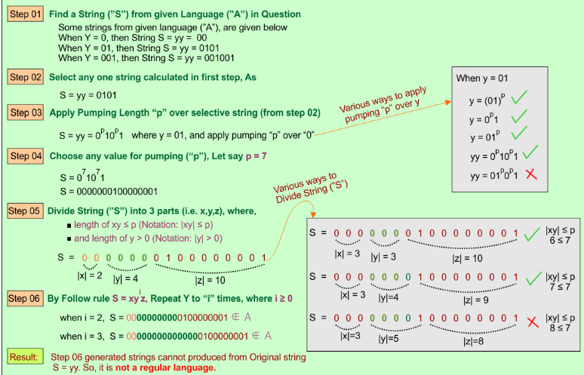
pumping lemma Ex:1
Using Pumping Lemma, prove that the language A = { yy | y ∈ {0,1}* } is not Regular

Slide 39
pumping lemma
A straightforward, short description of the given example to prove that the language A = { yy | y ∈ {0,1}* } is not Regular is given below, by using different “p” and “i” values
We want to prove A = {yy | y ∈ {0,1}*} is not regular.
Assume it is regular and choose a string S = 0101 from A.
Let pumping length be p = 2, so |xy| ≤ 2 and |y| > 0.
Split: x = 0, y = 1, z = 01 → S = xyz = 0101.
Pump y: xy²z = 01101, which is not in the form yy.
So, pumping fails → A is not regular.

Slide 40
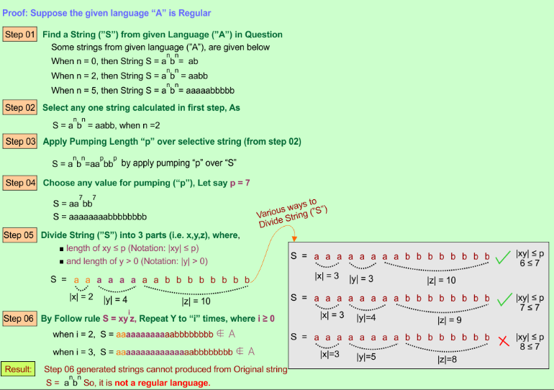
pumping lemma Ex:2
Pumping Lemma prove that the language A = { a^{n}b^{n} | n ≥ 0 } is not Regular

Slide 41
pumping lemma
A straightforward, short description of the given example to prove that the language A = { anbn | n ≥ 0 } is not Regular is given below, by using different “p” and “i” values
We want to prove that A = { aⁿbⁿ | n ≥ 0 } is not regular.
Assume A is regular and let the pumping length be p = 3.
Choose a string S = aaabbb from A (n = 3).
Split S into x = aa, y = a, z = bbb, where |xy| ≤ p and |y| > 0.
Pump y: xy²z = aaaabbb, which has 4 a’s and 3 b’s → not in A.
So, the string after pumping is not in the language → A is not regula

Slide 42
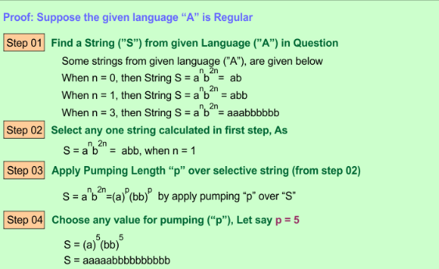
pumping lemma Ex:3
Using Pumping Lemma prove that the language A = { a^{n}b^{2n} | n ≥ 0 } is not Regular

Slide 43
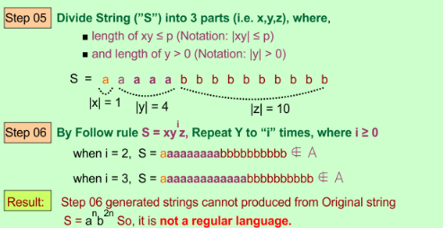
pumping lemma
A simple, short description of the given example to prove that the language A = { a^{n}b^{2n} | n ≥ 0 } is not Regular is given below, by using different “p” and “i” values
We want to prove that A = { aⁿb²ⁿ | n ≥ 0 } is not regular.
Assume A is regular and let the pumping length be p = 3.
Choose a string S = aaabbbbbb from A (n = 3 → 3 a’s and 6 b’s).
Split S into x = aa, y = a, z = bbbbbb, where |xy| ≤ p and |y| > 0.
Pump y: xy²z = aaaabbbbbb, which has 4 a’s and 6 b’s → not in A (should be a⁴b⁸).
So, the string after pumping is not in the language → A is not regular

Slide 44
pumping lemma
Pumping Lemma is used as a proof for irregularity of a language. Thus, if a language is regular, it always satisfies pumping lemma.
If there exists at least one string made from pumping which is not in L, then L is surely not regular. The opposite of this may not always be true.
A regular language is a set of strings that can be recognized by a finite automaton or described by a regular expression

Slide 45
pumping lemma
Pumping Lemma is used as a proof for irregularity of a language. Thus, if a language is regular, it always satisfies pumping lemma.
If there exists at least one string made from pumping which is not in L, then L is surely not regular. The opposite of this may not always be true.
A regular language is a set of strings that can be recognized by a finite automaton or described by a regular expression

Slide 46
pumping lemma
Pumping Lemma is used as a proof for irregularity of a language. Thus, if a language is regular, it always satisfies pumping lemma.
If there exists at least one string made from pumping which is not in L, then L is surely not regular. The opposite of this may not always be true.
A regular language is a set of strings that can be recognized by a finite automaton or described by a regular expression

Slide 47
pumping lemma
Pumping Lemma is used as a proof for irregularity of a language. Thus, if a language is regular, it always satisfies pumping lemma.
If there exists at least one string made from pumping which is not in L, then L is surely not regular. The opposite of this may not always be true.
A regular language is a set of strings that can be recognized by a finite automaton or described by a regular expression

Slide 48
pumping lemma
Pumping Lemma is used as a proof for irregularity of a language. Thus, if a language is regular, it always satisfies pumping lemma.
If there exists at least one string made from pumping which is not in L, then L is surely not regular. The opposite of this may not always be true.
A regular language is a set of strings that can be recognized by a finite automaton or described by a regular expression

Slide 49
pumping lemma
Pumping Lemma is used as a proof for irregularity of a language. Thus, if a language is regular, it always satisfies pumping lemma.
If there exists at least one string made from pumping which is not in L, then L is surely not regular. The opposite of this may not always be true.
A regular language is a set of strings that can be recognized by a finite automaton or described by a regular expression

