Slide 1
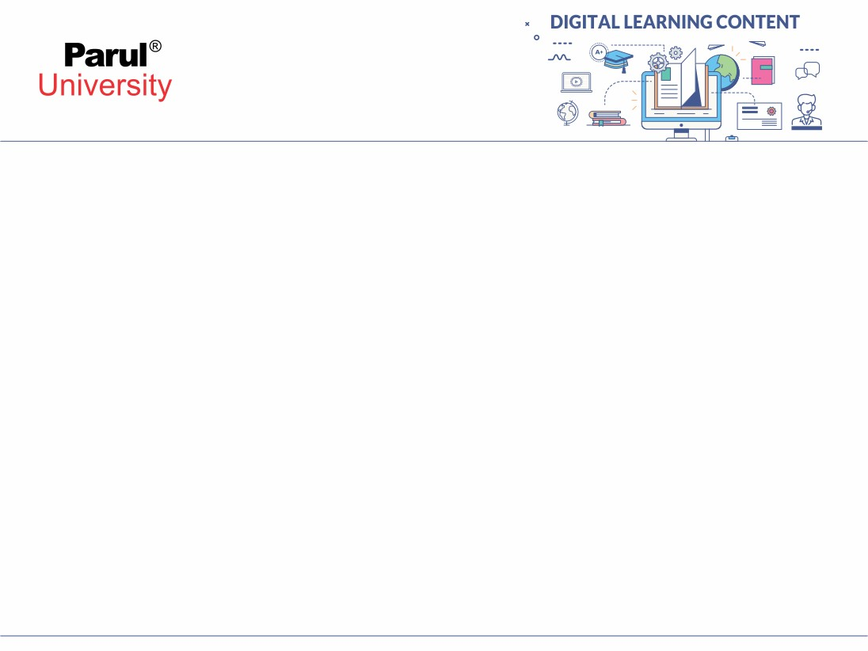

Web Basics and Java Servlets

Slide 2

Client-Server Architecture
Clients (e.g., browsers) request resources.
Servers (e.g., web servers) respond with data.
Based on the Request-Response model.

Slide 3
HTTP Protocol Basics
Stands for Hypertext Transfer Protocol.
It acts as a set of rules that govern how web browsers and servers communicate
It enables the display of web pages and other online content
It is stateless communication protocol.
Used for web communication.

Slide 4
HTTP Methods
GET: Retrieves data from a specified resource. It's used for reading information and should not have any other side effects on the server.
POST: Sends data to the server to create or update a resource. Often used for submitting forms or uploading data, and can have side effects on the server.
PUT: Replaces the entire resource at a specified URL with the data provided in the request. If the resource doesn't exist, it may be created.
PATCH: Partially modifies a resource at a specified URL. It's used when you want to update only specific parts of a resource, rather than replacing the entire thing.
DELETE: Deletes the resource at the specified URL.

Slide 5
HTTP Status Codes
1xx – Informational Responses:
100 Continue – Initial part of request received, continue with rest.
101 Switching Protocols – Server agrees to switch protocols.
2xx – Success:
200 OK – Standard response for successful requests.
201 Created – Resource successfully created (e.g., after POST).
204 No Content – Successful but no content to return.
3xx – Redirection:
301 Moved Permanently – Resource permanently moved to a new URL.
302 Found – Temporarily moved; use new URL for this request only.
304 Not Modified – Client can use cached version.

Slide 6
HTTP Status Codes
4xx – Client Errors:
400 Bad Request – Malformed syntax or invalid request.
401 Unauthorized – Authentication required.
403 Forbidden – Request is understood but refused.
404 Not Found – Requested resource doesn't exist.
5xx – Server Errors:
500 Internal Server Error – Generic server-side error.
502 Bad Gateway – Invalid response from upstream server.
503 Service Unavailable – Server is temporarily down or overloaded.

Slide 7
HTTP Headers – Request Header
Header | Purpose
Host | Specifies the domain name (e.g., www.example.com)
User-Agent | Information about the client (browser, OS, etc.)
Accept | Media types the client can process (e.g., text/html, application/json)
Accept-Language | Preferred language (e.g., en-US)
Content-Type | Type of the body being sent (e.g., application/x-www-form-urlencoded)
Authorization | Credentials for authentication (e.g., Bearer <token>)
Cookie | Sends stored cookies to the server
Referer | Indicates the previous web page (helps with analytics, CSRF protection)

Slide 8
HTTP Headers – Response Headers
Header | Purpose
Content-Type | Type of content being returned (e.g., text/html, application/json)
Content-Length | Size of the response body in bytes
Set-Cookie | Instructs client to store cookies
Cache-Control | Controls caching behavior (e.g., no-cache, max-age=3600)
Location | Redirects to a different URL (used with 3xx status codes)
Access-Control-Allow-Origin | Enables CORS, specifies which origins are allowed
Server | Name/version of the server software (e.g., Apache, Nginx, Tomcat)

Slide 9
What is a Web Server?
A web server handles HTTP requests and serves static content.
Responsible for delivering HTML, CSS, JavaScript, images, etc.
Common tasks include load balancing, SSL/TLS encryption, and logging.
Does not process dynamic Java-based content.
Examples: Apache HTTP Server, Nginx, Gunicorn.

Slide 10
Web Servers and Servlet Containers

Slide 11
What is a Servlet Container?
A servlet container (or web container) runs Java servlets.
It handles dynamic web content generated by Java code.
Manages servlet lifecycle: loading, instantiation, request handling.
Provides runtime environment for servlet execution.
Examples: Apache Tomcat, Jetty, WildFly, GlassFish.

Slide 12
Comparison: Web Server vs Servlet Container
Feature | Web Server | Servlet Container (Web Container)
Primary Role | Serve static content | Process dynamic content (Java Servlets, JSP)
Content Type | HTML, CSS, JS, images | Servlet-generated HTML, JSON, XML, etc.
Technology Support | No Java support | Full Java Servlet and JSP support
Examples | Apache HTTPD, Nginx, IIS | Tomcat, Jetty, WildFly, GlassFish
Communication | Uses HTTP protocol | Supports Servlet API, manages sessions
Performance | Optimized for static file delivery | Optimized for concurrent Java execution
Usage | Front-end or static asset handler | Backend application logic handler

Slide 13
Web Server and Servlet Container Together
Web server handles static content and forwards dynamic requests.
Servlet container processes business logic and generates dynamic content.
Integration is done using reverse proxy or AJP (Apache JServ Protocol).

Slide 14
Static and Dynamic Content

Slide 15
What is Static Content?
Delivered to users exactly as stored on the server.
Content does not change unless manually updated.
Common technologies: HTML, CSS, JavaScript.
Highly cacheable and fast to load.
Examples: Company homepage, documentation, brochure websites, blogs, documentation, landing pages.

Slide 16
What is Dynamic Content?
Generated on the fly based on user input or session data.
Involves server-side scripting.
Can display different content for each user.
Technologies: Java Servlets, JSP, PHP, ASP.NET, Python Flask/Django.
Requires database or application logic.
Examples: User profiles, shopping carts, dashboards.

Slide 17
Comparison: Static vs Dynamic Content
Feature | Static Content | Dynamic Content
Definition | Pre-written files served as-is | Content generated at runtime based on logic or input
Technologies Used | HTML, CSS, JavaScript, Images | Java Servlets, JSP, PHP, ASP.NET, Python (Flask/Django)
User Specific? | Same for all users | Can vary for each user/session
Speed | Very fast, minimal processing | Slower due to server-side computation
Database Interaction | No | Frequently interacts with a database
Server Requirements | Basic web server (e.g., Apache HTTP Server) | Requires application server/web container
Ease of Development | Easier to create and host | Requires programming and backend integration
Use Cases | Brochures, documentation, portfolios | E-commerce sites, dashboards, social platforms
Caching | Easily cacheable in browsers/CDNs | More difficult to cache due to changing content
Security Concerns | Minimal (content only) | Higher (e.g., SQL Injection, XSS, authentication)

Slide 18
Servlets

Slide 19
What are Servlets?
Server-side Java programs that handle client requests.
Generate dynamic web content (e.g., HTML, JSON).
Core part of Java EE (Jakarta EE).
Work within a web container (e.g., Tomcat).

Slide 20
Key Features of Servlets
Platform-independent: Runs anywhere Java is supported.
Efficient: Single instance handles multiple requests.
Scalable: Supports concurrent client interactions.
Extensible: Integrates with JDBC, JSP, and EJB.
Secure: Can use HTTPS and Java's security features.

Slide 21
How Servlets Work
Client sends HTTP request (e.g., form submission).
Web container forwards request to servlet.
Servlet processes request and generates response.
Response (HTML/JSON) sent back to client.

Slide 22
Servlet Lifecycle Phases
Lifecycle phases: Load → Instantiate → init() → service() → destroy()
Managed by the Servlet Container (e.g., Tomcat).
Ensures resource allocation, request handling, and cleanup.

Slide 23
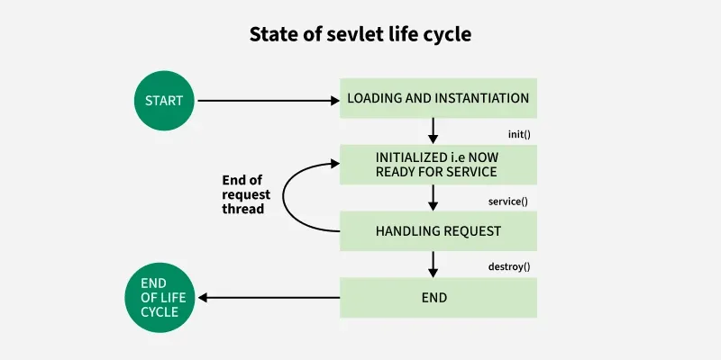
Servlet Lifecycle Phases

Slide 24
init() Method
Called once after loading, when servlet is instantiated.
Used to initialize DB connections, resources.
Accepts ServletConfig.
Syntax: public void init(ServletConfig config) throws ServletException{}

Slide 25
service() Method
Called for every request.
Dispatches to doGet(), doPost(), etc.
Uses ServletRequest, ServletResponse.
Method is called directly by server when an HTTP request is received; default service() method calls doGet() and related methods.
Syntax: public void service(ServletRequest req, ServletResponse res)

Slide 26
destroy() Method
Called once when servlet is being removed/unloaded.
Used to release resources (e.g., DB connections).
Syntax: public void destroy()

Slide 27
Servlet APIs and HTTP Servlets

Slide 28
javax.servlet.Servlet Interface
Root interface for all servlets.
Defines five key methods:
init(ServletConfig config): Called once during initialization.
service(ServletRequest req, ServletResponse res): Handles client requests.
destroy(): Called once before servlet is destroyed.
getServletConfig(): Returns servlet config object.
getServletInfo(): Returns servlet metadata.
Rarely implemented directly.
Forms the foundation of servlet design.
Notes:
Usually not implemented directly. Servlets use classes like GenericServlet.

Slide 29
javax.servlet.GenericServlet
Implements the Servlet interface.
Abstract class that simplifies servlet development.
Handles init(), destroy(), getServletConfig(), and getServletInfo().
Developers only need to override service() method.
Best for protocol-independent servlets which displays static content.
Not commonly used for web applications which are HTTP-based.

Slide 30
ServletRequest Interface
Represents incoming request.
Methods: getParameter(), getHeader(), getInputStream().
Represents the client request.
Provides methods to:
Read parameters: getParameter(), getParameterValues()
getParameter() returns a single value.
getParameterValues() returns an array of values.
Access headers: getHeader()
Get input stream: getInputStream()
Work with attributes: getAttribute(), setAttribute()
Used for all types of requests (not HTTP-specific).
Typically cast to HttpServletRequest in HTTP servlets.

Slide 31
ServletResponse Interface
Represents the server's response to the client.
Methods include:
Set content type: setContentType()
Write response: getWriter(), getOutputStream()
Set buffer size and flush output.
Like ServletRequest, not HTTP-specific.
Typically cast to HttpServletResponse.

Slide 32
javax.servlet.http.HttpServlet
Abstract class extending GenericServlet.
Designed for handling HTTP-specific requests.
Methods:
doGet(): Handle HTTP GET
doPost(): Handle HTTP POST
doPut(), doDelete(), etc.
Overrides service() to route requests to appropriate doXXX() methods.
Most commonly used servlet class.
Developers usually extend this class in real applications.
Notes:
Explain how service() automatically routes based on HTTP method.

Slide 33
HttpServletRequest
Extends ServletRequest with HTTP-specific features.
Useful methods:
getMethod(): GET, POST, etc.
getRequestURI(), getContextPath()
getSession(), getCookies(), getHeader()
Essential for understanding what the client is requesting.
Frequently used to retrieve session or request path.

Slide 34
HttpServletResponse
Extends ServletResponse for HTTP responses.
Key methods:
sendRedirect(String location)
addCookie(Cookie cookie)
setHeader(), setStatus()
Output content: getWriter()
Manages status codes, headers, cookies, and redirections.
Common for error handling and session management.

Slide 35
Servlet Demo Code
public class MyServlet extends HttpServlet {
public void init() {
System.out.println("Servlet Initialized");
}
public void service(HttpServletRequest req, HttpServletResponse res) {
System.out.println("Request Received");
}
public void destroy() {
System.out.println("Servlet Destroyed");
}
}

Slide 36
Handling HTTP Methods

Slide 37
Introduction to HTTP Methods in Servlets
Web clients use HTTP methods to interact with servers.
Java Servlets handle these methods via HttpServlet.
Common methods:
GET Retrieve data (Handled by doGet())
POST Submit data (Handled by doPost())
PUT Update resource (Handled by doPut())
DELETE Remove resource (Handled by doDelete())

Slide 38
doGet() Method
Handles data retrieval requests.
Idempotent(can be called multiple times with same result) and safe.
Limited URL length (usually ~2048 characters).
Example:
Displaying a webpage.
Query string data
Bookmarkable pages
Read-only operations

Slide 39
doPost() Method
Handles form submission and data updates.
Data is sent in request body, not visible in URL.
Not idempotent, used for sensitive actions like login.
Better for sending large amounts of data.
Examples:
Submitting forms
Login, registration, database updates

Slide 40
doGet() VS doPost() Method
Feature | doGet() | doPost()
Data Visibility | URL (Query String) | Request Body (Hidden)
Length Limit | Yes (~2048 characters) | No (depends on server)
Caching | Often cached | Not cached
Use Case | Read/display data | Submit/modify data
Bookmarkable | Yes | No
Idempotent | Yes | No

Slide 41
Servlet Configuration

Slide 42
What is a Deployment Descriptor?
Servlet configuration defines servlet behavior and interaction with the container.
This is also called as Deployment Descriptor.
Two methods:
XML-based (web.xml)
Annotations (@WebServlet).
Defines:
Servlet classes and mappings
Initialization parameters
Session config
Security constraints
Welcome/error pages

Slide 43
Web.XML
An XML-based config file for Java web apps
Named web.xml, inside WEB-INF/
Example:
<servlet>
<servlet-name>LoginServlet</servlet-name>
<servlet-class>com.example.LoginServlet</servlet-class>
</servlet>
<servlet-mapping>
<url-pattern>/login</url-pattern>
</servlet-mapping>

Slide 44
Location and Format of web.xml
An XML-based config file for Java web apps
Path: WebContent/WEB-INF/web.xml
Must follow Servlet API schema (e.g., 3.1)
Root element:
<web-app xmlns="http://xmlns.jcp.org/xml/ns/javaee" version="3.1">
</web-app>

Slide 45
Defining a Servlet in web.xml
<servlet>
<servlet-name>LoginServlet</servlet-name>
<servlet-class>com.example.LoginServlet</servlet-class>
</servlet>
servlet-name: Logical name
servlet-class: Fully qualified class name

Slide 46
Mapping the Servlet in web.xml
<servlet-mapping>
<servlet-name>LoginServlet</servlet-name>
<url-pattern>/login</url-pattern>
</servlet-mapping>
Maps URLs to servlets
One servlet can have multiple mappings

Slide 47
Welcome File List & Error Handling in web.xml
<welcome-file-list>
<welcome-file>index.jsp</welcome-file>
</welcome-file-list>
<error-page>
<error-code>404</error-code>
<location>/notfound.jsp</location>
</error-page>

Slide 48
Welcome File List & Error Handling in web.xml
<welcome-file-list>
<welcome-file>index.jsp</welcome-file>
</welcome-file-list>
<error-page>
<error-code>404</error-code>
<location>/notfound.jsp</location>
</error-page>

Slide 49
Configuration Using Annotations
Introduced in Servlet 3.0.
Example:
@WebServlet(name="LoginServlet", urlPatterns={"/login"})
public class LoginServlet extends HttpServlet {...}

Slide 50
Comparison
Feature | web.xml | Annotations (@WebServlet)
Configuration Location | External XML file (separate from code) | Inline in servlet Java class
Servlet API Requirement | Works with all versions | Requires Servlet 3.0+
Readability | Centralized config | Scattered if many servlets
Flexibility | Better for large-scale config | Better for quick/small apps
Dynamic Configuration | Can be modified without recompilation | Requires recompilation
Init Params | <init-param> tag | @WebInitParam annotation
URL Mapping | <url-pattern> in <servlet-mapping> | urlPatterns attribute

Slide 51
ServletContext
ServletContext provides application-wide context shared by all servlets.
Used for:
Init parameters
Logging
Inter-servlet communication

Slide 52
Session

Slide 53
What is a Session in Servlets?
A session tracks user requests over time
HTTP is stateless; session adds state
Each session has a unique ID (cookie-based)
Used to maintain user state (login, preferences, cart, etc.)
Essential for multi-step workflows like checkout, form wizards
Improves user experience by preserving context
Ensures personalized and secure interactions

Slide 54
Creating and Accessing a Session
Creates a session if not exists
Use getSession(false) to avoid creation
session.getId() returns session ID
Syntax:
HttpSession session = request.getSession();

Slide 55
Session Lifecycle
Created via getSession()
Accessed using request.getSession()
Invalidated:
Automatically (timeout)
Manually (session.invalidate())

Slide 56
Session Tracking
Used to maintain user state in stateless HTTP.
Techniques:
Cookies
URL Rewriting
Hidden Fields
HttpSession

Slide 57
Session Tracking Techniques
Used to maintain user state in stateless HTTP.
Techniques:
Cookies
URL Rewriting
Hidden Fields
HttpSession

Slide 58
Cookies – Client-side Session Tracking
Small text files stored on the user's browser
Automatically sent with every HTTP request to the server
Can be persistent or session-only
Syntax:
Cookie userCookie = new Cookie("userId", "abc123");
response.addCookie(userCookie);

Slide 59
Drawbacks of Cookies
Users can disable cookies
Limited storage (usually 4KB per cookie)
Privacy concerns as data is stored on client-side

Slide 60
URL Rewriting
Session information is appended in the URL
Useful when cookies are disabled
Visible to the user; not very secure
Syntax:
response.encodeURL("home.jsp?sessionId=abc123");

Slide 61
Hidden Form Fields
Hidden <input> fields used to store session data
Sent with every form submission
Useful for multi-page forms
Syntax:
<input type='hidden' name='userId' value='abc123'>

Slide 62
HttpSession – Server-side Session Management
Most secure and scalable approach
Managed by the servlet container
Accessed using request.getSession()
Automatically uses cookies or URL rewriting
Syntax:
<input type='hidden' name='userId' value='abc123'>

Slide 63
Working with HttpSession
Stores any Object type
Works like a key-value map
Create/Retrieve:
HttpSession session = request.getSession();
Store data:
session.setAttribute("username", "john"); Managed by the servlet container
Retrieve data:
String user = (String) session.getAttribute("username");
Invalidate session:
session.invalidate();

Slide 64
CRUD Operations

Slide 65
Overview of CRUD
CRUD stands for Create, Read, Update, Delete.
Used to interact with database records.
Servlets handle HTTP requests and JDBC manages DB operations.

Slide 66
Database Setup
Create a MySQL database and table.
Load JDBC driver in servlet.
Use PreparedStatement to prevent SQL injection.
Close connections properly.

Slide 67
Create Operation (INSERT)
Get form parameters using request.getParameter().
Connect to DB.
Execute INSERT SQL.
Example:
PreparedStatement ps = conn.prepareStatement("INSERT INTO users(name) VALUES(?)");
ps.setString(1, name);
ps.executeUpdate();

Slide 68
Read Operation (SELECT)
Connect to DB.
Use Statement or PreparedStatement.
Execute SELECT query.
Use ResultSet to loop through results.
Example:
ResultSet rs = stmt.executeQuery("SELECT * FROM users");
while(rs.next()){...};

Slide 69
Update Operation
Fetch record ID and updated values from form.
Use UPDATE query.
Example:
PreparedStatement ps = conn.prepareStatement("UPDATE users SET name=? WHERE id=?");
ps.setString(1, name);
ps.setInt(2, id);

Slide 70
Delete Operation
Retrieve record ID.
Use DELETE query.
Example:
PreparedStatement ps = conn.prepareStatement("DELETE FROM users WHERE id=?");
ps.setInt(1, id);
ps.executeUpdate();

Slide 71
Best Practices
Use try-with-resources for DB operations.
Validate user inputs.
Use MVC pattern.
Use connection pooling.
Separate DB logic into DAO classes.

