Slide 1
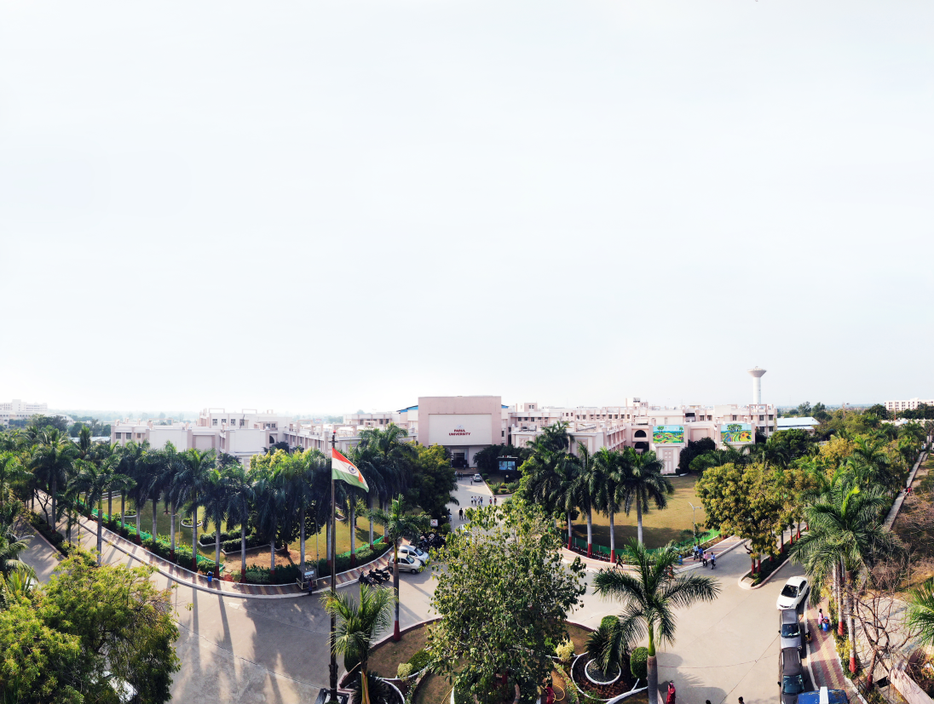


Distributed Computing
Prof. Yassir Farooqui, Assistant Professor
Computer Science & Engineering

Slide 2
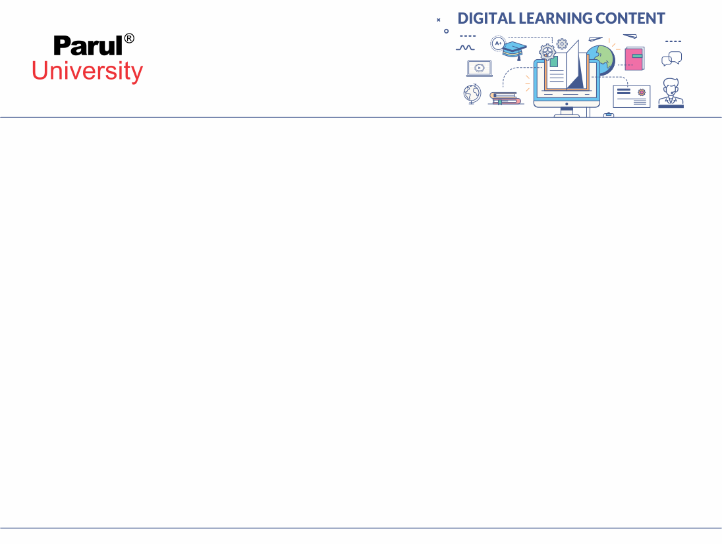

INTRODUCTION TO DISTRIBUTED SYSTEMS
Definition
Motivation for Distributed system
Distributed Operating system
Architectural Categories
Characteristics, Issues, Goals,
Disadvantages
Image source: Google

Slide 3
DEFINITION
A distributed system is a collection of independent computers, interconnected via a network, capable of collaborating on a task.
A distributed system can be characterized as collection of multiple autonomous computers that communicate over a communication network and having following features:
996
No common Physical clock
Enhanced Reliability
Increased performance/cost ratio
Access to geographically remote data and resources
Scalability
Image source: Google

Slide 4
DEFINITION
Distributed system is a collection of independent entities that cooperate to solve a problem that cannot be solved individually.
So, basically it is nothing but a collection of computers.
DCS do not share a common memory or do not have a common physical clock, and the only way they can communicate is through the message passing and for that they require a communication network

Slide 5
Importance Of Information
A distributed system is (Tannenbaum):
A collection of independent computers that appears to its users as a single coherent system.

Slide 6
Motivation for Distributed system
Inherently distributed computation that is many applications such as money transfer in the banking, or reaching a consensus among the parties that are geographically distant, the computation is inherently distributed.
Resource sharing the sharing of the resources such as
peripherals, and a complete data set and so on and so forth.
Access the geographically remote data and resources, such as bank database, supercomputer and so on.
Reliability enhanced reliability possibility of replicating the
resources and execution to enhance the reliability.

Slide 7
Distributed System

Slide 8
Distributed Operating System
Distributed operating system as a software system that runs on multiple machines and enables them to work together as a single coherent system.
The goal of a distributed operating system is to provide transparency and coordination among the distributed resources.

Slide 9
Distributed Operating System
key characteristics of distributed operating systems:
Resource Sharing: Distributed operating systems allow multiple machines to share resources such as files, printers, and network connections.
Transparency: Users perceive the system as a single, integrated entity, hiding the distributed nature of resources.
Scalability: Distributed operating systems can easily accommodate new machines and handle increasing workloads.
Fault Tolerance: Distributed systems are designed to continue functioning even if individual machines or components fail.
Concurrency: Multiple processes can execute simultaneously across different machines.

Slide 10
Distributed Operating System
Increased Performance: Distributed systems can harness the power of multiple machines to improve processing speed and response time.
Enhanced Reliability: Fault tolerance mechanisms ensure high availability and system resilience.
Improved Scalability: Distributed systems can easily accommodate growing workloads and adapt to changing requirements.
Resource Efficiency: Resource sharing and load balancing techniques optimize resource utilization across machines.

Slide 11
Distributed Computing
Early computing was performed on a single processor.
Uni-processor or monolithical computing can be called centralized computing.
A distributed system is a collection of independent computers, interconnected via a network, capable of collaborating on a task.
Distributed computing is computing performed in a distributed system.

Slide 12
EXAMPLES OF DISTRIBUTED SYSTEMS
Database Management System
Automatic Teller Machine Network
Internet/World-Wide Web
Mobile and Ubiquitous Computing

Slide 13
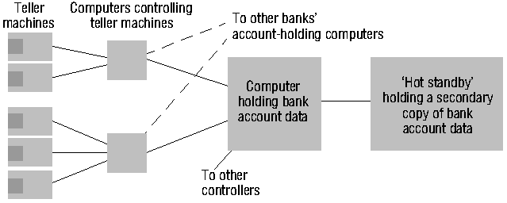
AUTOMATIC TELLER MACHINE NETWORK

Slide 14







INTERNET
intranet
🕭
ISP
🕭
🕭
🕭
backbone
satellite link
desktop computer:
server: network link:

Slide 15
REFERENCES
Tanenbaum, Andrew S., and Maarten Van Steen. Distributed systems: principles and paradigms. Prentice-Hall, 2007.
Sinha, Pradeep K. Distributed operating systems: concepts and design. PHI Learning Pvt. Ltd., 1998.
NOC:Distributed Systems,NPTEL

Slide 16


www.paruluniversity.ac.in

