Slide 1
CLOUD OPERATIONS · CONTROLLED EXIT
Azure subscription decommissioning
Close legacy subscriptions safely while preserving data, dependencies, cost control, and audit readiness.

Slide 2
THE OPERATING PRINCIPLE
Closing a subscription is a risk-management project.
Deleting first
Can trigger service disruption, data loss, or audit gaps.
Goal: close the subscription with no critical dependency left behind.
Legacy Azure subscriptions can still host business data, logs, backups, identities, and resources used by other workloads.
02

Slide 3

The hard part is what the inventory cannot see
Resource lists are necessary, but they do not reveal every dependency or owner.
Visible resources
Compute, databases, storage, networking, monitoring, and identities.
Hidden references
Cross-subscription references, private endpoints, external storage access, scripts, service principals, and managed identities.
Decision evidence
Ownership, active use, approvals, and business impact before removal.
03

Slide 4
Retain what the business may need later
Retention is a business decision before it becomes a storage decision.
01
CLASSIFY
02
PRESERVE
03
ENABLE
What matters?
What stays?
Can it be found?
Set retention periods and make retrieval available to authorized users.
Business-critical, regulatory, audit evidence, historical, or unnecessary.
Databases, application logs, activity and security logs, backups, and configuration information.
04

Slide 5
USE CASE 1 · ACTIVE WORKLOADS
Close without disrupting active workloads
01
02
03
04
Inventory and map
Move what is used
Test the edges
Remove in sequence
Inventory resources and map dependencies.
Confirm what is still used and migrate or recreate required workloads.
Test dependent applications, connectivity, and access.
Remove resources after business and technical approval.
05

Slide 6
Use case 2: preserve evidence beyond closure
EVIDENCE AFTER CLOSURE
The archive is part of the exit.
Closure does not end the need to explain what happened.
Define the destination
What must remain available, and where will it live?
Document the controls
Record retained data, retention periods, access rules, and archive location.
Authorized users still need a documented path to historical records.
Keep the trail usable
Maintain an evidence trail so historical records remain usable after closure.
06

Slide 7
Data movement can create a second risk: cost
Moving data protects continuity, but the transfer and the destination both have a price.
TRANSFER
RETENTION
MITIGATE
Slow and expensive
Recurring storage
Estimate first
Large databases, backups, and log archives can make transfers slow and expensive.
External transfer may create egress charges.
Long-term storage creates recurring cost.
Retain only what the business may need later.
Estimate volume, compress where appropriate, and compare storage options.
07

Slide 8

Choosing the Right Azure Storage Tier for Archives
HOT TIER
COLD TIER
Frequent access
Rare access
Higher storage cost, lower access and retrieval cost
Fast, convenient access for active audit records
Keep frequently accessed logs and recent audit records here during transition
Lower storage cost; higher access or retrieval costs may apply
For long-term archives; access may take longer depending on the service
Store older logs, backups, and infrequently accessed records to reduce long-term storage costs
Archive strategy
Recent audit data → Hot Storage
Older historical data → Cold Storage
Choose by access frequency, retention period, retrieval requirements, and total cost.
08

Slide 9
CONTROLLED PATH
A nine-step path keeps closure controlled
01
02
03
04
Discover
Assess
Plan
Execute and prove
Resources and dependencies.
Critical workloads and retained data.
Migration, archival, retention, and cost strategy.
Migrate, validate, archive, decommission, verify, and document.
The path keeps discovery, decisions, movement, closure, and evidence connected.
09

Slide 10
ACCOUNTABILITY
Before delete
Best practice is visible accountability.
Ownership tags, backup-before-delete, change management, and approvals.
After move
Record what moved, what was retained, who approved it, and how the final state was verified.
Every action should be attributable before the subscription is closed and explainable after it is gone.
Expected outcome
Lower cloud cost without unexpected workload disruption.
10

Slide 11
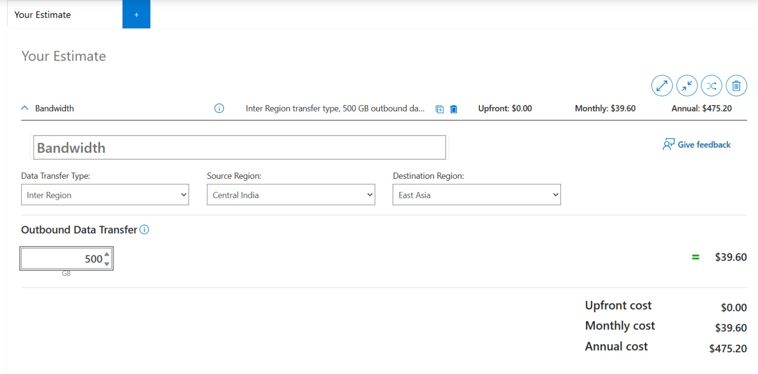

Slide 12
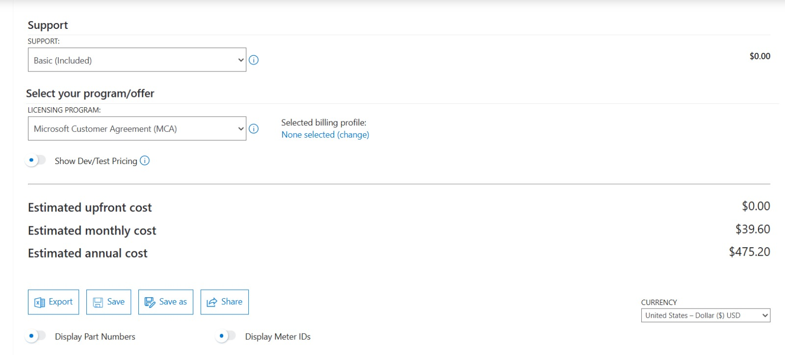

Slide 13
THE EXIT CRITERION
Close cleanly, keep the evidence.
Safe decommissioning leaves no active dependency behind and gives the organization a documented path back to its historical data.

