Slide 1
HR DATABASE MANAGEMENT SYSTEM
HR DATABASE MANAGEMENT SYSTEM
A SQL-Based Employee Data & Analytics Project
Prepared By: Jayesh Bacchav
CoachxLive –CX 144 BATCH

Slide 2
Project Scope
Create HR tables using SQL
Insert employee & salary data
Perform HR analytics
Demonstrate SQL joins, grouping, subqueries
Real-world HR data management simulation

Slide 3
Introduction
Organizations depend on reliable HR data to operate efficiently. The HR Database Management System developed in this project provides a structured framework for maintaining accurate employee records, salary details, and reporting hierarchy. Built entirely on SQL Server, the system ensures data consistency, improves information accessibility, and supports HR decision-making through analytical queries. This database serves as a foundational solution for HR automation and data-driven management.

Slide 4
Importance of HR Systems
Centralizes all employee information in one secure system
Ensures accuracy through validation and relational constraints
Enables fast retrieval of employee and salary data
Supports HR decision-making with data-driven insights
Simplifies reporting, compliance, and workforce analysis
Scales easily as the organization grows

Slide 5
Key HR Terminologies
Employee ID — Unique identifier for each employee
Manager ID — Shows reporting hierarchy
Date of Joining — Tracks employee tenure
Salary — Fixed compensation
Variable Pay — Incentive-based earnings
Project — Employee’s assigned work
Primary Key — Ensures unique records
Foreign Key — Maintains table relationships

Slide 6
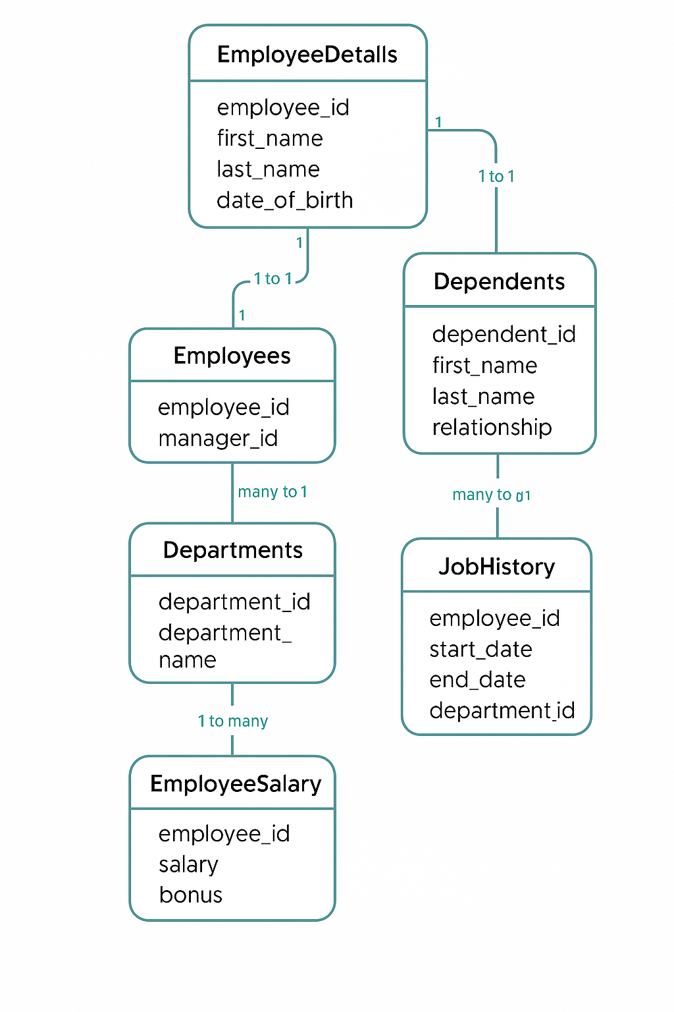
ER Diagram

Slide 7
HR Insights
Balanced workforce distribution across projects.
Salary and variable pay show structured compensation trends.
Manager–employee hierarchy clearly defined.
Hiring trends visible from year-wise joinings.
Missing or duplicate records easily identified.
Strong PK–FK schema ensures clean and reliable HR data.

Slide 8
Advantages
Centralized storage of all employee information.
Higher data accuracy through primary and foreign key constraints.
Faster retrieval of employee and salary details.
Improved HR decision-making through SQL-based insights.
Scalable structure for future HR modules.
Enhances reporting, compliance, and audit processes.
Reduces redundancy and maintains clean relational data.
Supports clear visualization of employee–manager hierarchy.

Slide 9
Advantages
Centralized storage of all employee information.
Higher data accuracy through primary and foreign key constraints.
Faster retrieval of employee and salary details.
Improved HR decision-making through SQL-based insights.
Scalable structure for future HR modules.
Enhances reporting, compliance, and audit processes.
Reduces redundancy and maintains clean relational data.
Supports clear visualization of employee–manager hierarchy.

Slide 10
LIMITATIONS
No graphical user interface; requires SQL knowledge to operate
Limited HR modules—does not include attendance, leave, or performance tracking
Manual data entry may lead to human errors
No real-time updates without manual SQL operations
Not integrated with payroll or other HR management systems
Requires periodic maintenance and data validation
Cannot automatically generate advanced HR reports or dashboards

Slide 11
Conclusion
The HR Database Management System provides a structured and efficient way to store, manage, and analyze employee information. Through the use of SQL-based tables, constraints, and analytical queries, the project demonstrates how organizations can maintain accurate employee records, understand reporting hierarchies, and evaluate salary structures.
This system successfully meets the objectives of designing a relational database, ensuring data integrity, and delivering meaningful HR insights. Overall, it serves as a strong foundation for more advanced HR modules, automation, and future integration with enterprise HR systems.

Slide 12
Future Enhancements
Add attendance and leave management modules
Integrate performance evaluation and appraisal tracking
Introduce department and job role hierarchy tables
Implement a user-friendly web or mobile interface
Automate HR reporting and monthly payroll generation
Integrate with payroll, onboarding, and HRMS systems
Add data visualization dashboards using Power BI or Tableau
Enable real-time data updates and automated validations

