Slide 1


Superstore Sales & Customer Analytics Course: Data Science[CX-144] Student Name: Jayesh Bacchav Institute: CoachX.Live
Project Overview
This Project Focuses On Analyzing A Retail Superstore’s Sales Data Using Power BI To Convert Raw Transactional Data Into Meaningful Business Insights. The Dashboard Evaluates Overall Business Performance By Tracking Sales, Profit, Customer Behavior, And Product Performance Across Different Regions And Segments.

Slide 2

Introduction
Retail organizations generate large amounts of transactional data through daily sales operations. However, raw data alone cannot support effective decision-making. Businesses require analytical dashboards to convert data into meaningful information.
This project focuses on analyzing retail sales data using Power BI to monitor performance, identify trends, and support business strategy through data-driven insights.
The dashboard provides a centralized platform for management to evaluate company performance across products, customers, and regions.

Slide 3

PROBLEM STATEMENT
The company lacked a centralized reporting system to analyze sales performance. Decision makers were facing the following issues:
• Unable to track sales and profit trends over time • No visibility into top-performing products • Difficulty identifying high-value customers • Inability to detect loss-making categories and regions • Manual reporting process was time-consuming
Therefore, there was a need to develop an interactive business intelligence dashboard for real-time monitoring and analysis.

Slide 4

REQUIREMENT ANALYSIS
Business Requirements
The business required a dashboard that could:
• Monitor overall sales and profit performance • Analyze product category contribution • Identify top customers and repeat customers • Compare regional performance • Evaluate impact of discount on profitability • Track customer purchasing behavior
These requirements guided the design of dashboard visuals and KPIs

Slide 5

DATASET DESCRIPTION
The dataset contains detailed order-level transactional records including:
• Order ID and Order Date • Customer ID and Customer Segment • Product Category and Sub-Category • Sales, Quantity, Discount and Profit • State and Region information • Shipping mode and delivery details
This data allows analysis of operational performance, customer behavior, and product profitability

Slide 6
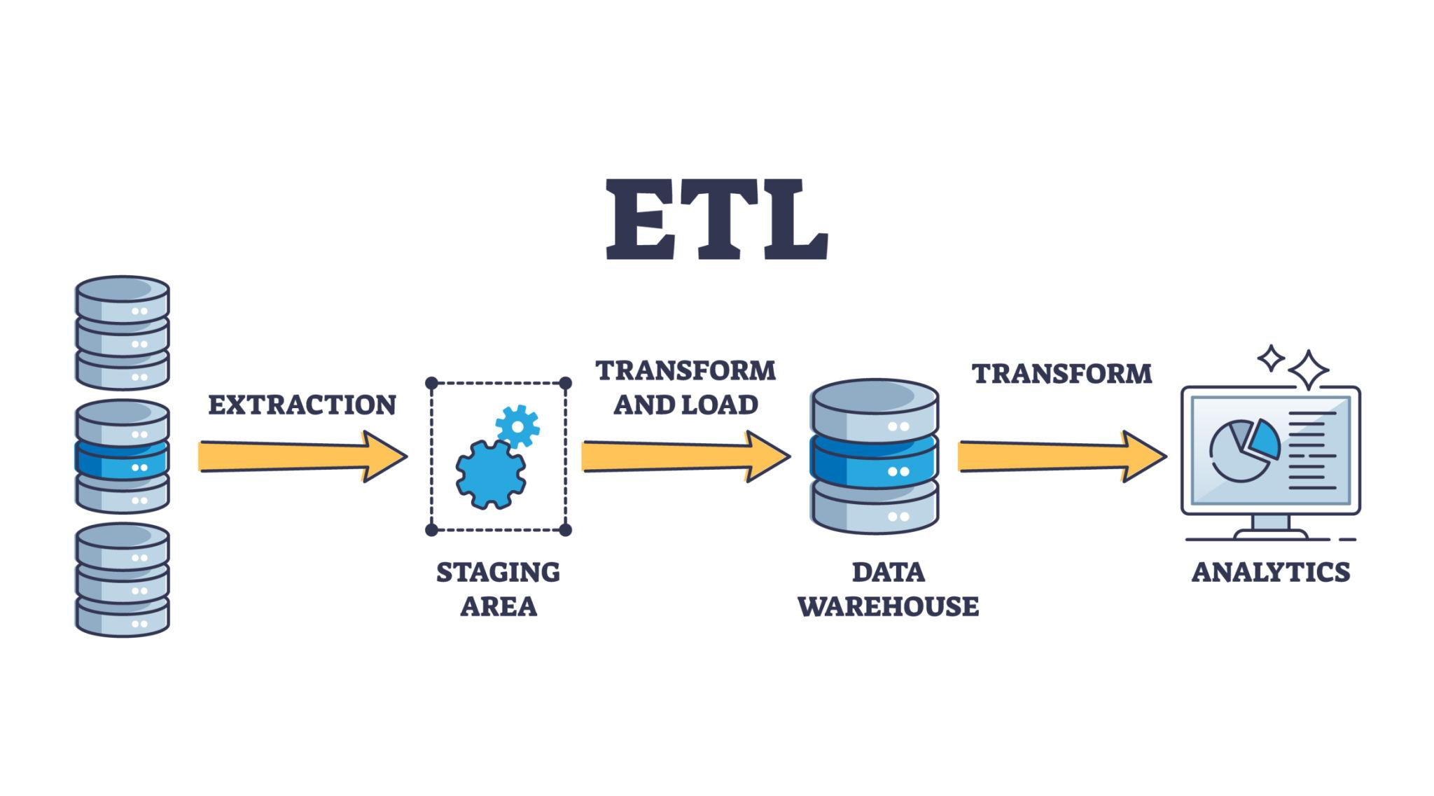
METHODOLOGY
The project was implemented using the Business Intelligence workflow:
Data Collection – Imported retail dataset
Data Cleaning – Removed nulls and corrected data types
Data Transformation – Created calculated columns
Data Modeling – Built relationships between tables
Data Analysis – Created KPIs using DAX
Data Visualization – Designed interactive dashboards
Insight Generation – Derived business recommendations

Slide 7
DATA PREPARATION
Data preparation was performed using Power Query:
• Removed duplicate records • Handled missing values • Standardized date format • Converted numeric columns (Sales, Profit, Quantity) • Created new columns (Year, Month, Profit Margin)
This step ensured data accuracy and reliability before analysis.

Slide 8
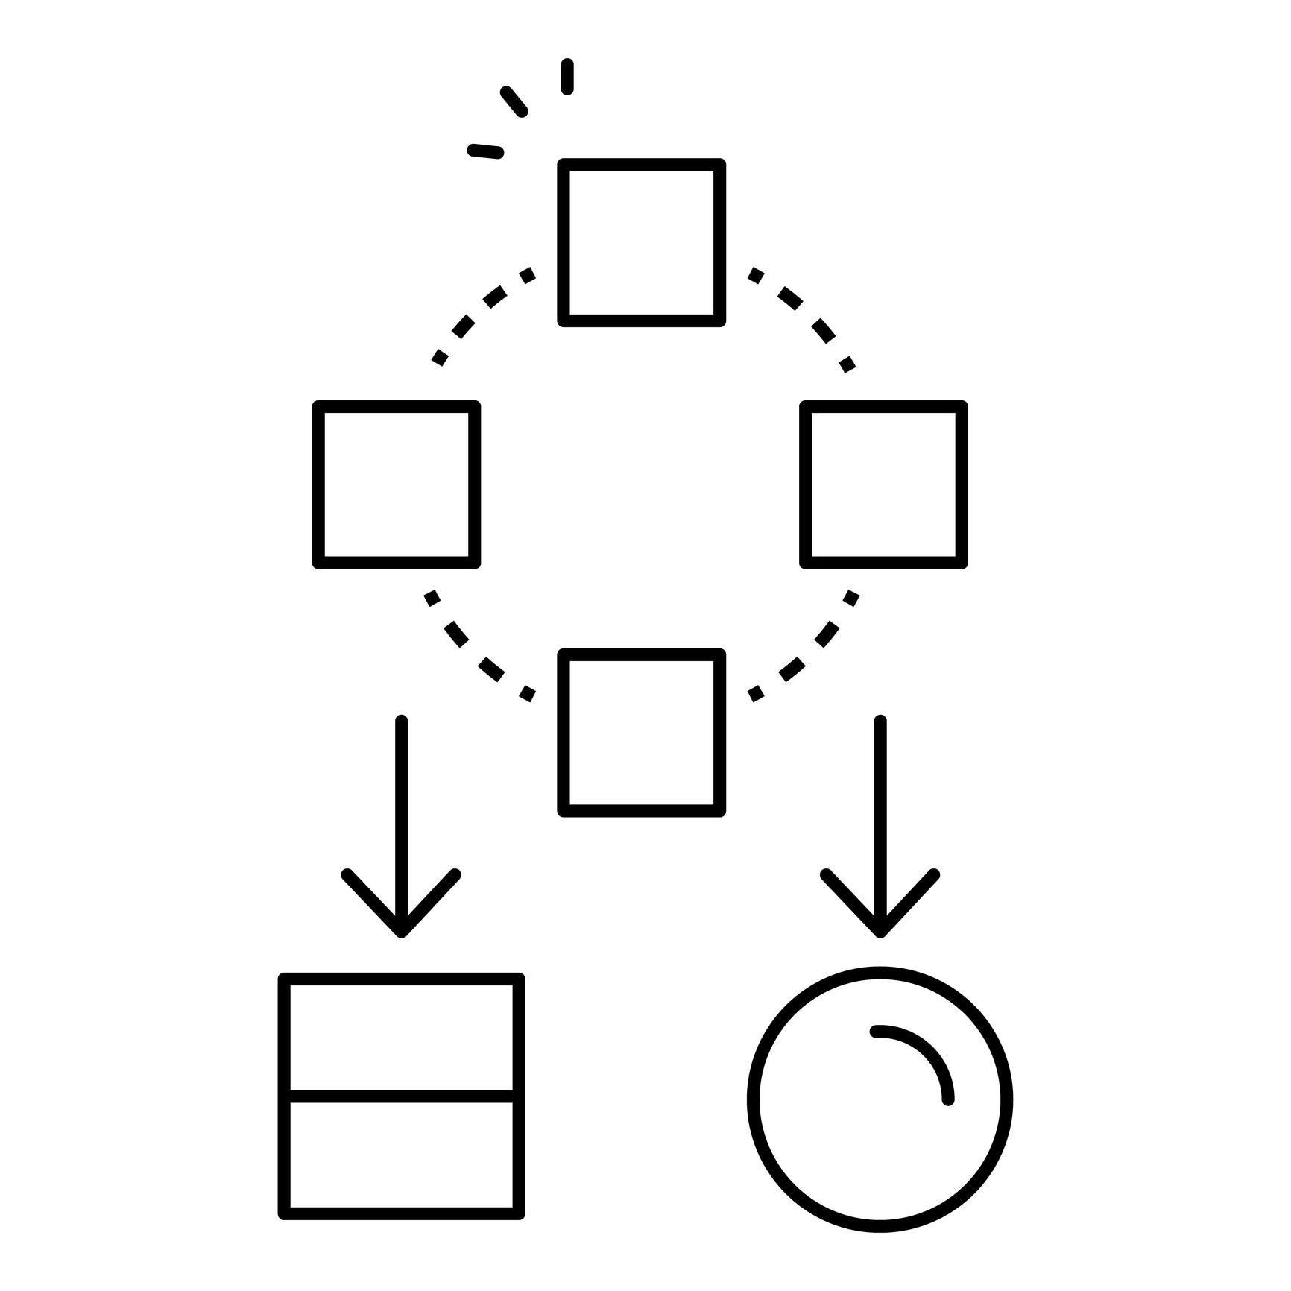
DATA MODELING
A Star Schema data model was implemented.
Fact Table: Sales/Orders Table (Sales, Profit, Quantity)
Dimension Tables: • Customer Table • Product Table • Region Table • Date Table
One-to-many relationships were created between dimension tables and the fact table to optimize performance and enable filtering.

Slide 9

KPI DEFINITIONS
The following Key Performance Indicators were created using DAX measures:
• Total Sales • Total Profit • Total Orders • Total Customers • Average Order Value • Profit Margin % • Repeat Customers
These KPIs provide a high-level overview of business performance.

Slide 10
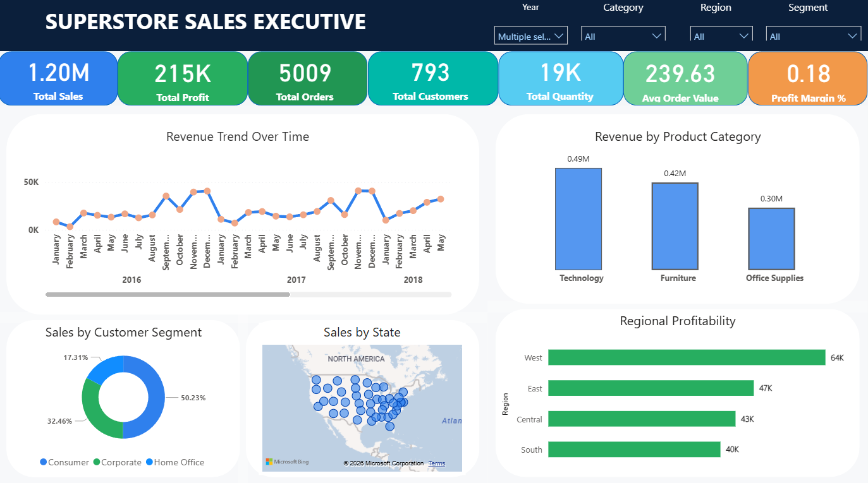

Slide 11
The Executive Dashboard provides a high-level summary of overall business performance using key performance indicators.
Key KPIs Monitored:
Total Sales
Total Profit
Total Orders
Total Customers
Average Order Value
Profit Margin %
Analysis Provided:
Monthly revenue trend analysis
Sales by product category
Regional profitability comparison
Customer segment contribution
Geographic sales distribution by state
Purpose: This dashboard helps management quickly monitor company performance and identify growth or decline trends.

Slide 12
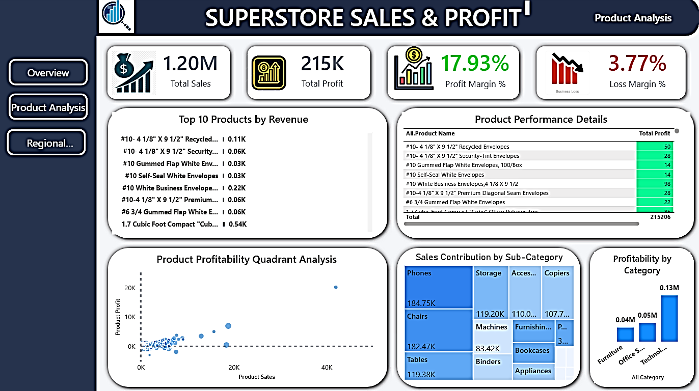

Slide 13
Product Performance & Profitability Analysis
This dashboard focuses on analyzing product-level performance and profitability.
Key Insights Available:
Top 10 products by revenue
Product-wise profit comparison
Sub-category sales contribution
Profitability quadrant analysis
Category-wise profit distribution
Business Questions Answered:
Which products generate maximum revenue?
Which products are profitable or loss-making?
Which categories require inventory optimization?
Purpose: Helps management optimize product strategy, pricing, and inventory decisions.

Slide 14
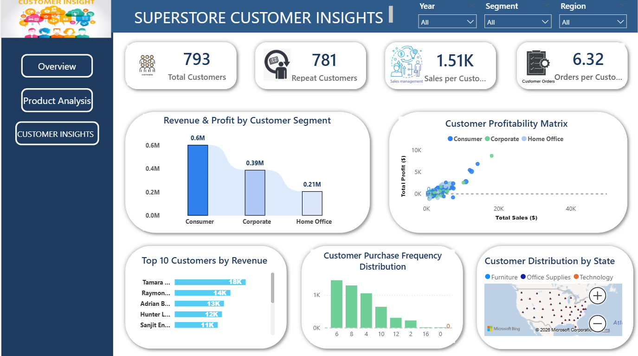

Slide 15
CUSTOMER INSIGHTS DASHBOARD
This dashboard analyzes customer purchasing behavior and segmentation patterns.
Analysis Included:
Total and repeat customers
Sales per customer
Orders per customer
Customer profitability matrix
Top 10 customers by revenue
Purchase frequency distribution
Customer distribution by state
Business Questions Answered:
Who are high-value customers?
Which segment contributes most revenue?
How frequently customers purchase?

Slide 16

Key Insights from Analysis
Sales & Profit
• Technology category generated the highest revenue • Some categories show high sales but low profit margins • Profit margin varies significantly across regions
Customer Behavior
• A small number of customers contribute a large share of revenue • Repeat customers generate higher profitability • Consumer segment is the dominant purchasing segment
Product Performance
• Certain products sell frequently but provide low profit due to discounting • Sub-categories like Chairs and Tables show inconsistent profitability • High discounts directly reduce profit
Regional Analysis
• Western region shows strongest profitability • Some regions generate sales but comparatively lower profit • Geographic demand varies across states

Slide 17

BUSINESS RECOMMENDATIONS
Reduce discounting on low-margin products
Focus marketing campaigns on repeat customers
Increase inventory for high-profit products
Improve pricing strategy for low-profit categories
Expand operations in high-profit regions
Introduce loyalty programs for valuable customers

Slide 18

CONCLUSION
The project successfully transformed raw transactional data into meaningful business insights using Power BI. Interactive dashboards enabled monitoring of sales, profit, customers, and product performance in a single platform.
The analysis helped identify profitable products, valuable customers, and weak business areas. The dashboard can support management in data-driven decision-making and long-term strategic planning.

Slide 19
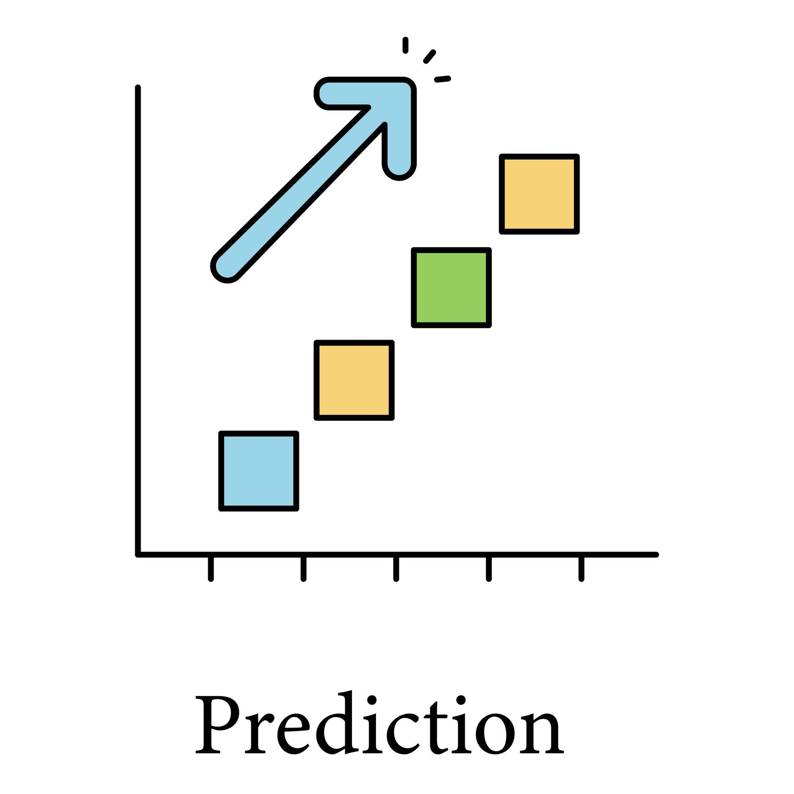
Future Scope
Sales forecasting using time-series analysis
Customer churn prediction using machine learning
Product recommendation system
Automated reporting with real-time database integration
Integration with cloud services

