Slide 1

AI-Powered Sustainable Agriculture Project Category: Research
Guide Name Student Name & Registration Number
Saisanthiya D Jayesh Poonia(RA2111030010261)
Assistant Professor Vedika Singh (RA2111030010295)
NWC

Slide 2
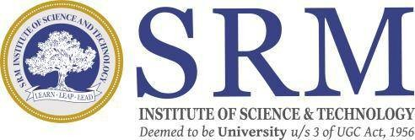
Abstract
The agricultural sector faces challenges in soil health, crop management, and disease prevention, impacting productivity and sustainability. This research proposes a system that leverages machine learning to provide real-time farming guidance and an AI-powered agriculture chatbot. By integrating data sources such as soil conditions, weather forecasts, and image-based disease detection, the system delivers personalized advice, including crop recommendations, fertilizer usage, and disease management strategies, through an interactive chatbot interface.
The platform also enables farmers to rent equipment, buy and sell crops directly, and offers pest and weed control methods to boost crop yield. Future enhancements can include IoT sensors for monitoring antimicrobial compounds like phytoalexins to reduce pesticide use and soil humidity sensors to optimize irrigation.
The project aims to deliver a scalable web or mobile application that bridges traditional and modern farming practices, improving yield and sustainability. A key challenge is tracking dynamic market prices in India’s diverse agricultural landscape. This system combines AI, machine learning, and IoT to revolutionize sustainable farming practices while empowering farmers with better market access.

Slide 3
Introduction to Project
Agriculture, a critical sector for global food security and livelihoods, faces significant challenges such as declining soil health, inefficient crop management, pest infestations, and disease outbreaks. These challenges are particularly pronounced in regions where traditional farming practices dominate, resulting in lower productivity and unsustainable methods. To address these issues, this research proposes a system that leverages machine learning to provide real-time farming guidance and an AI-powered agriculture chatbot. By integrating data sources such as soil conditions, weather forecasts, and image-based disease detection, the system offers personalized advice on crop selection, fertilizer usage, pest control, and disease management, empowering farmers with data-driven solutions.
In addition to delivering actionable insights, the platform facilitates direct buying and selling of crops, ensuring farmers can access fair pricing and better market opportunities. It also enables the rental of agricultural equipment, making advanced tools accessible to small-scale farmers. Future advancements include integrating IoT sensors to monitor antimicrobial compounds like phytoalexins to reduce pesticide use and soil humidity sensors to optimize irrigation. By combining AI, machine learning, and IoT technologies, the project aims to create a scalable, sustainable application that bridges the gap between traditional and modern farming practices, improving crop yields, market access, and environmental sustainability.

Slide 4
Existing Approaches/Related Works
AI in Agriculture:
Traditional farming practices often rely on manual inspection and heuristics, which are limited in scalability, timeliness, and adaptability to environmental changes. AI brings precision and real-time analytics to optimize decision-making in farming.
Crop Recommendation Systems:
Early machine learning models such as Decision Trees and Support Vector Machines (SVMs) were used for basic crop selection tasks. These models lacked generalization across ago climatic zones.
Random Forest Models:
More recent approaches use Random Forest (RF) algorithms due to their ability to model complex relationships among soil, weather, and historical crop data. However, they still require extensive feature engineering and large datasets.
Yield Prediction Models:
Traditional regression models fell short in capturing temporal trends. LSTM (Long Short-Term Memory) networks now provide better accuracy by handling time-series data and identifying long-term dependencies.
Limitations:
Many models still do not integrate real-time agronomic data (e.g., pest infestations, soil health), limiting their usefulness in dynamic field conditions.

Slide 5
Problems in Existing Approaches
Plant Disease Detection: CNNs like VGG16, ResNet, and Inception have been applied to identify plant diseases from leaf images. ResNet, in particular, excels with deeper networks and skip connections.
Challenges in CNNs: Most disease detection models are trained on limited datasets, making them less effective in diverse real-world scenarios. Transfer learning and data augmentation are used to improve performance.
NLP-Based Chatbots: Early chatbots were rule-based, offering limited flexibility. Newer NLP tools use transformer-based models like m BERT for multilingual support and real-time conversation.
Accessibility Issues: Many farmers lack literacy or digital skills. Voice-enabled chatbots bridge this gap by supporting regional languages and speech recognition.
Supporting Technologies: IoT devices collect real-time data, edge computing allows offline AI processing, and blockchain ensures secure, transparent data sharing.

Slide 6
Novelty
Road blocks/ Bottle Necks:​
Computational Resources: Training large language models like BERT Large is computationally intensive, limiting ​and optimization.​
Domain-specific Challenges: Detecting bias demands capturing nuanced linguistic patterns and domain-specific knowledge, ​posing adaptation challenges.​
Better accuracy for the plant disease​
Ours uses the ResNet9 model for the prediction and it does better then CNN and other models that comes at 92-96% accuracy better then these models.(S. Priya, D. S. Meena and R. Kumar, "AI-powered sustainable agriculture: Integration of deep learning and machine learning for crop disease detection and yield prediction," Discover Artificial Intelligence, vol. 3, no. 1, pp. 1–12, Dec. 2023. [Online]. Available: https://www.sciencedirect.com/science/article/pii/S2666154323002715)

Slide 7
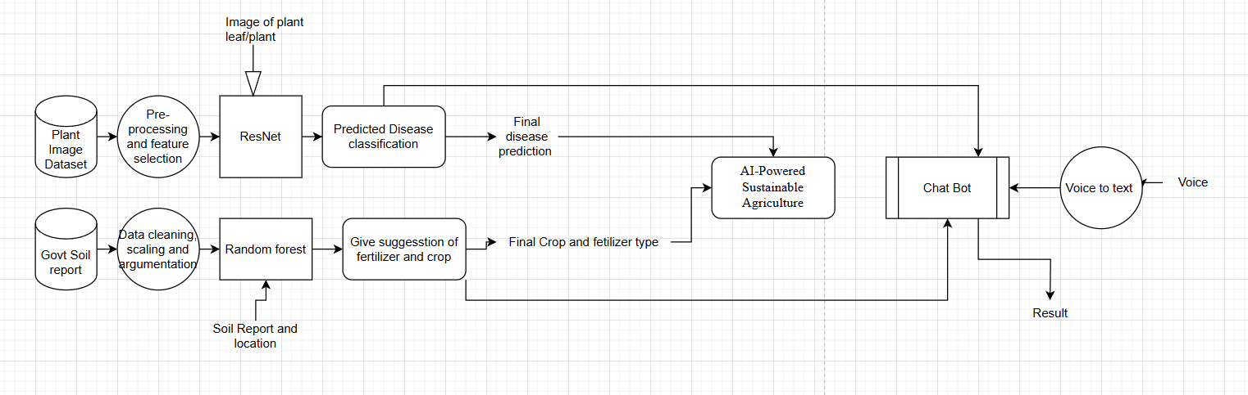
Proposed Methodogy

Slide 8
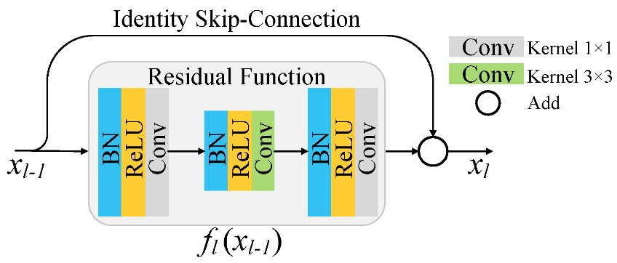
Proposed Methodology
Crop Recommendation:​
Uses a classification algorithm to suggest the most suitable crop based on soil and environmental conditions.​.​
Disease Detection:​
Processes plant images with a ResNet9 CNN-based image classifier to identify diseases .
Yield Prediction:​
Applies a regression model to estimate crop yield based on historical and real-time data.​
Multilingual Chatbot:​
Utilizes NLP models to provide query-based insights in multiple languages.

Slide 9
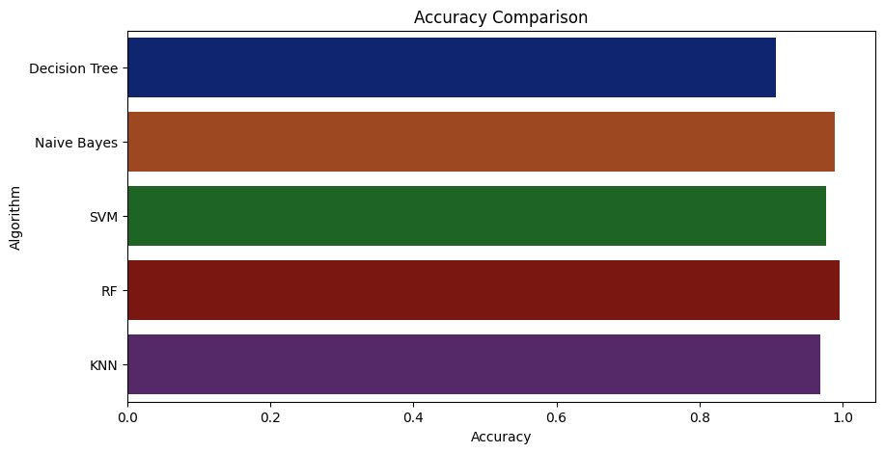
Results and Discussion

Slide 10
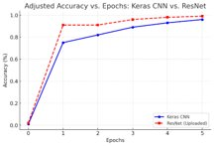
Results and Discussion
Model Accuracy:
Crop Recommendation (RF): >95% accuracy across test datasets.
Yield Prediction (LSTM): Accurate time-series forecasting with minimal error.
Disease Detection (ResNet9): Achieved 99.41% accuracy with strong generalization.
Observation
Data Augmentation improved CNN robustness.
Hyperparameter tuning (dropout, learning rate, batch size) optimized model performance

Slide 11
Results and Discussion
Conclusion:
Proposed AI-based system effectively integrates crop recommendation, yield forecasting, plantdisease detection, and chatbot interaction.
Achieved high accuracy across models: RF (>95%), LSTM (robust trend prediction), ResNet9 (99.41%).
System enables real-time, accessible, and scalable precision farming solutions for diverse agricultural needs
Future Work:
Soil Report Upload: Enable farmers to upload soil test reports (PDF/CSV) for personalized crop and fertilizer recommendations.
Expand Disease Dataset: Increase the number and variety of plant diseases covered in the detection module for broader applicability.
Improve Regional Adaptability: Incorporate region-specific datasets to boost model performance in varied ago-climatic zones.
Offline Access: Optimize models for edge devices to support usage in low-connectivity rural areas.
Explainable AI: Integrate explainable AI for transparent, trustable decision support.

