Slide 1
Construction Cost Estimation

Slide 2
Agenda
Project overview
Core features
Technology stack
Architecture overview
Key integrations
Challenges and solutions
Future enhancements

Slide 3
Project Overview
Goal:
To create a web application that connects users with constructors, providing accurate construction cost estimates based on the preferences of the user.
Objectives:
Streamline user interactions in a secure environment.
Provide an accurate cost estimator for the constructor to estimate costs.
Provide seamless communication between user and constructor.

Slide 4
Core Features
User Features:
Create requests for area that is to be estimated.
Access the reports generated by the constructor.
View reports generated by different constructors.
Constructor Features:
View all the area requests generated by users.
Estimate the cost for user’s area request based on various factors.
Share the report to user
Other Functionalities:
JWT-based authentication for user and constructor.
Admin dashboard to view all the reports.

Slide 5


Technology Stack
Frontend:
React with TypeScript and Context API.
Material UI
Backend:
Node.js and Express for REST APIs.
Database:
MongoDB for document-based storage.
Mongoose for schema modelling.

Slide 6
Architecture Overview
MERN Stack:
React (Frontend), Express with Typescript + Node.js (Backend), MongoDB (Database).
Microservices:
User Service, Constructor service, Cost-Estimate service, Report service, Area-request service, Admin
Flow:
User and Constructor authentication, session management, and role-based access control.
User requests estimation for his/her land. Constructors can estimate the report and send it to the user.
Admin can view all requests and reports.

Slide 7
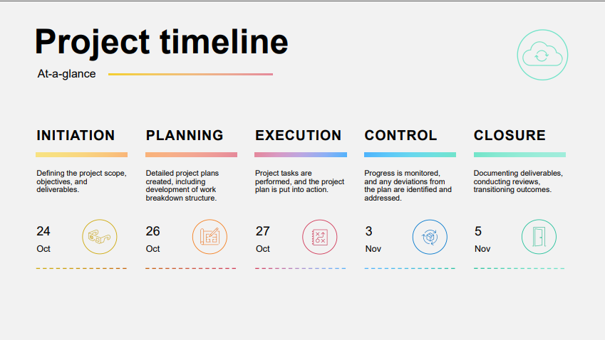

Slide 8
Challenges and Solutions
Authentication:
Solution: Used JWT tokens to implement authentication.
City wise estimation:
Solution: Filtered all the cities and assigned a type and calculated estimation.

Slide 9
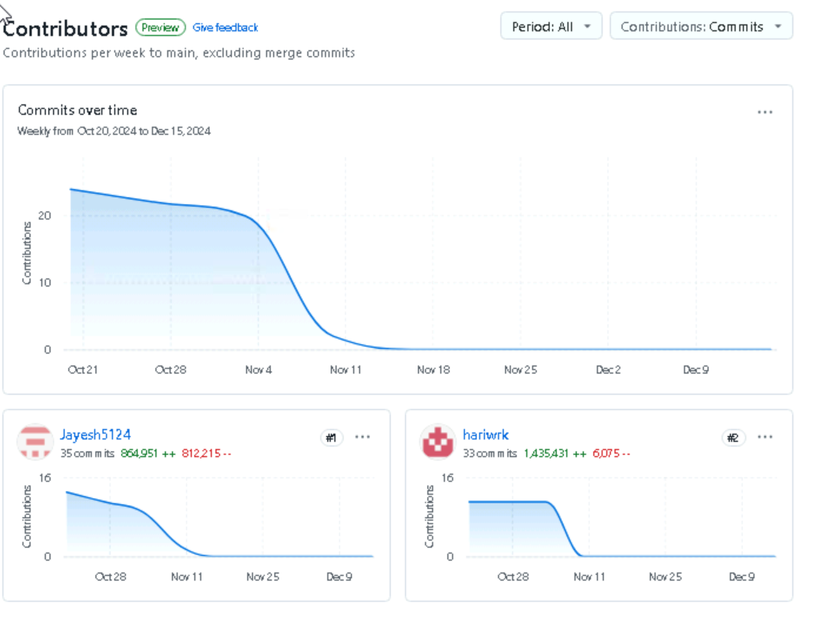
Github Contributions

Slide 10
Future Enhancements
Payment gateway integration for secure transactions.
Real-time chat between users and constructors.
Track constructors estimation history and recommend areas.
Add land image and verify land image.

