Slide 1
Advanced Computer Networks Literature Review
Blockchain Networks(Layer0-2)
Sai Jayesh Bondu Luv Khurana

Slide 2






Background Dependence of Commerce and Internet on Financial Institutions

Slide 3
Problems
Financial Institutions or Big Corporations control the world of Commerce.
Too much power with these central authorities.
Financial Institutions mediate which increases cost of transactions.
Nonreversible transactions are not possible

Slide 4


Problem Of Trust
Can we completely trust the financial institutions and Government???
Too much Centralization

Slide 5
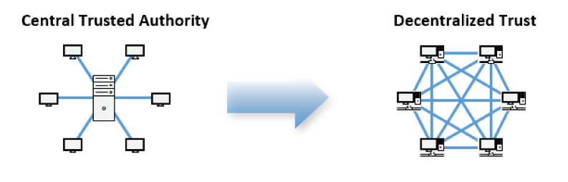
A Decentralized Solution
Data is stored / computed on distributed devices.
Cryptographic proof instead of trust.
Transactions that are computationally impractical to reverse.
No need for a trusted third party

Slide 6

Blockchain - Introduction
A transparent and efficient data structure for storing and verifying consensus results.
A technology used to build applications where multiple parties can interact through a peer-to-peer-network and record immutable transactions with no central trusted authority
A blockchain is a decentralized, distributed, and oftentimes public, digital ledger that is used to record transactions

Slide 7
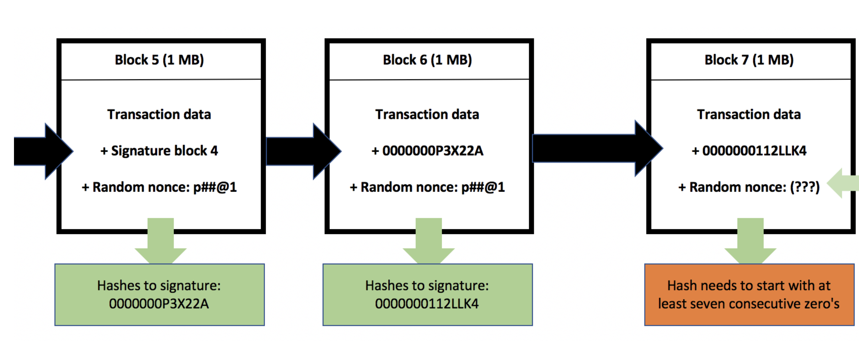
Components of Blockchain
Block: data structure used for keeping a set of transactions
that is distributed to all nodes in the network.
Chain: Each block hash(points) to the previous one.
Modifying one block needs to modify all blocks after
()

Slide 8
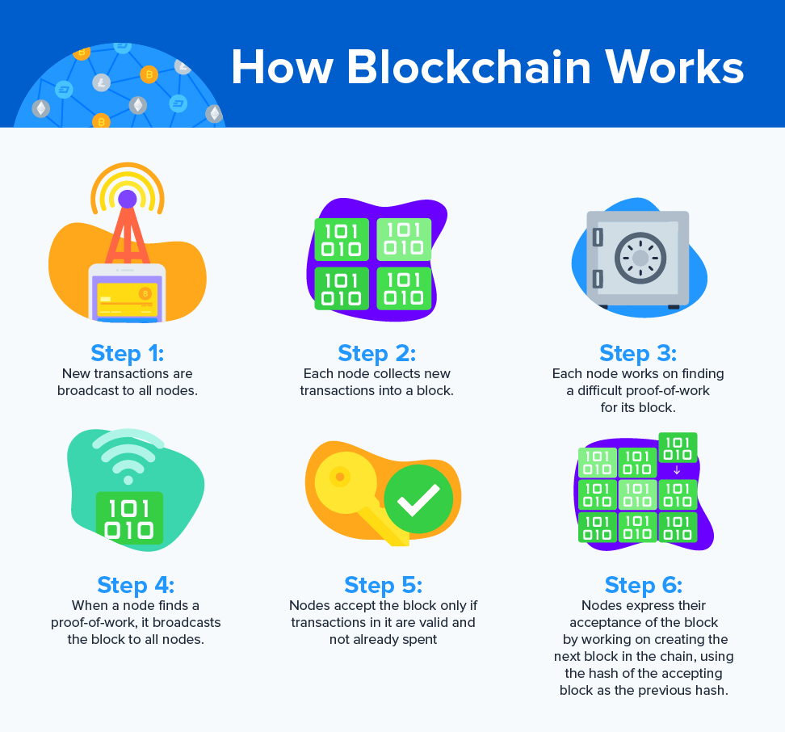
So how does a blockchain network works?

Slide 9
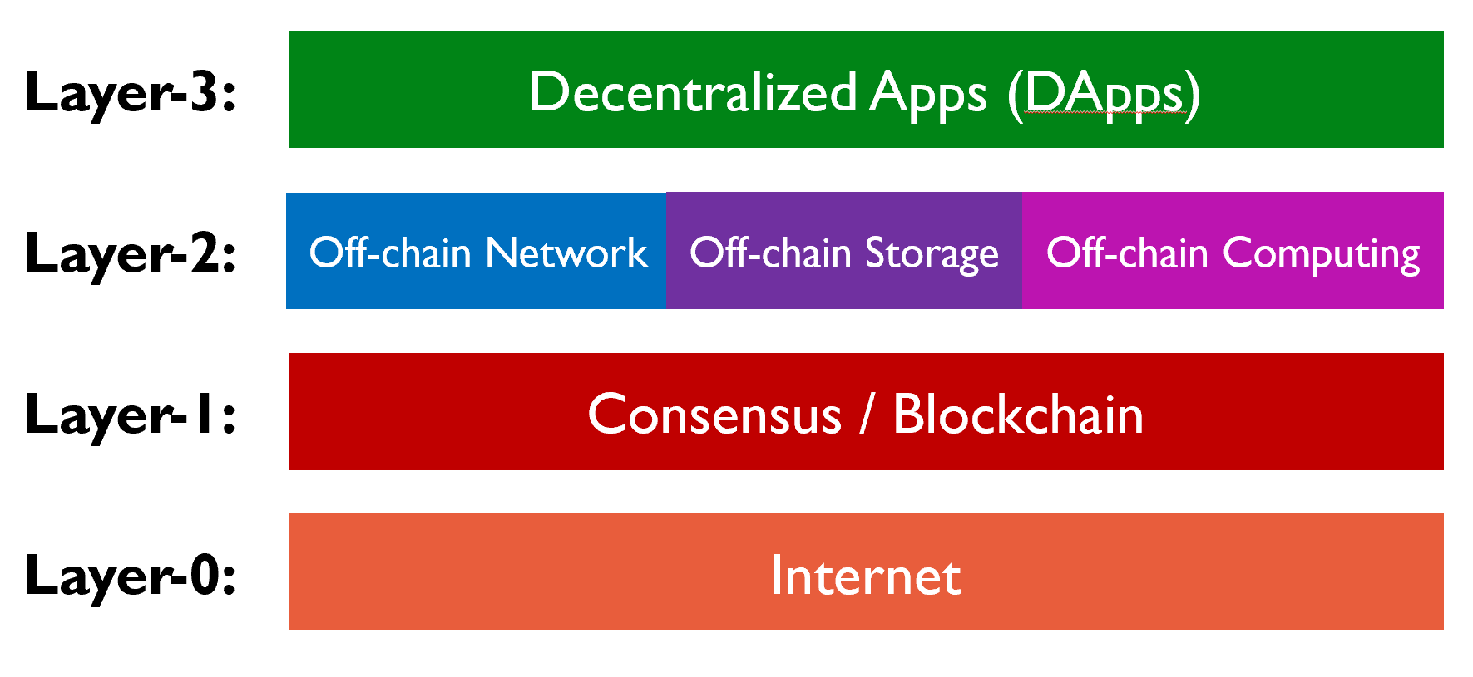
Methodology
Since its introduction in 2008 , extensive research has been done on Blockchains and Cryptocurrencies. In our research review we have
used layer based approach and discussed paper from Layer(0-2).

Slide 10
Bitcoin P2P Network
Blockchain application like Bitcoin is structured as a peer-to-peer network architecture on top of the Internet.
The network nodes connect in a mesh architecture and there is no centralized server.
One node creates a TCP connection with other node on the network.

Slide 11
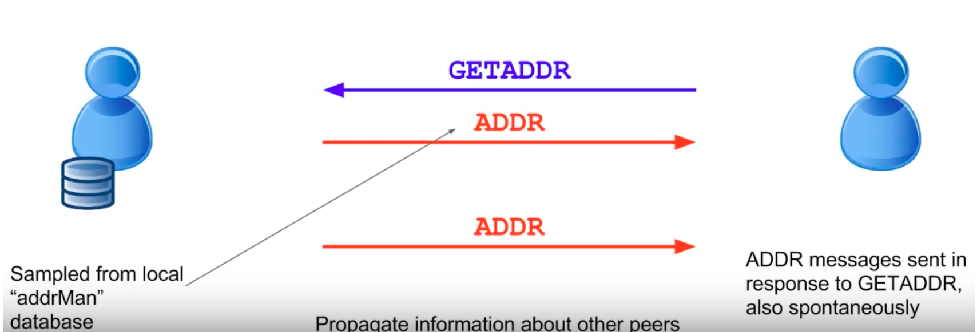
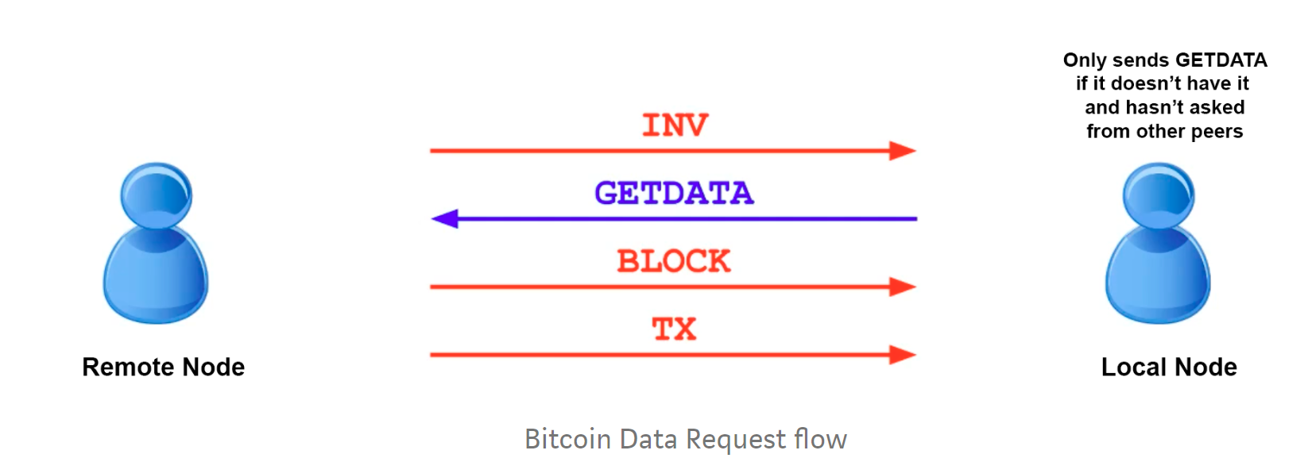
Message Flow in Bitcoin Network

Slide 12
Types Of Bitcoin Nodes
Full Nodes: Fully validating nodes as they engage in the process of verifying transactions and blocks against the system’s consensus rules. Usually, a full node downloads a copy of the Bitcoin blockchain with every block and transaction. Eg: Bitcoin Core
Lightweight or SPV clients: Also known as Simplified Payment Verification (SPV) clients, the lightweight clients are the ones that make use of the Bitcoin network but do not really act as a full node
Listening Node(Super Node) :Listening node or super node is a full node that is publicly visible. It communicates and provides information to any other node that decides to establish a connection with it
Miner Node:The process of repeatedly changing the nonce and hashing the block’s data to find an eligible signature is called mining and is what miners do. Miners spend electricity in the form of computational power by constantly changing th block composition (nonce) and hashing it until they find an eligible signature (output).

Slide 13
Attacks on Blockchain and Insights
DDOS Attacks: Distributed Denial of Service: Fee Based , Age Based Solutions
Sybil Attack: Attack by creating multiple fake identities. Bitcoin has a specific set of rules for the creation of new blocks. These rules make sure that the ability to add the block to the chain is proportional to the processing power
Replay Attacks: Fraudulently repeating the transaction. A special marker is added to the new ledger that emerges from the hard fork to ensure that the transactions conducted on it will not be valid on the old ledger or the other way around
51% Attacks : A malicious node controls the majority of network compute. Merged mining is a technique which allows multiple cryptocurrencies to be merged to mine at
the same time.

Slide 14
Insights
First, if blocks can be relayed using less network data, then the maximum block size can be increased which means an increase in the overall number of transactions per second.
Scaling the transaction rate of Bitcoin is a critical performance issue driving many fundamental design choices such as inter-block time, block size, and layering.
BIP 152 — Compact blocks: This aimed to address decreasing the bandwidth used during block relay between nodes on the bitcoin network.
The “high-bandwidth” & “low-bandwidth” mode. In the low-bandwidth mode, peers send new block announcements with the usual inv/headers announcements. And a node without support for compact blocks can still use the legacy block relay protocol.

Slide 15
Graphene
Graphene is a novel and highly efficient protocol for the transmission of blocks (developed by A. Pinar Ozisik, Gavin Andresen and more).
The primary goal of Graphene is to reduce the amount of network traffic resulting from synchronization of a sender and receiver; we do so in the context of block propagation
It proposes the use of Bloom filters to identify transactions within a block from the local mempool.
It’s an improvement over BIP 152 (Compact blocks). It combines bloom filters & Invertible Bloom Lookup Tables (IBLTs), to reduce the cost of block propagation.

Slide 16
Consensus Algorithms

Slide 17
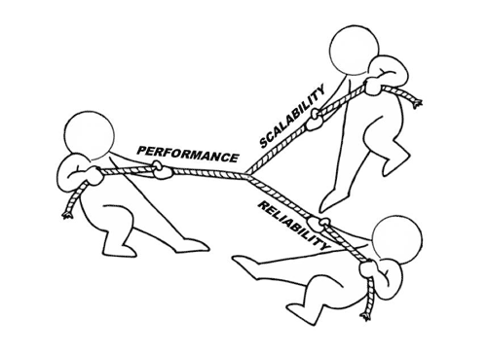
Double spending problem
Byzantine General problem

Slide 18
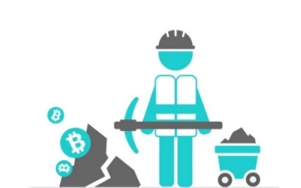
Proof of Work

Slide 19
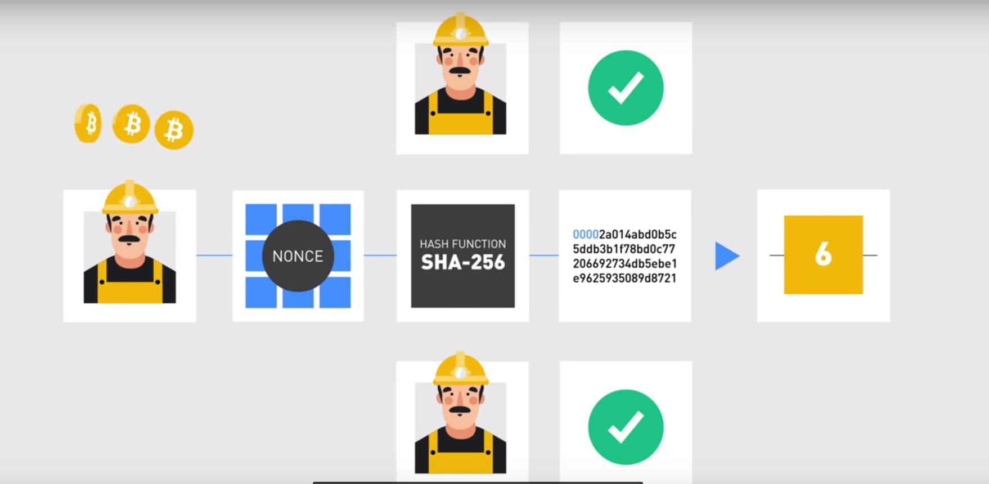

Slide 20
Insights
The maximum rate at which these systems can process transactions is capped by the choice of two parameters:
block size
block interval
Increasing block size improves throughput, but the resulting bigger blocks take longer to propagate in the network.
Reducing the block interval reduces latency, but leads to instability where the system is in disagreement and the blockchain is subject to reorganization

Slide 21
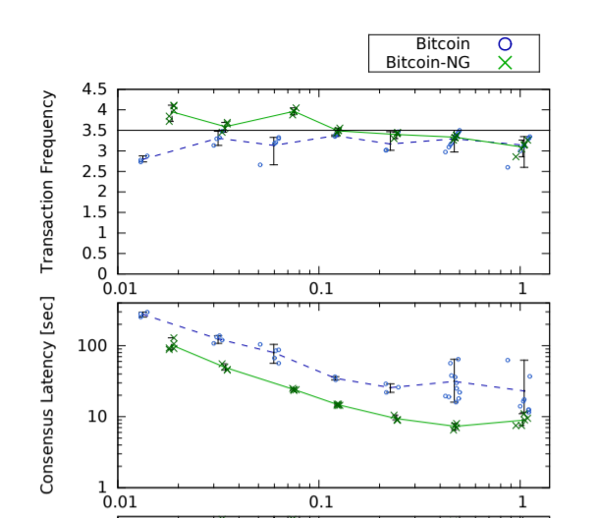
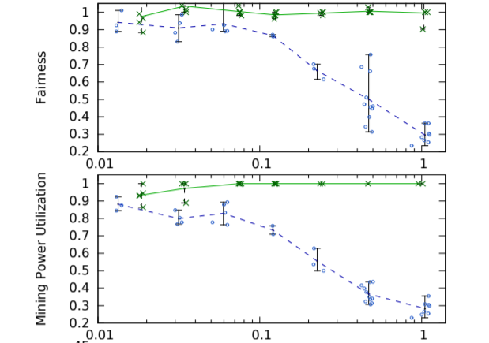
Insights
Bitcoin-NG is a Byzantine fault tolerant blockchain protocol
Bitcoin-NG’s latency - propagation delay of the network
bandwidth - processing capacity of the individual nodes
Bitcoin-NG: A Scalable Blockchain Protocol Ittay Eyal, Adem Efe Gencer, Emin Gün Sirer, and Robbert van Renesse, Cornell University (NSDI ’16). March 16–18, 2016 • Santa Clara, CA, USA

Slide 22
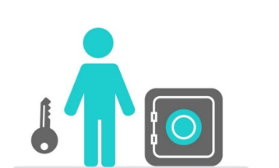
Proof of Stake

Slide 24
Working
Pseudo random algorithm to select the validator of next block the criteria could include combination of
Stake age
Randomization
Nodes wealth
Randomized block selection – combination of lowest hash and highest stake
Coin age selection – Based on how long the tokens have been staked for
Coin age = no. of days staked * no of coins staked

Slide 25
Insights
Nothing at stake Problem - Block generators vote multiple blockchain forks
Coin age problem - attacker saves up enough coin age to become the node with the highest weight on the network
PPCoin: Peer-to-Peer Crypto-Currency with Proof-of-Stake Sunny King, Scott Nadal August 19th, 2012
Two Bitcoins at the Price of One? Double-Spending Attacks on Fast Payments in Bitcoin Elli Androulaki and Ghassan O. Karame; iacr.org

Slide 26
Insights
The research paper on Blackcoin PoS v2 proposes
Taking the Coin Age out of the equation
The block hash has been changed back to SHA256d.
Ouroboros proposes
Fragmentation Threshold is proposed to mitigate fragmentation attack(which tries to increase the delegate population
coin tossing to elect delegates
Ouroboros: A Provably Secure Proof-of-Stake Blockchain Protocol Aggelos Kiayias∗ Alexander Russell† Bernardo David‡ Roman Oliynykov§ July 20, 2019
BlackCoin’s Proof-of-Stake Protocol v2 Pavel Vasin

Slide 27
 | PoW | PoS | PBFT
Consistency | Probabilistic | Probabilistic | Immediate
Scalability of peer Network | High | High | Low
Performance | Low | High | High
Byzantine Tolerance | <25% | Depends* | <33%
Energy | Very High | Medium | Low
51% attack | Low | High | Medium

Slide 28
Layer 2 (Off-Chain Networks)
Limitations of Blockchain Network:
All state modifications to the ledger are broadcast to all participants.
Transaction Per Second (TPS) of a Blockchain network is much less than a conventional Payment Gateway like Visa.
The bandwidth and resources of a decentralized node like a home personal computer cannot compare the centralized servers.

Slide 29
Bitcoin Lightning Network
A network of micropayment channels can solve the scalability.
These payment channels are a collection of unconfirmed transactions that aren’t yet broadcasted to the bitcoin network.
These payment channels work completely off-chain before the final
settlement
Your payment can be routed off another channel balances.

Slide 30
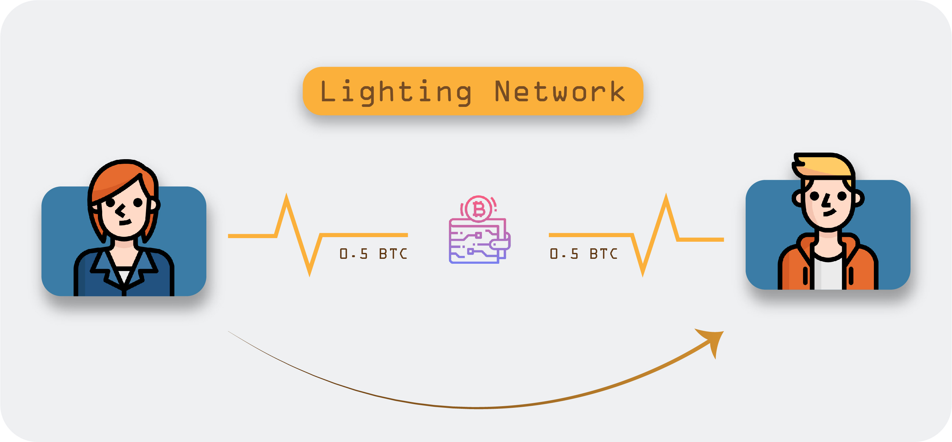
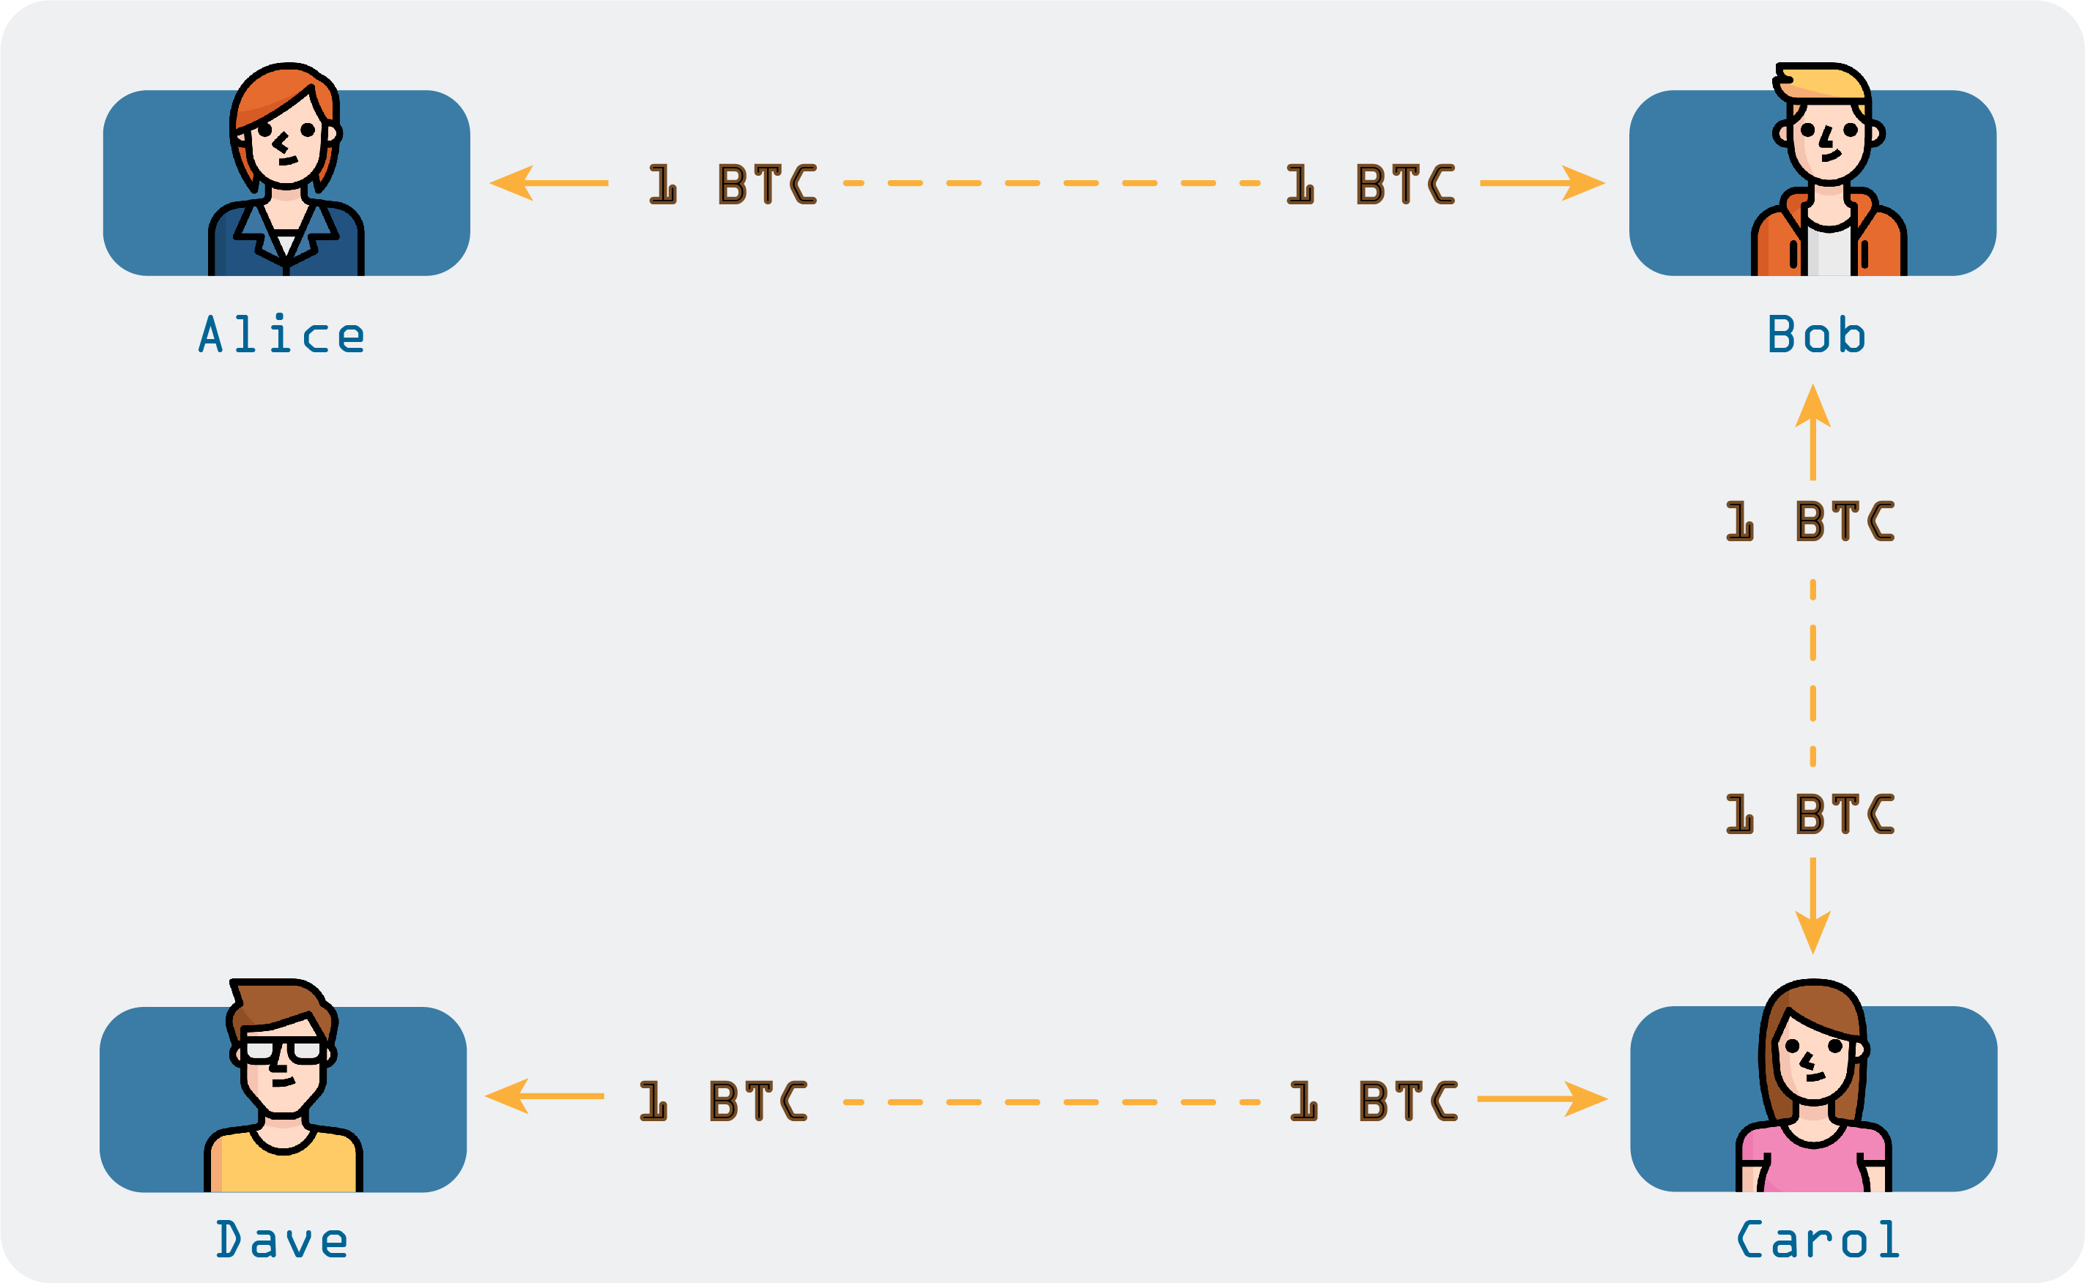
Scenario’s in Bitcoin Lightning Network
Suppose Alice runs a coffee shop and Bob walks in to buy a coffee worth $3.
Alice would open a payment channel ,generate a multi-sig address.
Bob would send $3 to this address and will sign the transaction. Now
Alice would not broadcast but will keep channel open for other customers.
Alice broadcasts all the transactions at the end of day.

Slide 31
Major Problems
You have to be online to receive funds.
No cold storage is possible.
Routing is unsolved.
Mesh Routing with adversaries is an unsolvable problem.
One of the Solutions : BOLT

Slide 32
Off-chain Computation
State transition function is computed by a Off-chain Node
Challenges in off-chain computation
Data integrity
Availability

Slide 33
Insights
The proposed Enigma platform guarantees scalability and privacy.
Scalability - Unlike blockchains, computations and data storage are not replicated by every node in the network. Only a small subset perform each computation over different parts of the data. The decreased redundancy in storage and computations enables more demanding computations.
Privacy- data queries are computed in a distributed way, without a trusted 3rd party using secure multi-party computation
Enigma: Decentralized Computation Platform with Guaranteed Privacy Guy Zyskind Oz Nathan Alex ’Sandy’ Pentland arXiv:1506.03471 [cs.CR]

Slide 34
Off-chain Storage
Off-chain data is any non-transactional data that is too large to be stored in the blockchain efficiently, or, requires the ability to be changed or deleted
IPFS
Swarm

Slide 35
Insights
IPFS
P2P distributed file system
IPFS has no single point of failure, and nodes do not need to trust each other
Swarm
It stores the data redundantly and distributed over multiple nodes
For motivating the peers to offer their resources, an incentive system is integrated which can even penalize a peer for losing the hosted data of another party
IPFS - Content Addressed, Versioned, P2P File System (DRAFT 3) Juan Benet arXiv:1407.3561 [cs.NI]
Ethereum Foundation. Swarm Distributed Data Storage. Dec. 2017. https://github.com/ethersphere/swarm.

Slide 36
Future Scope
Blockchains combined with AI and IOT for different business models.
Web 3.0 – Decentralized Web
Governments adopting Blockchains(National Cryptocurrencies)
Blockchain identity For All

Slide 37


