Slide 1

Computer Engineering Department
A.P. Shah Institute of Technology
G.B.Road,Kasarvadavali, Thane(W), Mumbai-400615
UNIVERSITY OF MUMBAI
Academic Year 2021-2022

Slide 2
A Mini Project Report on GENERATING ART USING GAN
Submitted in partial fulfillment of the degree of
Bachelor of Engineering(Sem-IV)
In
Computer Engineering
By
Zenil Gosher(19102045) Jayesh Jain(19102021) Hardika Lalwani(20202003) Jainam Zaveri(20202007)
Under the Guidance of
Name of Guide Prof.Brinal Colaco

Slide 3
1.Project Conception and Initiation

Slide 4
1.1 Abstract
CycleGAN incorporates a novel unpaired image-to-image translation technique that can be used for style transfer.
CNNs have been usually used with paired datasets. This approach is a very human way of unsupervised learning because the model learns what not to do and then improves itself over time.
The loss functions evaluate the accuracy or the similarity between real and fake images. CycleGAN provides us the ability to perceive the plausible what-if situation? Like how it was possible for us to translate input images into a Monet-esque paintings even after a century.

Slide 5
1.2 Objectives
To capture special characteristics of one image collection and figure out how these characteristics could be translated into the other image collection, all in the absence of any paired training examples.
Capture the styles of legendary artists like Picasso, Monet etc. and give modern images their signature touch.

Slide 6
1.3 Literature Review
Ian Goodfellow, the inventor of GAN proposed a new framework for estimating generative models via an adversarial process, in which we simultaneously train two models: a generative model and a discriminative model.
In the proposed adversarial nets framework, the generative model is pitted against an adversary: discriminative model that learns whether sample is from the model distribution.
Many problems in image processing, graphics, and vision involve translating an input image into a corresponding output image Phillip Isola’s paper on Image-to-Image Translation with Conditional Adversarial Networks proposes a framework simplifies problem.
CNNs learn to minimize a loss function – an objective that scores the quality of results – and although the learning process is automatic, a lot of manual effort goes into designing effective losses.
GANs learn a loss that tries to classify if the output image is real or fake, while simultaneously training a generative model to minimize this loss.

Slide 7
1.4 Problem Definition
Generating stylistically inspired artwork of modern settings by implementing a GAN, based on the works of legendary artists.

Slide 8
1.5 Scope
It is possible to create modern artworks by leveraging the styles of legacy artists.
With artists there’s always a feeling of what they would do next if they had more time. By studying the individual styles of the artists, it is possible to create what they would paint if they were present now and create new masterpieces.
We can actually see how they would portray a modern setting in their style.

Slide 9
1.6 Technology stack
PyTorch
TenserFlow
Numpy
Pandas
Matplotlib
GoogleColab

Slide 10
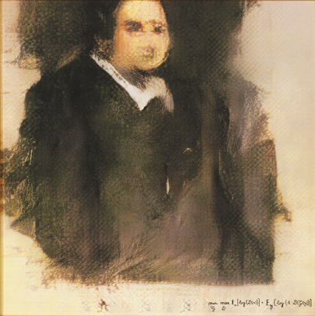
1.7 Practical Application
Edmond de Belamy is a generative adversarial network portrait painting constructed in 2018 by Paris-based arts-collective ‘Obvious’. The name Belamy is a tribute to Ian Goodfellow, inventor of GANs; In French “bel ami” means “good friend" so it is a translated pun of Goodfellow.”
It achieved widespread notoriety after Christie's announced its intention to auction the piece as the first artwork created using artificial intelligence to be featured in a Christie's auction. It surpassed pre-auction estimates which valued it at $7,000 to $10,000, instead selling for $432,500. Than translates to more than 3 Crores in INR.

Slide 11
1.8 Benefits for Environment & Society
Reduces manual work.
Managing customers and orders.
No misunderstanding.
Duplication is avoided.
Simple to manage.

Slide 12
2. Project Design

Slide 13
2.1 Proposed System
Importing Required Libraries
Connecting to the TPU
CycleGAN Building
Generator building function
Discriminator building function for real photo
Data-Augmentation functions

Slide 14
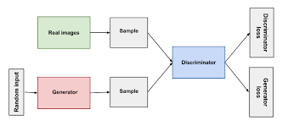
2.2 Flow Diagram

Slide 15
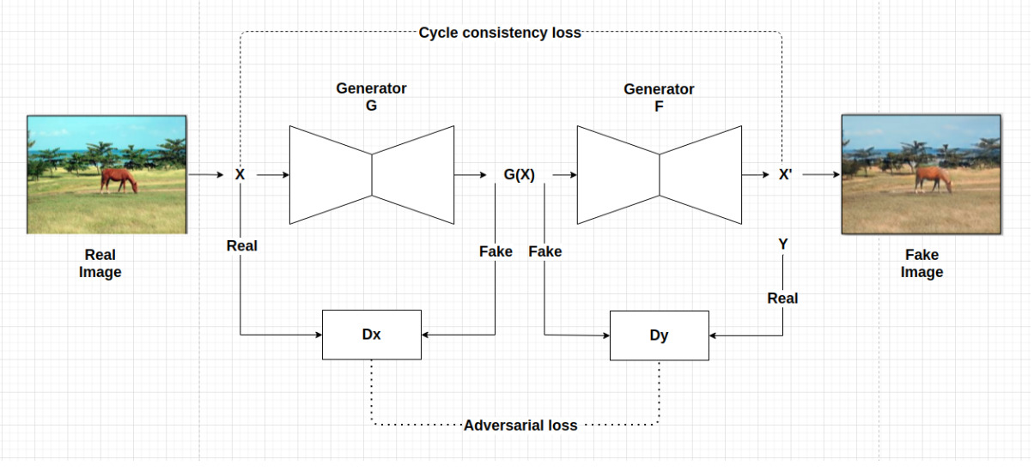
2.3 Design(UML Diagram)

Slide 16
3.Implementation

Slide 17
3.1 Execution
If a discriminator achieves 50% accuracy it means that it cannot tell the difference between the real image and a fake image.
With our implementation we have achieved 63% accuracy in generating a fake Monet image . Thus, we have translated the respective input images into the artistic style of Monet incorporating a style transfer using CycleGAN.
The following results are based on 200 epochs and the output image becomes sharper and more clear with subsequent epochs which signifies that our model is improving with time.

Slide 18
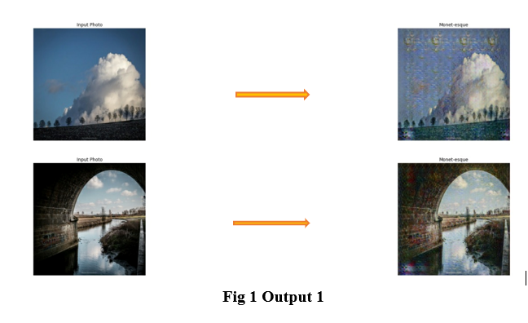
4. Results

Slide 19
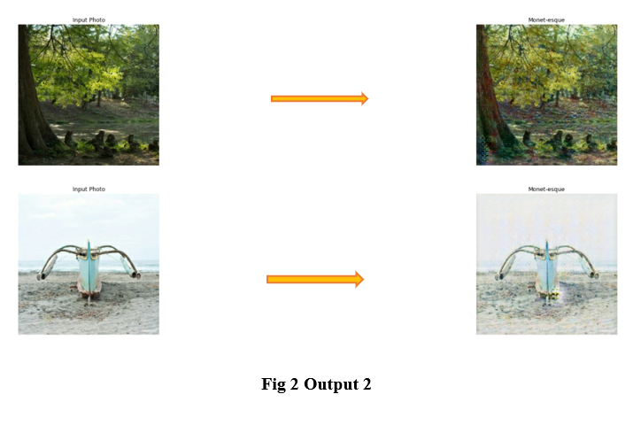

Slide 20
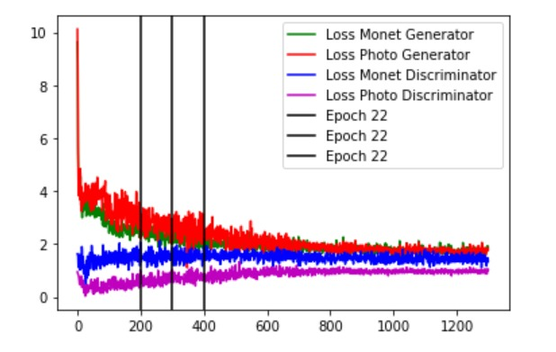

Slide 21
5.Conclusion
The results of our implementation suggest that conditional adversarial networks are a promising approach for many image to-image translation tasks, especially those involving highly structured graphical outputs. These networks learn a loss adapted to the task and data at hand, which makes them applicable in a wide variety of settings. Generating a stylistically inspired painting built by training a dataset of given paintings is possible by translating a given input image through CycleGAN

Slide 22
6. References
[1] Neural information processing system Goodfellow I, Pouget-Abadie J, Mirza M, Xu B, Warde-Farley D, Ozair S, et al. Generative adversarial nets. In: Advances ins. 2014. p. 2672–80.
[2] Radford, Alec et al. “Unsupervised Representation Learning with Deep Convolutional Generative Adversarial Networks.” CoRR abs/1511.06434 (2016): n. pag.
[3] Jun-Yan Zhu*, Taesung Park*, Phillip Isola, and Alexei A. Efros. "Unpaired Image-to-Image Translation using Cycle-Consistent Adversarial Networks", in IEEE International Conference on Computer Vision (ICCV), 2017.
[4] Martin Heusel et al. GANs Trained by a Two Time-Scale Update Rule Converge to a Local Nash Equilibrium. 2018. arXiv: 1706.08500v6 [cs.LG]
[5]https://www.christies.com/features/A-collaboration-between-two-artists-one-human-one-a-machine-9332-1.aspx

Slide 23
Thank You

