Slide 1
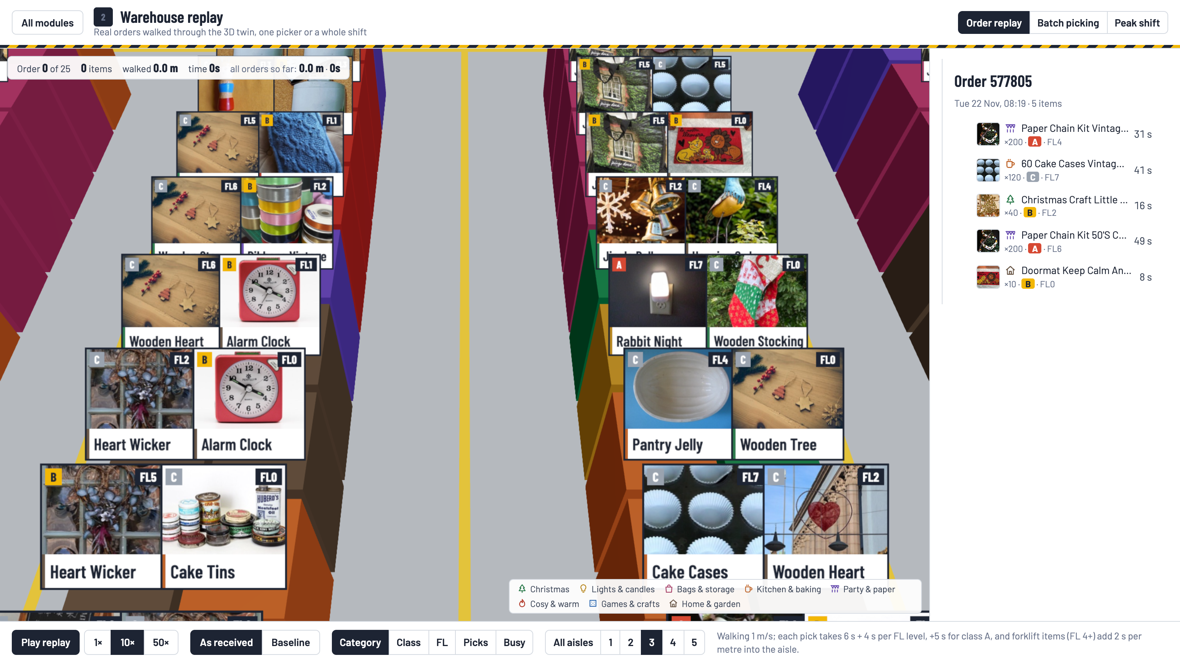
Pick & Pack
A warehouse digital twin that replays real orders, so every layout change is measured, not claimed
NEXAI 2026 · Track 4 · PS 4.2 · Jayesh Pani, Megha Gautam, Meet Kumar
pick-and-pack-twin.vercel.app · github.com/JayeshPani/NEXAI
Notes:
We built a digital twin of a gift wholesaler's picking floor. Every layout change is replayed on real orders, so it's measured, not claimed.

Slide 2

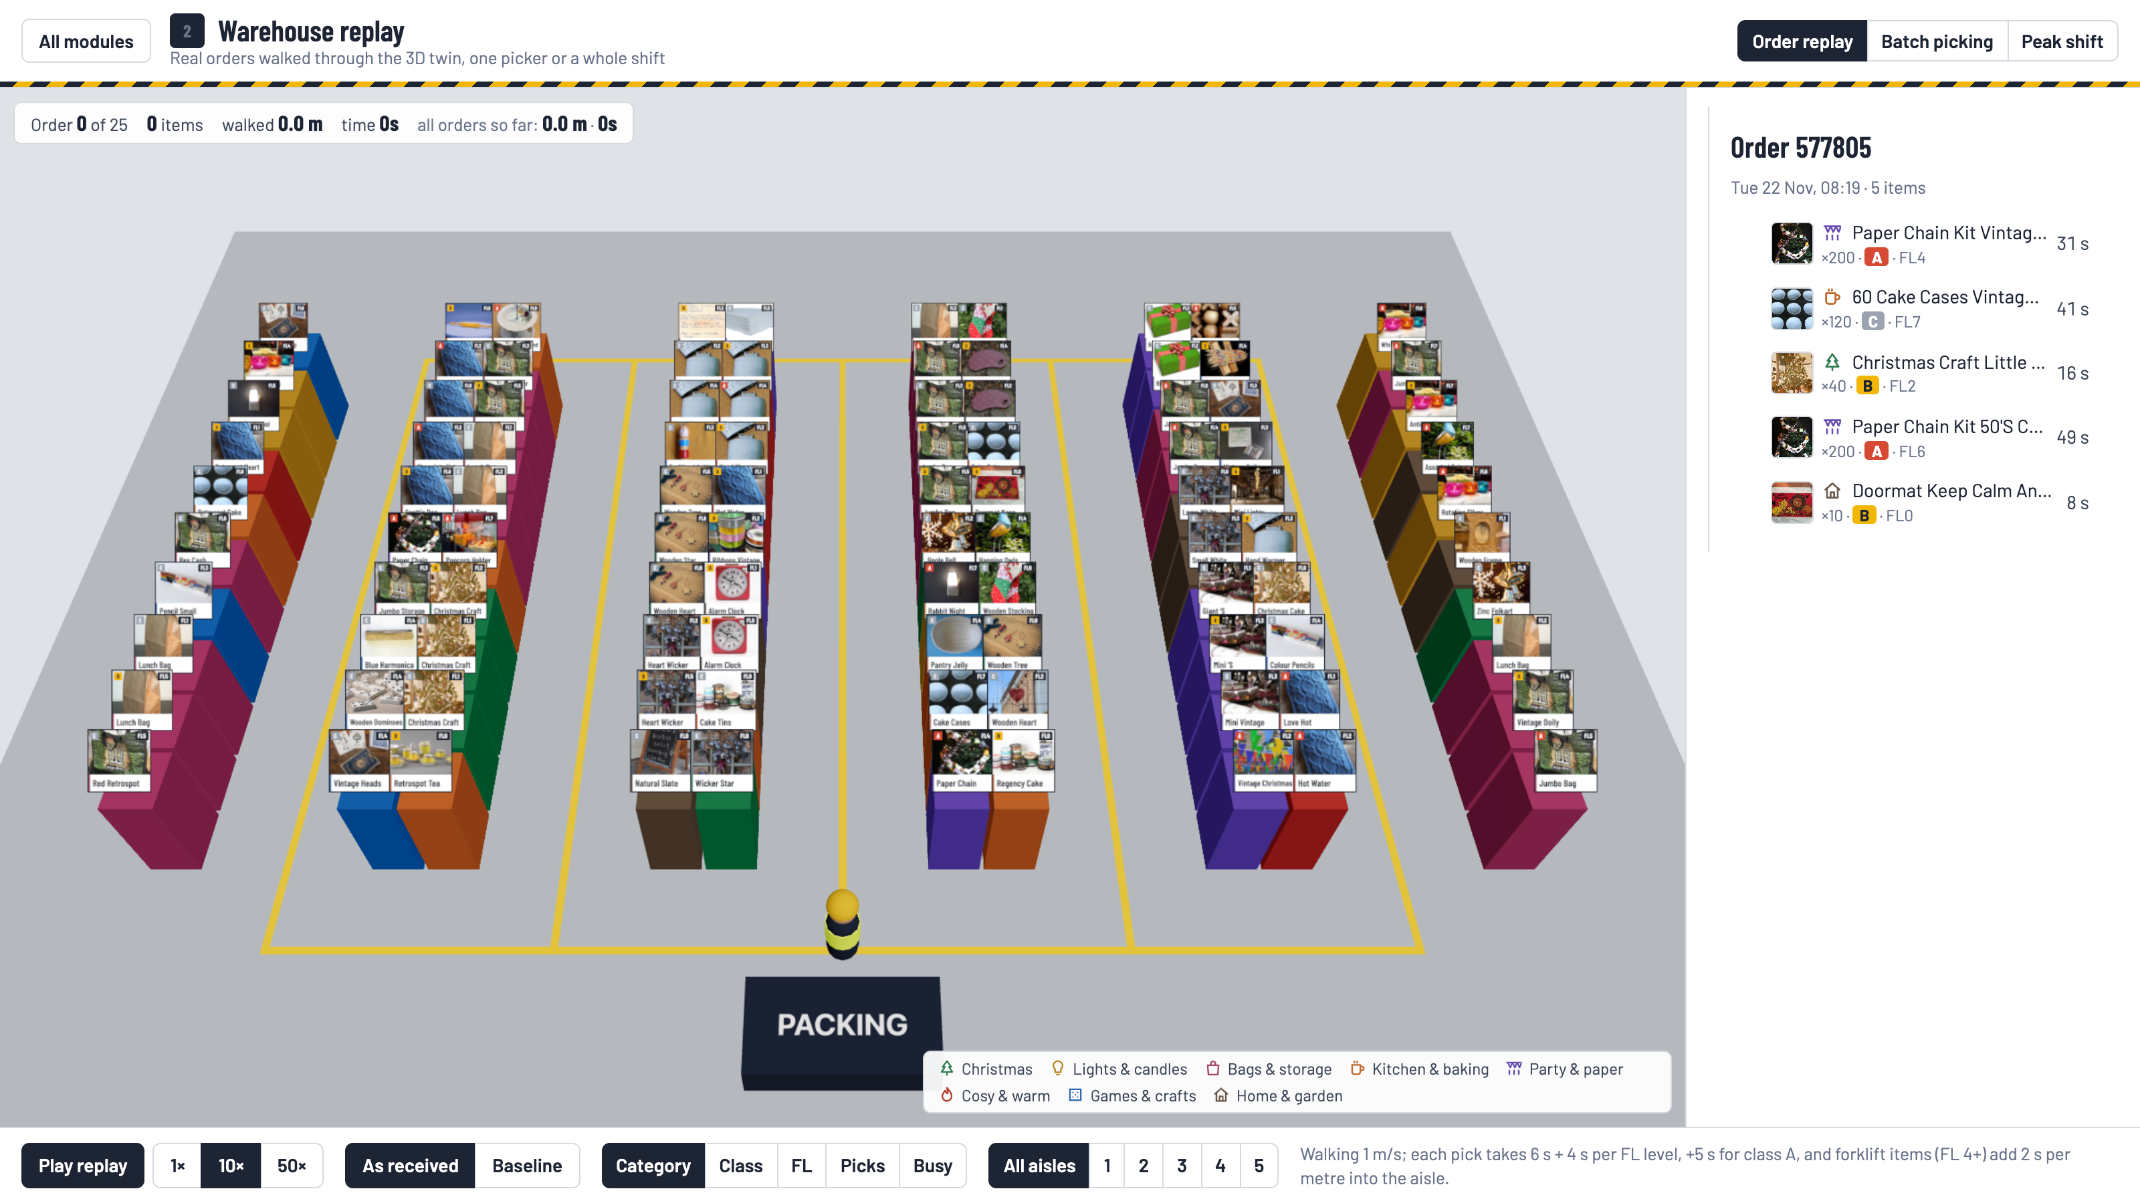


Pickers walk more than they pick, and slotting decides the walk
Walking is the hidden cost
In picker-to-shelf warehouses, travel is typically the largest share of a picker's time.
Where a product sits decides the walk
Fast movers far from the dock, or items bought together far apart, add metres to every order.
Decided once, lived with for months
Re-slotting is expensive, so a layout change needs proof before anyone moves stock.
Our answer: a 3D twin driven by real orders, where every change is replayed on the same orders
Notes:
Slotting is decided once and lived with for months. We make it testable.

Slide 3
Real orders, and an honest split between learning and scoring
541,910
527,725
100
735
rows in Online Retail II (UCI)
after removing cancellations, returns and non-products
products: the most-picked in the learn weeks
test-week orders every result is scored on
Learn: 1–21 Nov 2011 · 1,617 orders
Test: 22–30 Nov · 735
Top 100 products, classes, bought-together pairs, the Baseline and AI Suggest use the learn weeks only.
Every reported result is on the test week. Even the player's score stays hidden until they submit.
Handling level FL0–7 comes from real order quantities (units per line), not guesses.
Notes:
Everything is tuned on three weeks and scored on the fourth, which it never saw. Even the player's score is hidden until they submit.

Slide 4
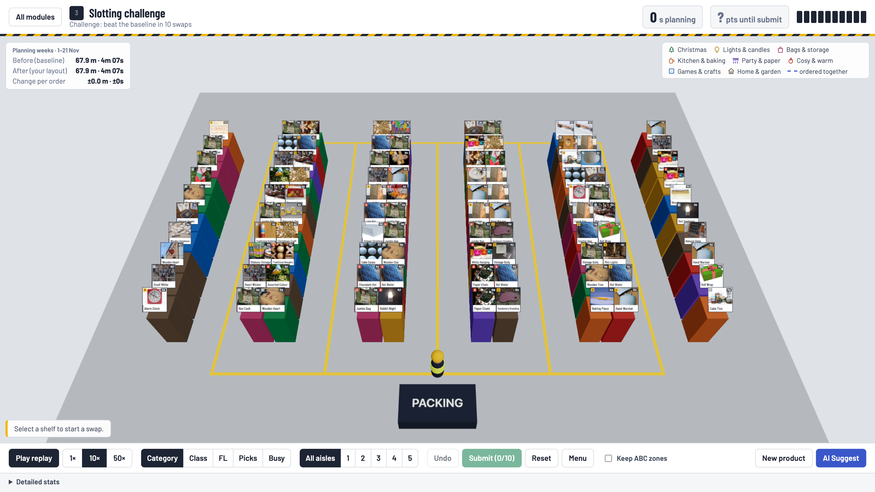



Three modules, one per requirement
1 · Order data
One month of order lines turned into JSON: products, pick counts, classes, handling levels.
2 · Warehouse replay
3D floor with photo cards; the picker walks the aisles with live distance and time. Batch picking and a peak shift.
3 · Slotting challenge
Swap products in 10 moves, replay the same orders, beat the fast-movers-first baseline.
Notes:
The animated walk and the score come from one function, and a test proves they match. Each pick takes 6 seconds plus 4 per handling level; forklift items lose time the deeper they sit in an aisle.

Slide 5
The textbook rule barely helps; bought-together placement does
−1.4%
time for the textbook rule vs Original (−4.7% walking)
−6.3%
time for AI Suggest vs Baseline (−8.0% walking)
Wholesale orders average 7 lines and cross the whole floor, and frequency alone ignores forklift access at aisle ends.
Test week 22–30 Nov 2011, 735 orders. AI: reproducible seed-1 run.
Notes:
Fast movers by the dock help walking a little, but wholesale orders cross the whole floor, and it ignores forklift access. What works is putting products that are bought together next to each other.

Slide 6
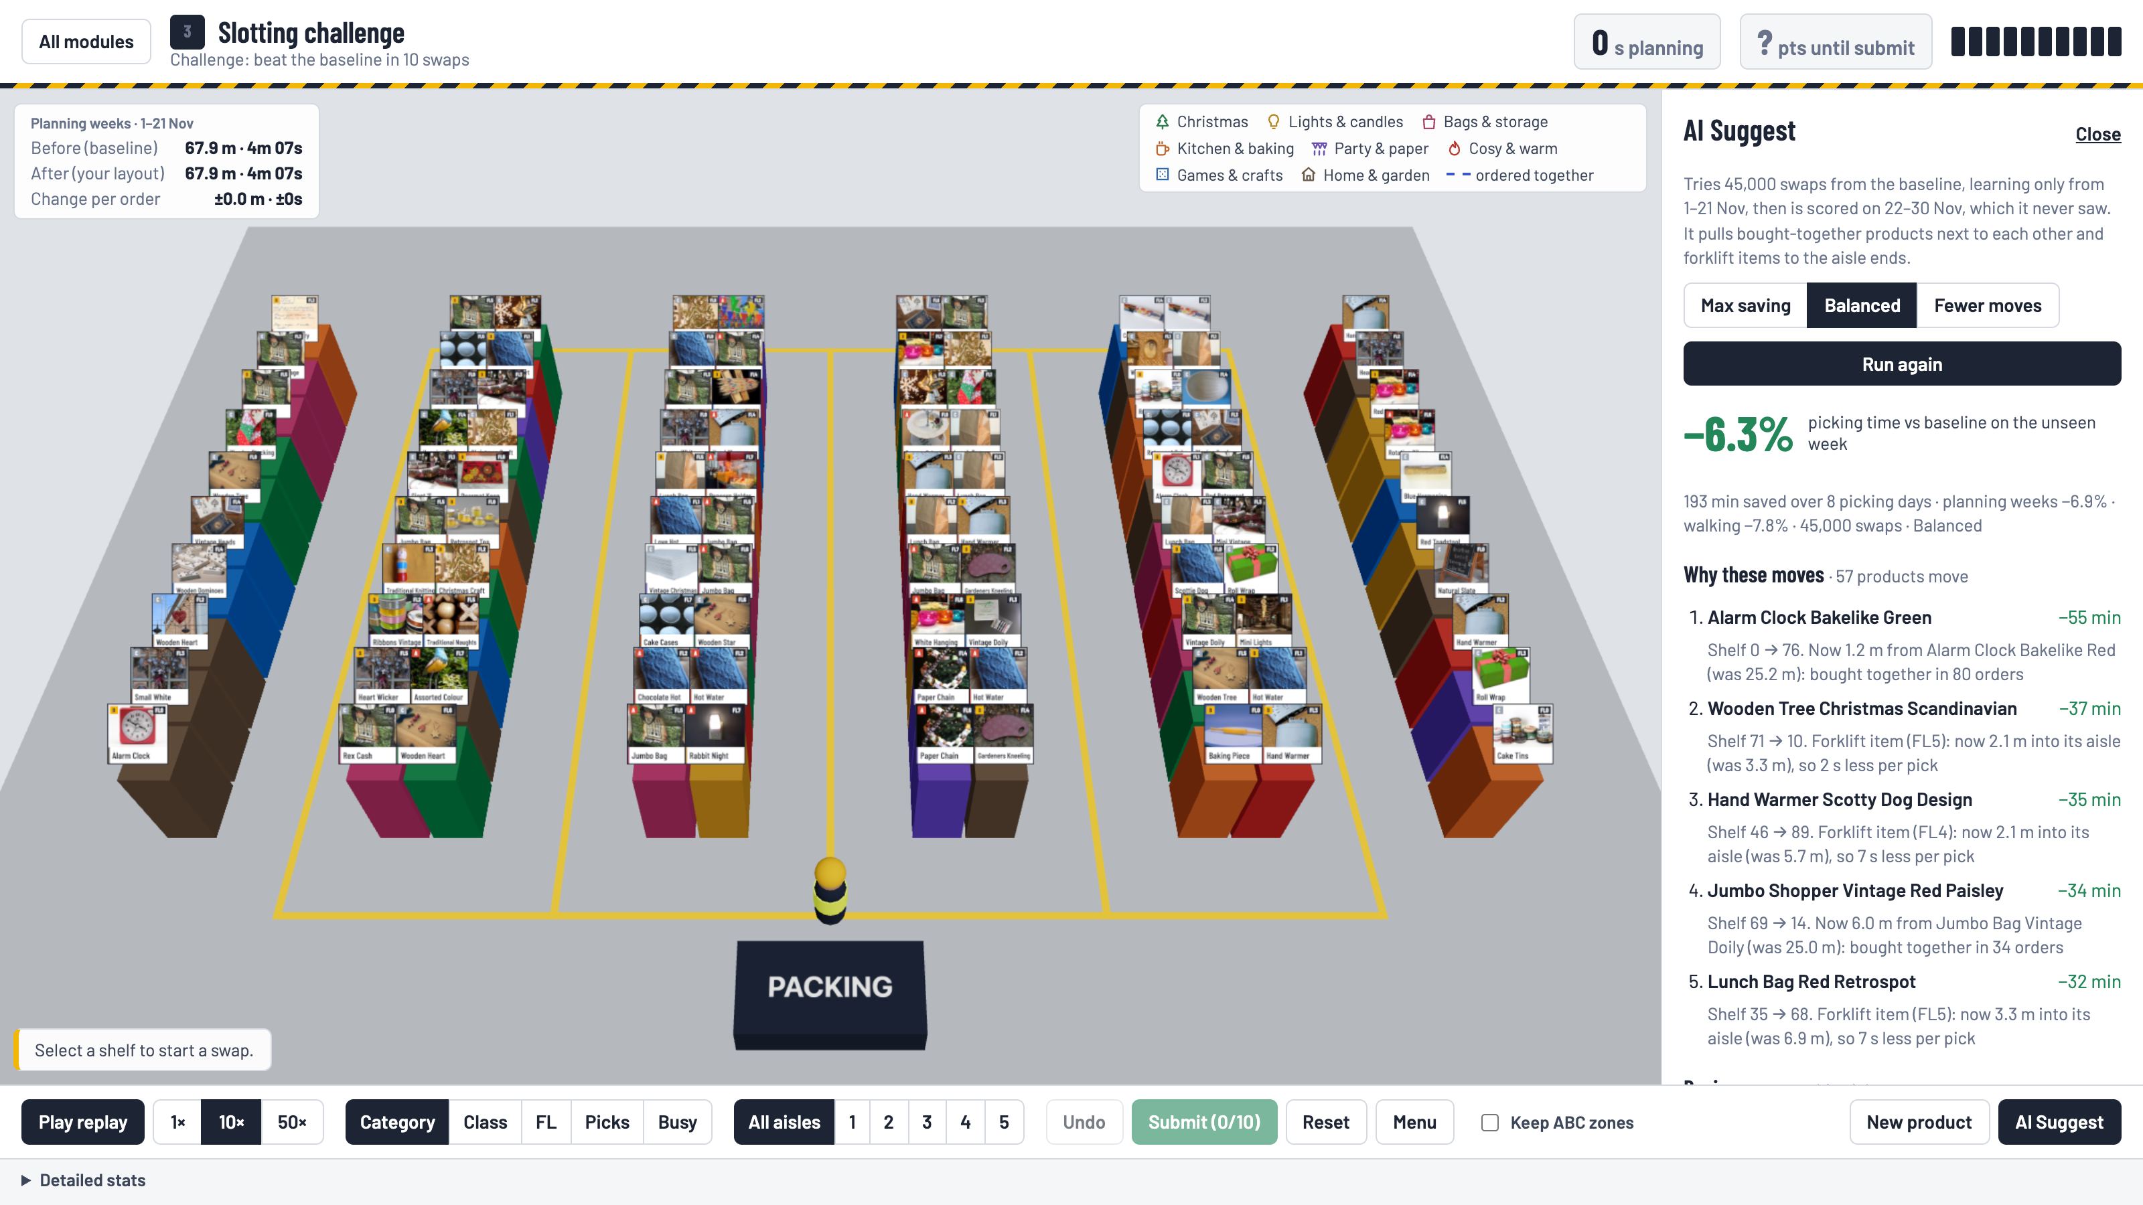



AI Suggest: explained, and scored on a week it never saw
45,000 swaps in the browser
Simulated annealing in a Web Worker, so the 3D scene never freezes.
Learns 1–21 Nov, scored 22–30 Nov
The test week stays unseen, so the saving is not overfitted.
Every move has a reason
"Now 1.2 m from Alarm Clock Bakelike Red, was 25.2 m: bought together in 80 orders."
Notes:
It searches 45,000 swaps in a few seconds in the browser, explains every move, and never sees the week it's scored on. No trained model: frequency is a count and the optimiser is a classical search.

Slide 7
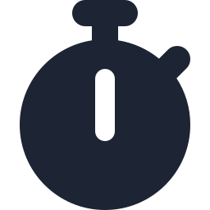


It counts the cost of change, and pays for itself
~24 min
~£1.5k
57
picking time saved a day
a year for this 100-product zone
products to re-slot (Balanced plan)
Three plans trade saving against effort
Each moved product costs the optimiser time, so it keeps the moves that pay. Assumptions (£ per hour, minutes per move) are editable in the app.
Plan | Time saved vs Baseline | Products moved
Max saving | 7.0–8.1% | 92–97
Balanced (default) | 5.7–6.9% | 50–57
Fewer moves | 3.6–4.4% | 26–33
Seeds 1–3 on the test week; £ and hours cover this pick zone only.
Notes:
Real warehouses don't move everything. The optimiser charges for every move, so it picks the moves that pay. These figures cover one 100-product zone of about 92 orders a day; the method scales with the zone.

Slide 8
Batch picking is the biggest lever, and slotting still adds to it
−60%
walking with carts of 4 orders, grouped by proximity
−63.7%
with the AI layout as well: batching cuts trips, slotting cuts each trip
vs Original single-order picking. Sorting at the dock not included.
Notes:
Batching cuts trips; slotting cuts each trip. They add up: 4-order proximity carts on the AI layout walk about 64% less than the original single-order picking.

Slide 9
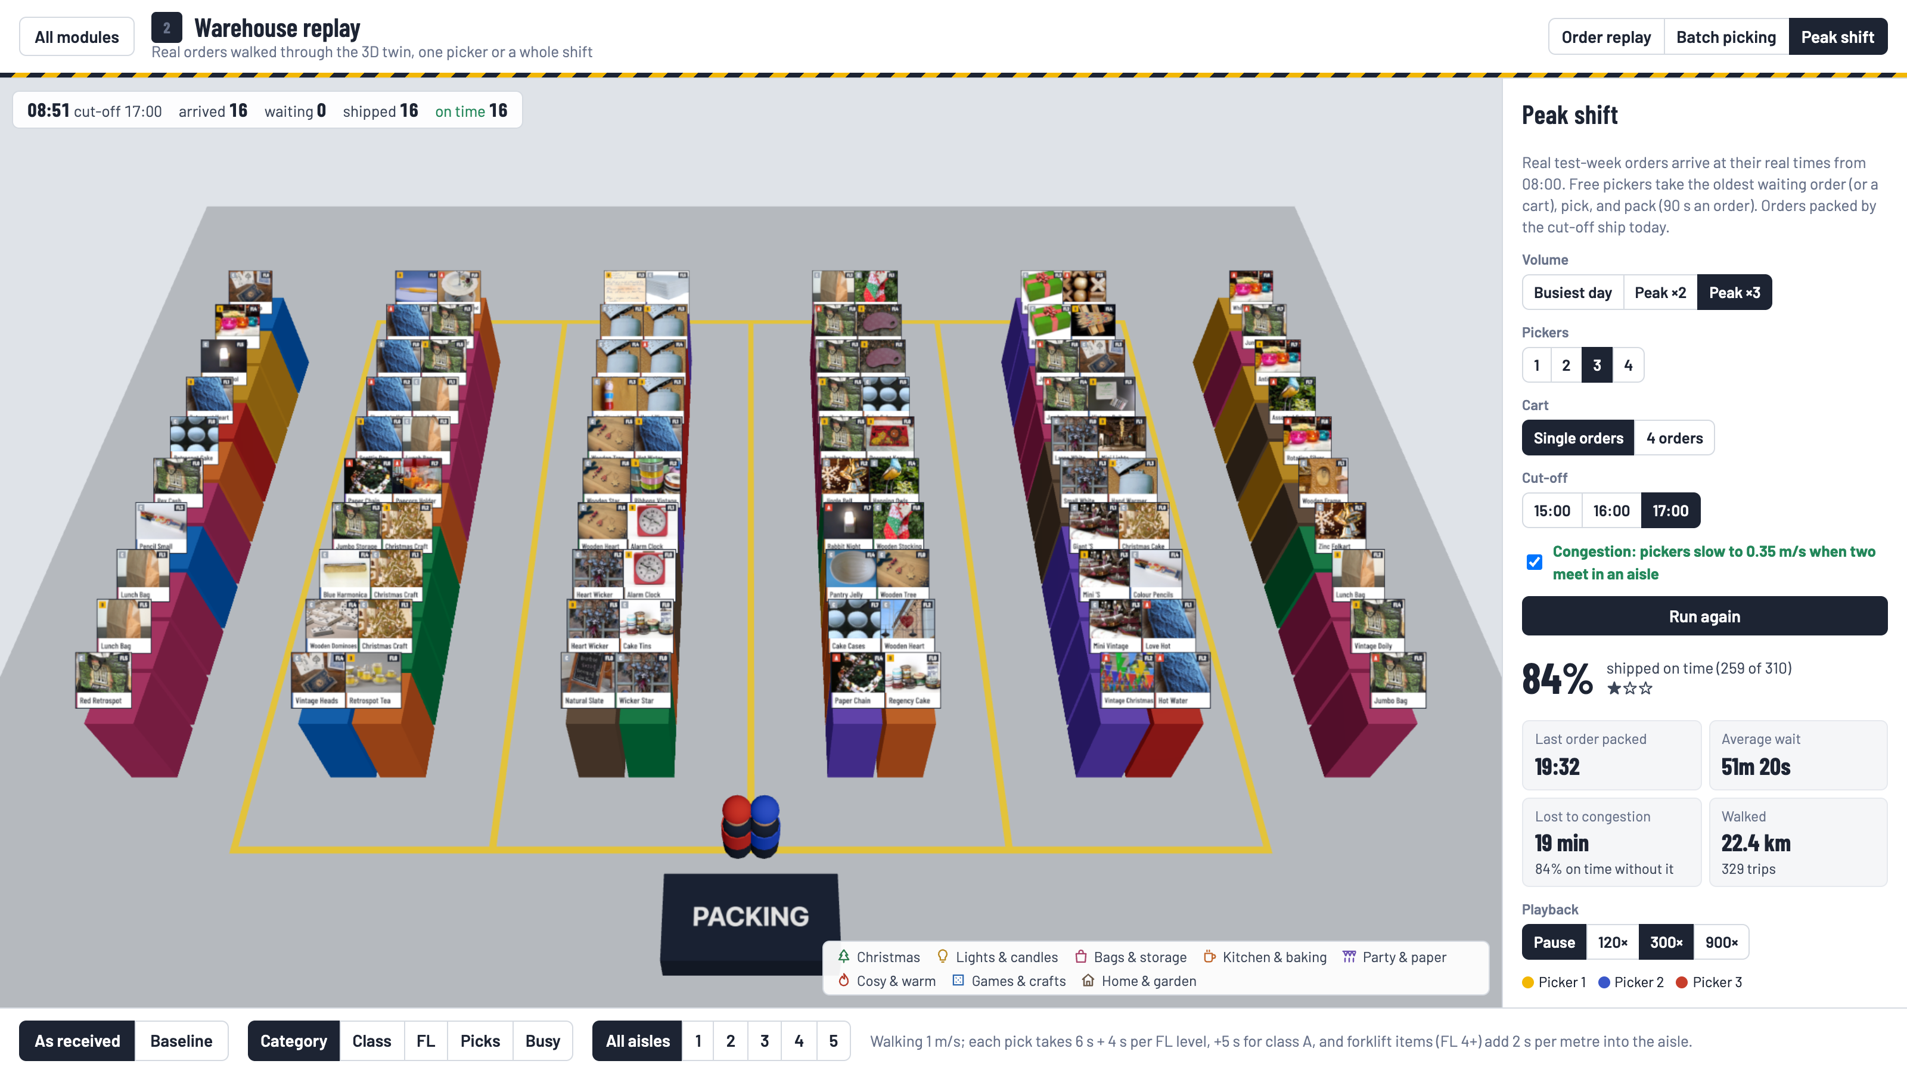
Peak day: people, carts and congestion against a courier cut-off
Pickers, cart | Baseline | AI layout | Congestion
2, single orders | 62% | 64% | 11 min
3, single orders | 84% | 87% | 22 min
3, carts of 4 | 90% | 91% | 9 min
4, single orders | 99% | 99% | 34 min
Orders shipped on time, and minutes lost to congestion (Baseline). Peak ×3: 329 real orders from the three busiest test-week days, at their real times, 17:00 cut-off.
More pickers ship more, but they start meeting in the aisles. Carts cut both trips and congestion: 3 pickers with carts beat 3 without.
Notes:
More pickers ship more, but they start bumping into each other in the aisles. The twin shows you that before you staff the shift.

Slide 10

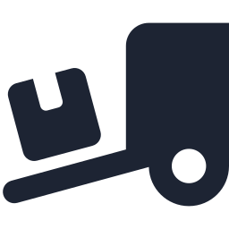


Built like a real warehouse
ABC classes
Handling levels FL0–7
Frequency drives the zones; cost class A/B/C shows why arranging by value would push cheap fast movers away.
From real units per order line; forklift items lose time the deeper they sit in an aisle.
New products (cold start)
Congestion
A new SKU with no history: look-alikes predict its picks, and every shelf is tested.
Two pickers in one aisle slow to 0.35 m/s, and the twin reports the minutes lost.
Notes:
We arrange by frequency as the brief asks, and model what a real warehouse has to respect: cost classes, handling levels and forklifts, new products, and congestion.

Slide 11
Measured, tested, and honest about its limits
68
automated tests (62 TypeScript, 6 Python)
Limitations we state
Layout and company name are ours; the orders are real.
Results cover a 100-product zone (about 21% of order lines).
Times and congestion are simple, stated models.
Sorting at the dock is not counted.
AI runs vary a little; slides use the seeded run.
1
function scores and animates every walk
0
results reported on data the model learned from
Notes:
Every number here is reproducible from the repository, and CI runs the data checks, lint, type checks and all tests before each deploy. We also state what the model doesn't cover.

Slide 12
Same orders before and after
So every saving is measured, not claimed
Try it: pick-and-pack-twin.vercel.app
Code: github.com/JayeshPani/NEXAI
Demo: youtube.com/watch?v=ivEmdlQU4yc
Next: real case sizes and shelf levels, a live WMS feed, the whole catalogue
Notes:
Same orders before and after, so every saving here is measured, not claimed. Thank you; happy to take questions.

