Slide 1

SAMSUNG PRISM
Generative AI
Hackathon
3rd Edition 2026 – 27
Theme ID - 05: Interruptible Real-Time Agents
Team Name - Jupyter
College Name – Vit Vellore
Member Name & Email 1- Megha Gautam
(meghagautam2304@gmail.com)
Member Name & Email 2- Jayesh Pani (jayeshpani.2023@vitstudent.ac.in)
Member Name & Email 3- Stuti Arya
(stuti.arya2023@vitstudent.ac.in)
Member Name & Email 4- Rithik Meedinti (rithik.meedinti2023@vitstudent.ac.in)
Submission Github link - github.com/JayeshPani/prism-duplex
Notes:
PRISM Duplex, our Theme 05 submission: a full-duplex voice agent you can interrupt and correct mid-sentence, built as a custom LiveKit agent with every model running locally.

Slide 2
Theme
Theme 05: Interruptible Real-Time Agents
Voice-native assistant architecture: fast-and-slow execution and robust interruption handling.
Today’s assistants work half-duplex: listen, think, speak. Real people interrupt, hesitate and correct themselves mid-sentence.
“Take me to the airport… actually, the office first.”
Turn-taking agent: route to airport, then route to office. Two calls are logged, so the benchmark fails the scenario.
PRISM Duplex: one route call, to the office, sent after you finish.
The brief asks for all three at once
Stay responsive
Meaningful spoken feedback within a few hundred milliseconds. No dead air, no false “done”.
Work asynchronously
Tool calls and reasoning run in the background without blocking the conversation.
Recover cleanly
Discard stale intent, update tool arguments, and never repeat a state-changing action.
Notes:
Real people pause, hesitate and correct themselves. A turn-taking assistant acts on the first half of the sentence, so a stale airport route gets computed before the correction arrives. Full-Duplex-Bench v3 passes a scenario only if exactly the expected tools are called, so one stale call fails it. The brief asks for three things at once: respond fast, never block on tools, and recover from corrections without repeating actions.

Slide 3
Existing Solutions & Gaps
What exists today
Gaps we target
Native speech-to-speech models
GPT Realtime, Gemini Live, Grok, Ultravox: fast and natural, but hosted, and when a tool call fires is up to the model.
Acting on half a sentence
A pause looks like the end of a turn, so a stale call fires before the correction.
No guard on repeated actions
Nothing stops a retried or repeated request from booking twice.
Dead air or a false “done”
Silence while tools run, or completion claimed before it happened.
Long tool chains
Multi-step requests break when a later call needs an earlier result.
Cascaded pipelines
Whisper, then GPT-4o, then TTS: modular, but each stage waits for the last, so the agent acts on whatever turn it heard.
Voice-agent frameworks
LiveKit Agents and similar handle audio, voice activity and stopping speech. Which tool calls are still valid is left to the application.
The organizers’ guide notes that self-correction and multi-step tool chains are where published systems lose the most points.
Notes:
Native speech-to-speech models are fast but hosted, and the model decides when to call tools. Cascaded pipelines are modular but sequential. Voice frameworks like LiveKit handle audio and stopping speech, but deciding which tool calls are still valid after a correction is the application's job. Those are the gaps we target: stale calls from half a sentence, repeated actions, dead air or false completion, and long chains.

Slide 4
Our Solutions & Architecture Diagram
A custom LiveKit voice agent: the fast path keeps talking, the coordinator decides when to act, the slow path does the work.
Room audio
mic or benchmark WAV via LiveKit
Speech to text
Silero VAD, then Parakeet
Acknowledge
“One moment.” if planning is slow
Fast path
keeps the floor
Intent resolver
Qwen3 plan; the last value wins
Commit gate
waits 350–700 ms for more words
Ledger
blocks an identical write
Coordinator
decides when to act
Spoken reply
Kokoro-82M voice into the room
Responder
a reply grounded in results
Tools
FDB-v3 mocks or the car backend
Executor
async calls; stale reads cancelled
Slow path
does the work
Runs locally: Qwen3 (MLX or vLLM), Parakeet-TDT 0.6B v2, Kokoro-82M and Silero VAD; LiveKit carries the audio. Every room gets its own coordinator, ledger and tool state.
Notes:
The fast path keeps the floor: voice activity detection and Parakeet transcribe each finished segment, and if planning takes over 700 milliseconds the agent says a generic 'One moment.', never 'done'. The coordinator decides when to act: Qwen3 turns the disfluent request into a plan of tool calls, the commit gate holds it 350 to 700 milliseconds in case you keep talking, and the ledger blocks an identical state-changing call. The slow path runs the plan as async calls, cancels stale reads, grounds a reply in the real results and speaks it back into the room. Nothing executes until the utterance is resolved and has passed the gate.

Slide 5
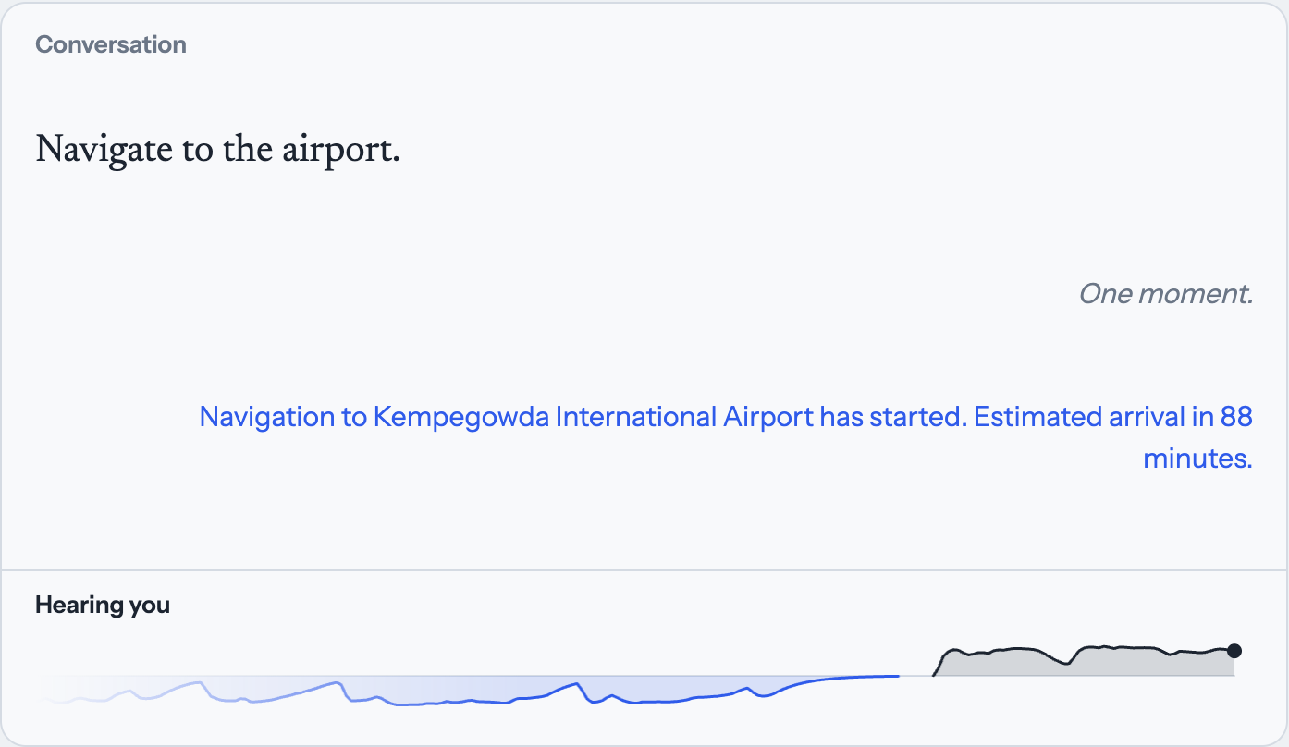
Demo & Product Walkthrough
Walkthrough
1
Choose In-car and click Start talking. The agent joins your LiveKit room and the strip reads “Listening”.
2
Say “Navigate to the airport.” The strip shows “Hearing you”, then “Working on it”.
3
“One moment.” covers planning, then the reply: route to Kempegowda Airport, 88 minutes.
4
Talk over the reply: “Actually, go to the office instead.” Both voices show on the strip at once.
Live run on 4 Oct 2026, local Mac with LiveKit Cloud. The strip at the bottom shows your voice above the line and the agent’s below.
Demo video:
5
The timeline ribbon shows each hold, cancellation and tool call as it happens.
Notes:
This is a live run from today on a Mac with LiveKit Cloud. Saying 'Navigate to the airport' starts a real route on the simulated Bengaluru map, with an 88-minute estimate. The strip under the conversation is the listening view: your voice above the line, the agent's below, so when you talk over the agent you see both at once. The timeline ribbon under the map shows every commit-gate hold, cancellation and tool call.

Slide 6
Tools and tech stack used
Layer | What we use | Why / how
Language model | Qwen3-8B 4-bit on MLX (Mac); Qwen3-14B-AWQ on vLLM (CUDA) | Planner and responder; pinned revisions, seed 7
Speech to text | NVIDIA Parakeet-TDT 0.6B v2 | parakeet-mlx on Mac, NeMo on CUDA
Text to speech | Kokoro-82M v1.0 | kokoro-onnx, hash-checked model files
Voice activity | Silero VAD | livekit-plugins-silero, local
Real-time audio | LiveKit Agents 1.8.3 with LiveKit Cloud | One room and one coordinator per conversation
Benchmark | Full-Duplex-Bench v3 | Pinned submodule; the benchmark’s own scorers
Web demo | Next.js 15, React 19, MapLibre GL, livekit-client | Transcript, map, timeline, listening strip
Engineering | Python 3.11 asyncio, uv, pytest | 797 unit tests; one-command benchmark script
Notes:
Everything that thinks or speaks runs locally. On a Mac we serve Qwen3-8B 4-bit with MLX; on the organizers' 48 GB NVIDIA machine the script switches to Qwen3-14B-AWQ on vLLM and NeMo for speech recognition. Kokoro speaks, Silero detects voice activity, and LiveKit carries the audio. Model revisions and the seed are pinned so a re-run matches our logs.

Slide 7
Impact & Use case
Use case: hands-free in-car navigation
A driver can’t look at a screen and changes plans mid-sentence. The same coordinator drives six navigation tools on a deterministic Bengaluru map; only the tool manifest changes.
Where else it matters
Customer support
Change a booking mid-request without booking twice.
Mind changed mid-sentence
“Airport… actually, the office first” computes only the office route.
Mind changed after commit
The in-flight airport route is cancelled; navigation starts once.
Accessibility
People who hesitate or correct themselves are understood, not rushed.
Talking over the agent
“Add a coffee stop” during the arrival estimate adds one waypoint.
Repeated request
A stop already on the route is not added again.
Benchmark domains
Travel, finance, housing and shopping tools from FDB-v3 run on the same coordinator.
Impact: fewer wrong actions, no repeated bookings or charges, and a conversation that keeps moving while the work happens.
Simulated routes and arrival times: no GPS, traffic or vehicle control.
Notes:
Our extension is a hands-free driving assistant. It reuses the coordinator unchanged; only the tool manifest differs, with six tools on a deterministic Bengaluru map. It handles a destination change mid-sentence or after commit, a coffee stop added while the agent is talking, and a repeated stop that is ignored. The same behaviour matters for support bots that must not double-book and for users who hesitate. Routing and arrival times are simulated.

Slide 8
Innovation highlights, results and limitations
Innovation highlights
Results on FDB-v3
58/100
strict pass rate, all 100 scenarios
82.3% right tools chosen*
69.9% right arguments*
87/100 turns taken
4.94 s mean response time
Only 1 of 42 failures was an extra call; 23 made no call at all.
*in answered scenarios. Our own run, 25 Sep 2026: Apple Silicon, exact-match scoring, MLX speech recognition in place of NeMo; not yet re-run on the current code.
Limitations
Commit gate: a plan waits 350 ms for reads or 700 ms for writes in case you keep talking.
Intent versions: new words drop the held plan and cancel stale reads in flight.
Action ledger: a state-changing call identical to one already made is blocked, not rerun.
Plans are checked before anything runs: unknown tools, missing arguments and broken references are rejected.
Exact-match scoring, not the official LLM judge; only the organizers’ re-run counts.
Slow on a laptop: 4.94 s mean benchmark response; cold live replies took about 18 s.
Long chains are weak: three-call scenarios pass 5 of 16.
The ledger lives in memory: no exactly-once guarantee across crashes or restarts.
Tested with recorded and synthetic speech; human microphones and echo are untested.
Notes:
Our best full run passes 58 of 100 FDB-v3 scenarios under strict scoring. When the agent took its turn it chose the right tools 82.3 percent of the time and the right arguments 69.9 percent. The most telling number: only one of the 42 failures came from an extra call, the error the commit gate exists to prevent; 23 failures made no call at all. Caveats: exact-match scoring instead of the LLM judge, a Mac with an MLX port of the same speech model, and the 25 September revision. Only the organizers' re-run is official.

Slide 9
What’s next
1
Re-run on the organizers’ setup
Current code on CUDA: Qwen3-14B-AWQ on vLLM, NeMo speech recognition and the official LLM judge, so our number can be compared with theirs.
2
Stop missing calls
23 of 42 failures made no tool call, and three-call chains pass 5 of 16. Study each one and strengthen planning for dependent calls.
3
Cut response time
Stream partial transcripts instead of whole segments. The benchmark mean is 4.94 s, and a cold live reply took about 18 s on a 16 GB Mac.
4
Test with real people
Human microphones, speaker echo and two live rooms at once are still unverified.
Notes:
In priority order. First, re-run the current code the way the organizers will, so our self-reported number is comparable. Second, the failure analysis points straight at missed calls and long chains. Third, latency: we transcribe whole segments today; streaming partial transcripts would let the planner start earlier. Fourth, everything so far used recorded and synthetic speech; real people, real speakers and simultaneous rooms still need testing.

Slide 10
Brownie points slide( differentiation)
Fully local
No hosted model API at evaluation time. Qwen3, Parakeet and Kokoro run on the machine; inference costs nothing.
Correct by construction
Commit gate, intent versions and an action ledger, enforced in code rather than hoped for in a prompt.
Honest evaluation
No benchmark answers in prompts or tuning. We tuned on our own synthetic set and report every caveat.
Reproducible
One command installs, downloads pinned models, starts the agent and scores FDB-v3.
Tested
797 unit tests cover the coordinator, tools, scoring and failure paths.
Observable
The web demo shows a live timeline of every hold, cancellation and tool call, plus the listening strip.
Notes:
What sets us apart: the whole stack runs locally; correctness comes from the coordinator's design rather than prompting; we never used benchmark answers and we report our caveats; one command reproduces the benchmark run; 797 unit tests guard the behaviour; and the web demo makes every decision visible.

Slide 11
Checklist- Updated on Public GitHub
Working prototype code — public or shared GitHub repo (Y/N): Y
README with reproducible setup instructions (Y/N): Y
Demo video, max 5 minutes (YouTube or Drive link):
Presentation file (PPT or PDF) (Y/N): Y
Notes:
Code, README with setup steps, and this presentation are in the public repository. Add the demo video link before submitting.

Slide 12
Thank you
Organised by the Language AI Team and the PRISM Team, Samsung R&D Institute India
Notes:
Closing slide. Add the Google Form URL and a contact email before sharing. Edition 2 organising team for reference: Language AI - Sourabh Tiwari, Gaurav, Sanjeeth Pothireddy, Gorang Maniar; PRISM - Binny Lakra, Prakhar Chandrakar, Vishu Kumar; Kick-off and mentors - Giridhar Jakki, Deepraj Prabhakar Patkar (Language AI), Srimanu Prasad Nagaraju, Ashish Kumar (Tech Strategy).

