Slide 1
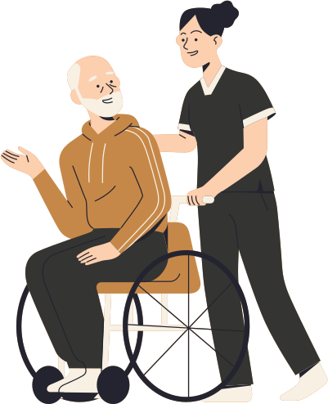








Problem Statement:
Unique Value Proposition:
Senior citizens living alone are vulnerable to emergencies such as health changes, accidents, or falls.
Ensuring immediate support is critical, but identifying and notifying the nearest nurse can be a slow process.
SOS Button:
A physical or app-based button that patients press to trigger an immediate emergency alert.
SOS Voice Activation
Allows patients to initiate an emergency alert using voice commands, helpful for those unable to press the button.
Heart Beat Alert
Our Solution:
Integration with wearable devices to monitor vitals; sends automatic alerts if abnormal heart rates are detected.
Real-time geo-location tracking for both patients and nurses.
Automated nurse assignment based on proximity and travel time.
Continuous notifications sent to nurses until one accepts the emergency.
Ensures the fastest response time for critical situations.
Chat/Video call with Nurse:
Secure in-app chat or voice,video call between the patient and the nurse for real-time communication during emergencies or non-critical queries.
Track Nurse in Real-Time
Patients can track the nurse's live location and estimated time of arrival after the alert is accepted.

Slide 2

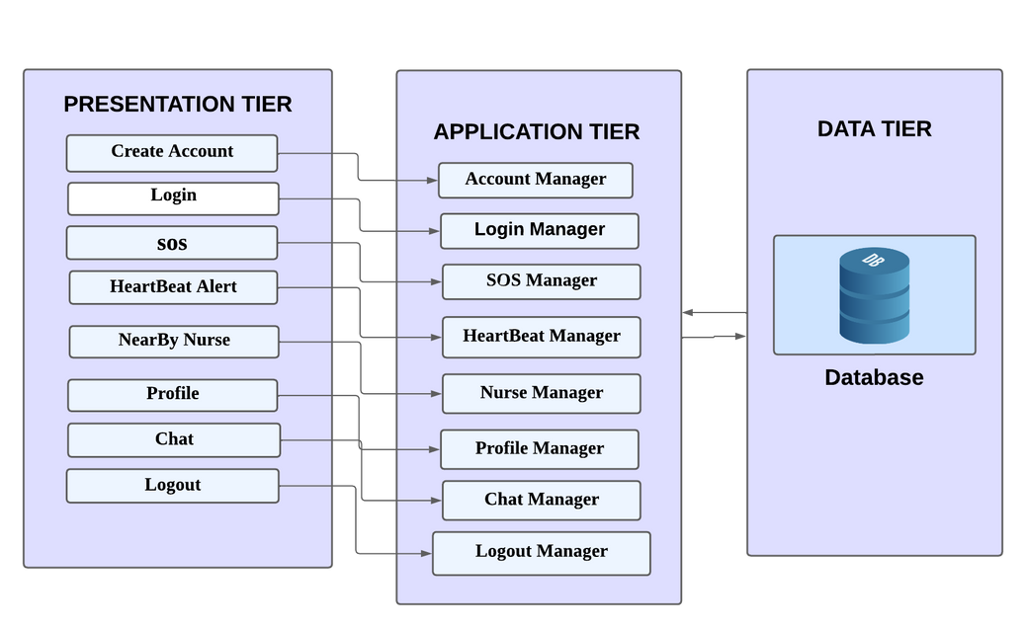



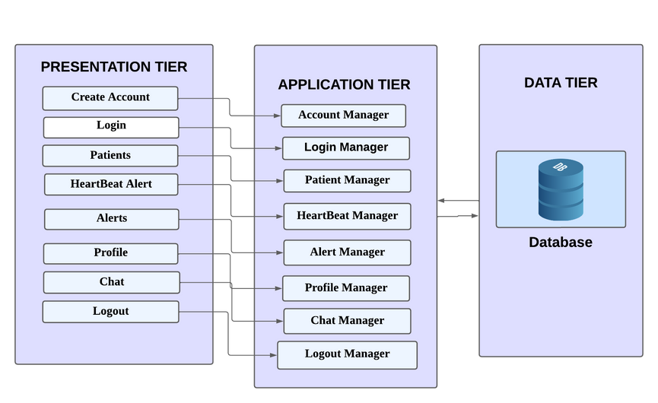


Tech Stack
01
02
Front-End
Back-End
3-Tier System Architecture Patient App
03
04
Database
Google Map
API
3-Tier System Architecture Nurse App

Slide 3





Business Model
Partnership
Revenue Streams
Customer Segments
Channels
Hospitals & Clinics
Insurance Companies
Subscription Plans
Device Sales (Digital Watches)
Primary
Secondary
Mobile App & Web Platform
Healthcare Partnerships
Insurance Companies

