Slide 1
Big Messy Data ORIE 5741
Predicting Three Pointer Accuracy of NBA Players
Team:
Manas Koppar (mk2235)
Jayesh Paunikar (jap452)
Trevor Idayaa Kevin Xavier (tx28)

Slide 2
Background and Motivation
As any sport, Basketball has evolved through time
Three pointing shooting is valued highly in the modern Basketball
Basketball is trending towards being position-less
We wanted to devise a method to predict a player’s three-point shooting accuracy

Slide 3
Goal: Predict the three-point accuracy of the NBA Players
Dataset: Compiled the dataset from basketballreference.com, nbastats.com and nbastuffer.com
Preprocessing: Feature engineering Standardization Dropping samples with NaN

Slide 4
Types of features used: Physical Attributes Game Stats
List of features used: Height, Wingspan, Position, Games played, Usage rate, Turnover rate, FTA, FT%, 2PA, 2P%, PPG, RPG, APG, SPG, BPG, TOPG, ORTG, DRTG

Slide 5
Techniques Used: Regression- Linear, Ridge, Random Forest Regressor Classification- Logistic, Ensemble Methods, Decision Tree Neural Networks- Feedforward NN for Regression Feedforward NN for Classification

Slide 6
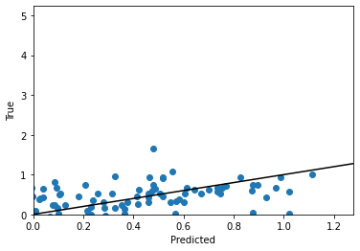



Regression Tested each technique to find best performing model on validation data One hot encoded the position of the players Used ridge regression to avoid overfitting
Without regularization
One Hot
With regularization

Slide 7
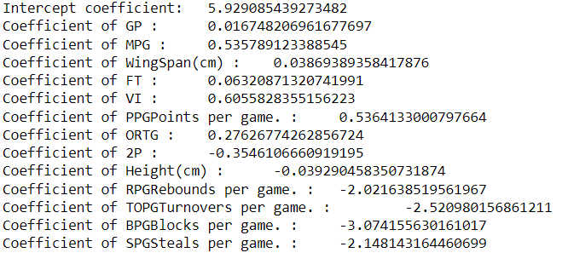
Regression coefficients
VI, FT and MPG affect 3P % positively
BPG and SPG affect 3P% negatively

Slide 8
Random Forests Much more sophisticated model Used same training procedure as previous methods Generalizes the model better Combines a high number of weak learners Best: Trees = 100, Depth = 10
Trees | Depth | MSE
10 | 10 | 0.827
50 | 10 | 0.710
100 | 10 | 0.682
Depth is kept constant at 10 to have weak learners

Slide 9
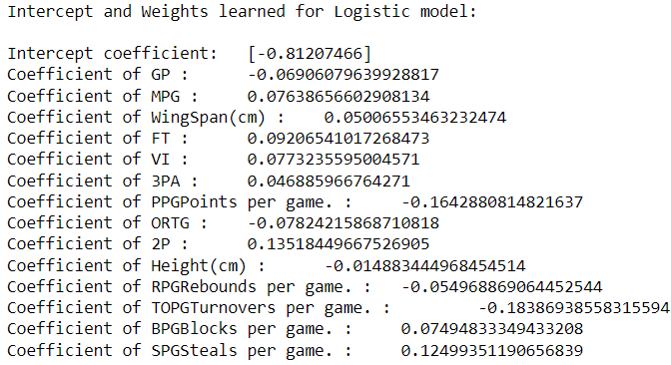
Classification Used to classify whether an NBA player will shoot above 36.5% by feeding the same features into the classification techniques we used.
Logistic Regression
Best Regularizer: 0.01
Misclassification Rate on Validation: 35.85%
SPG & FT affect 3P% positively

Slide 10
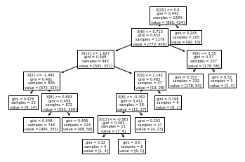
Random Forest: Decision Tree
Misclassification rate: 36%
Ensemble
# Bagged Models: 100
Leaf nodes: 10
# Bagged Samples : 30
Reduce bias and variance
Misclassification rate: 35%

Slide 11
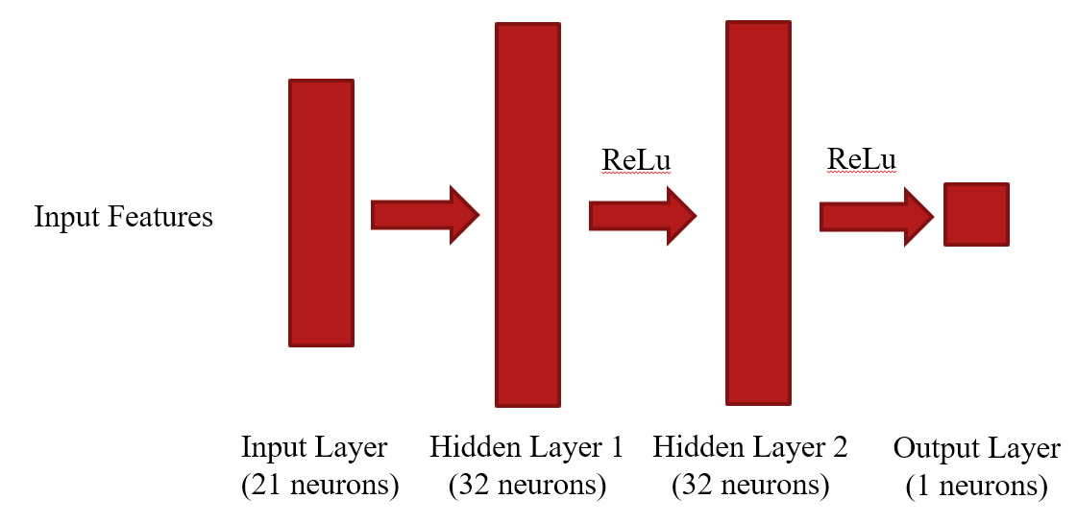
Neural Network for Regression: Architecture used: Input features- 22
# of hidden layers- 2 # of neurons in each hidden layer- 32 One output node without activation Optimizer- Adams Activation function- ReLu
Bias included in the input layer

Slide 12
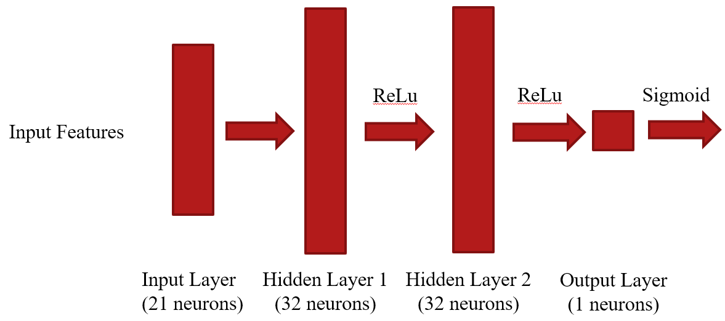
Neural Network for Classification: Architecture used: Input features- 22
# of hidden layers- 2 # of neurons in each hidden layer- 32 One output node followed by Sigmoid Optimizer- Adams Activation function- ReLu
Bias included in the input layer
Validation Misclassification rate of 35.14%

Slide 13
Best Models
Best Model Regression: Neural Net with a Validation MSE of 0.6380
Best Model Classification:
Neural Net with Misclassification rate of 35.14%
Test Error for Regression NN: 1.28
Test Misclassification rate of 37.65% for classification

Slide 14
Robustness of Best Models Regression
Used best 3P shooters ever in the history of basketball to check robustness of model
Made sure that these players were not in the training set. Test set was 38 players
Test MSE Error: 0.97
Lower than original test set error of 1.28, proves robustness

Slide 15
Higher Order Analysis
Found best polynomial fit for each feature in training set with respect to 3P%
Generated the higher order training dataset including positional one hot encoding
Did this to add nonlinearity to the model
Improved the result significantly

Slide 16
Conclusion:
VI, FT and MPG were the heavy favorites that made a player a better 3P shooter
We are moderately comfortable with this model
Future Scope:
More data to supplement the model
Evaluate and analyze team strategies, zonal 3P accuracy, and quarterly efficiency of each player

Slide 17
Bibliography
https://www.basketball-reference.com/
https://www.nbastuffer.com/

