Slide 1




Analysis of Indian Movies Data
India‑centric EDA and trends | Jayesh Salunke | 2025

Slide 2
Executive summary
India‑centric catalog with Hindi/Tamil/Malayalam leading language share.
Runtimes have risen; average ratings softened in recent years.
Drama and drama‑adjacent genres dominate across the corpus.
Output concentrated among a core set of directors and studios.

Slide 3
Dataset overview
Fields: MovieTitle, ReleaseYear, RunTime, Genres, DirectorName, Rating, Studio, OriginCountry, OriginalLanguage, cast.
Scope: Highly India‑dominated by country and language composition.
Use case: Time, language, geography, creator, and studio cuts.

Slide 4
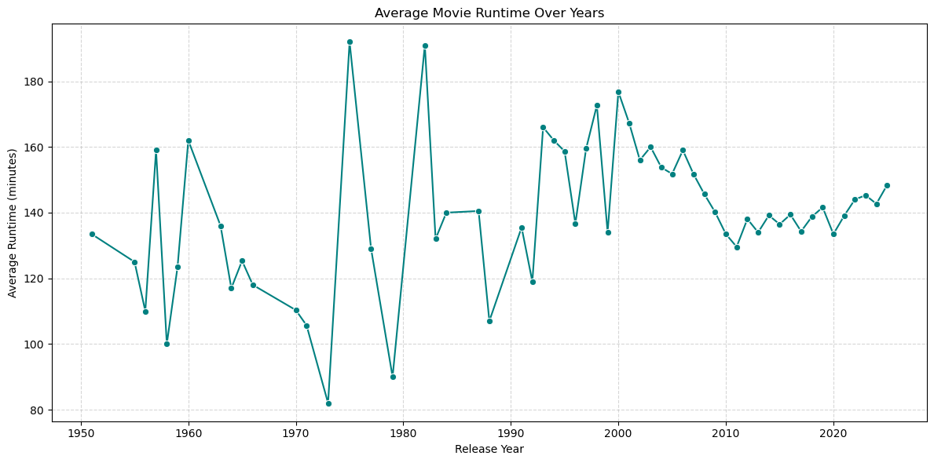
Runtime trend
Mean runtime increases into 2020s; ~148 minutes in 2025.

Slide 5
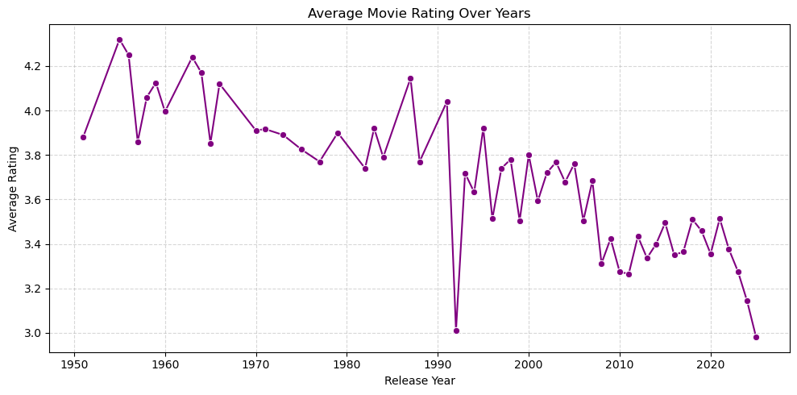
Rating trend
Mean ratings dip to ~2.98 in 2025 with variability by year.

Slide 6

THANK
YOU!

